Slide 2
Meet The Teachers
Year 5/6

Slide 3
Who works with our children?
What do our children learn?
How can I help my child at home?

Slide 4
Adults working in
Year 5/6
Willow
Oak
Cedar
Teachers: Miss Blackwell
Teaching Assistants: Miss Papanova, Mrs Douglas and Mrs Hazelwood
Teachers: Miss Proctor
Teaching Assistants: Mrs Forbes-Gosling, Mrs Speed and Mr Hiller
Teachers: Miss Cattini
Teaching Assistants: Mrs Marangoni, Mr Hiller, Mr Davies and Mrs Speed

Slide 8
Our Curriculum:
At The Rackham C of E Primary School we offer a knowledge based curriculum that builds on prior learning, knowledge, understanding and skills of all children, whatever their starting points so ensuring progression through each Key Stage.
We offer a broad and balanced curriculum that promotes spiritual, moral, cultural, mental and physical development in order to prepare our children for the opportunities, responsibilities and experiences of life. We promote community cohesion and embed British values.
The curriculum incorporates the statutory requirements of the National Curriculum (2014), experiences and opportunities to best meet the learning and developmental needs of pupils.

Slide 9
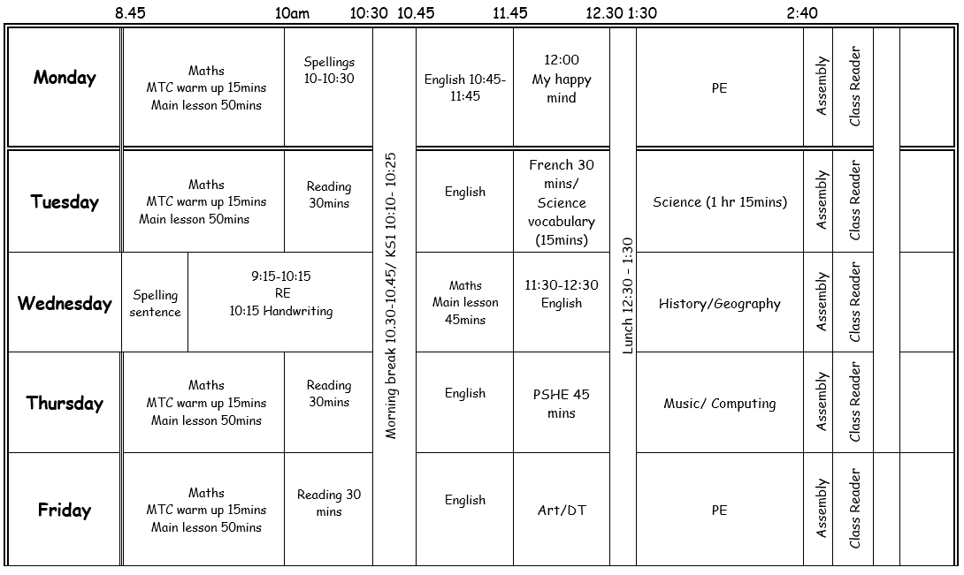
Example timetable

Slide 10
PE kit:
Plain tracksuit: navy, grey, black (outside Games)
Plain white or red t-shirt (or with school logo)
Plain shorts (must be worn for gymnastics)
Please no fashion or sporting logos, sequins, multi-coloured tops
Hair must be tied up
Earrings must be taken out

Slide 11
End of Year Expectations

Slide 12
Assessment
Summative and formative
Moderated internally, by subject leads and across the cluster
At the end of the year, for each core subject (reading, writing, maths) you will be told that your child is:
Pre Key Stage
Working towards Age Related Expectations (WTS)
Working at Age Related Expectations (ARE)
Working at Greater Depth (GDS)

Slide 13
Assessment
In Year 5, we test using NFER
In Year 6, the children will take statutory tests in May for reading, maths, grammar and spelling. This will begin from Monday 12th May.

Slide 14
Passing
The main expectation for the end of Year 6 is reaching the magic 100.
70
85
100
120
(Yr 5 140)

Slide 15
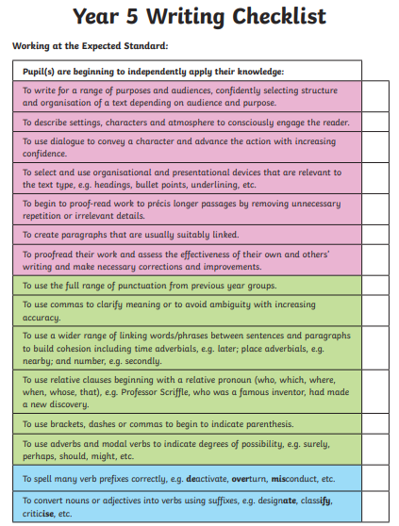
Writing in Year 5

Slide 16
Writing in Year 6

Slide 17
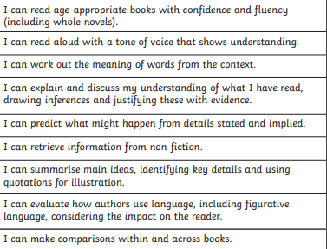
Reading in 5/6

Slide 18
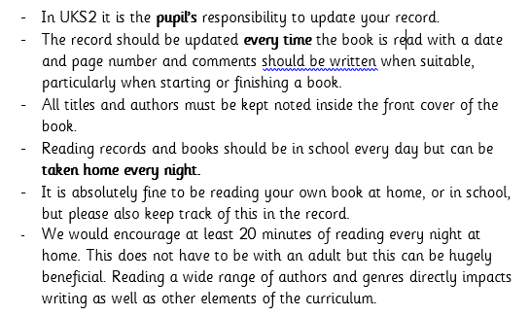
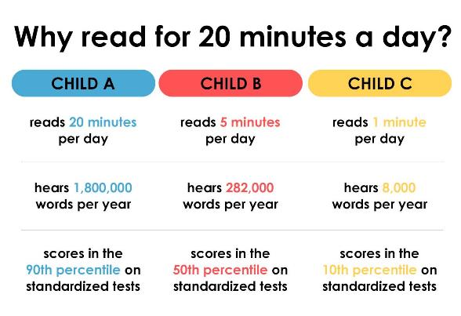
Reading in 5/6

Slide 19
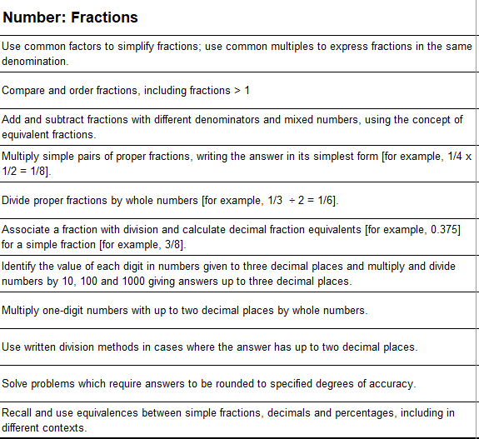
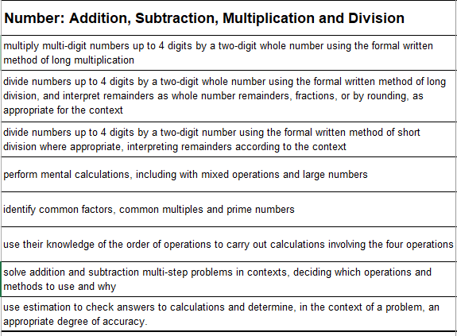
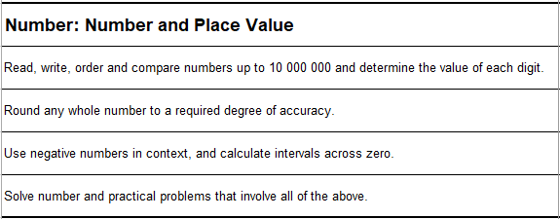
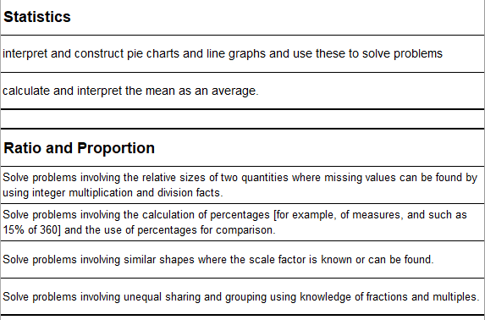
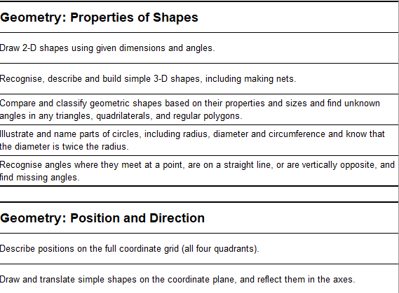
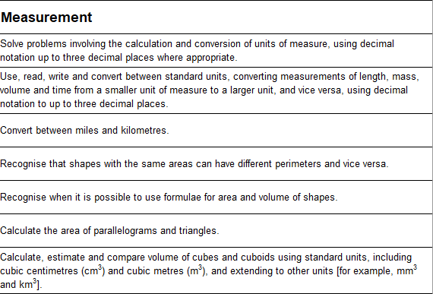
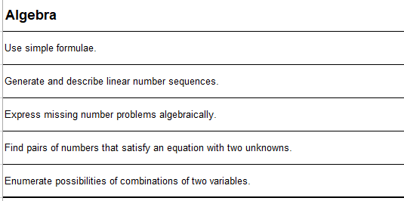
Maths in Year 5/6

Slide 20
How you can help at home?
Reading records
Homework books

Slide 21
Homework
Homework:
Every week, the children will be taking home CPG books. They will be given a specific page to complete and hand in for the following week.
Books remain at home and photos need to be uploaded into Tapestry. We will let you know the page numbers also through Tapestry.
Every day, we expect the children to be reading for approximately 20 minutes. They need to record their reading in their reading records and hand those in every morning.

Slide 22
Comments for Reading Records

Slide 23
Comments for Reading Records
Or the children might like to put vocabulary or phrases they have noticed from their books into the comment section.

Slide 24
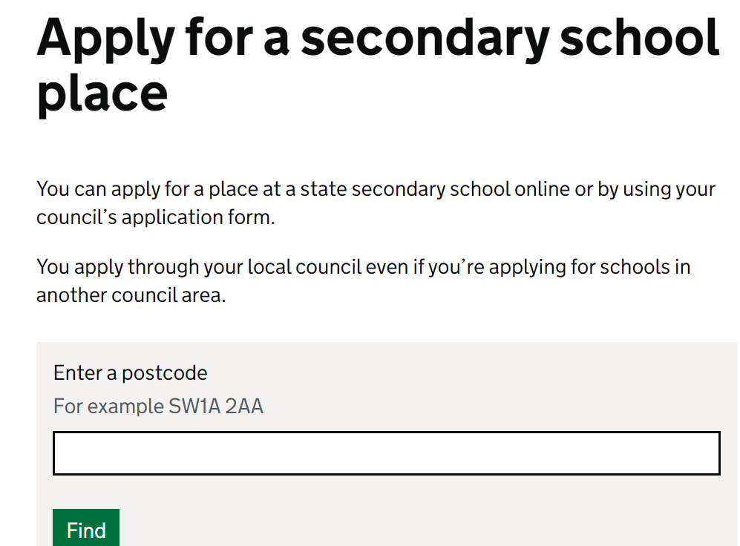
Secondary school
Deadline date: 31st October
Witchford VC open evening: Thursday 19th September 5:30-8:00pm
Ely College open evening: Tuesday 24th September 5:15-7:30pm

Slide 25
Communication
Class email
Office email- office@rackham.cambs.sch.uk
Make an appointment – virtual or real life
Parent consultations
Tapestry

Slide 26
Keeping updated
Willow
Oak
Cedar
willowclass@rackham.cambs.sch.uk
oakclass@rackham.cambs.sch.uk
cedarclass@rackham.cambs.sch.uk

Slide 27
Thank you for coming!
We welcome any general questions.

