Slide 1
Step 1: Download the app
Type in Connect Careers Manager into your Apple or Google Play store and download the app.

Slide 2
Step 2: Log into the App
Scan your unique QR Code or click the link in your invite email and create
your own password.
Do not share QR codes with friends, these are unique to you!

Slide 3
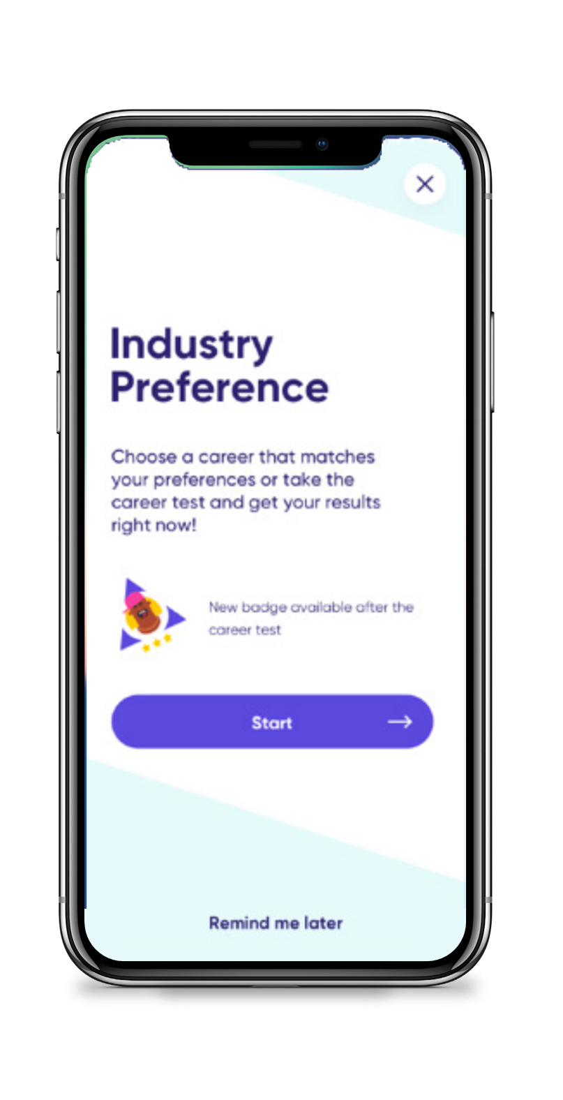
Step 3: Select Your Industry Preference
We prompt students to input their industry preferences to help school understand which career paths students are considering.
It is also helpful for you to log your industry preferences during the pre-placement phase to reflect back on post-placement to see if your preferences have changed or remained the same.

Slide 4
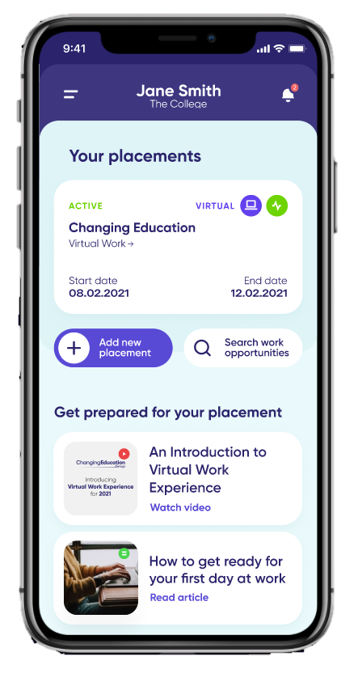
Step 4: Inputting your placement
Once you have found your own placement you will need to input the employer details into the app so that we can help the employer complete the risk assessment process.
You will need to input your self-found placement on the app at 5th July.

Slide 5
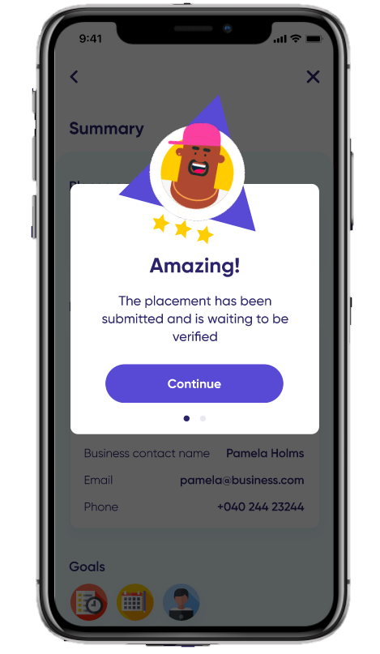
Step 5: Placement Verification
The teacher or staff member in charge of work experience at your school will then verify or deny your placement based on whether or not they are satisfied with your chosen employer and their details.
If your placement is denied, there will be a comment from your school contact telling you why your placement is not suitable to go ahead.

