Slide 1
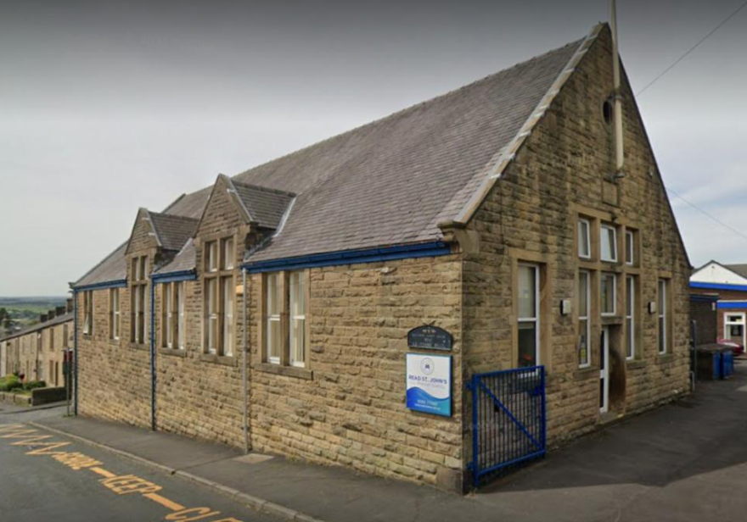
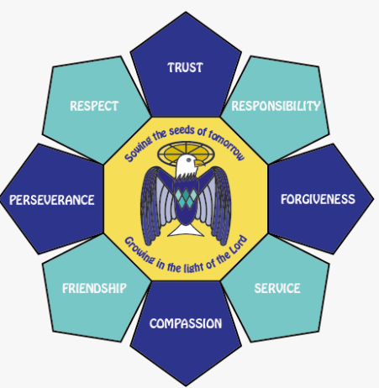
Year 5
Curriculum Overview
26-27
Our school is an amazing place to be and the staff and children are all very proud of our vision and core values which underpin our day to day life. At Read St. John’s we aim to unlock the potential for everyone to flourish whilst being rooted and grounded in God’s love. We aim high, so together as one family, we can fly. This vision is underpinned by our Christian values of: Trust, Friendship, Compassion, Perseverance, Forgiveness, Respect, Service and Responsibility.
All children feel valued and loved in school and staff pride themselves on building strong relationships with children, parents/carers and THE COMMUNTY. We treat every child as an individual and are committed to the development of the ‘whole child’. We want children to BE happy, self-assured, independent learners with a thirst to learn and the confidence to know that they can do anything they want to do and that we will support them on their journey.
‘Sowing the Seeds of tomorrow; growing in the light of the Lord’
Notes:
1

Slide 2

Year 5 Curriculum Overview 26-27
 | Autumn 1 | Autumn 2 | Spring 1 | Spring 2 | Summer 1 | Summer 2
British Values | Mutual respect We are all unique. We respect differences between different people and their beliefs in our community, in this country and all around the world. All cultures are learned , respected, and celebrated. | Mutual Tolerance Everyone is valued, all cultures are celebrated and we all share and respect the opinions of others. Mutual tolerance of those with different faiths and beliefs and for those without faith. Done through celebrations | Rule of law We all know that we have rules at school that we must follow. We know who to talk to if we do not feel safe. We know right from wrong. We recognise that we are accountable for our actions. We must work together as a team when it is necessary. Class rules | Individual liberty We all have the right to have our own views. We are all respected as individuals. We feel safe to have a go at new activities. We understand and celebrate the fact that everyone is different. | Democracy We all have the right to be listened to. We respect everyone and we value their different ideas and opinions. We have the opportunity to play with who we want to play with. We listen with intrigue and value and respect the opinions of others. | Recap all British Values Fundamental British Values underpin what it is to be a citizen in a modern and diverse Great Britain valuing our community and celebrating diversity of the UK. Fundamental British Values are not exclusive to being British and are shared by other democratic countries.
Enrichment | TBC | TBC | TBC | TBC | TBC | Class Trip Sports Day Summer Fair Leavers Service
Special events and celebrations | Harvest Festival Black History Month Reading is Magic Festival Jeans for genes day Diwali | Guy Fawkes / Bonfire Night Remembrance Day Anti-Bullying Week Road Safety Week Children in Need Christmas Jumper day Advent | RSPB’s Big Schools’ Birdwatch National Handwriting Day Chinese New Year National Storytelling week Children’s Mental Health Week Internet Safety Day | Pancake day Lent World Book Day Science Week Mother’s Day Red Nose day Easter | St. George’s Day Earth Day Children’s Gardening Week Father’s Day | 30 Days Wild Pride Month World Environment Day World Ocean Day World Refugee Day Summer Fair Family Picnic
Notes:
2

Slide 3
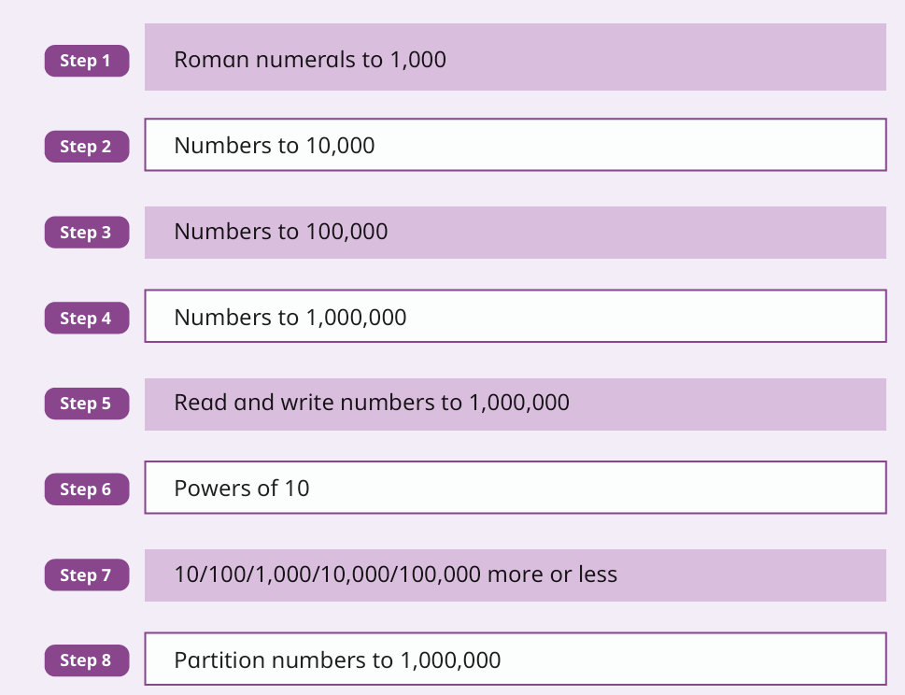
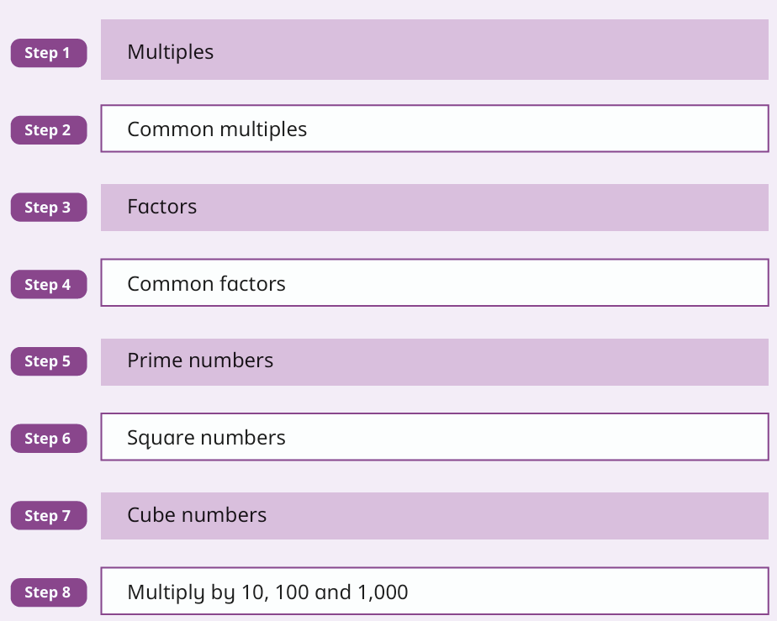
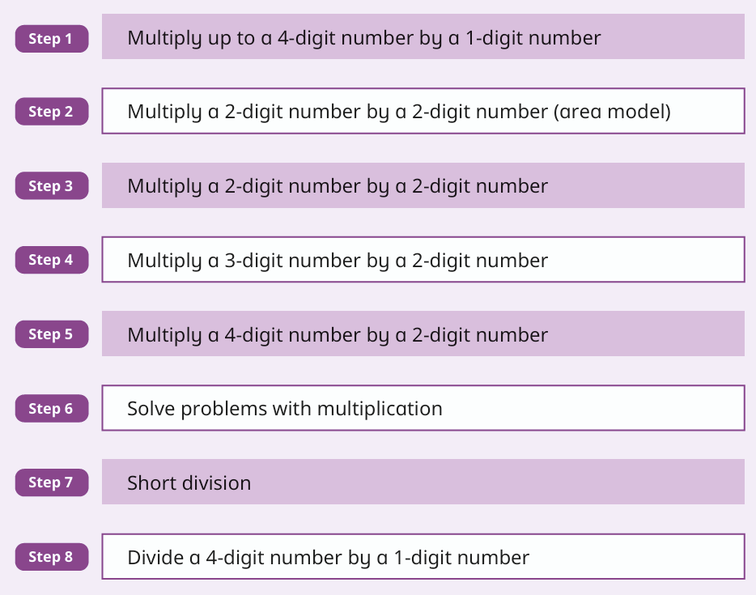
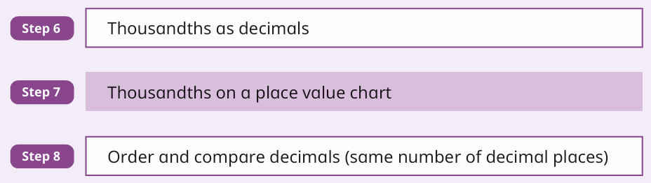
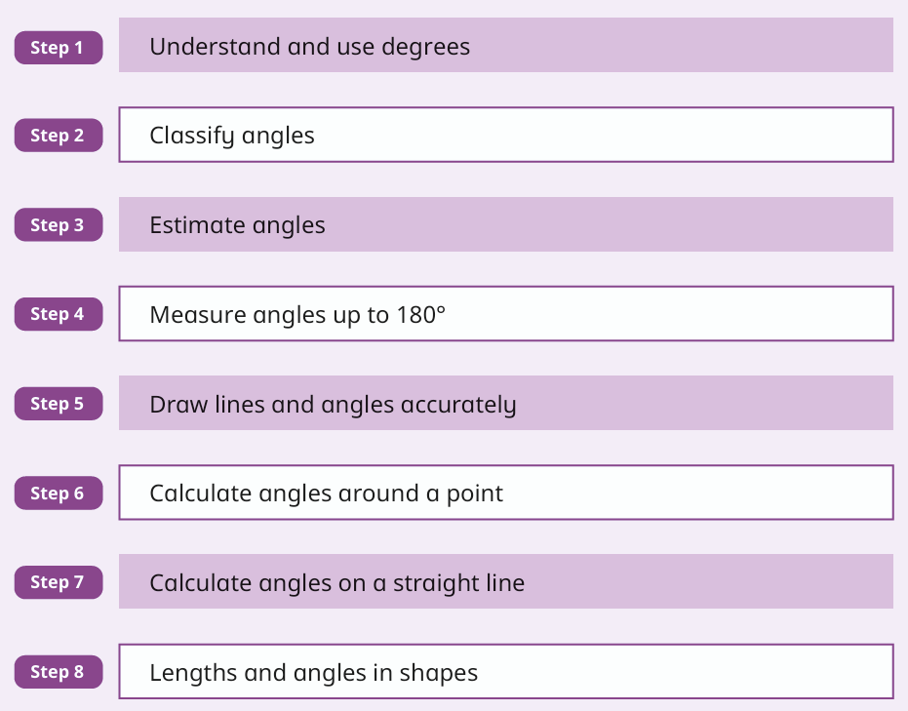
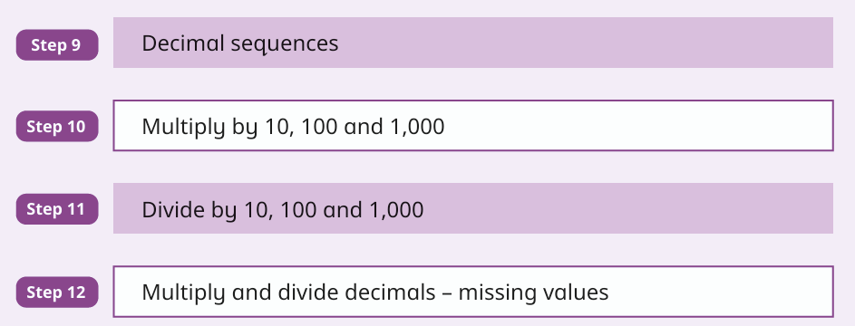
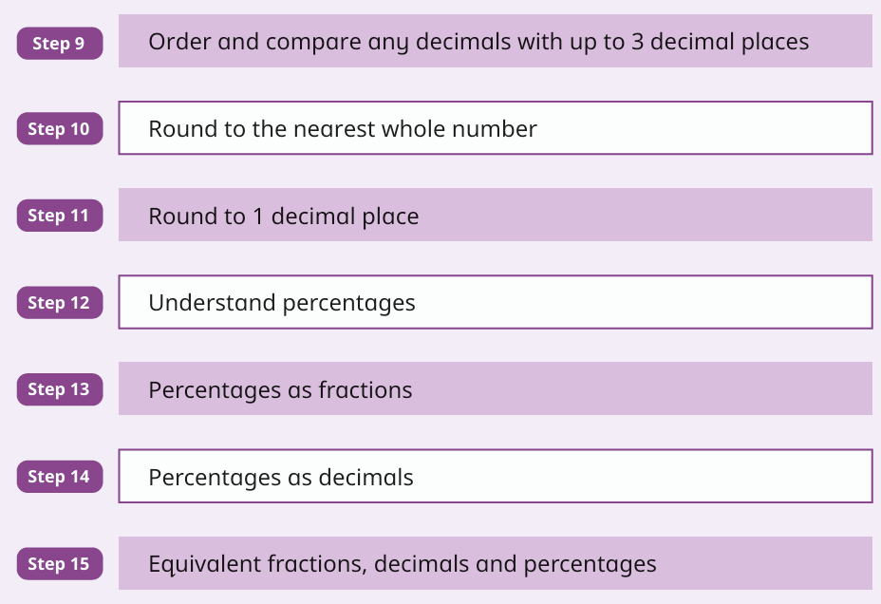
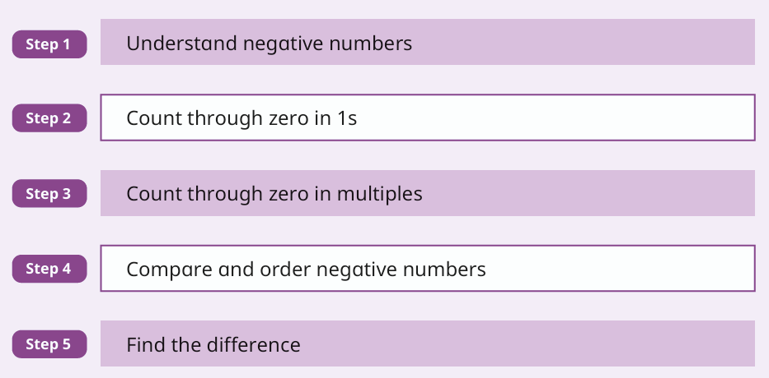
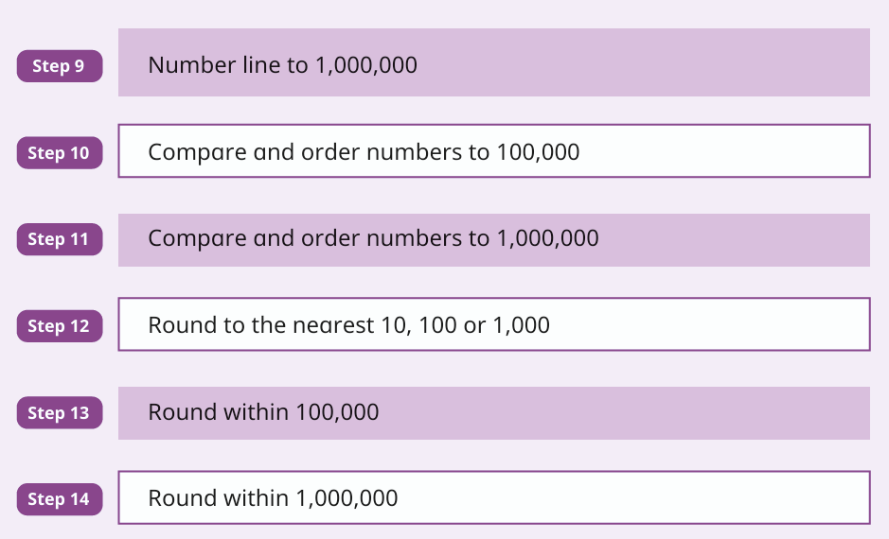
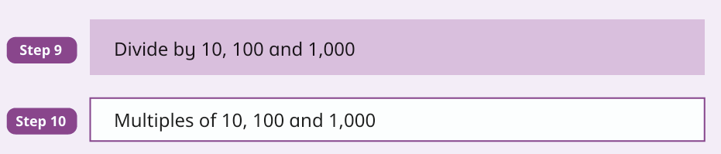
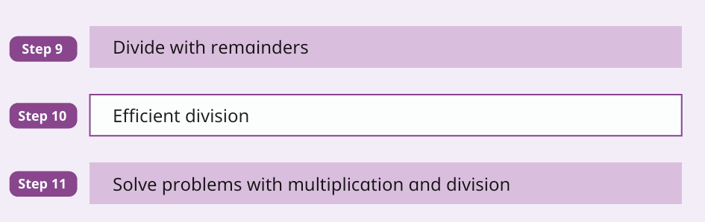
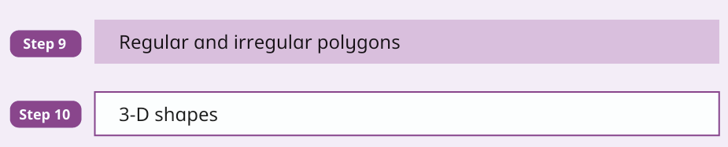
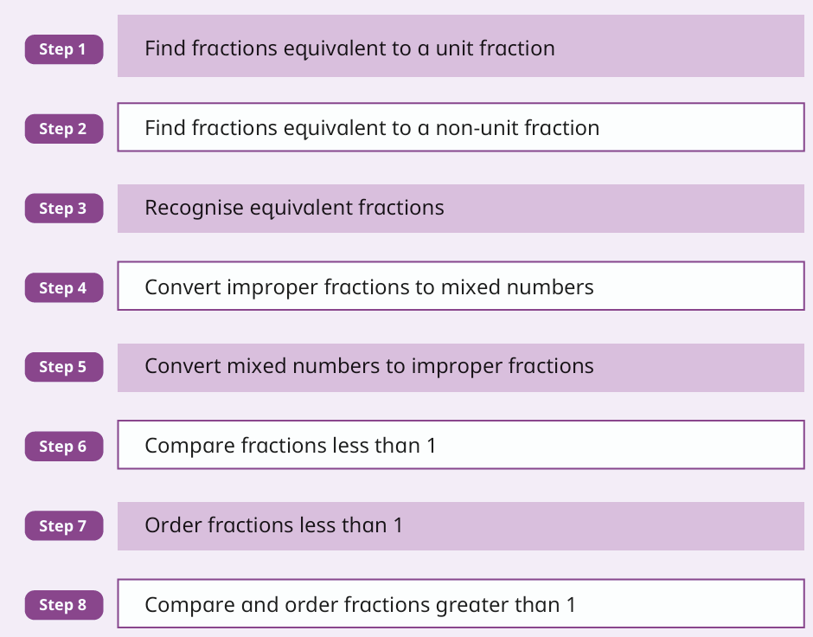
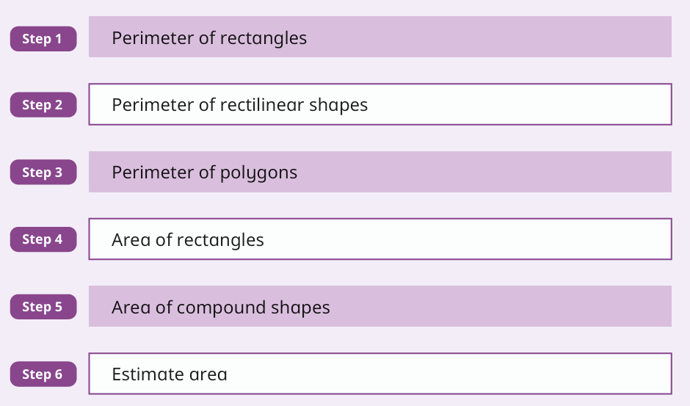
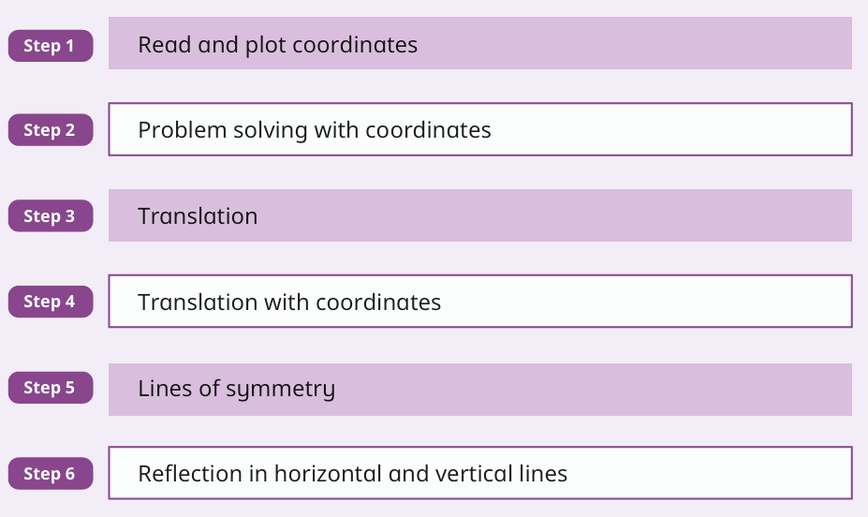
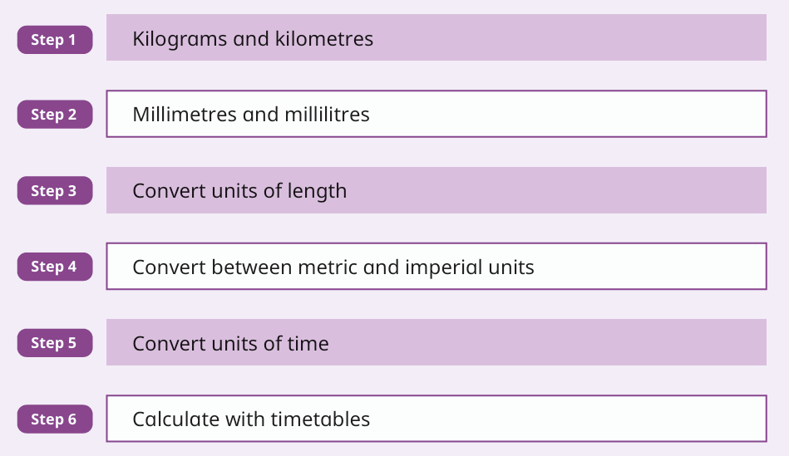
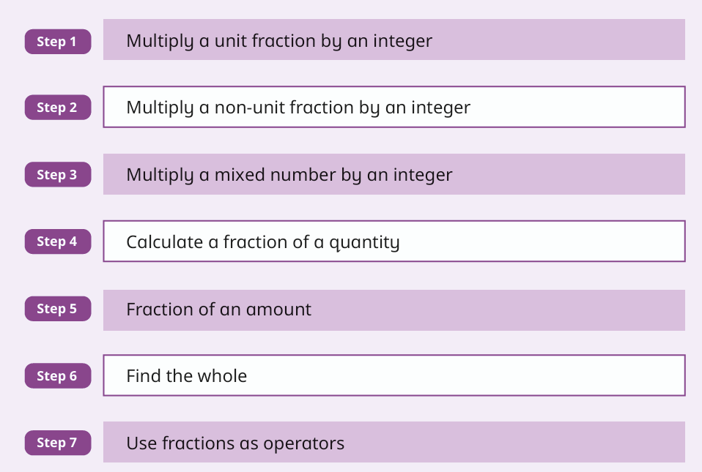
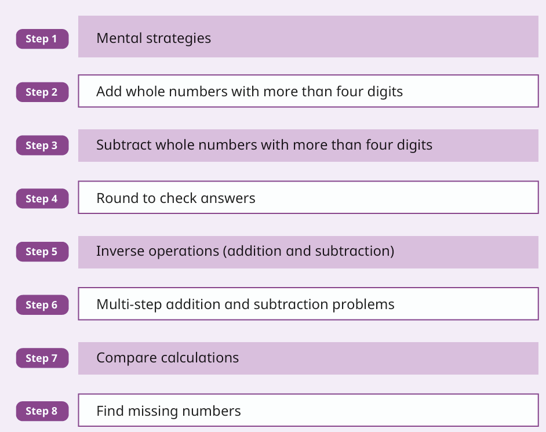
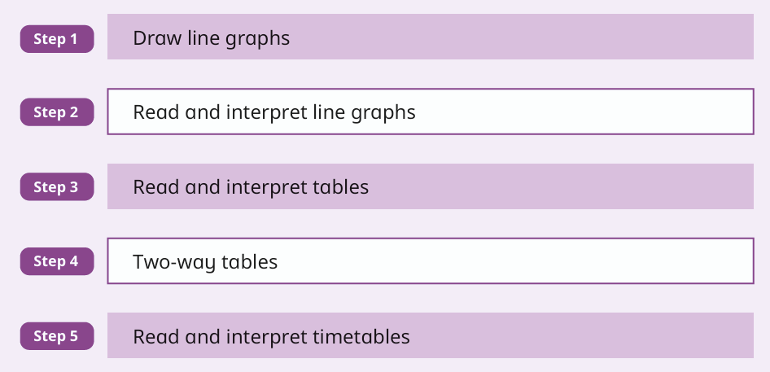
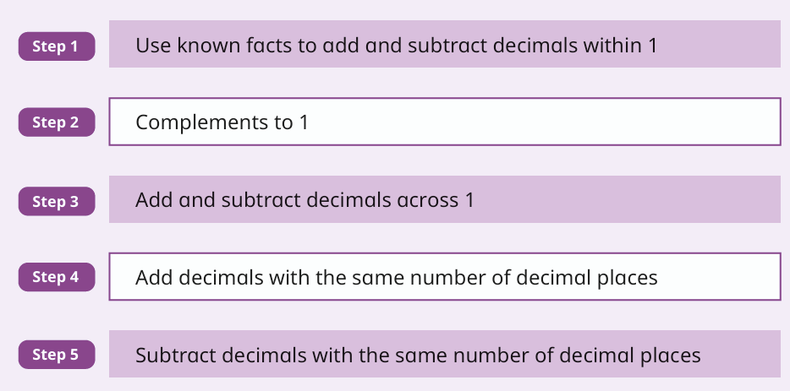
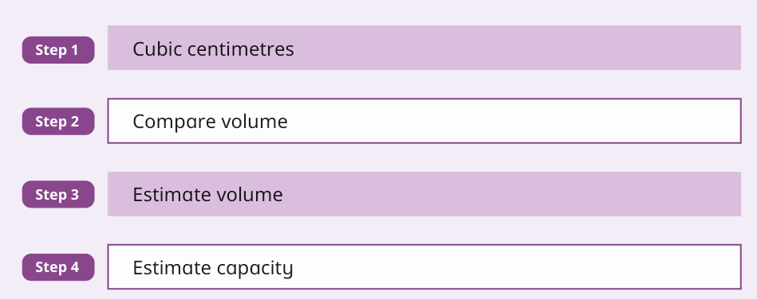
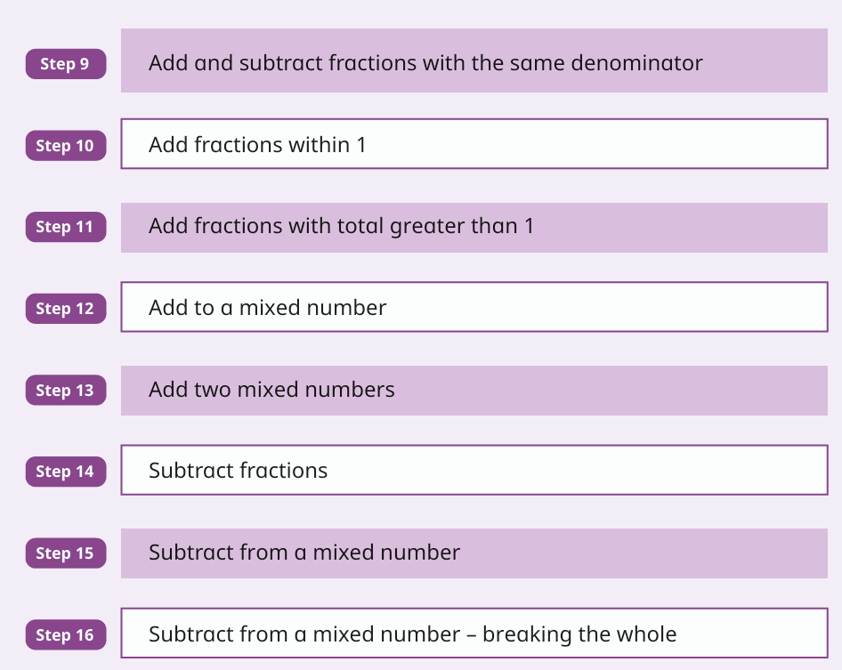
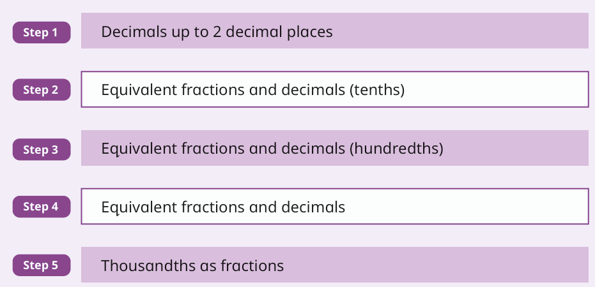
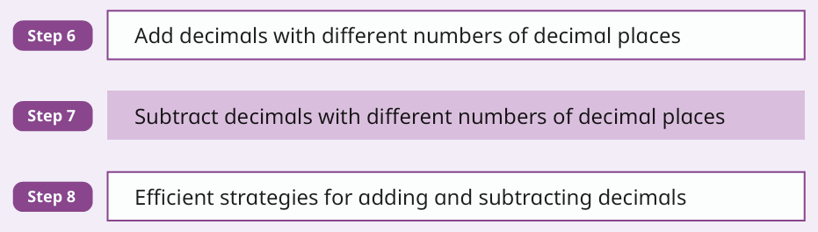

Year 5 Curriculum Overview 26-27
 | Autumn 1 | Autumn 2 | Spring 1 | Spring 2 | Summer 1 | Summer 2
Maths
Number: Place Value
Number: Multiplication and Division A
Number: Multiplication and Division B
Number: Decimals and Percentages
Geometry: Shape
Number: Decimals
Number: Negative Numbers
Number: Fractions A
Measurement: Perimeter and Area
Geometry: Position and Direction
Measurement: Converting units
Number: Fractions B
Number: Addition and subtraction
Statistics
Number: Decimals
Measurement: Volume
Number: Decimals and Percentages
Notes:
3

Slide 4
Year 5 Curriculum Overview 26-27
 | Autumn 1 | Autumn 2 | Spring 1 | Spring 2 | Summer 1 | Summer 2
English | Writing Units Overview
Units / Texts | The Lion, the Witch and the Wardrobe 6-7 weeks | Legends + A Kingdom United 4-5 + 2-3 weeks | Earthlings 5-6 weeks | Inventors and Inventions 5-6 weeks | Amazon Adventure 4-5 weeks | Jabberwocky
Focus Text | The Lion, the Witch and the Wardrobe C. S. Lewis | The Legend of Gelert | Cosmic Frank Cottrell-Boyce | The Invention of Hugo Cabret Brian Selznick | Journey to the River Sea Eva Ibbotson | Jabberwocky Lewis Carroll
Linked Texts | Evacuees of the Second World War; Prince Caspian; The Voyage of the Dawn Treader | St George and the Dragon; Fin MacCool; Fairy Flag of Macleod | Aquila 2; Blast Off; Crash Course; Bug Wars; Ice Breaker; Space Pirates | Small Change for Stuart; Mortimer Keene; Professor Branestawm stories | The Great Kapok Tree; The Vanishing Rainforest; The Shaman's Apprentice | Other Lewis Carroll poems, including The Lobster Quadrille and The Mouse's Tale
Text Types / Skills | Integrated unit; classic narrative; non-chronological report | Legends; persuasive film/TV broadcast; formal presentation | Science fiction stories; poems with a structure | Novel as a theme; magazine information hybrid | Stories from other cultures; debate; persuasive speech | Integrated unit; classic narrative poetry; informal letters; action scenes
Skill Focus | Fronted adverbials; -ing openers; parenthesis; expanded noun phrases | -ed openers; relative clauses; action/dialogue paragraphs; modal verbs | Expanded noun phrases; action/dialogue/description; commas to demarcate and clarify | Relative clauses; root words; cohesion; organisation and presentation devices | Suffixes -ate/-ise/-ify; -ed/-ing openers; tense; subject/verb agreement; modal verbs | Relative clauses with commas; cohesive devices; action, dialogue and description
Writing Outcomes | Evacuee letter; diary extract; Top Trumps summary; setting description; dialogue | Prediction/story ending; diary in role; Top Trumps summary | Evaluative report; persuasive letter; short burst narrative; poem | Diary entries; internal monologues; letters; summary; prediction; invention action scene | Diary entries; internal monologues; letters; persuasive poster | Poetry response; discussion text; letter in role; poetry; report; action scene
Extended Outcomes | Narrative with innovated plot structure; non-chronological report on mythical creatures | Innovated legend; persuasive film/TV broadcast; formal presentation | Science fiction narrative; new poem drawing on structures studied | Short story/chapter about an invention; magazine page using a range of text types | Story set in the Amazon rainforest; persuasive speech; debate | Classic-poem narrative; independent innovated narrative using literary language
Notes:
4

Slide 5
Year 5 Curriculum Overview 26-27
 | Autumn 1 | Autumn 2 | Spring 1 | Spring 2 | Summer 1 | Summer 2
Science | Ongoing: observe life cycles of plants and animals in the local environment throughout the year
 | Properties of Materials | Changes of Materials | Earth and Space | Forces | Animals including humans | Living things and their habitats
 | What would happen if your house was made from metal? | Is climate change reversible or irreversible? | If our solar system had two Suns, what would happen? | What would happen if there was less gravity on Earth? | Why and how do our bodies change throughout our lives? | What mystery about an animal or habitat would you like to solve?
 | Compare and group everyday materials by hardness, solubility, transparency, conductivity and magnetism. Explore thermal conductors and insulators, hardness, solubility, and separating mixtures by filtering, sieving, evaporating or magnets. | Recover substances from solutions and explain reversible changes. Observe and investigate irreversible chemical changes, including rusting, burning and acid reactions with bicarbonate of soda. | Explore the solar system and planets, heliocentric and geocentric models, Earth's movement in space, night and day, sundials and time zones, the movement of the Moon and designing a planet. | Explore gravity and the work of Isaac Newton. Investigate air resistance, water resistance and friction, then examine how levers, pulleys and gears allow a smaller force to have a greater effect. | Describe changes as humans develop to old age, including mammal life cycles, gestation, foetal development and physical changes from childhood through adulthood and old age. | Understand reproduction in plants and animals. Compare life cycles of mammals, amphibians, insects, birds and reptiles, learn about Jane Goodall and David Attenborough, and research a creature's life cycle.
Notes:
5

Slide 6
Year 5 Curriculum Overview 26-27
 | Autumn 1 | Autumn 2 | Spring 1 | Spring 2 | Summer 1 | Summer 2
Geography
 | Our Local Area |  | Our Connected World |  | Our Blue Planet
 | Children identify human and physical features of the local area, use keys and symbols, learn four- and six-figure grid references, carry out fieldwork, interpret data, create charts/graphs and present what it is like to visit the local area. |  | Children use latitude, longitude, the Equator, hemispheres, tropics, the Prime Meridian and time zones to locate places. They explore natural resources, global trade, food miles and how extreme weather events affect trade. |  | Children learn why oceans are important, explore the water cycle, compare river features, investigate how people use rivers such as the Colorado River, and consider climate change, pollution, conservation and how to help our blue planet.
Notes:
6

Slide 7
Year 5 Curriculum Overview 26-27
 | Autumn 1 | Autumn 2 | Spring 1 | Spring 2 | Summer 1 | Summer 2
History
 |  | Vikings in Britain |  | Ancient Maya Civilisation |  | The Tudors
 |  | Children learn who the Vikings were, where they came from and why they travelled. They explore longships, Norse beliefs, Viking settlement in England, Alfred the Great, the Danelaw, the end of the Viking Age and whether Vikings should be remembered as raiders or settlers. |  | Children place the Ancient Maya on a timeline and learn how they lived in the rainforest. They explore Maya society, food and farming, writing and number systems, beliefs and evidence before evaluating why the civilisation was significant and what its legacy is today. |  | Children study the Tudor monarchs and how this period shaped British history. They learn about Henry VII, Henry VIII, Edward VI, Mary I and Elizabeth I, explore religion, portraits, Armada, social class and the Golden Age, then judge the most significant Tudor monarch.
Notes:
7

Slide 8
Year 5 Curriculum Overview 26-27
 | Autumn 1 | Autumn 2 | Spring 1 | Spring 2 | Summer 1 | Summer 2
Art & Design | How can I convey 3-dimensional form through drawing? |  | How can we use forces to create art? |  | How can we use our skills of making gestural marks to create sculpture?
Focus Artist(s) | Andy Warhol Yvonne Coomber |  | Peter Thorpe |  | Henry Rousseau
 | Drawing skills: following instructions to develop techniques. Use a range of pencils and techniques from sticky learning to add shade, tone and texture. |  | Drawing and painting developed: Forces and falling objects into abstract textual paintings. |  | Painting developed into printmaking/collage and digital art: Figure drawing developed into 3D sculpture.
Notes:
8

Slide 9
Year 5 Curriculum Overview 26-27
 | Autumn 1 | Autumn 2 | Spring 1 | Spring 2 | Summer 1 | Summer 2
Design and Technology |  | What is rationing?
 |  | Cooking and nutrition |  | Mechanical systems - gears, pulleys, cams. |  | 3D textiles –combining fabrics.
 |  | The children will compare WWII diets against modern diets, discussing seasonality. They will understand the meaning of rationing and the implications this had. They will create personalised criteria in keeping with a WWII cake recipe. They will design a cake recipe based on own ingredients – with seasonality in mind. Peel, cut, mix, and bake (using oven), with appropriate independence, creating a finished cake which meets the criteria. They will then evaluate the cake against criteria. |  | The children will learn about products that incorporate gear or pulley systems. They will investigate a range toys and other products and will learn how the mechanisms work, further developing their understanding of input, process and output. They will design a moving product for an intended user and purpose. They will apply their learning from the unit to make their product and will evaluate their completed products, judging the extent to which they have met the original design criteria. |  | The children will explore a range of textiles products and will learn about how 3D products are made from joining two fabric pieces together. They will learn a range of joining techniques and will develop skills in measuring, cutting out fabrics and stitching. Children will design a product for an intended user and purpose and will apply their knowledge and skills learnt in the unit to make their product. Children will evaluate their completed products, judging the extent to which it meets the original design criteria.
Notes:
9

Slide 10
Year 5 Curriculum Overview 26-27
 | Autumn 1 | Autumn 2 | Spring 1 | Spring 2 | Summer 1 | Summer 2
Music | How does music bring us together? | How does music connect us with our past? | How does music improve our world? | How does music teach us about our community? | How does music shape our way of life? | How does music connect us with the environment?
 | Melody and Harmony in Music The children will learn that a melody (or a tune) is a group of notes played one after another. They will learn that in music, 'melody' contrasts with 'harmony'. Harmony means notes which are played at the same time, like chords. They will understand that composers often think of a melody and then add harmony to it. The children will explore the voices that sing the melodies and the instruments used within the music in this unit to create the harmonies. Additional Unit Living On A Prayer | Sing and Play in Different Styles The children will learn that singing and playing in different styles with different grooves is part of being in a band or an ensemble. They will learn about music from all around the world, too. They will understand that in music, ‘tempo’ refers to the speed of the beat or how fast or slow the music sounds. They will also understand that sometimes tempos stay the same throughout a song, and sometimes they change. Additional Unit Classroom Jazz 1 | Composing and Chords The children will learn that if they play three or more pitches together, they can create chords in music. Chords provide the basis for accompaniment in music. By using chords in compositions, they can create music that is really interesting. In this unit, they will create an accompaniment, and the composition extension activities will help them to learn about chords. Additional Unit Make You Feel My Love | Enjoying Musical Styles The children will learn that there are so many different, wonderful and interesting styles of music. They will learn that something that happens in music that makes it so interesting is ‘texture’. They will learn that ‘texture’ refers to the layers of sound you hear in a piece of music. They will learn that texture can be the number of voices and instruments you hear at once and that styles of music have different textures. The children will explore how voices and instruments combine to create texture in music. Additional Unit Fresh Prince of Bel-Air | Freedom to Improvise The children will learn that improvisation gives you the freedom to express yourself, to really go for it! They will learn that an ‘interval’ in music refers to the distance between two pitches. They will also learn that some notes lie right next to each other (stepping motion) while other notes lie further apart (skipping motion). Additional Unit Dancing In The Street | Battle of the Bands! The children will create a fun and confident performance with their choice of music and songs. They will perform in small groups and as a whole class. They will Introduce their music professionally and think about their audience and what they would like to see and hear. Additional Unit Glockenspiel Individual instrumental work.
Notes:
10

Slide 11
Year 5 Curriculum Overview 26-27
 | Autumn 1 | Autumn 2 | Spring 1 | Spring 2 | Summer 1 | Summer 2
 | How is information transferred between systems and devices? | What makes a video effective? | How can selection be used in physical computing? | How can a database organise records? | How are vector drawings created? | How can a quiz be designed using algorithms?
computing
 | Computing systems and networks - systems and searching | Creating media - Video production | Programming A – Selection in physical computing | Data and information – Flat-file databases | Creating media - Introduction to vector graphics | Programming B – Selection in quizzes
 | The children will develop their understanding of computer systems and how information is transferred between systems and devices. They will consider small-scale systems as well as large-scale systems. They will be able to explain the input, output, and process aspects of a variety of different real-world systems. The children will discover how information is found on the World Wide Web, through learning how search engines work (including how they select and rank results) and what influences searching, and through comparing different search engines. | The children will get the opportunity to learn how to create short videos in groups. They will be exposed to topic-based language and develop the skills of capturing, editing, and manipulating video. Active learning is encouraged through guided questions and by working in small groups to investigate the use of devices and software. The children will be guided with step-by-step support to take their idea from conception to completion. | The children will use physical computing to explore the concept of selection in programming through the use of the Crumble programming environment. They will be introduced to a microcontroller and learn how to connect and program components (including output devices- LEDs and motors) through the application of their existing programming knowledge. They will be introduced to conditions as a means of controlling the flow of actions. | The children will look at how a flat-file database can be used to organise data in records. They will use tools within a database to order and answer questions about data. They will create graphs and charts from their data to help solve problems. They will use a real-life database to answer a question and present their work to others. | The children will start to create vector drawings. They will learn how to use different drawing tools to help them create images. They will recognise that images in vector drawings are created using shapes and lines, and each individual element in the drawing is called an object. They will layer their objects and begin grouping and duplicating them to support the creation of more complex pieces of work. | The children develop their knowledge of selection by revisiting how conditions can be used in programs. They will represent this understanding in algorithms and then by constructing programs using the Scratch programming environment. They use their knowledge of writing programs and using selection to control outcomes to design a quiz in response to a given task and implement it as a program.
Notes:
11

Slide 12
Year 5 Curriculum Overview 26-27
 | Autumn 1 | Autumn 2 | Spring 1 | Spring 2 | Summer 1 | Summer 2
PE
 | Dance The children will learn different styles of dance. They create, perform and watch dances in a range of styles, working with partners and groups. They will be improvising and exploring ideas developing their knowledge of dance. | Dance The children will learn different styles of dance. They create, perform and watch dances in a range of styles, working with partners and groups. They will be improvising and exploring ideas developing their knowledge of dance. | Invasion Games The children will learn how to work well as a team when attacking and explore a range of ways to defend. They play uneven-sided games leading to 5 v 4 or 4 v 3, Children will also learn a wider range of sport specific techniques. | Striking and Fielding The children will develop the range and quality of their skills and understanding. They learn how to play the different roles of bowler, backstop, fielder and batter. | Invasion Games The children will learn how to work well as a team when attacking and explore a range of ways to defend. They play uneven-sided games leading to 5 v 4 or 4 v 3, Children will also learn a wider range of sport specific techniques. | Athletics The children will focus on developing their technical understanding of athletic activity. They learn how to set targets and improve their performance in a range of running, jumping and throwing activities.
 | Gymnastics Children will develop a wider range of actions and use their skills and agilities individually and in sequence with a partner. Children will create longer sequences with a partner to perform paired balances for an audience. | Gymnastics Children will develop a wider range of actions and use their skills and agilities individually and in sequence with a partner. Children will create longer sequences with a partner to perform paired balances for an audience. | Net/Wall The children will learn to develop the range and quality of their skills when playing games using rackets. They also learn specific tactics and skills for net/wall type games. | Net/Wall The children will learn to develop the range and quality of their skills when playing games using rackets. They also learn specific tactics and skills for net/wall type games. | OAA Activities The children will develop their orienteering and problem-solving skills in familiar and unfamiliar situations and environments. | OAA Activities The children will develop their orienteering and problem-solving skills in familiar and unfamiliar situations and environments.
Notes:
12

Slide 13
Year 5 Curriculum Overview 26-27
 | Autumn |  |  | Spring |  |  | Summer
PSHE
 | Friends and Family | Being part of a community | Healthy Lifestyles - Adults and children’s views | Healthy Relationships | Digital understanding and resilience | Growing and changing - Adults and children’s views | Respecting ourselves and others | Money and work | Keeping safe. Adults and children’s views
 | Managing friendships and peer influence. 1Decision Inclusion and acceptance | Protecting the environment; compassion towards others. 1Decision : Looking out for others | Healthy sleep habits; sun safety; medicines, vaccinations, immunisations and allergies. 1Decision : Smoking | Physical contact and feeling safe. 1Decision : Peer pressure | How information online is targeted; different media types, their role and impact. 1Decision ; image sharing | Physical and emotional changes in puberty. 1Decision : Puberty | Responding respectfully to a wide range of people; recognising prejudice and discrimination 1Decision : Anger - Permission seeking and giving | Identifying job interests and aspirations; what influences career choices; workplace stereotypes. 1Decision: Enterprise | Keeping safe in different situations, including responding in emergencies, first aid. 1Decision : First Aid year 5
Notes:
13

Slide 14
Year 5 Curriculum Overview 26-27
 | Autumn 1 | Autumn 2 | Spring 1 | Spring 2 | Summer 1 | Summer 2
French
 | Are French Primary schools different to ours? | What is the capital city of France? | How do you make a fruit salad? | What is a carnival outfit? | Can I name all of the planets? | What should I take to the seaside?
 | Me and my friends at school During this half term the children will revisit and build on language knowledge to include extended feelings phrases. They will also learn to speak about another person in the third person. In addition, the children will be introduced to an authentic French primary school timetable, learn nouns for school subjects and to give opinions of school including a reason to extend. | Time in the city During this half term, the children will review and build on prior learning about places. They'll learn about Paris, explore its facts, and practice language for buying tickets and asking for directions. They'll also become tour guides, writing rainbow sentences. For a Christmas-themed activity, they'll design festive jumpers. | At the market This half term the children will start by revisiting prior learning about fruits and vegetables. This time the children will explore going to the market to buy fruits and vegetables and take part in a role play at the market. The children will then follow instructions in a fruit and vegetable recipe. | Clothes This half term the children will be learning nouns for clothes, and they will look at the verb “to wear”. The children will see how to use adjectives of colour to describe clothes. They will then look at and unpick a detailed description of an outfit and finish the unit with a focus on Carnival and carnival outfits. | Out of this world This half term, pupils will become space travellers and astronauts, exploring personal info Q and A, understanding important personal information on ID cards and creating their own ID card. They will listen to and join in with a “Galaxy adventure story”, practise adjectives and create their own imaginary planets, revisiting prior learning: colours, places in the city and weather phrases. | Going to the seaside This half term is all about going to the seaside. The children will start by learning about beaches in France and items they might take to the seaside. They will then start familiarising themselves with persuasive sentences about visiting the seaside to create and perform a spoken advert and a leaflet about visiting the seaside and build up to creating extended sentences designed as sandcastles using the language they have learnt plus conjunctions to extend.
Notes:
14

Slide 15
Year 5 Curriculum Overview 26-27
 | Autumn 1 | Autumn 2 | Spring 1 | Spring 2 | Summer 1 | Summer 2
RE | Ongoing – Prayer Spaces and trips to church
 | How and why do Christians read the Bible? | How do our celebrations reflect the true meaning of Christmas? | Why do Christians believe Jesus was a great teacher? | Why do Christians believe that Easter is a celebration of victory? | How did the news of Jesus resurrection spread around the world? | Did she make the right choice?
 | The Bible The children will deepen their understanding of the importance and impact of the contents of the Bible in the lives of Christians. They will further develop their understanding of the significance of holy books in the lives of the people of all world faiths. | Christmas The children will be given a Biblical perspective on the nativity story. This unit will deepen children’s understanding of what Christians believe to be the true meaning of Christmas and increase their knowledge and understanding of the place of the incarnation in God’s Big Story. | Jesus This unit will emphasise Jesus’ skills as a great teacher. The children will consider carefully the messages of the parables and how they impact on the lives of practising Christians. | Easter This unit emphasises that Christians believe that Easter is the celebration of Christ’s triumph and victory over death. This is is at the very heart of Christian belief. The children will gain an understanding of the importance of Jesus death and resurrection in Christian belief, as a rescue plan to restore the relationship between God and his people | St. Paul The children with have the opportunity to gain greater understanding of the lives and resilience of the early Christians. They will realise the significance of the life of St Paul and the concept of mission. The children will learn basic facts about how Christianity spread throughout Britain. | Old Testament Women This unit will increase and widen the children’s knowledge and understanding of the role and significance of women in the Bible and God’s big story. They will reflect upon the actions of these women and consider what we can learn from their stories. The children will deepen their understanding that it isn’t always easy being a person of faith and tough choices have to be made. They will explore the story of Esther and the Jewish Festival of Purim.
Notes:
15

