Slide 1
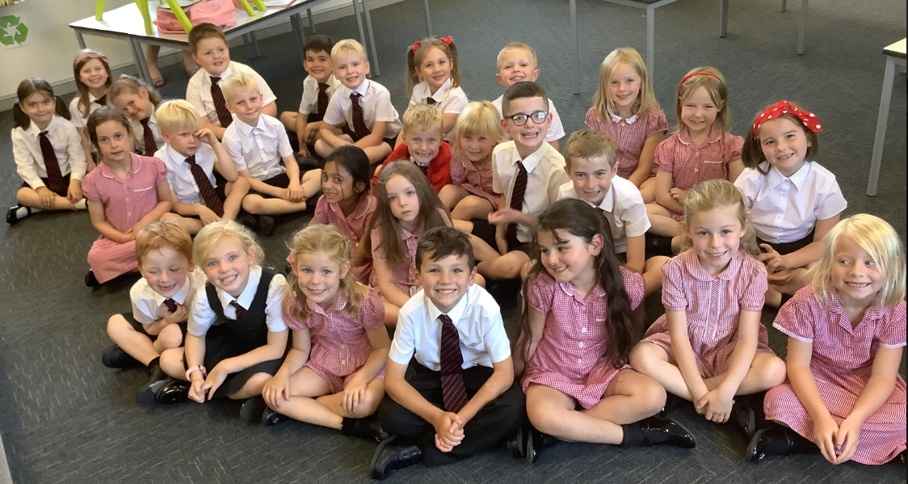
WELCOME TO CLASS 2
Parent’s welcome meeting – September 2023

Slide 2
AGENDA
Welcome letter
Our class timetable
Behaviour system
Google classroom - Homework
Website
Any questions?

Slide 3
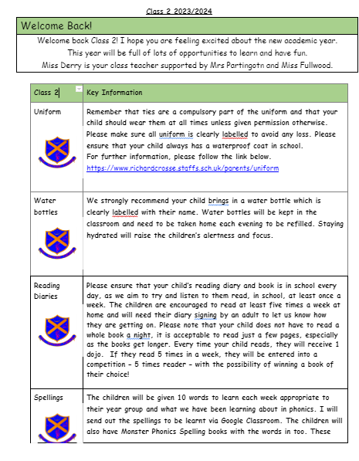
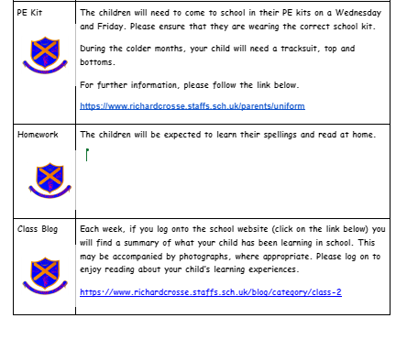
WELCOME LETTER

Slide 4
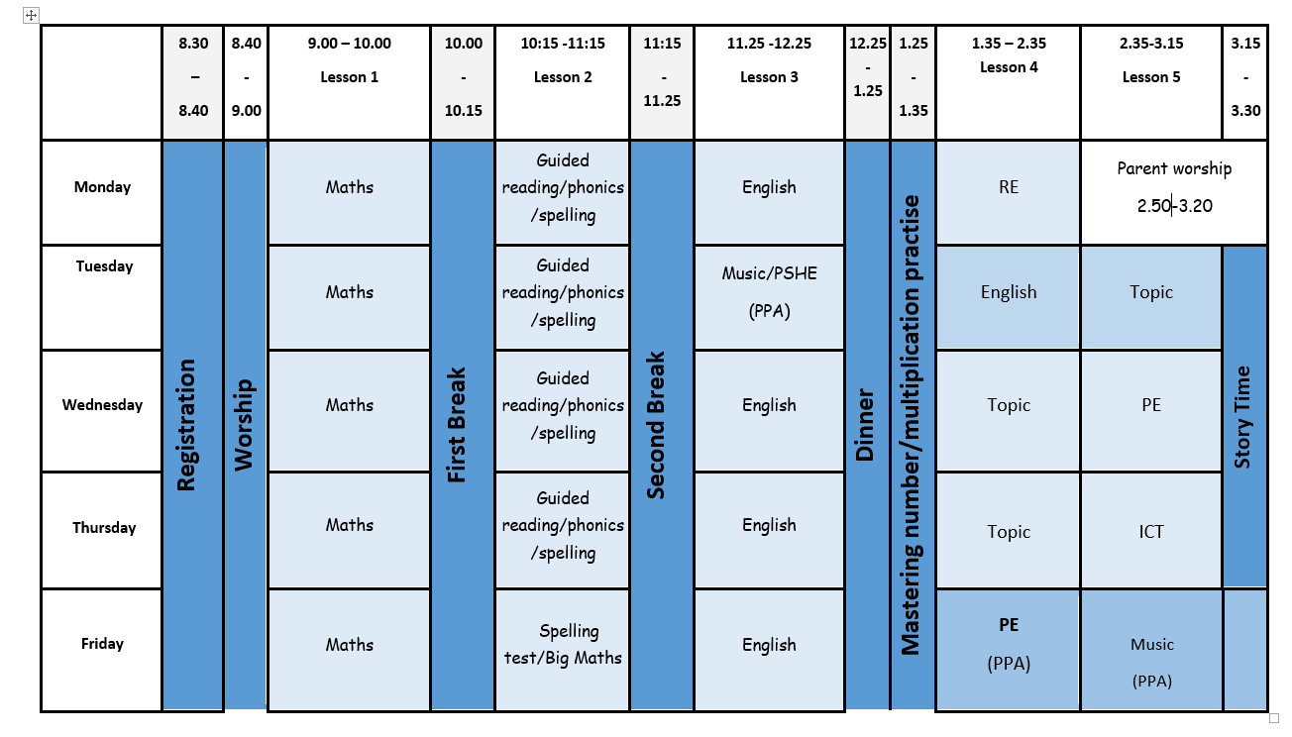
OUR CLASS TIMETABLE

Slide 5
BEHAVIOUR SYSTEM
Here at Richard Crosse our behaviour policy is underpinned by our Christian vision and ethos. We encourage positive behaviour by teaching the children clear Christian values each month such as tolerance, respect and love. All our pupils are valued as God's children.
Behaviour chart and Class Dojo
We no longer access the messaging
Service through dojo. If you need to contact us,
please send an e mail via the office.

Slide 6
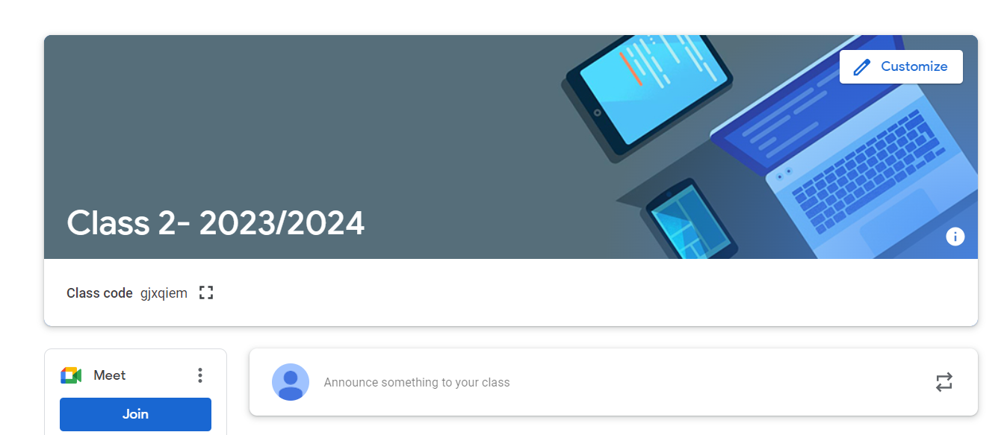
GOOGLE CLASSROOM/ HOMEWORK
https://classroom.google.com/c/MzgyMzA2Njg0MDU0

Slide 7
WEBSITE

Slide 8
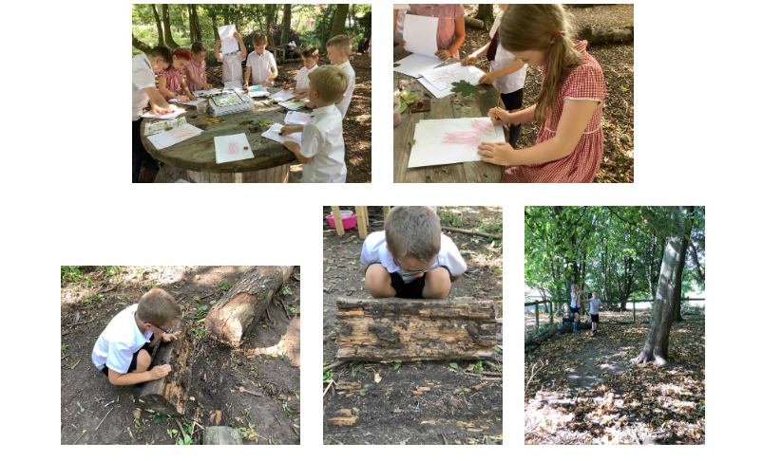
Outdoor Learning Days
Once a term the children are going to be spending the day either at St Mary’s or The Howard Primary schools. Here the children will be able to make use of the extensive outdoor facilities that both schools have. Further information will follow, once dates have been confirmed.

Slide 9
ANY QUESTIONS?
Thank you for attending our welcome meeting.

Slide 10
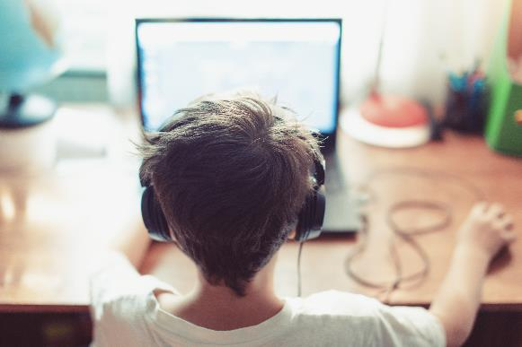
E-Safety
https://www.youtube.com/watch?v=hZIYSCE-ZjY&t=2s

