Slide 1
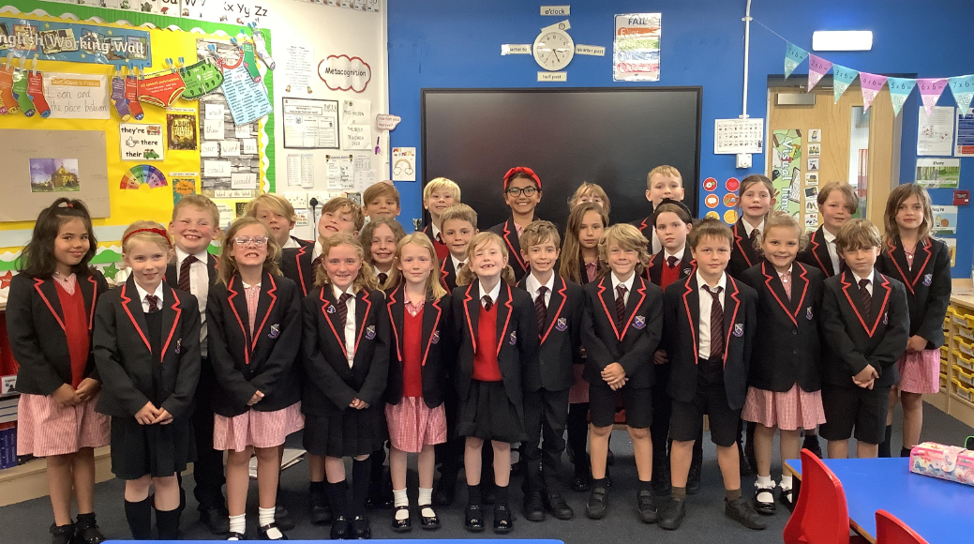
Insert

Slide 2
Agenda
Welcome letter
Time table
Google Classroom
Swimming
Behaviour system
Snacks
Website
E -Safety

Slide 3
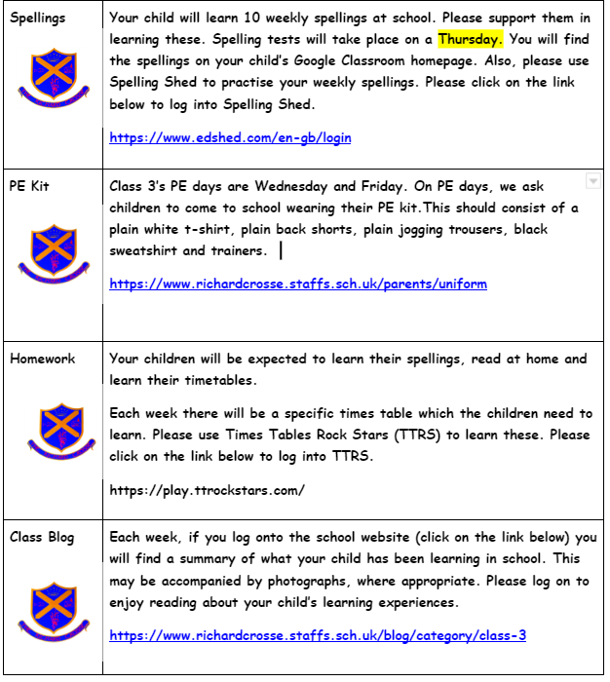
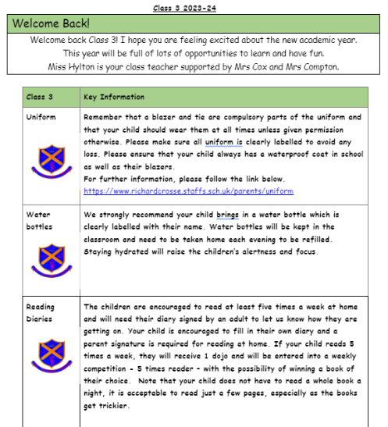
Welcome Letter

Slide 4
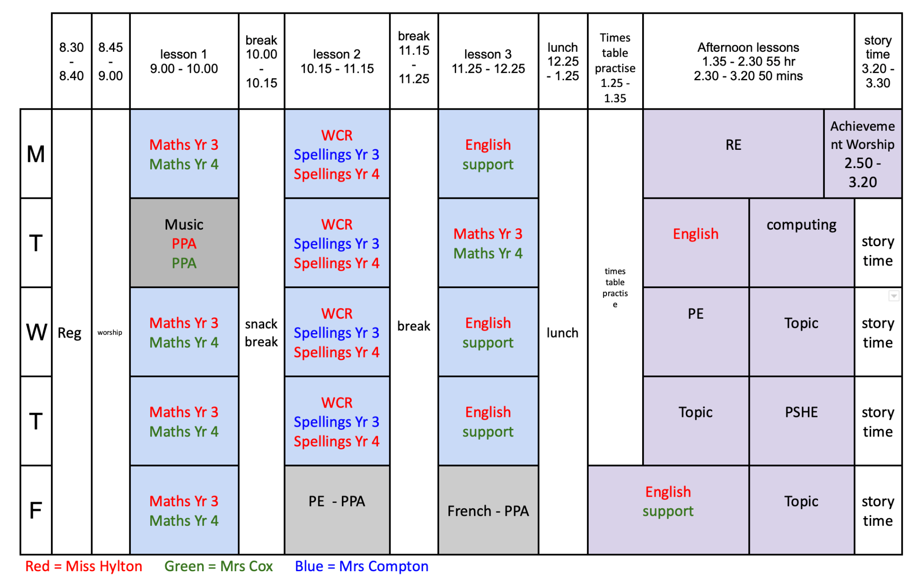
Time Table

Slide 5
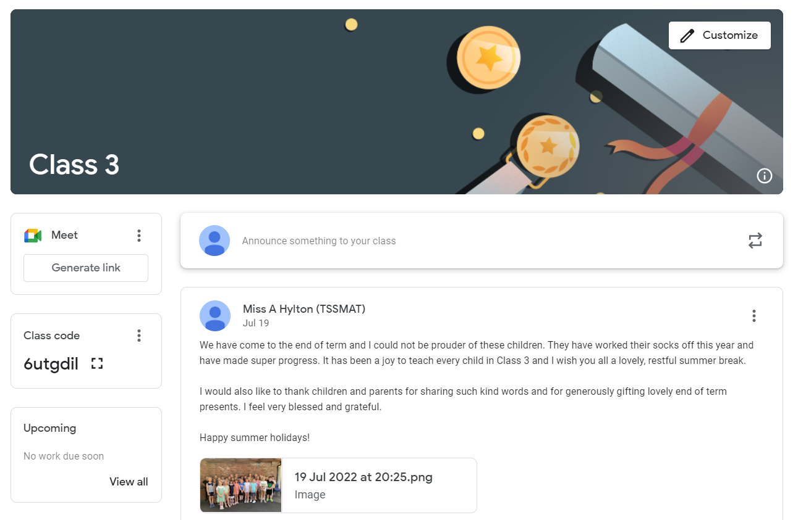
Google Classroom
Notes:
Please accept my invitation

Slide 6
Swimming
Swimming lessons will take place after Christmas for Year 4
Please ensure your child arrives at school with an appropriate swim kit.

Slide 7
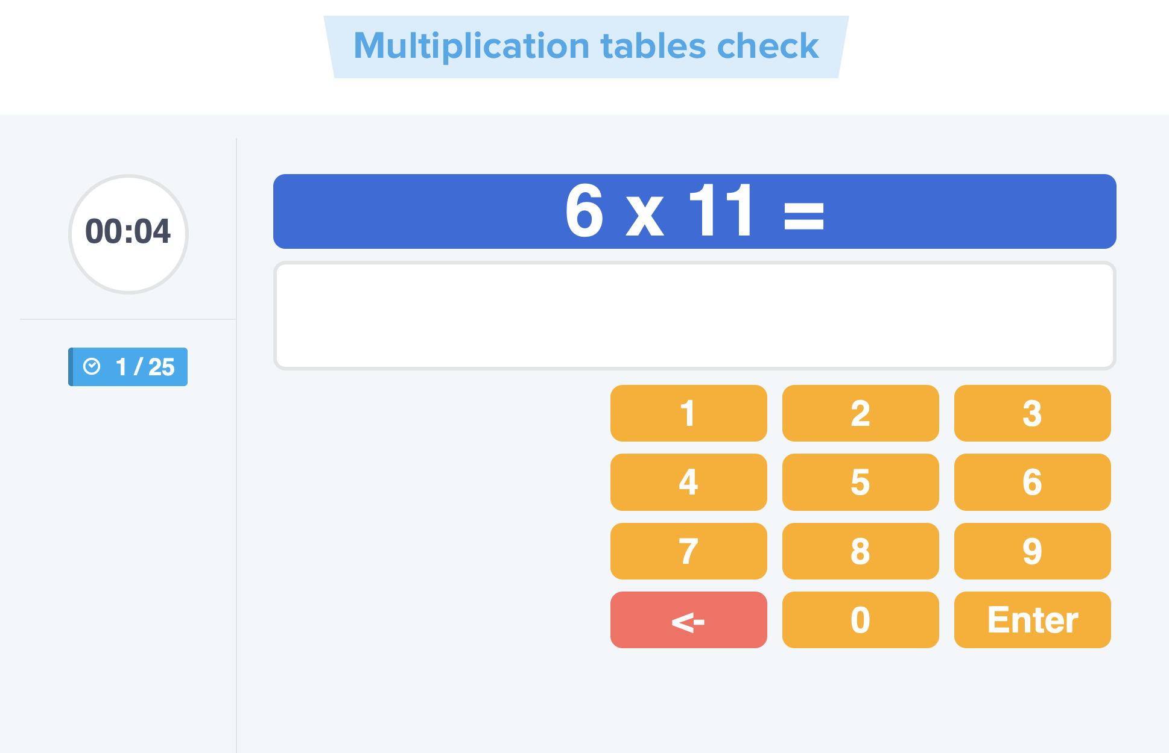
Multiplication Check Test
The purpose of the MTC is to determine whether pupils can recall their times tables fluently, which is essential for future success in mathematics.

Slide 8
Behaviour System
Here at Richard Crosse our behaviour policy is underpinned by our Christian vision and ethos. We encourage positive behaviour by teaching the children clear Christian values each month such as tolerance, respect and love. All our pupils are valued as God's children.
Behaviour Chart
Class Dojo
We no longer access the messaging service through Dojos, please contact me via the office.

Slide 9
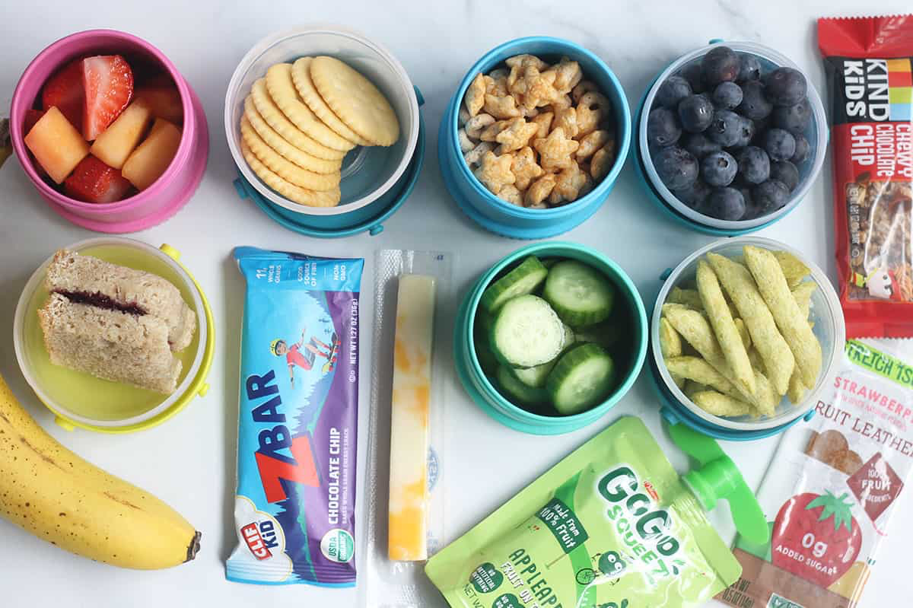
Snacks
We encourage pupils to bring a suitable healthy snack for 1st break.

Slide 10
Website

Slide 11
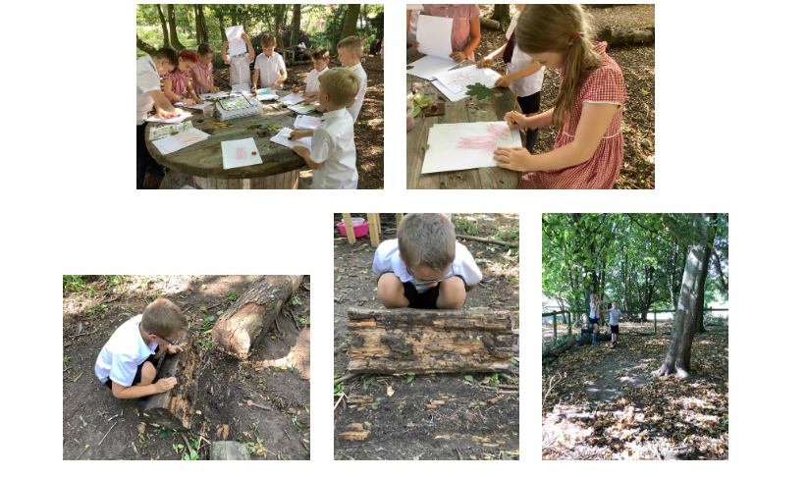
Outdoor Learning Days
Once a term the children are going to be spending the day either at St Mary’s or The Howard Primary schools. Here the children will be able to make use of the extensive outdoor facilities that both schools have. Further information will follow, once dates have been confirmed.

Slide 12
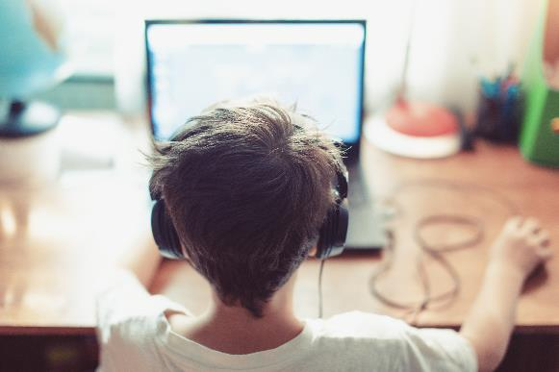
E-Safety

