Slide 1
ow

Slide 2
how

Slide 3
now

Slide 4
brown

Slide 5
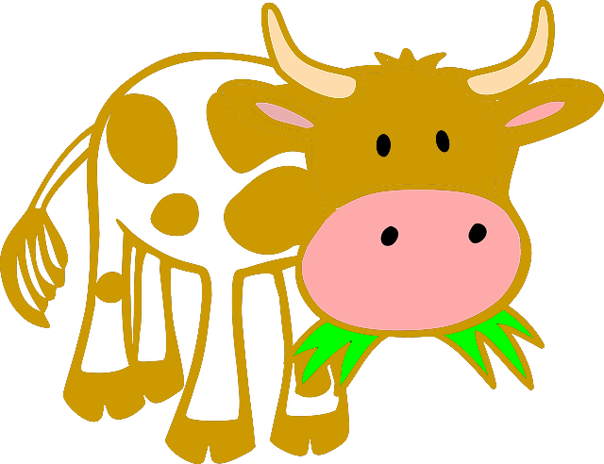
cow

Slide 6
down

Slide 7
crown

Slide 8
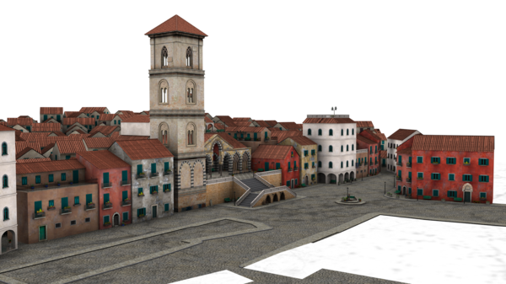
town

Slide 9
shower

Slide 10
flower

