Slide 1
Desert Life Aim: To write a diary entry as if you live in a desert. Linked to topic work.

Slide 2
I have included a link of a day in the life of a young Maasai girl, just to give you some ideas.
https://www.youtube.com/watch?v=XQ7wV9DeEqw
You can write about any desert, maybe you want to write about the day in the life of an indigenous Australian person.
Remember to look at your topic work before you do this as it should help you.

Slide 3
You are writing in the first person, so you are pretending to be the child living in the desert.
Here are some questions to think about before you start writing.
You can not switch a tap on and have fresh water, you may need to walk for miles for it.
What animals are around you, do you feel safe?
What if you are sick, there is not a car to get you to the doctor.
Do you go to school, or do you have to help farm the animals and try and find water?
Is you family nomadic, do they have to pack their home up and travel?
What is the weather like? Is it hot in the day and cold at night?
How do you get food?
How long is your day?

Slide 4
Remember when we started our diaries for ‘Floodland’, we talked to the diary as if it was our only friend. How might you start this diary entry?

Slide 5
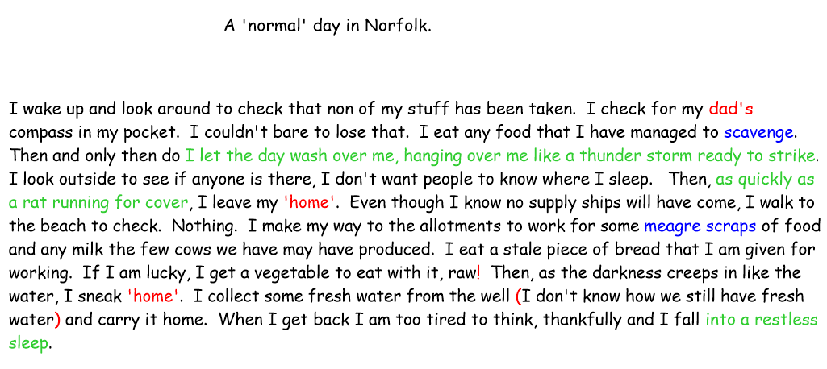
This is one of the timeline diary entries we wrote in ‘Floodland’.
Draw out the time line of your day, starting with waking up, are you hungry? What you do through the day, and then going to bed. Are you coughing because of the smoke in your hut?

Slide 6
Steps to Success
Remember your punctuation
Make you diary entry flow.
Put it in time order.
Show case your writing, use similes, add lots of description.
Check your work.

