Slide 1
Poetry

Slide 2
https://www.youtube.com/watch?v=Oaq3gzswei0
Michael Rosen is a really fun poet.
Some of his poems rhyme and a lot don’t.
I have included a fun one that rhymes – just so you can see if you can pick up on the patterns, and for a bit of fun.
He has a YouTube Channel if you would like to take a look.

Slide 3
Only the 2 , 4, 6, 8, 10 , 12 lines rhyme
Deep – asleep
Light – bright
See – be
The lines are not in sentences, but in a structure that allows the poem to flow.

Slide 4
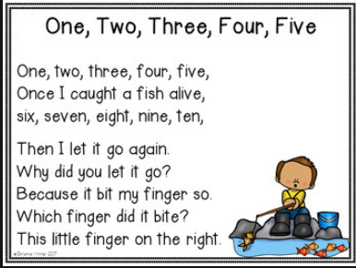
You use a lot of rhyming poems without thinking about it – here are a few

Slide 5
Let’s look at some rhyming words – what can you think of to go with the words?
Love
Shoe
Fade
Orange

Slide 6
It is the phonetically sound of the word that you are rhyming, so it does not have to be spelt the same.
Love – glove, dove, shove
Shoe – new, boo, two, loo, poo
Fade – shade, tirade, made, laid
Orange – haha tricked you! You can’t rhyme orange with a word

Slide 7
How might you add lines to this poem –
The nice old lady
From sixty- two
Ran out of her door
____________________
She sounded so shocked
When she shouted, “BEWARE!”
We all turned around
____________________
We threw her some rope
And she tied it so tight
We heaved her up
____________________
Her knickers on show
And her wig scew-wiffed
It really was no wonder
____________________

Slide 8
This is what I did –
The nice old lady
From sixty- two
Ran out of her door
And into a zoo
She sounded so shocked
When she shouted, “BEWARE!”
We all turned around
just so we could stare
We threw her some rope
And she tied it so tight
We heaved her up
It was a terrible sight
Her knickers on show
And her wig scew-wiffed
It really was no wonder
She was a little bit miffed
I changed a word slightly so that I could add a word that rhymed in. This is why poems are fun – you can play around with words.

Slide 9
If you are having problems thinking of a poem, adapt ones that have already been written.
One, two, three, four, five
The fox and the hen went for a drive,
Six, seven, eight, nine, ten
They went so fast they crashed into their den.
You don’t have to use all the poem and remember, it does not need to make sense.

Slide 10
Your turn…
If you can, record your poem and send it to me.

