Slide 1
Science Light

Slide 2
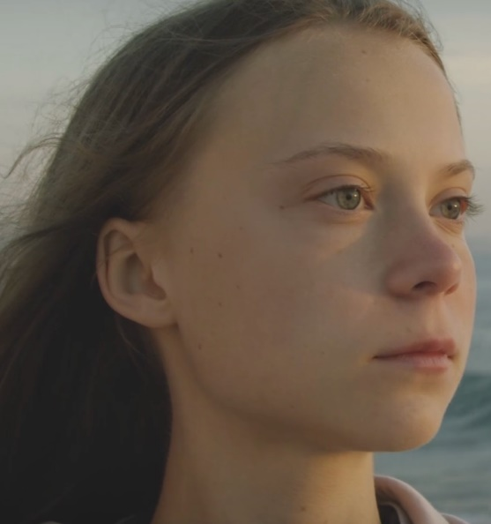
When we think about how light travels we need to remember it comes from the source to the object.
Object / thing looking at the light
Source / light

Slide 3
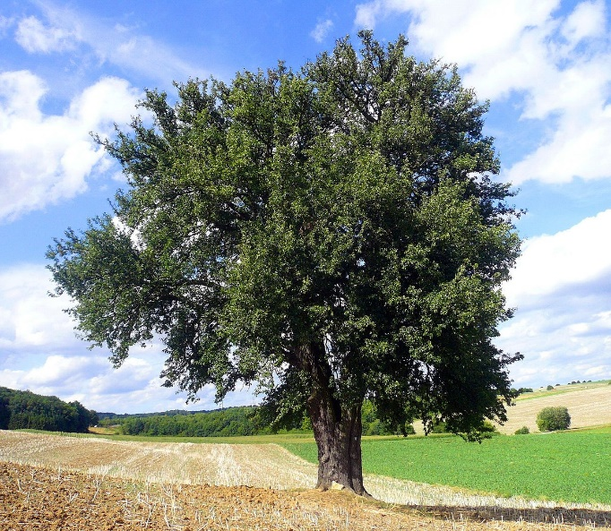
The light from the bulb lets Greta see the tree.
Bulb shines on the tree.
Which means when Greta looks at the tree the light shinning on the tree will travel to Greta’s eyes.

Slide 4
The mirror reflects / blocks the light so that the light bounces / turns the light.
Any shiny surface will do this.

Slide 5
https://www.youtube.com/watch?v=rExDkyJ6thU
Watch this YouTube clip to see how you would conduct an experiment to see how light affects shadow.
Remember variables are the things that change, her the size of the shadow and the objects distance for the light are variables as they change.

Slide 6
Have a go at the Light quiz I have sent you.

