Slide 1

Maths at Rose Wood
Contents
Learning Essentials
Calculation & CPA Policy
Vocabulary
S Plan and Interweaving
The Big 5 Ideas
Working Walls
5 a day
Resources & Websites

Slide 2
Learning Essentials
These are core areas that form the basis of maths teaching. Other elements can be added, but all children should be exposed to these learning opportunities.
Introduce new vocabulary
Making Connections
Plenty of opportunities should be provided for children to make connections with previous learning. The interweaving principles adopted allow opportunities for this.
Small steps and CPA approach
Opportunities to reason and problem solve
Use of stem sentences to deepen understanding
Use 5 a day to embed fluency

Slide 3
Vocabulary
Vocabulary is an essential aspect of mathematical understanding. Children will be introduced to mathematical vocabulary at the beginning of a new unit. This vocabulary will be defined by the teacher and then displayed at the beginning of each lesson. Children will then be challenged to recall the definition of the vocabulary.

Slide 4



Small steps/coherence

Slide 5

Fluency
Fluency can be separated into the following areas.
Number sense
An understanding of how numbers work
Accuracy
Recognise whether the result is accurate
Useful resources
Understanding of representations
Translate values across symbols and objects
Automaticity
Worked Examples
Automaticity
Recall facts without consciously thinking
Efficiency
Working out the shortest path from problem to solution
Flexibility & appropriate response
To know multiple ways to solve a problem

Slide 6
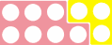
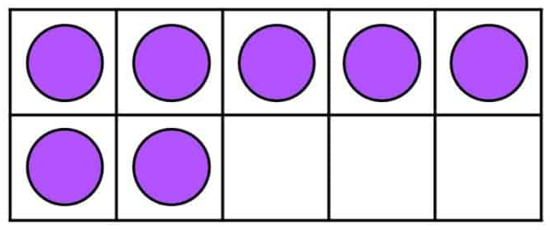
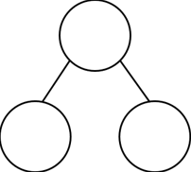
Representation and Structure
Representation and structure allows children to experience a concept in many different ways through the use of the Concrete, Pictorial, Abstract Approach (CPA)
Number bonds:
Useful resources
C
P
A
Four operations
10
10
7 | 3
7
3
7 + 3 = 10 3 + 7 = 10
10 - 7 = 3 10 - 3 = 7

Slide 7
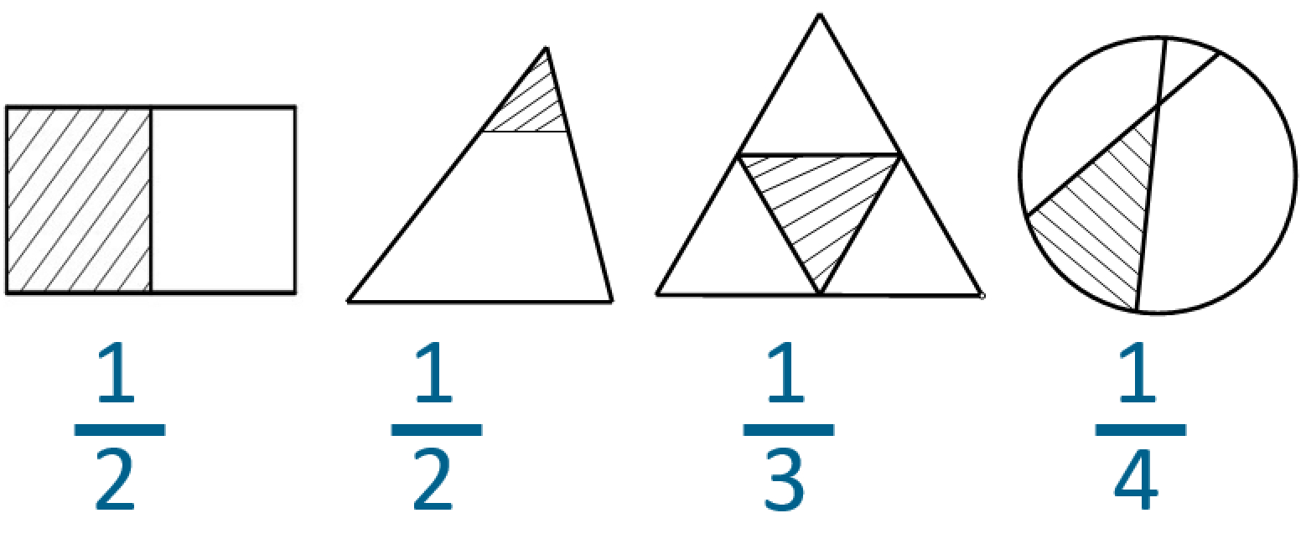
Variation
Variation allows children to be able to spot patterns within their learning. Conceptual variation provides the opportunity to work on different representations of the same problem. Procedural variation involves keeping most things the same and making one change.
Conceptual Variation
Procedural Variation
9 x 8 =
90 x 8 =
0.9 x 8 =
90 x 80 =
Follow-up Task
How many ways can you find to create a product of 0.72 using the same digits?
True or false?
Conceptual understanding can improve depth of knowledge through the use of non-examples.

Slide 8
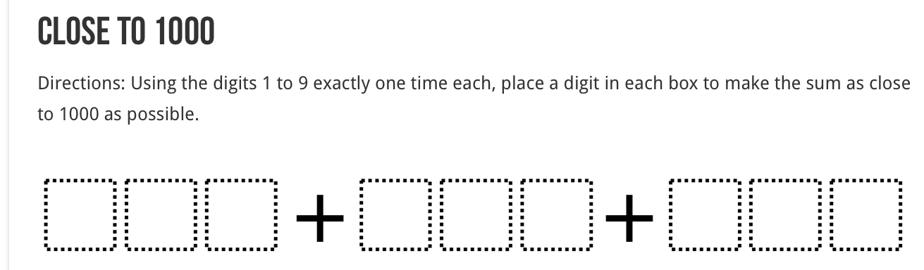
Mathematical Thinking
The aims of mathematical thinking are to provide opportunities for children to think deeper. This can be achieved by encouraging children to look for patterns and relationships, pose questions and reason logically. Children who are adept at thinking mathematically will be able to select the best method to complete a problem.
Rose Wood Stem Sentences
Mathematical Thinking - Nrich

Slide 9
5 a day
5 a day is used at the beginning of a maths lesson and covers a wide range of questions:
▪️revisiting previous learning and preparing for new content
▪️exploration of pictorial representations
▪️interweaving
▪️pre-teaching a new concept
▪️variation used to reduce cognitive load

Slide 10
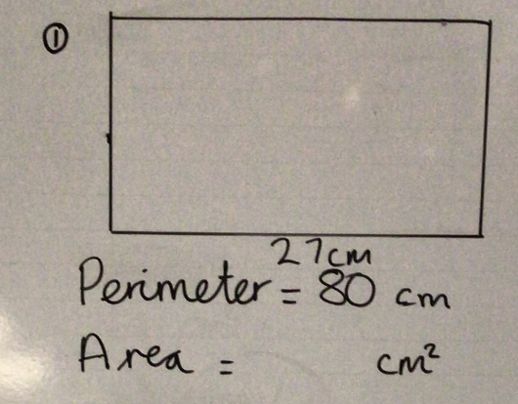
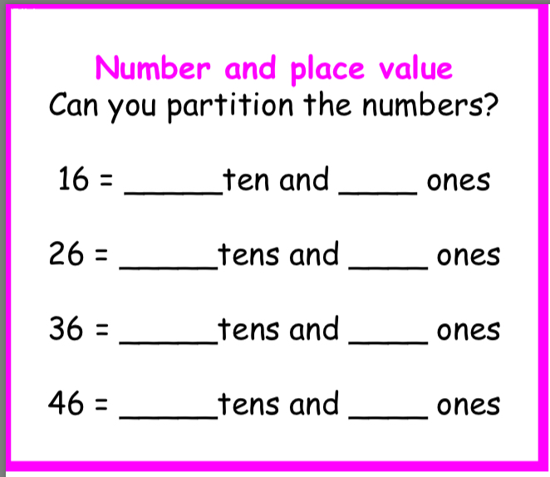
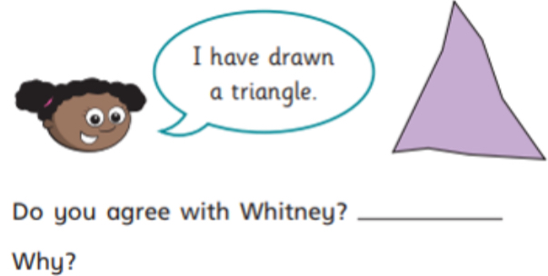
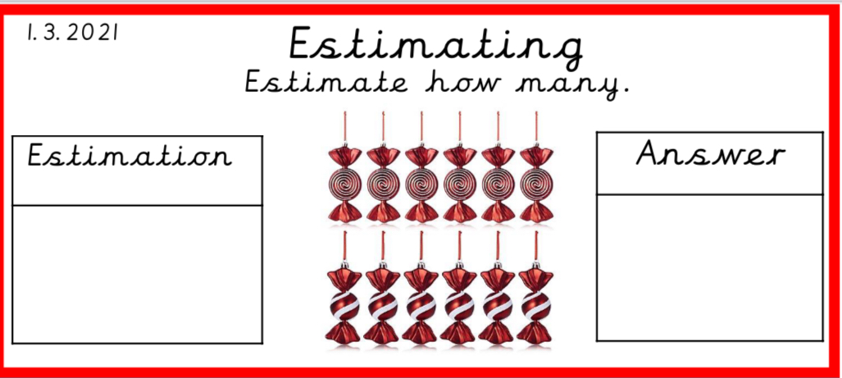
Revisiting previous learning and preparing for new content
Year 1
Year 3
Revisiting from previous unit
Revisiting from previous week
Revisiting from previous year

Slide 11
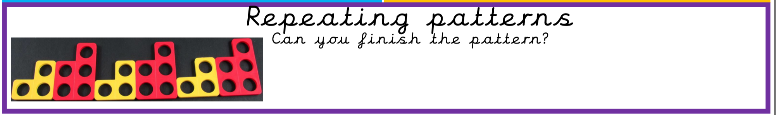
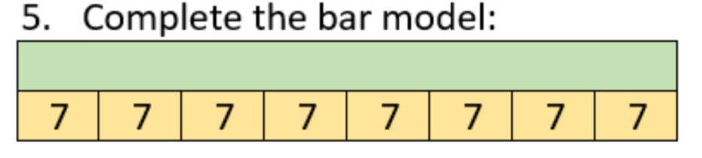
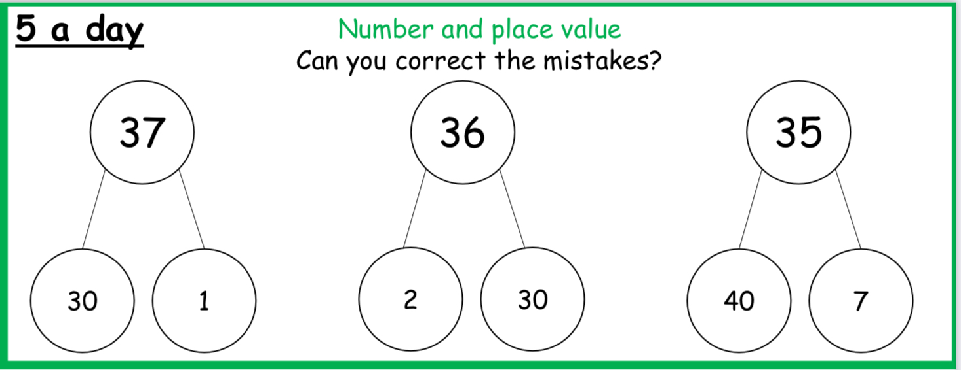

Exploration of pictorial representations
42
Find 2 of 42
7

Slide 12
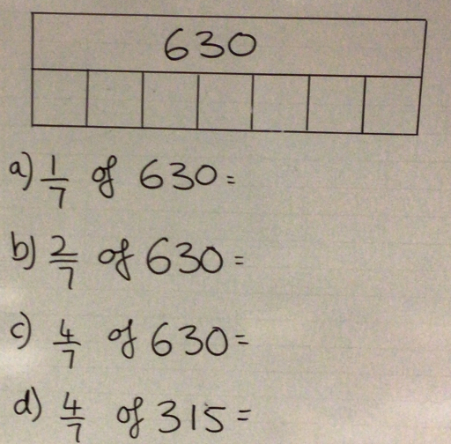
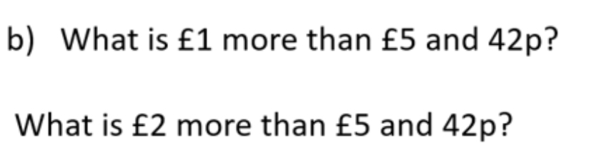
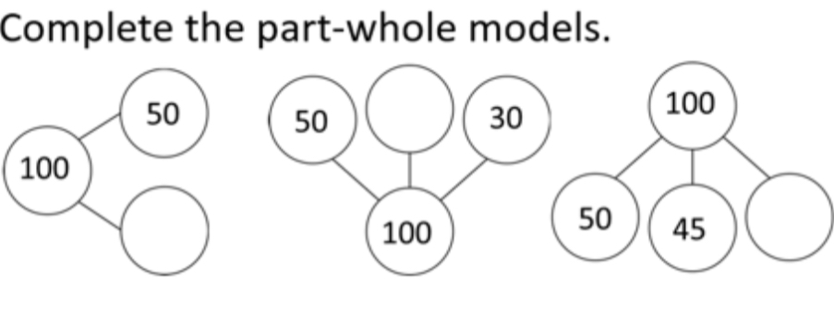
Variation used to reduce cognitive load

Slide 13
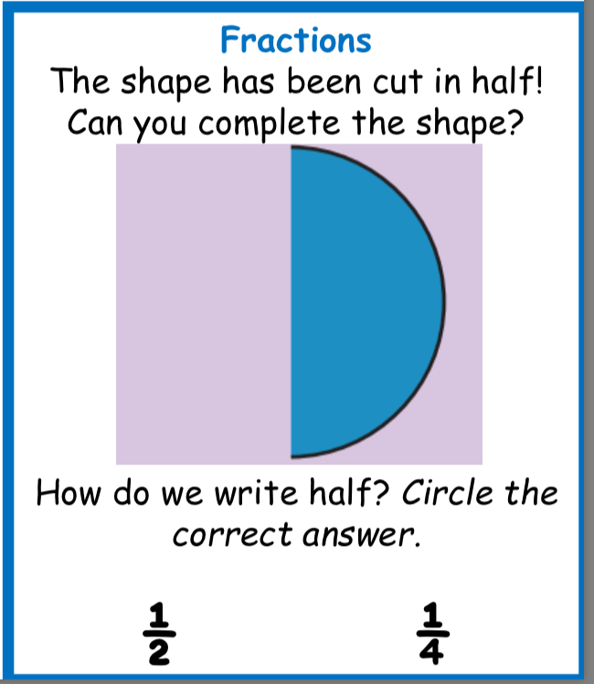
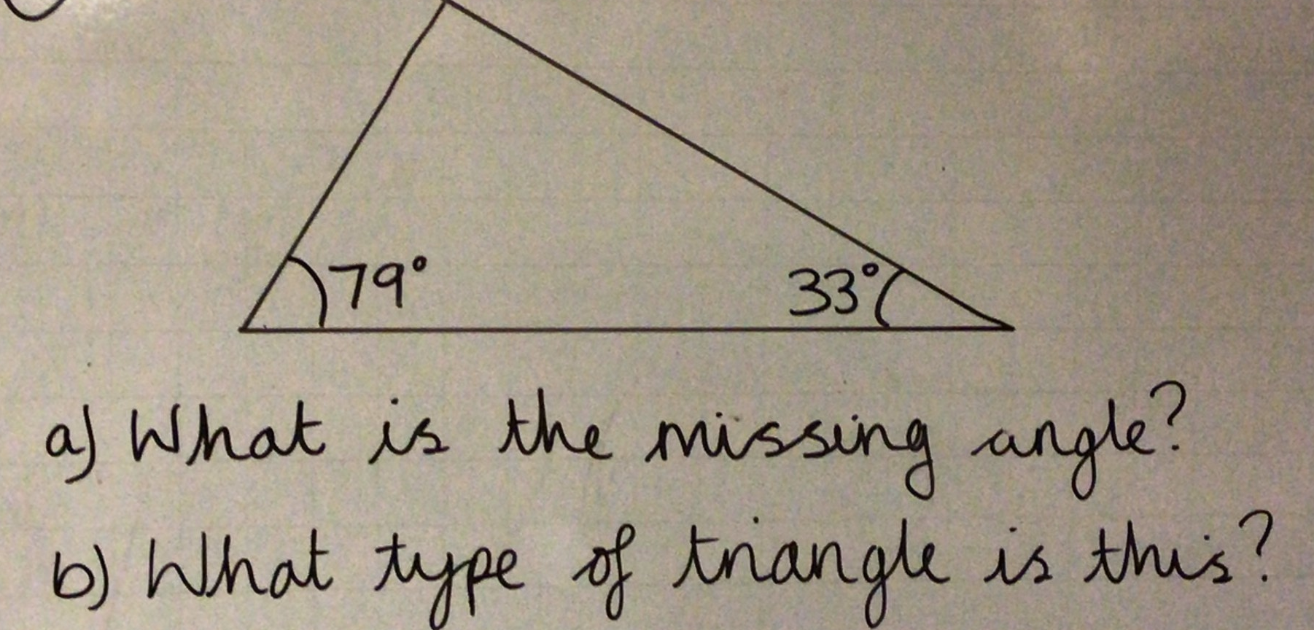
Pre-teaching a new concept
Year 1
Year 3
Year 6
Year 1 have been exploring half in preparation for future teaching on fractions.
Year 6 found out that the interior angles of a triangle total 180 degrees and also refreshed types of triangles.

Slide 14
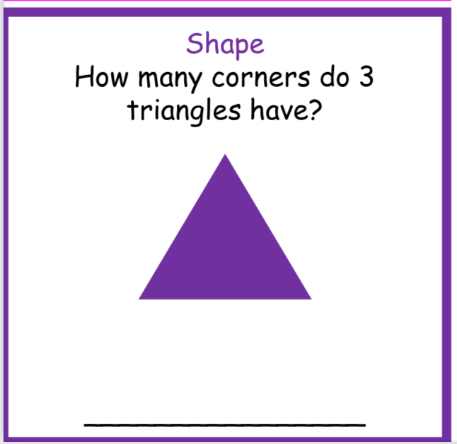
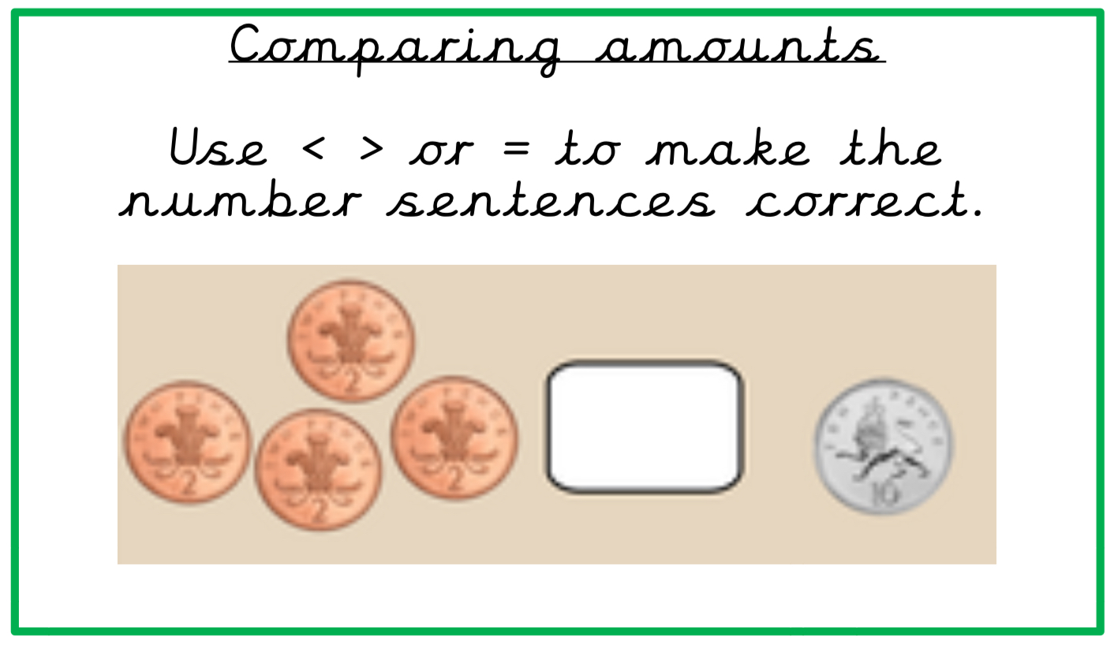
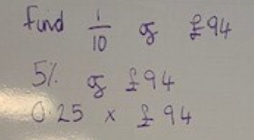
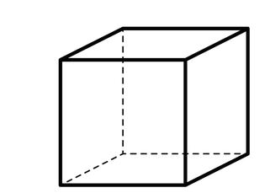
Interweaving
Year 1
Year 3
Year 6
How many vertices are there in 6 cubes?
Your S Plans will support interweaving in your 5 a day.

Slide 15
Medium Term S Plan
Aspects of calculation and their impact on place value
Multiply and divide by 10, 100 1000
Add and take away 10, 100 1000
Fractions and Decimals
Properties of shapes
PLACE VALUE
Place value
NUMBER
Roman Numerals
Money
Units of measure
Money
Units of measure
Calculation
Area and Perimeter
Money
Number
CALCULATION
Place value
Properties of shapes
PLACE VALUE
Fractions and Decimals
NUMBER
CALCULATION

Slide 16
Year 6 Place Value Unit S Plan
Add and take away 10, 100 1000
Multiply and divide by 10, 100 1000
NUMBERS TO 10,000,000
Roman Numerals
Money
Units of measure
Decimals
Money
Units of measure
COMPARE AND ORDER
Roman Numerals
Fractions, decimals and percentages
Fractions and decimals
Money (bank balance)
Temperature
ROUND ANY NUMBER
NEGATIVE NUMBERS
Money
Units of measure
Roman Numerals
Addition and subtraction

Slide 17
Resources & Websites
Busy Ants is a text book that is available to support lessons in Key Stage Two. Below are the links to both purchased and free resources available that are used to support teaching and learning.
DfE Teaching Mathematics in Primary School
Stem Sentences
White Rose Premium
Vocabulary
Four operations
NCETM
Automaticity
Classroom Secrets
Worked Examples
Open Middle
My Mini Maths

