Slide 1
Fighting Coronavirus
Social Distancing…
…We are all heroes!

Slide 2

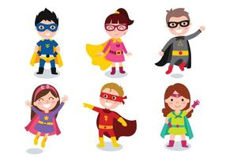
We are all working together to fight the coronavirus and stop it spreading and making people sick.
The virus germs are SO tiny we can’t see them.

Slide 3
The good news is that germs can’t jump very far!
If we stay far away from people, then the germs can’t jump from person to person and make us sick!

Slide 4
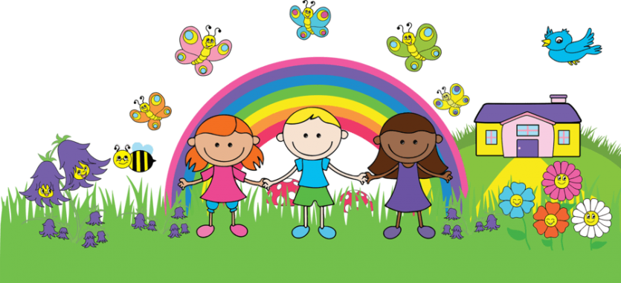
So at the moment, we have to stay far away from other people…
…we can’t hug, hold hands, or even go to each other’s houses

Slide 5
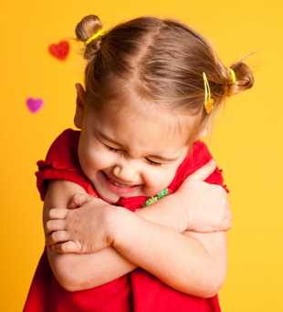
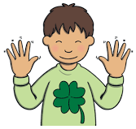
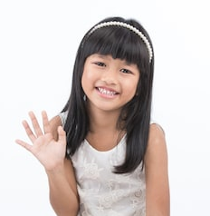
But…. we can do this instead!
1, 2, 3 Hug!
Jazz hands
Wave
Or a silly wink… what else can you think of?

Slide 6

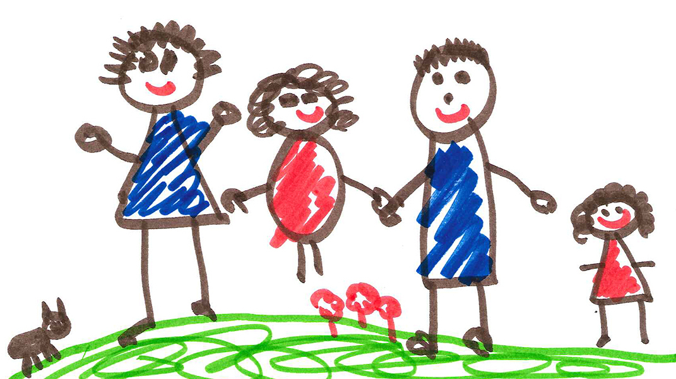
Or we can write letters or draw pictures to show someone we care about them

Slide 7
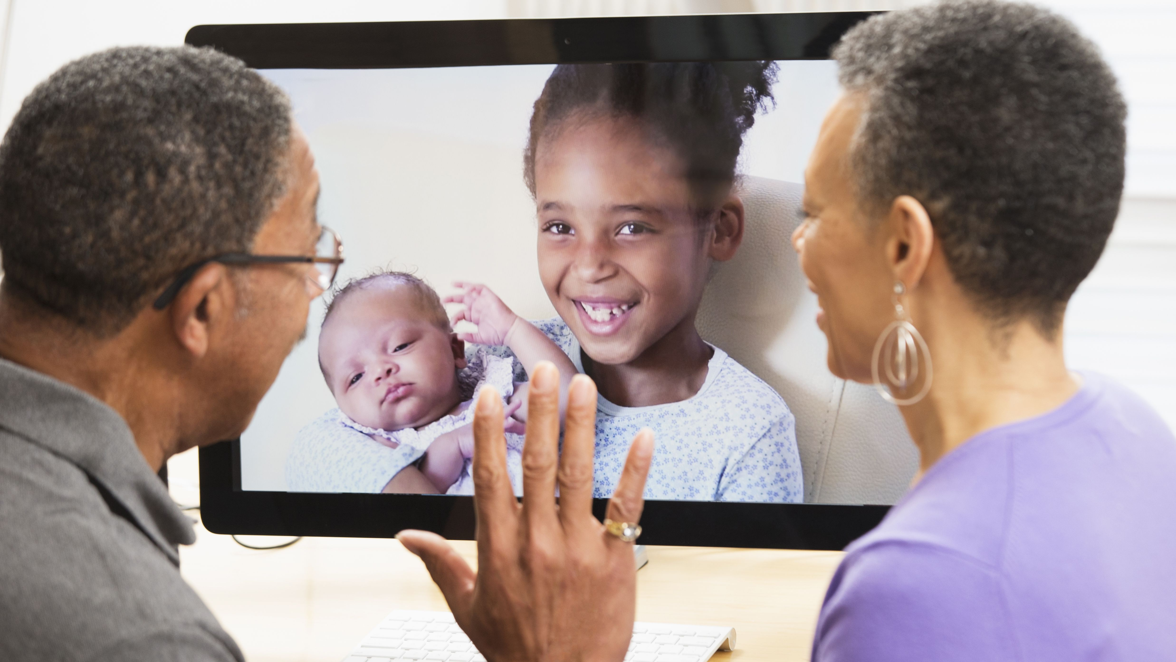
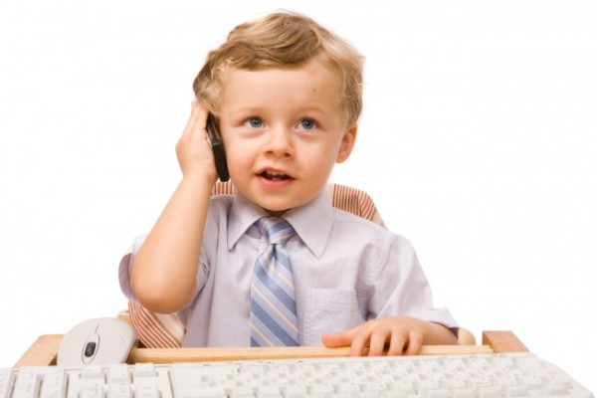
At home, we might phone or Facetime people that we care about
Hi Grandma!

Slide 8
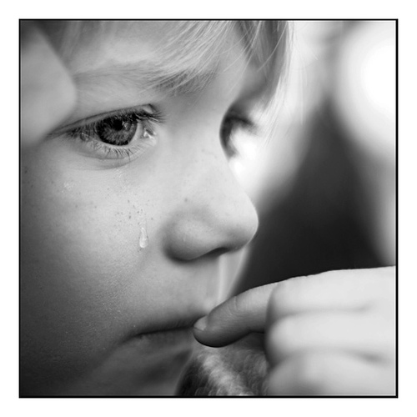
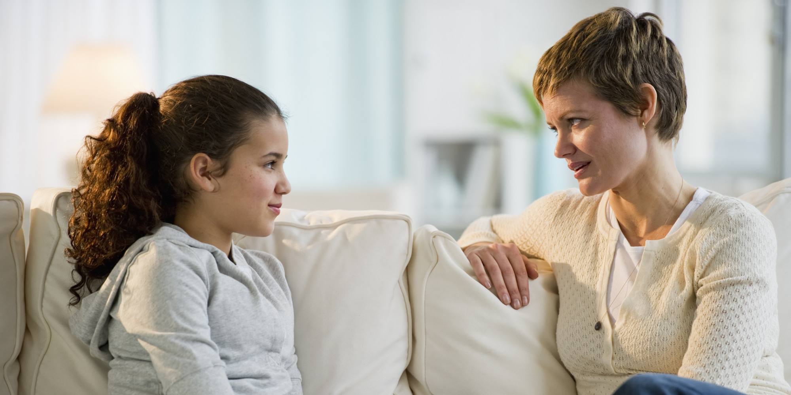
Sometimes this all feels a little bit weird or sad…
…but that’s OK.
We can talk to our grown ups about any worries we have

Slide 9
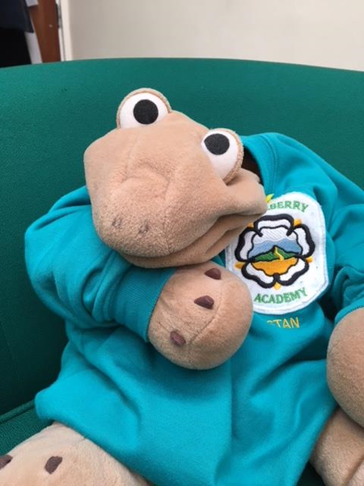
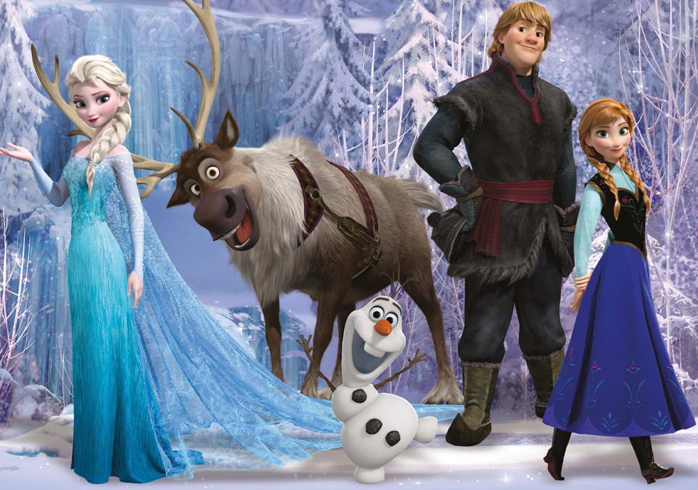
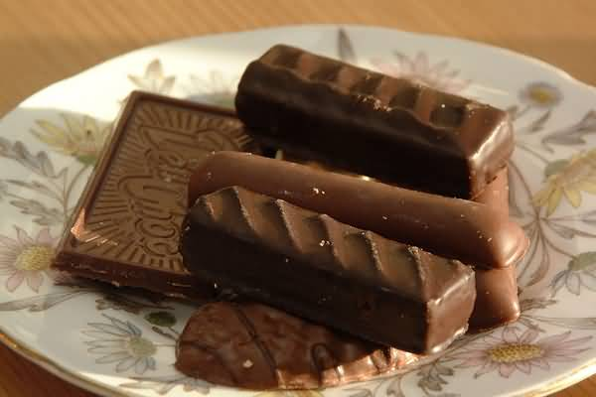
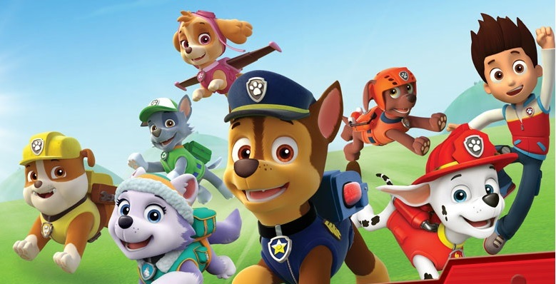
Lots of things are still the same

Slide 10
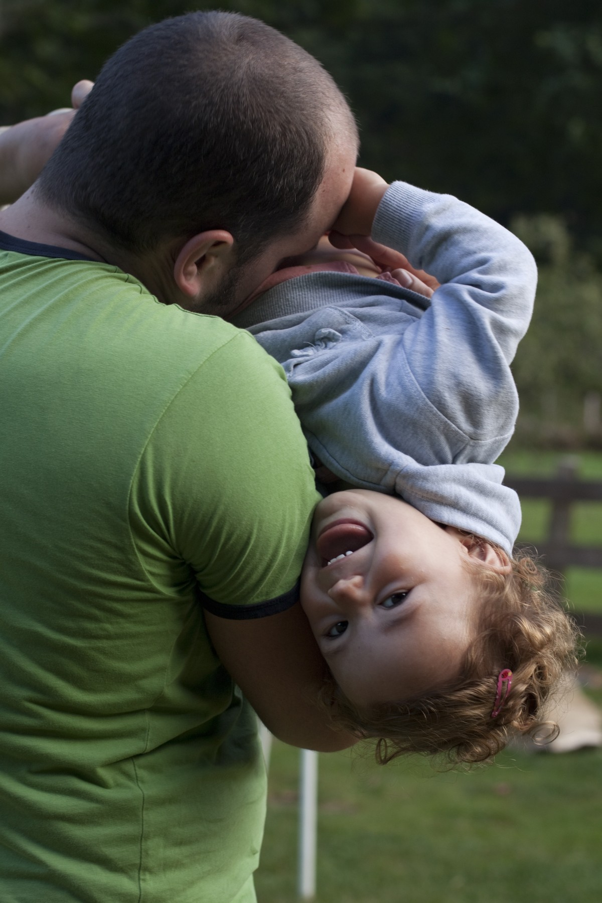
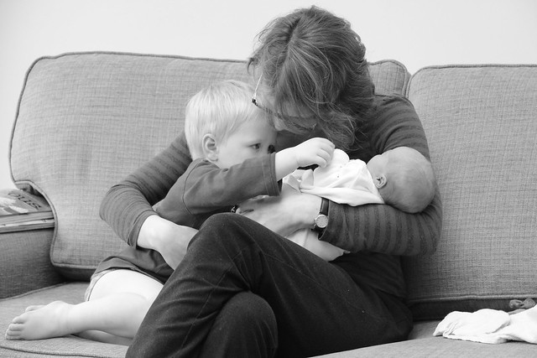
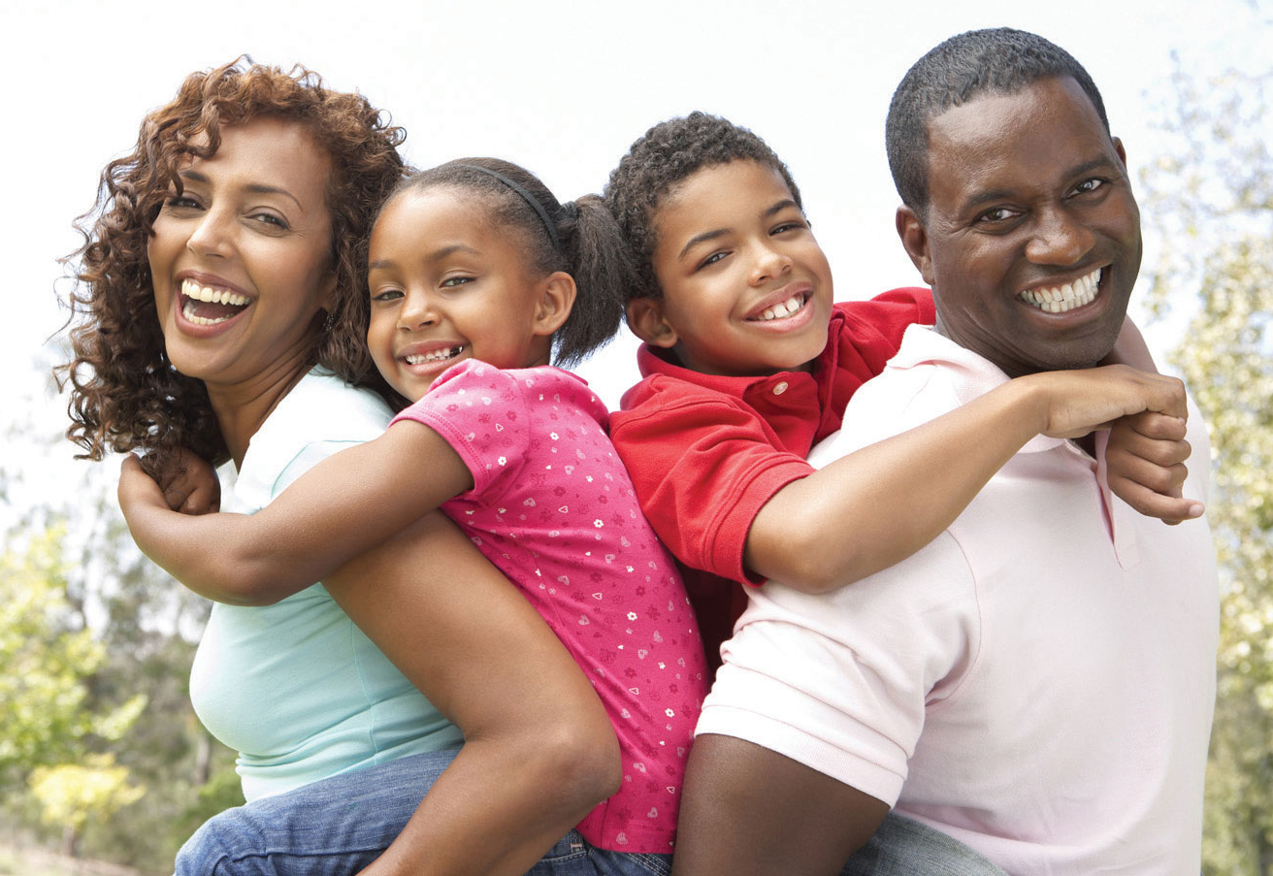
…and the people we love still love us (a little bit more each day)

Slide 11
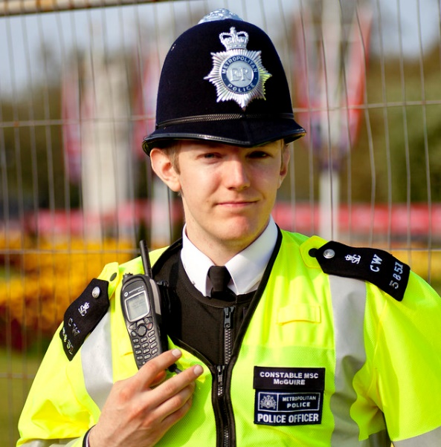


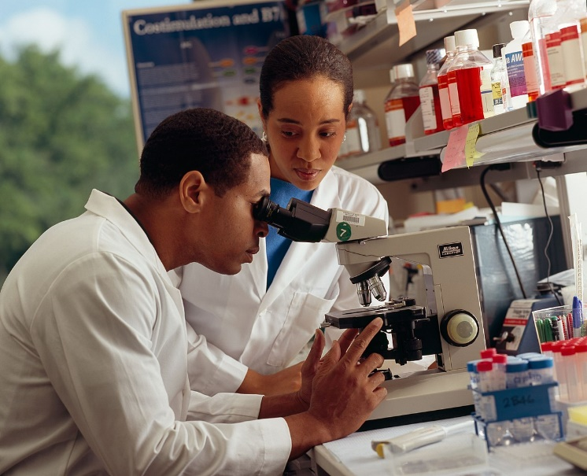
Lots of grown ups are doing things to fight the coronavirus

Slide 12
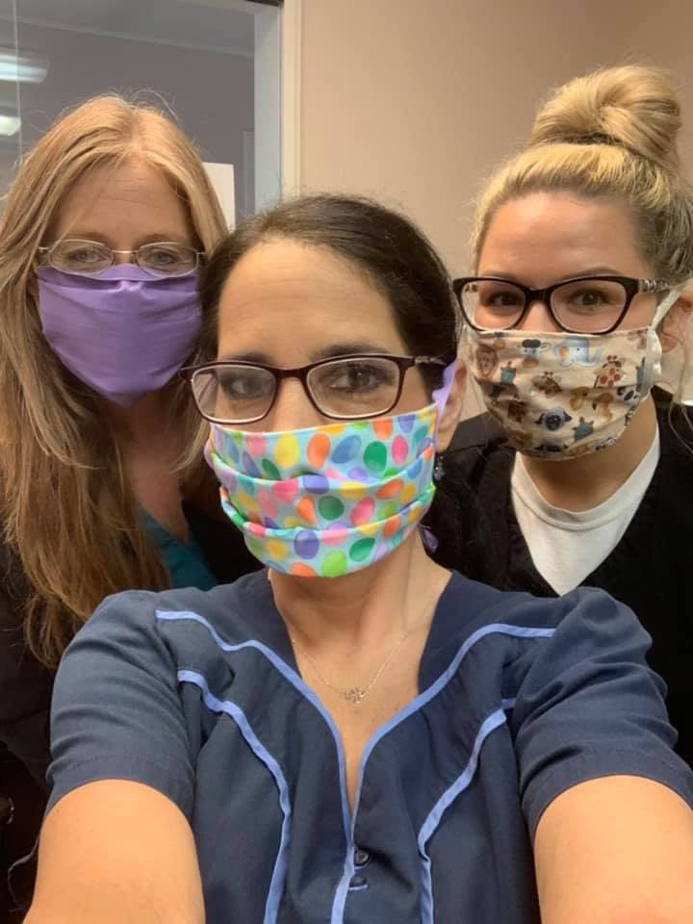
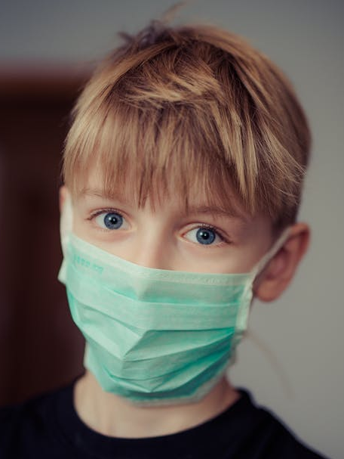
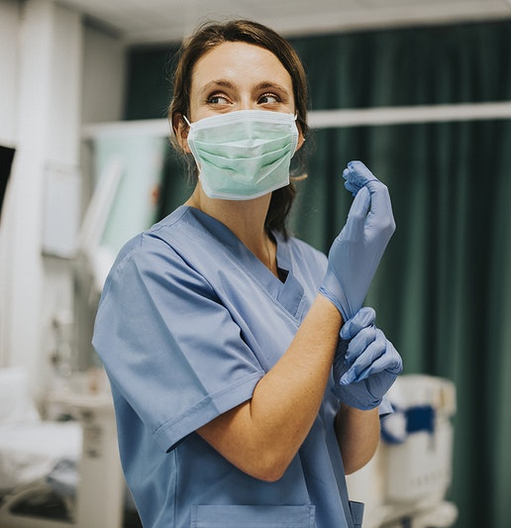

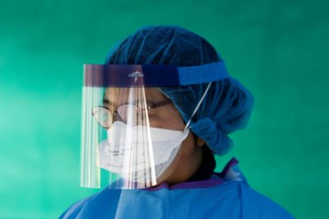
Some people wear masks – they might look different but we don’t need to be scared… they are helping to fight the virus too!

Slide 13
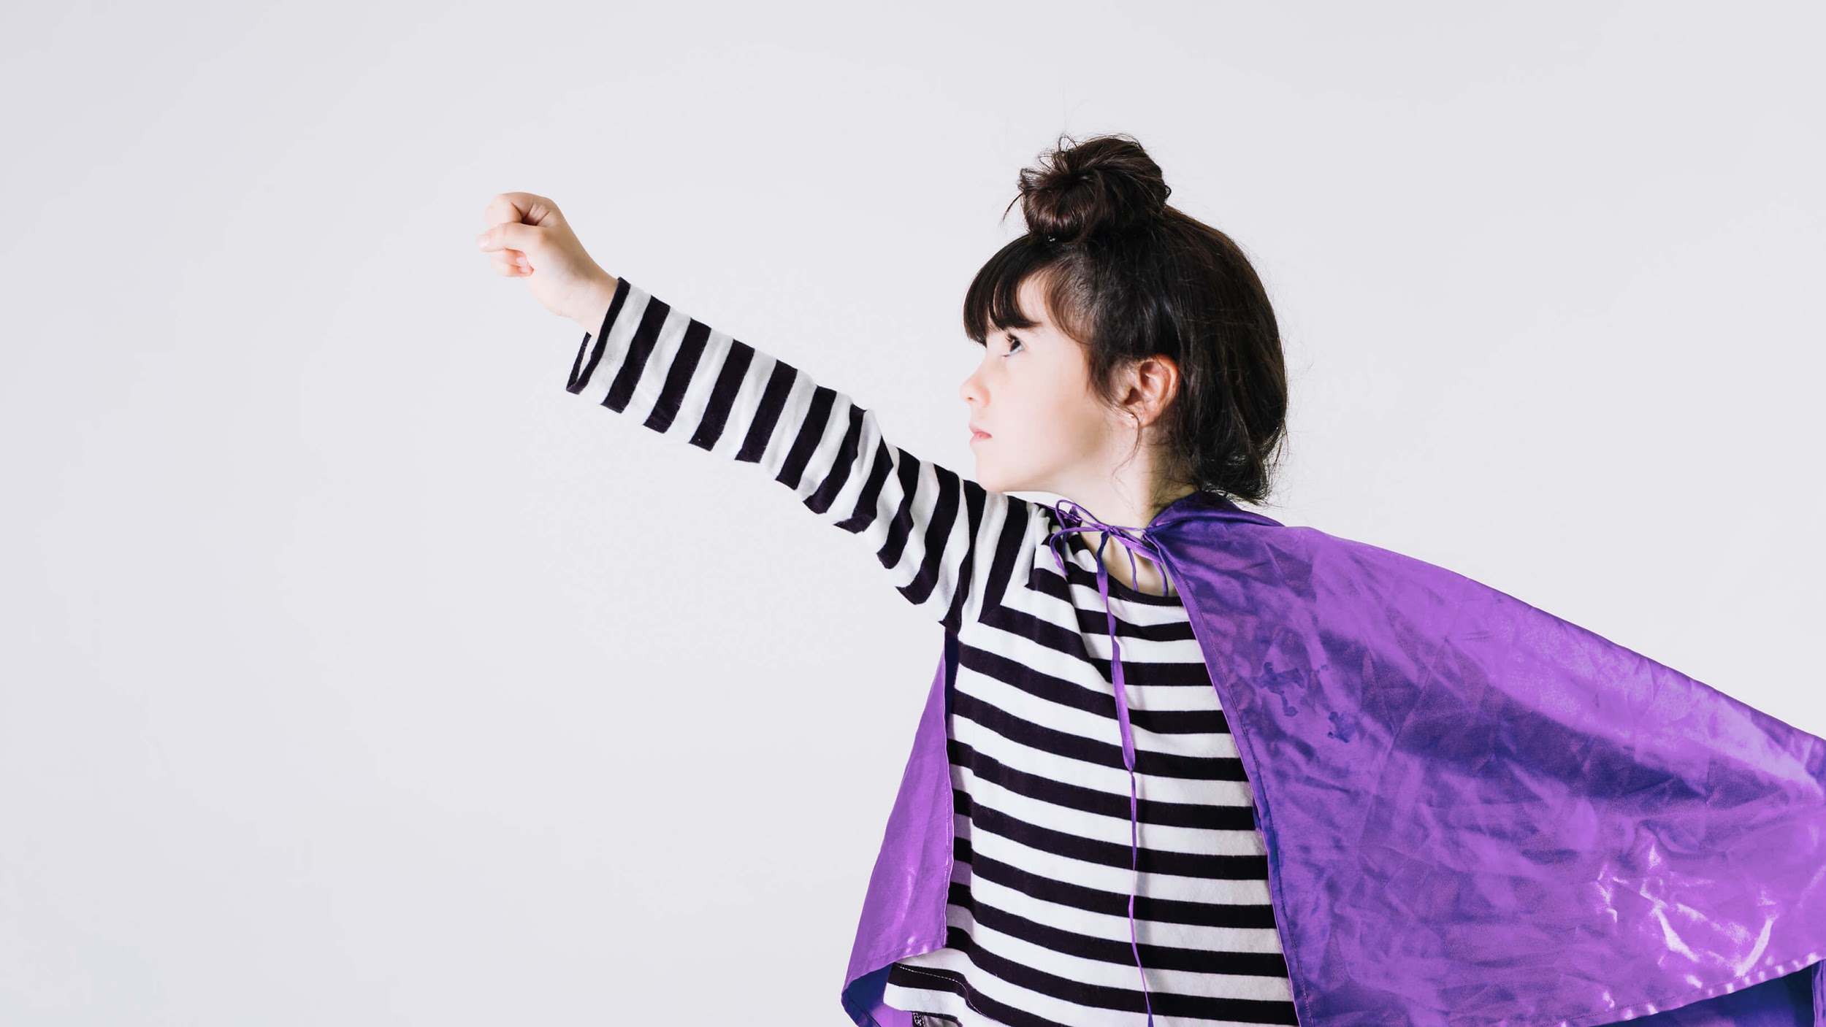
…and we help fight it too!

Slide 14


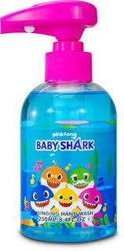

WE WASH OUR HANDS A LOT!
Carefully, using soap and water, making sure we clean every bit of our fingers and hands
Singing a song can help
https://youtube/L89nN03pBzI
We sometimes use hand sanitiser gel too!

Slide 15
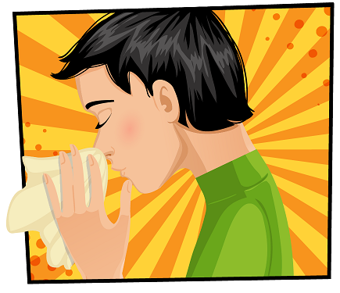
We must be careful when we cough or sneeze to catch it in a tissue and throw it in the bin.
Did you know that a sneeze can travel up to 100 miles per hour!!

Slide 16
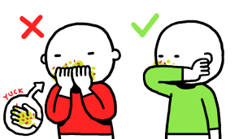
If you don’t have a tissue, cough or sneeze into your elbow so all the germs get stuck there and can’t jump on to your hands and into your body
https://www.youtube.com/watch?v=BV005Zx7Dp8

Slide 17
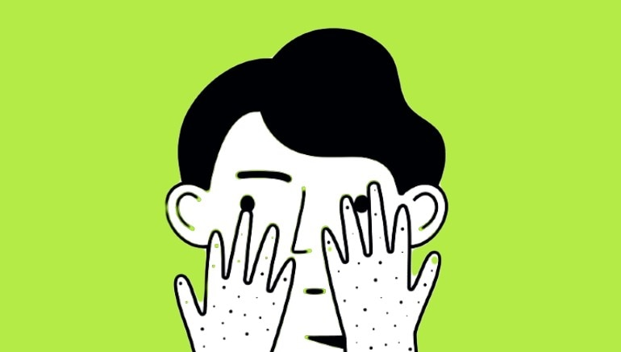
We shouldn’t touch our faces, because the germs might try to jump in

Slide 18
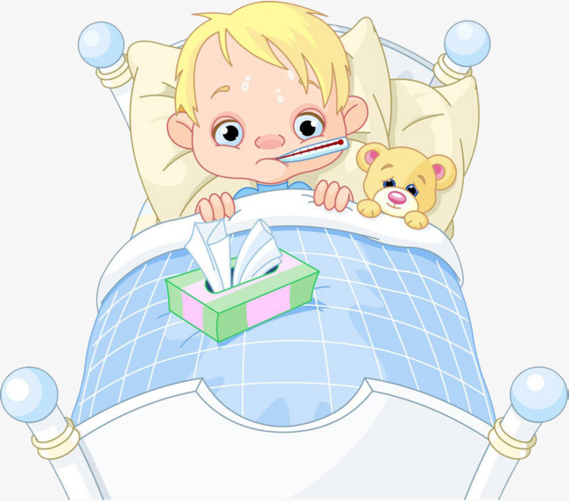
If the germs get in our bodies, they can make us sick
Tell an adult if you feel poorly
You might feel like you’ve got a cold, with a cough and feel a bit hot

Slide 19


Coming into school
Yay… we can see our friends and teachers again!

Slide 20
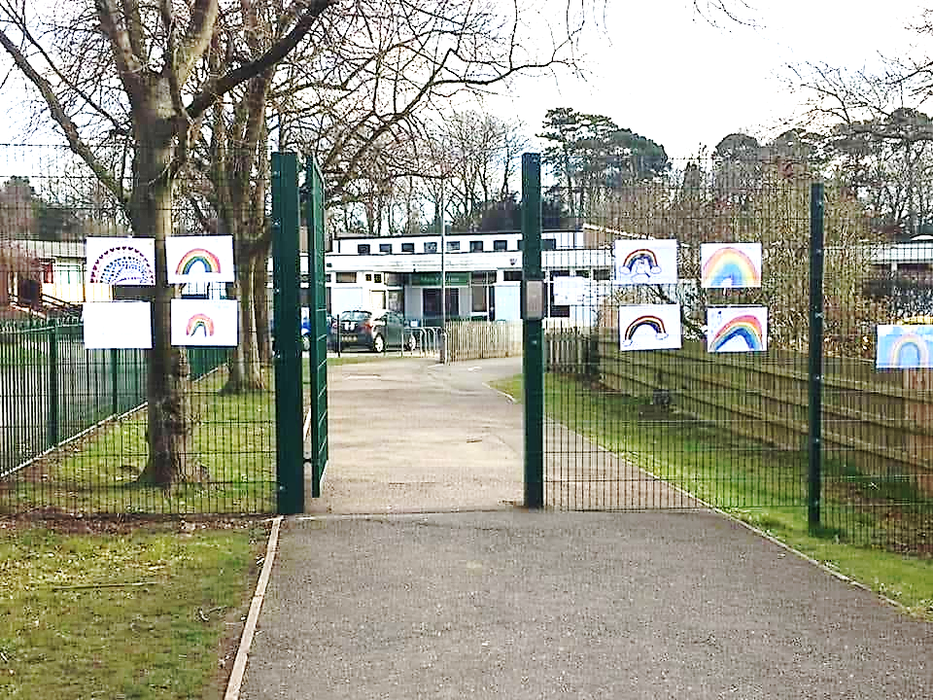

Wait at the school entrance until your teacher invites you in
Remember not to get too close to people who don’t live in your household
Wash or sanitise your hands

Slide 21
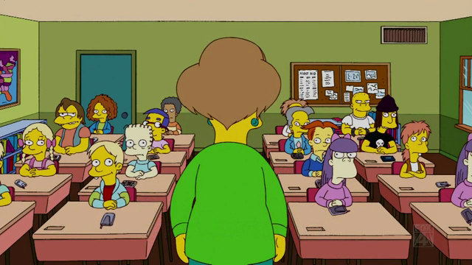
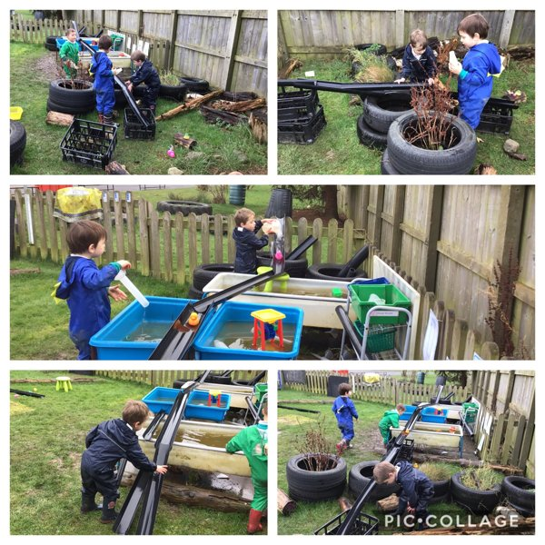

You will be working in a ‘family’ group with an adult. You will stay with this group at playtime and lunchtime.

Slide 22
Everyone is fighting the coronavirus!
You, your friends, your grown-ups at school and at home, young people, old people…
Everyone!
All over the world!

Slide 23
BE SAFE!
You are precious
Please keep this slide for attribution

