Slide 1
Welcome to Rushey Green Primary School
Mrs Williams – Headteacher
Miss Fisher – Deputy Headteacher
Jules - Foundation Stage Lead
Lily & Irene – Class Teachers

Slide 2
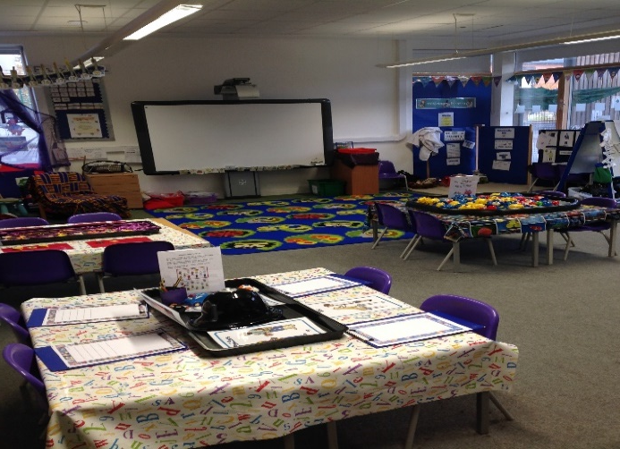
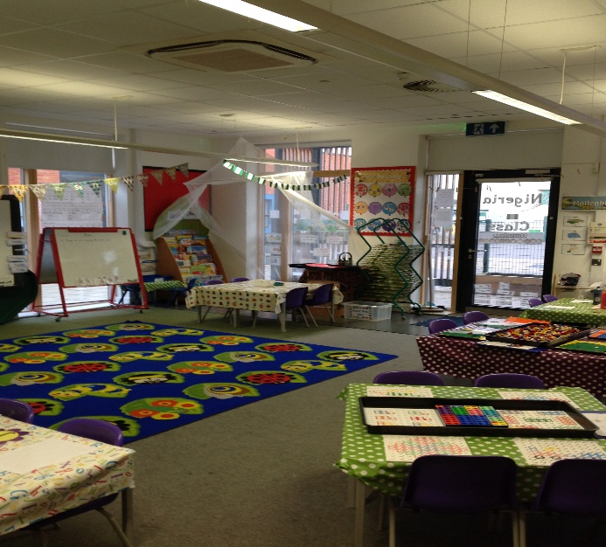
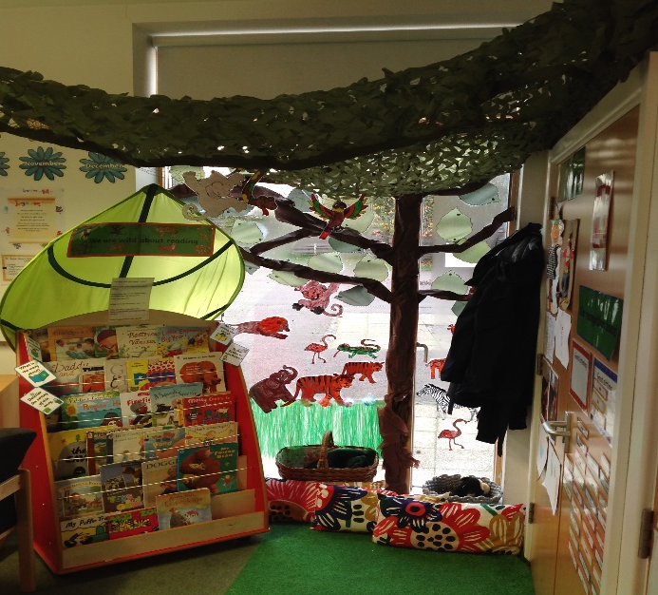
Our Classrooms…. We have three large classrooms each with a book corner.

Slide 3
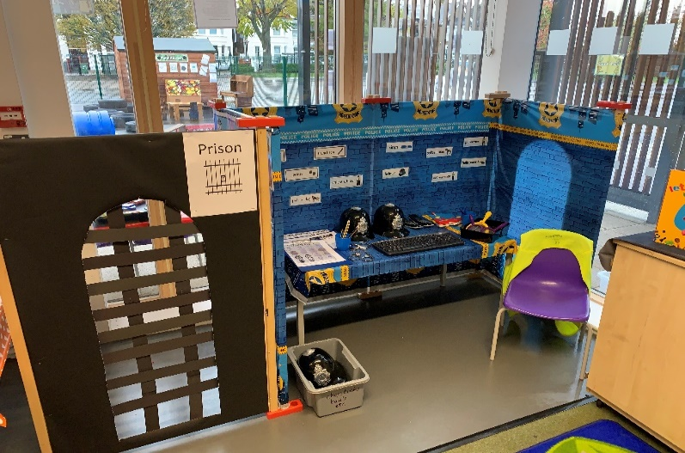
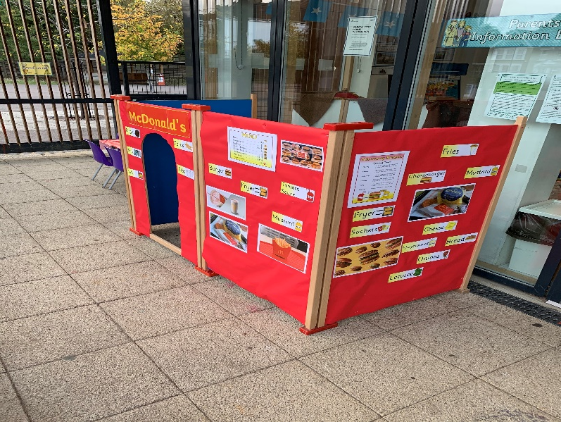
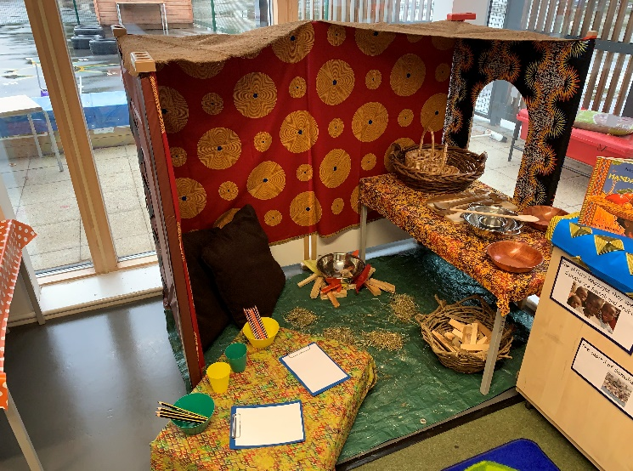
Our role play areas Where children can develop their personal, social and emotional skills, as well as their communication and language.

Slide 4
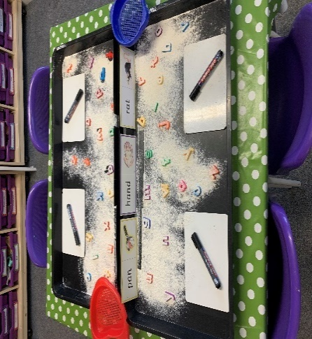
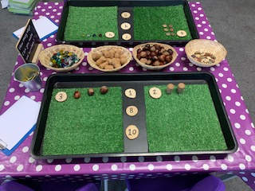
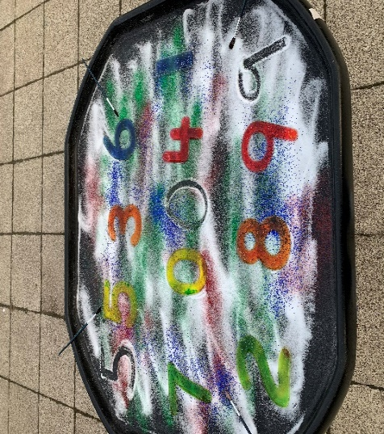
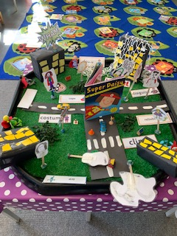
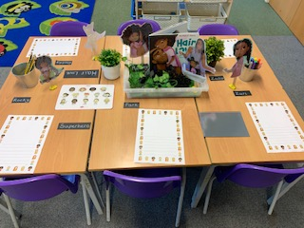
Our learning environments We ensure all seven areas of learning are covered in our learning environments.

Slide 5
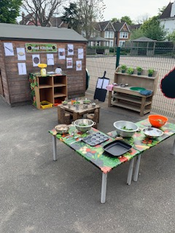
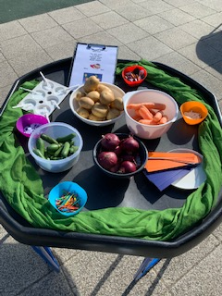
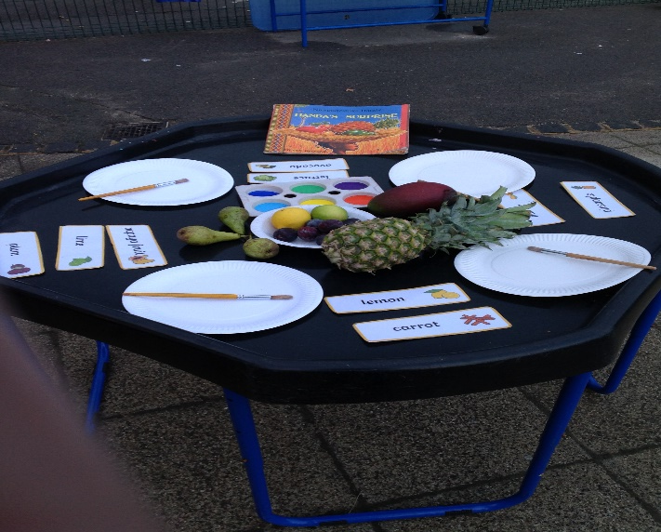
Our outdoor provision Children are able to develop their gross motor skills outside as well as take part in lots of ‘messy’ play.

Slide 6
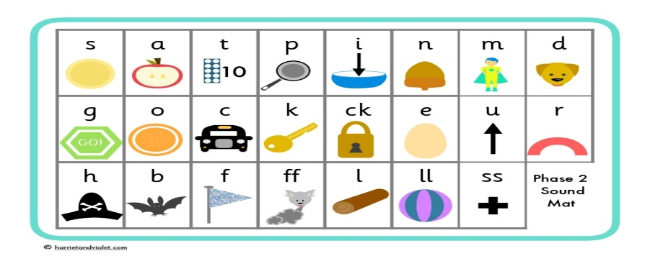
The school day……
A phonics lesson will take place each morning (www.littlewandlelettersandsounds.org.uk
Children will have access to the indoor and outdoor environments throughout the day.
An adult led activity will take place each day
Daily supported reading sessions will happen in the Spring term
Lunch time is between 11.20-12.20
A maths lesson will take each day
A one hour forest school sessions will take place each week
A one hour PE lesson will take place each week

Slide 7
Daily supported reading
Children take part in a daily supported reading session usually at the beginning of the Spring term
Each session lasts for approximately 20-30 minutes
Children enjoy daily independent reading in small groups matched to their independent reading level. Each session is led by a trained adult.
Staff use differentiated lesson guides to move children on and make sound judgements about when to do so.
Children will also take home a reading book matched to their current reading level twice a week to read at home with their parent/carer.

Slide 8
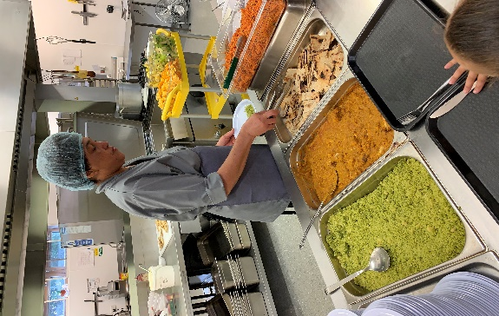
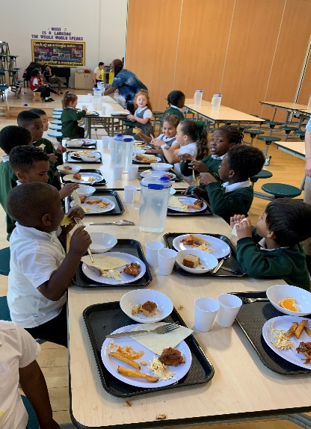
Lunch time……
Our school lunches are provided by a company called Chef’s in Schools. The meals are fresh, nutritious and creative. Two hot meal choices are provided daily (one always vegetarian) and accompanied by two vegetable choices, a wide range of salads, freshly baked bread, cut fruit and organic yogurts. Freshly cooked puddings are made on alternate days.
Children eat their lunch in the school hall
All children are entitled to a free school meal
We can cater for all children who have allergies

Slide 9
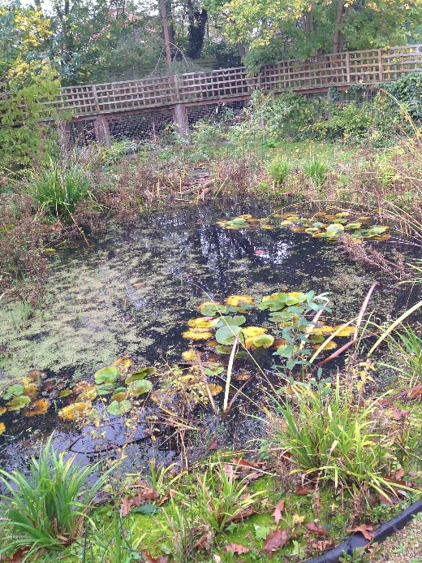
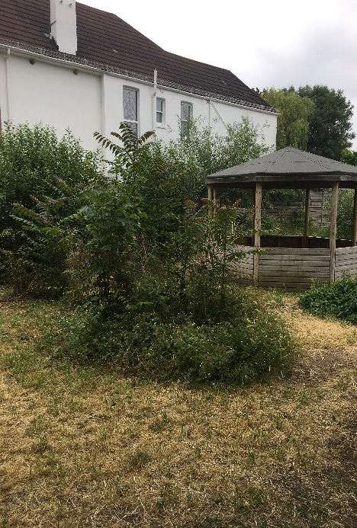
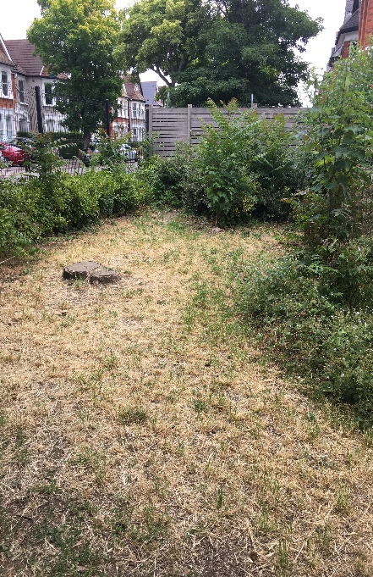
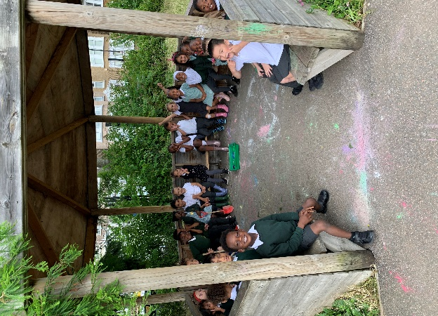
Forest School Sessions – one hour each week
Once the children are settled they will start taking part in some Forest School sessions on the school site. Forest school sessions are to help boost self-esteem and self-awareness, with an element of risk taking. Activities could include arts and crafts using tools, mud painting and den building, but the main incentive is to encourage children to explore the outside environment. All activities are supervised and teach the children how to manage their own learning and independence.

Slide 10
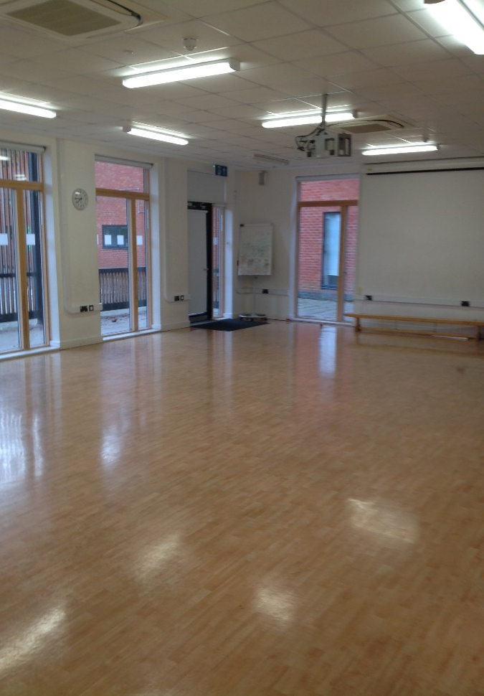
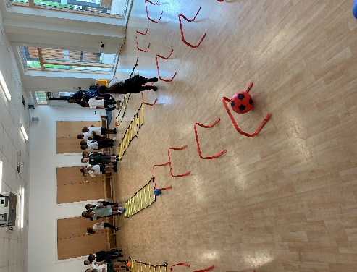
PE Sessions – one hour each week
A PE lesson takes place once a week in the small school hall. Each session is lead by the class teacher and teaching assistant.

Slide 11
Specialist teachers in school
Music teacher who teaches music lessons to children in Key Stage 1 and 2. Reception also take part in a music assembly during the Spring term.
PE coach for Key Stage 1 and 2
A Spanish teacher for Key Stage 2

Slide 12
Outings
Children take part in outings throughout the year. In reception this will usually be a a local trip to start with, for example to Moon Lane book shop, the local park etc.
Children in Key Stage 1 and 2 also take part in trips throughout the year. These may be include trips to museums, sports centres and trips into London.

Slide 13
Learning at home
Children can take home a book from our class libraries everyday.
During the first part of the Spring term children will take home a guided reading book twice a week to read to an adult.
We will also provide extra resources and materials for children that need further support at home.

Slide 14
Breakfast and after school club
Breakfast and after school club is run by a company called ‘Superkids on the school site in the main hall.
Breakfast club is open from 7.45am
After school club is open from 3.30-6.00pm
To book a place you need to email Superkids directly. www.superkidsclub.co.uk 07732305454

Slide 15
Applying to start primary school in September 2023
The deadline for applying for a primary school place is Sunday 15th January 2023
Even if your child is currently attending Rushey Green Nursery you must still apply for a reception place.

Slide 16
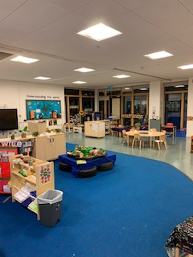
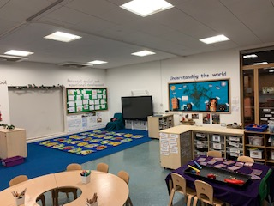
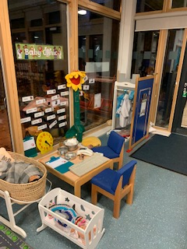
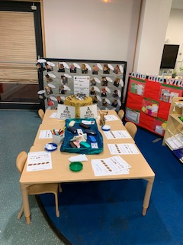
And finally…. if you are looking for a nursery place this is our nursery at Rushey Green

Slide 17
Follow us @ rusheygreen_primary
Thank you for listening
are there any question?

