Slide 1
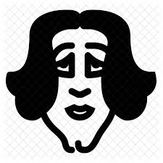
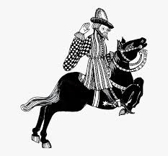
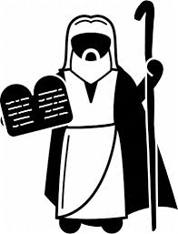
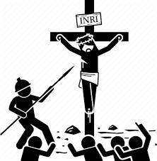
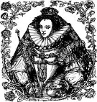
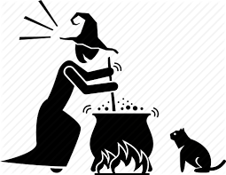
Icons made by <a href="https://www.flaticon.com/authors/freepik" title="Freepik">Freepik</a> from <a href="https://www.flaticon.com/" title="Flaticon"> www.flaticon.com</a>
English Literature and Language
Learning Journey
Who are the characters in each text? What do they symbolize? What are the themes in each text? What is the context? What is the writer’s intentions? How can you thematically link the Anthology Poetry? How should you approach the Unseen Poetry?
Revision of all
Literature texts and Poetry
How do you compare two non-fiction texts? How should you structure your answer?
How do you answer the 19th and 21st Century Non-Fiction section of the exam? What technique should you use?
What is the effect of poetic devices used?
What is the effect of the form and structure?
How do you ‘show’ to ‘tell’ in your Narrative Writing?
YEAR
GCSE Language exam: Narrative Writing, 20th Century Prose extract, 19th and 21st Century Non-Fiction and Transactional Writing
11
What are the DAFOREST techniques and how do you use them in your Transactional Writing?
How do you structure the different forms you might be asked to write in?
How do you answer the 21st Century Prose section of the exam? What technique should you use?
What does effective charactersation look like?
How do you structure and sequence a Narrative?
Poems:
The Soldier: Brooke
Dulce et Decorum Est – Wilfred Owen
Mametz Wood – Sheers
The Manhunt – Armitage
A Wife in London – Hardy
Hawk Roosting – Hughes
Ozymandias - Shelley
Poems:
London – William Blake
Living Space – Imitaz Dharker
To Autumn – John Keats
Death of a Naturalist – Seamus Heaney
The Prelude – William Wordsworth
As Imperceptibly as Grief - Dickinson
What can remember about the Romantic Poets and their beliefs from KS3? How are they reflected in the poems?
What can you remember about socialism, communism and capitalism from
KS3?
Anthology Poetry
‘War and Power’ Cluster
What are the wider themes of the novel?
What do each of the characters symbolize in the play?
The Living world
In what ways is Dickens successful in changing the way the rich view the poor?
Anthology Poetry ‘Nature
and Place’ Cluster
Priestley’s An Inspector Calls
How is Scrooge presented throughout the novel?
How is the theme of Nature presented in the poems? What other themes are present?
Who was J.B. Priestley and what were his social beliefs? What are his intentions in writing the play?
What are the themes of the play and how are they presented through the characters and events?
How are the themes of War and Power presented in the poems? What other themes are present?
Dicken’s A
Christmas Carol
How is the theme of love presented in the poems? What other themes are present?
What is the purpose of the Cratchit family?
How does Dickens explore the Christian concept of Redemption in the novel?
How does Shakespeare use the structure of the play to create tension?
How are Rome and Juliet and their relationship presented throughout the play?
What is the purpose of the Prologue and how does it make the audience omniscient? How could this link to the theme of Fate?
Anthology Poetry
‘Love’ Cluster
Shakespeare’s Romeo and Juliet
What can you remember from Year 9 about Dickens’ childhood and how it affected his social beliefs?
What is the effect of poetic devices used?
What is the effect of the form and structure?
Poems:
Sonnet 43 – Barratt Browning
She Walks in Beauty – Byron
Cozy Apologia – Rita Dove
Valentine – Carol Ann Duffy
Afternoons – Phillip Larkin
How are the themes of Fate, Love, Hate and Death presented throughout the play?
How is Juliet a victim of a Patriarchal society?
How are George and Lennie presented?
YEAR
Why is the sow’s head named ‘The Lord of the Flies’? What does this symbolize?
Who was John Steinbeck and how does the novel reflect his own experiences?
How is the theme of love presented in the play?
How does Shakespeare present the theme of Conflict throughout the play?
10
Steinbeck’s Of Mice and Men
Shakespeare’s Much Ado
About Nothing
How does Jack’s character develop throughout the novel?
What was the Great Depression and what caused it?
How does Steinbeck explore the themes of friendships and loneliness?
How are Beatrice and Benedick presented throughout the play?
How is Don John presented as villainous in the play?
Golding’s The Lord of the Flies
How is the theme of civilization vs savagery presented in the novel?
How does Shakespeare explore the concepts of Reputation and Slander in the play?
Wat does the Conch symbolise?
How does Ishiguro explore the concept of the soul in Never Let Me Go?
What is Offred’s life like in the novel?
What are the conventions of the Dystopian genre?
How do the pigs manipulate the other animals in the novel?
Who was George Orwell and why did he write the novel?
What is the effect of the poetic devices the poet has used?
Dystopian Fiction: 1984, The Handmaid’s Tale and Never Let Me Go
Orwell’s Animal Farm
How do poets use language to present the horror of war?
Who was William Golding and how did his experiences in WW2 influence the novel?
How does the Republic of Gilead link to your knowledge of the Bible in The Handmaid’s Tale?
How is ‘Big Brother’ and their Government presented in 1984?
How do the 10 Commandments the animals created link to the Bible?
How is the novel an allegory of the Russian Revolution?
What was the Russian Revolution and who were the key figures involved?
Conflict Poetry
How did Edgar Allan Poe change the Gothic genre?
What were Charles Dickens views of society?
How does Dickens present characters living in poverty?
How does the Detective genre link to the Gothic?
How is Sherlock Holmes presented?
How was poetry used for recruitment in WW1?
What is aestheticism and how does it link to Oscar Wilde?
YEAR
Dickens and the Bronte’s
Sherlock Holmes and
Detective Fiction
9
Romanticism and The Gothic
How did the Gothic reflect the repressed views of society?
How were Dickens’ view shaped by his experiences as a child?
How is Heathcliff an example of the Byronic Hero?
What are the conventions of the Detective genre?
What narrative techniques does Conan Doyle use?
What is the Gothic genre and how does it link to Romanticism?
What different generation of the Romantic Poets were there and how did their beliefs differ?
Who is Jane Austen and why is she such an important figure in the Literary Cannon
What were the Regency attitudes to love and relationships?
Who were the Pilgrims and what were their beliefs?
How is Abigail and Proctor’s relationship presented?
How is Abigail presented?
Austen’s Pride and Prejudice
Miller’s The Crucible
How does the demonization of women in the play link to Lady Macbeth?
What beliefs did the Romantic Poets have and how did this link to 18th and 19th Century society?
How are the themes of Pride and Prejudice presented through Elizabeth and Darcy?
How is Mr Darcy presented?
What examples of prejudice and discrimination to we see?
How are women demonized in the play?
YEAR
What moral messages do we learn from the Bible and how has this influenced our society?
How is Elizabeth Bennet presented?
Who was William Shakespeare and why is he such an important figure in the Literary Cannon?
8
What do we mean by Original Sin?
How has language developed from Old to Middle English?
Why is Chaucer such a significant figure in the Literary Cannon?
How were both Spenser and Shakespeare inspired by Elizabeth I?
Bible Studies
Chaucer
Spenser’s The Faerie Queen
Shakespeare’s Macbeth
How does Shakespeare present Christian morality through Lord and Lady Macbeth ?
What is the Feudal System and how is this shown in The Lady of Shallot?
What is a parable
What is the story of the Crucifixion?
How do The Wife of Bath and The Millar present Medieval society?
How is the virtue of chastity presented through Brittomart?
How is witchcraft presented in Macbeth?
How is Lord and Lady Macbeth’s relationship presented throughout the play?
Arthurian Legend
Based on the evidence historians have, do you think Sheila Maidens existed?
What are Roman Stock characters and how do they link to typical character archetypes?
What is the Legend of King Arthur?
How does Beowulf compare to Odysseus?
How did the Viking Gods and Goddesses reflect the values of Viking society?
What is a Epic hero?
Greek and Roman
Mythology
YEAR
Viking Mythology and Beowulf
7
What is Romanticism and how was Keats influenced by Arthurian Legend in La Belle Dame Sans Merci?
How did their Gods and Goddesses reflect the values of Greek and Roman society?
How is Grendal presented as monstrous?
Is Beowulf presented as an Epic Hero or an Anti-Hero?
What is a Republic and why was this concept important to the Romans?
What was the Viking legal system and do you think it was effective?
‘ People don’t realise how a whole person’ life can be changed by just one book. ’ Malcolm X MICHAEL PALIN

