Slide 1
Student Bulletin 14th June 2021
Life-Transforming-Learning

Slide 2
COVID Reminders: Now back in different teaching rooms across the site it is even more important to observe the following:
The wearing of masks in school by staff and students is now personal choice. Please respect those who still choose to wear them,
You MUST wear face masks in shops and on public transport (for the entire journey)
Wash your hands frequently
Sanitise your hands when you enter and leave the room
Now you are back in your subject teaching rooms your teacher will set the seating plan for their subject. These must be adhered to at all times.
Socially distance (2 metres) wherever possible, in and outside school
Avoid physical and intimate contact with other students
Please report anyone failing to comply with COVID regulations to the Student Hub
Please adhere to the COVID rules over the weekend
Remember: Hands – Face – Space
Please keep to the one-way system that is in place
Remain in your year group bubbles during breaks

Slide 3
Lateral Flow Testing
Continue to test at home twice a week on a Monday and Thursday if possible
Remember to record your results on the NHS test and trace app

Slide 4
Theme of the week
Make Music Day (21st June)

Slide 5
Trick Logic Quiz: Answers
Lunch and dinner
A towel
Your age
She was on the bottom rung
An envelope
She sleeps in the evening
They are all couples
Add a ‘G’ to it
Nothing
Friday was the name of the horse

Slide 6
Drama Club
All Year 7 + 8 Welcome
Tuesday 3:20 – 4:20 in the studio
This Photo by Unknown author is licensed under CC BY-SA-NC.

Slide 7
Assembly Days
Monday – Student bulletin
Tuesday – Year 10 assembly
Wednesday – Year 9 assembly
Thursday – Year 8 assembly
Friday – Year 7 assembly
Please line up in the outside area between the hall and PE for your Tutor to register you
Please enter the hall silently, dressed correctly and sit with your form

Slide 8
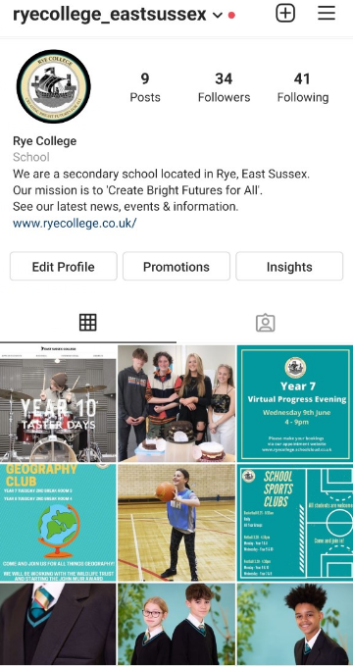
New! Rye College Instagram Account
We are happy to announce that in addition to Facebook and Twitter we have added Instagram to our social media portfolio.
Working in conjunction with the Student Leadership team we identified this channel as a good opportunity to keep older students and families up to date on important school dates, news, events, good news stories and achievements.
Please note the minimum age restriction for an Instagram account is 13.
Find us -
ryecollege_eastsussex

Slide 9
EDI

Slide 10
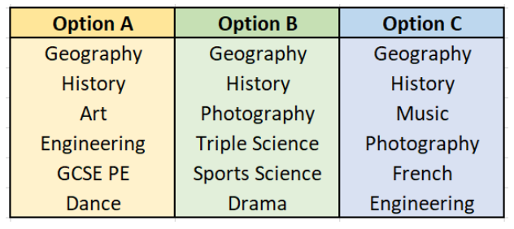
Year 9 Choices at 14
Online preference form deadline – Sunday 20th June

Slide 11
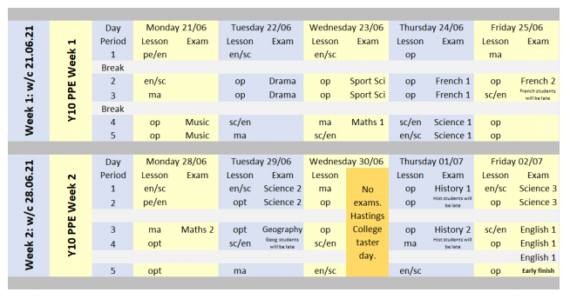
Year 10 Mock exams
Check your outlook email for letter

Slide 12
Action Your Potential
Meetings continue Tuesday
Students are now working with Andrew Wright on developing their study habits
Your form Tutor has information on meeting times.

Slide 13
Reminders
No hoodies are to be worn at ANYTIME. They must be kept in your bags
Equipment on your desks at the start of Tutor Time ready to be checked
Mobile phones should be off / on silent and in bags – On site out of sight
Line up sensibly and quietly outside your teaching room to be met by your teacher
Sit in your correct seat from seating plan

