Slide 1
Student Bulletin Monday 15th March
Life-Transforming-Learning

Slide 2
COVID Reminders
Ensure your facemask is always on in the classroom
You MUST wear facemasks in corridors and communal areas inside school buildings
You MUST wear face masks in shops and on public transport (for the entire journey)
Wash your hands frequently
Sanitise your hands when you enter and leave the room
Remain in the seating plan that has been set – This is NOT negotiable
Socially distance (2 metres) wherever possible, in and outside school
Avoid physical and intimate contact with other students
Please report anyone failing to comply with COVID regulations to the Student Hub
Please adhere to the COVID rules over the weekend
Remember: Hands – Face – Space

Slide 3
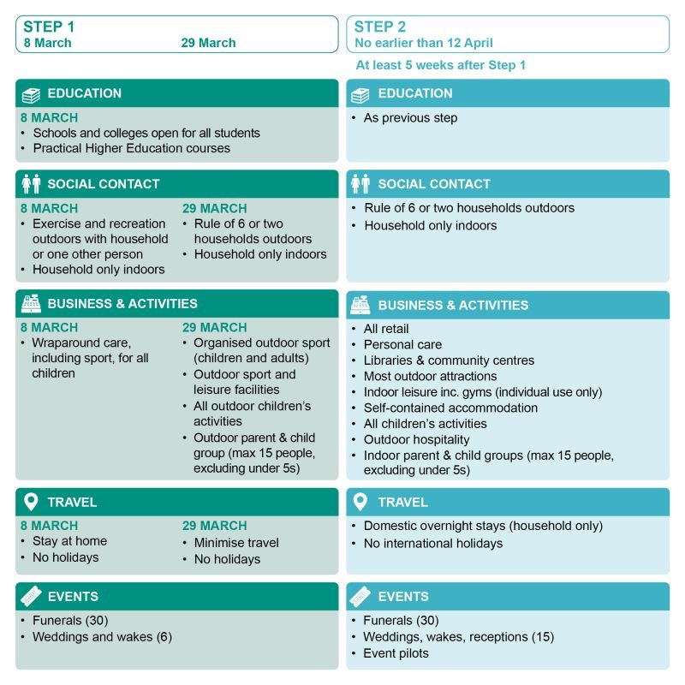
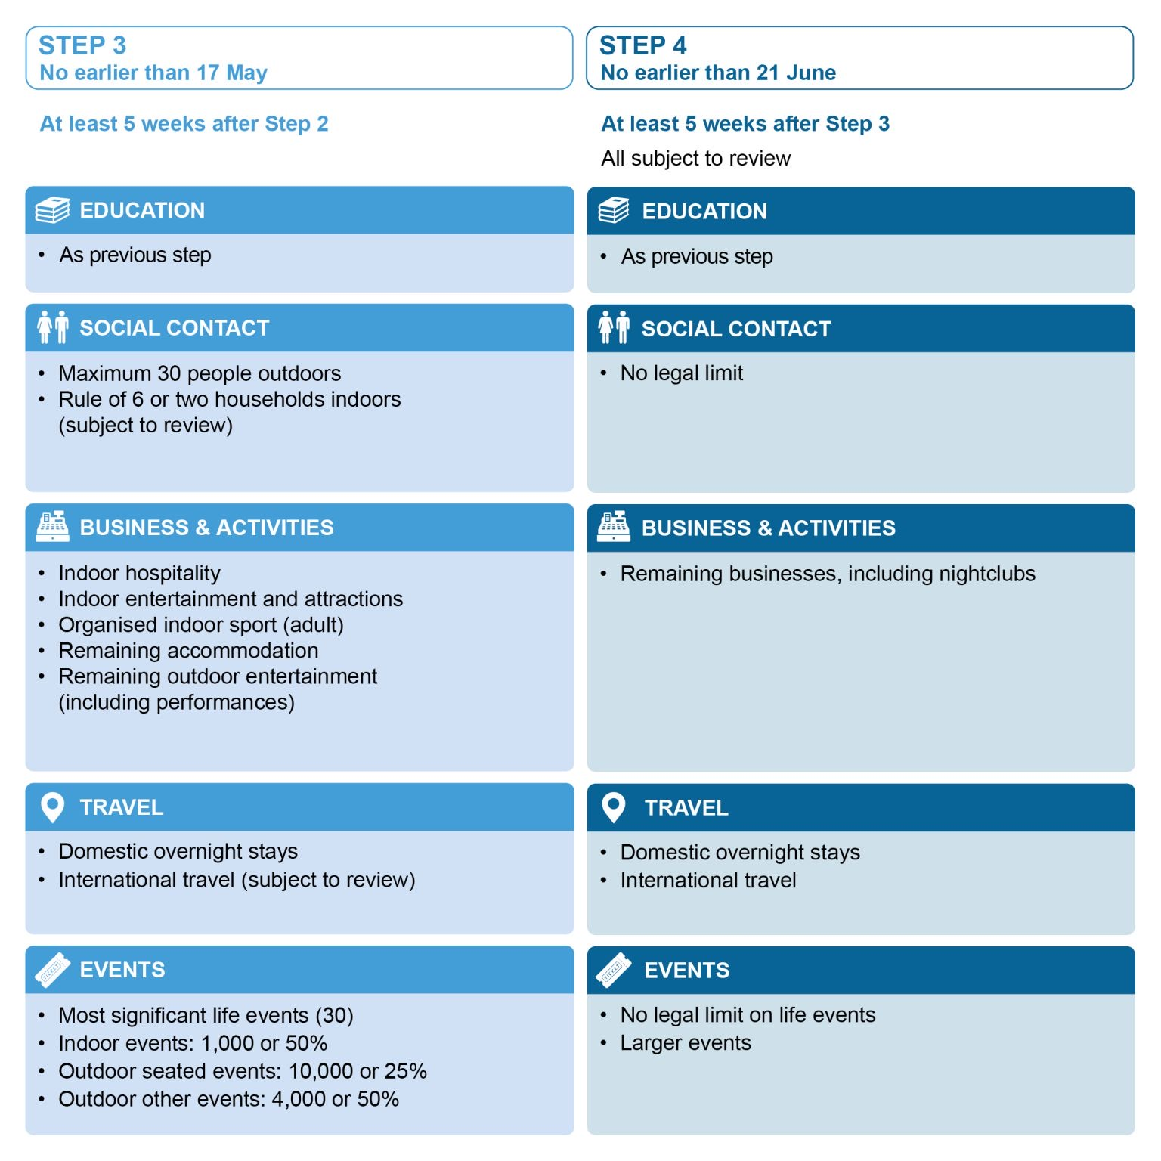
The road map!

Slide 4
Quiz answers
Boxing
Horror
Mabel or Billie Eilish
1990's
Cleopatra
True
Queen's Gambit
Sri-Lanka - Sirimavo Bandaranaike
Phoebe Waller-Bridge
Barbara Windsor

Slide 5
Lateral FlowTesting
Mr Blakelock would like to congratulate you all on your engagement with the testing. Over 80% of students have engaged with this process. Your conduct has been exemplary – well done!
Testing this week:
Monday: Year 7 to 1220; Year 10 to 1350; Year 11 to 1520
Tuesday: Year 8 to 0950; Year 9 to 1140
Thursday: Year 7 to 1020
Once you receive the home testing kits please try to stick to the following days:
Year 7: Monday and Thursday
Year 8: Friday and Tuesday
Year 9: Friday and Tuesday
Year 10: Thursday and Monday
Year 11: Thursday and Monday

Slide 6
PE Congratulations! Here are the results from the cross-fit virtual school competition. Thank you to all students who took part and managed to submit a full set of result. We are very impressed as KS3 came 3rd and KS4 came 1st!
Year groups and top scorers from the whole area:
Year 7 girls (2nd)
Summer McHenry 1st
Romy Edwards 11th
Year 8 boys (3rd)
Caleb Preussener 20th
Year 9 girls (3rd)
Laura Dobinson 4th
Pearl Gair 12th
Maisy Law 15th
Ebony Hollingsworth 19th
Year 9 boys (3rd)
Josh Neville Podmore 16th
Jake Neve 18th
Year 10 girls (1st)
Lily Hancock-Hughes 1st
Scarlett Holder 2nd
Lucy Dilworth 3rd
Year 10 boys (1st)
Paddy Wilde 1st
Elwyn Cooke 2nd
Seb Cameron-Clarke 3rd
Year 11 girls (1st)
Bea Marini 1st
Tayla Salmon 2nd
Freya Moore 3rd

Slide 7
Year 9 careers interviews with MFSH – 22nd-24th March
Year 9 interviews Monday, Tuesday, Wednesday in the boardroom and library (Wednesday only)
These are to support your KS4 choices and help you develop aspirations
List of names/times are displayed in classrooms
Please do not be late.

Slide 8
You will start to notice changes around the school! Including inspiring quotes picked by your student leaders about equality!
Mrs Halvey is now the lead of equality, diversity and inclusion and is working with Mrs Willis to adapt your education!
YEAR 10 EDI – Wednesday, room 36!!

