Slide 1
Student Bulletin May 17th 2021
Life-Transforming-Learning

Slide 2
COVID Reminders
The wearing of masks in school by staff and students is now personal choice. Please respect those who still choose to wear them,
You MUST wear face masks in shops and on public transport (for the entire journey)
Wash your hands frequently
Sanitise your hands when you enter and leave the room
Remain in the seating plan that has been set – This is NOT negotiable
Socially distance (2 metres) wherever possible, in and outside school
Avoid physical and intimate contact with other students
Please report anyone failing to comply with COVID regulations to the Student Hub
Please adhere to the COVID rules over the weekend
Remember: Hands – Face – Space

Slide 3
Lateral Flow Testing
Continue to test at home twice a week on a Monday and Thursday if possible
Remember to record your results on the NHS test and trace app

Slide 4
Theme of the week
The theme for this week continues with 'Delete the Hate'
The activities for this come from collaborative work with other local schools.
The focus is on developing awareness of and tackling hate crime.
#deletethehate

Slide 5
PE Clubs reminder
Well done to all those students who have attended clubs this week. The PE department have really enjoyed running these activities.
Basketball in the gym daily before school: 8:25-8:55am - All year groups welcome
Monday after school:
Year 7 & 8 Netball
Year 9, 10 & 11 Football
Wednesday after school:
Year 9, 10 & 11 Netball
Year 7 & 8 Football

Slide 6
Science Congratulations
Ms Szczesnowska is really proud of her Year 9 Science class and said the following:
The class have just completed a mid-topic assessment. We spoke about the need to really try their best and to make it their mission to write something for every question, even if it was just a guess.
Rubie, Ella, Pearl, Henry and Persephone answered every single question and as a result they all achieved grade 7 or higher!
Although Harry didn’t answer all the questions, he achieved a grade 8!
I think huge well done needs to be given to all of them!

Slide 7
History congratulations
Mrs Richford would like to congratulate all of her Year 11 Historians.
She says that they are all working brilliantly and trying their absolute best to achieve as well as they can in these unusual circumstances.

Slide 8
Eurovision Week
To celebrate the return of the Eurovision Song Contest, we are doing a week of reading, quizzes, creative writing and, of course, music.
For this week only, the library becomes Eurovision HQ, so literacy lessons will have added Euro-flavour.
In addition, we are looking for Rye College's top Super Fans, so stop in the library to pick up a quiz and to vote for your all-time favourite Eurovision winner.

Slide 9
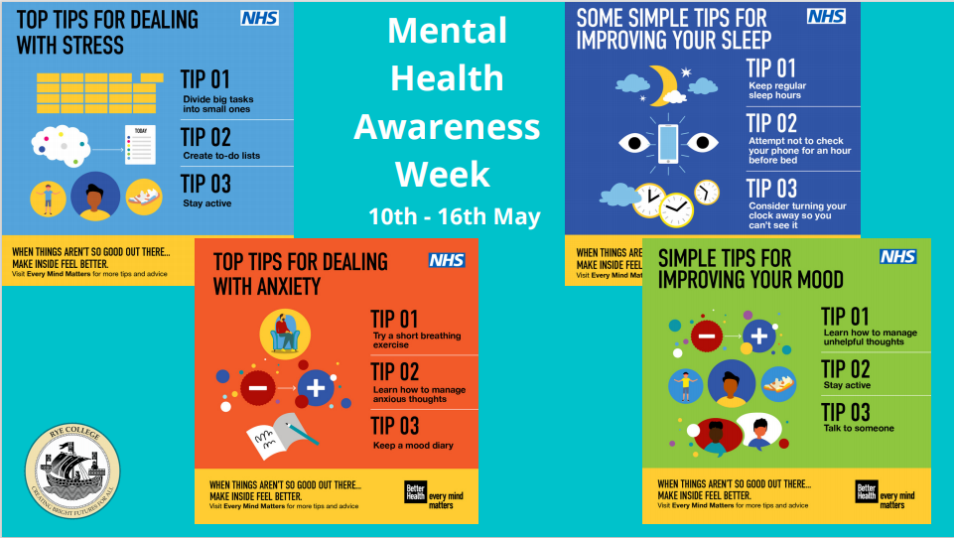
Mental Health Awareness
Top Tips from the NHS Mental Health awareness week

Slide 10
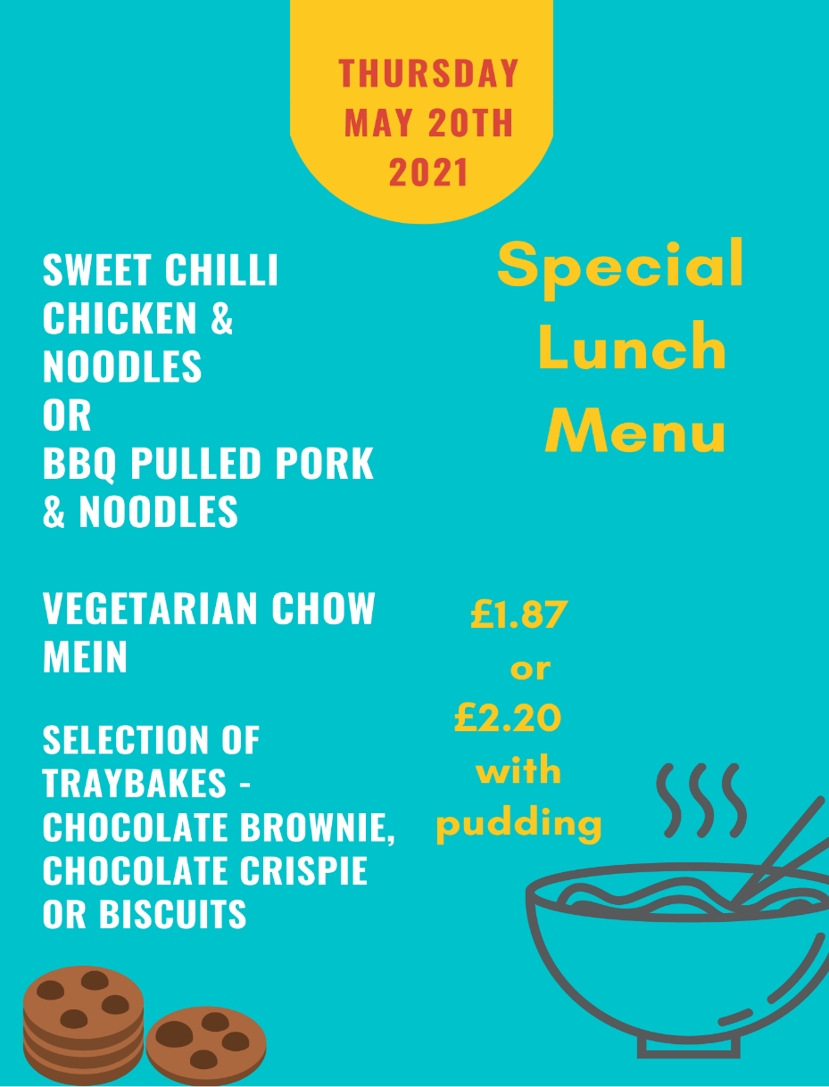
Canteen News
There will be a special lunch menu on Thursday 20th May

Slide 11
Action Your Potential
Meetings continue Tuesday
Well done to those students who engaged with the introductory conversations this week. Andrew was very impressed.
Your form Tutor has information on meeting times for today

Slide 12
Year 11 YES meetings
Selected students will be having follow up interviews with Sam Sorrenti or Phil Waite from the Youth Employability Service on the following dates:
Monday 17/5
Tuesday 18/5
Thursday 20/5
Tuesday 25/5
Form Tutors have the details for today and a list will be left in the Hub and the library. Please ensure you attend.
Meetings will take place virtually, in the library on the laptop provided.
The meeting link is the same for the whole day, so please do not end the meeting. Take the headphones off and leave with the laptop for the next person.

Slide 13
Rye SMART
Focus: Attributes
This strand focuses on employability skills. These are really important through school and when you continue into further and higher education and the world of work. They are ultimately what make you more employable than someone else. Some employers see these as more significant than qualifications!
We really want to see students who are well organised, able to self-manage, able to work as part of a team, able to communicate well and can adapt to solving everyday problems.
Watch the video to find out more: Rye SMART | Attributes on Vimeo

Slide 15
Rally Your Excitement Newsletter by Rye College Student Leaders
12th May 2021
studentleadershipteam@ryecollege.co.uk

Slide 16
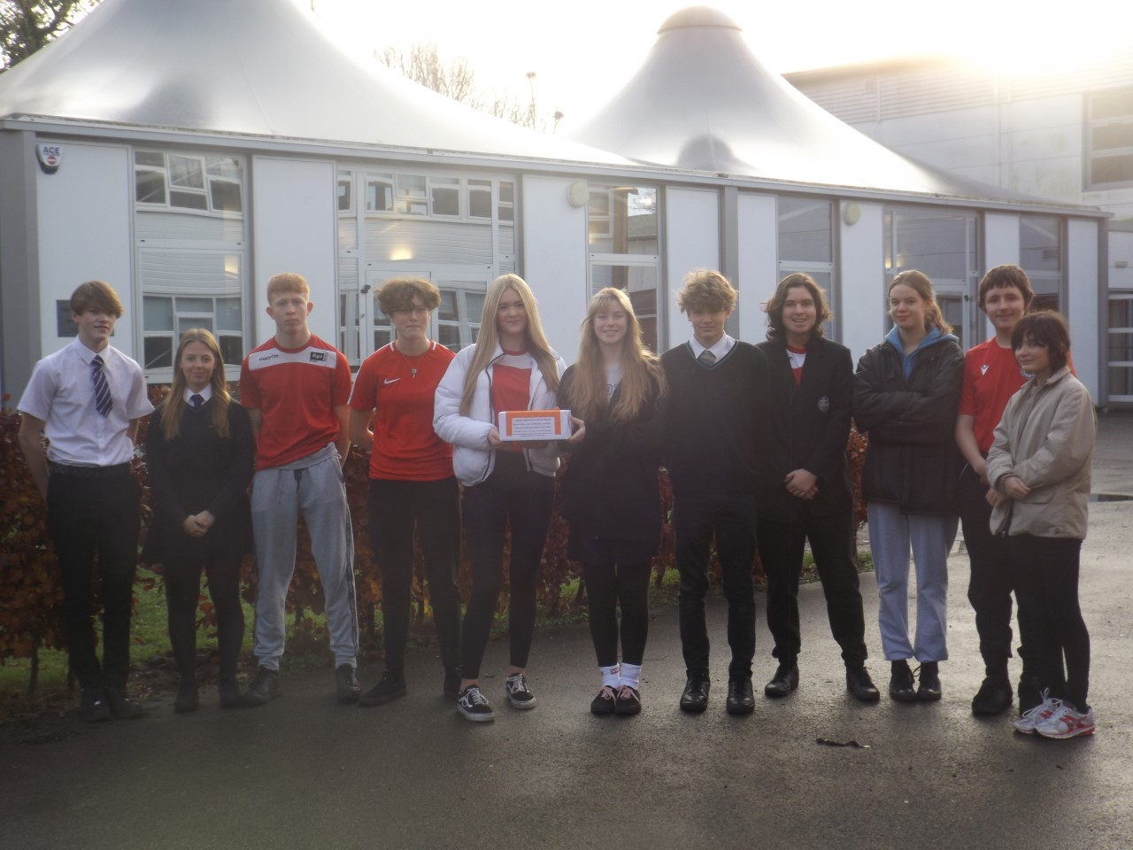
The Student Leadership team have been meeting with different year groups to find out their priorities and needs.
We have met with the canteen to discuss changes to the menus and the canteen’s carbon footprint. We are pleased the salad bar has been reinstated from this and there are more exciting changes to come.
We have checked your feedback boxes and are acting on the advice you are sharing. Meetings have taken place with Mr Downes and Kathy Griffith CEO of the trust.
We are organising charity events, setting up support groups and looking at how the school communicates with students.
Please email us to say hello and help us to make your school better.
studentleadershipteam@ryecollege.co.uk

Slide 17
Updates for you for next week
Masks will no longer be compulsory for staff or students in lessons or corridors.
Staff and students may choose to wear masks, but from Monday it is no longer a requirement.
You CANNOT take your mask off on transport,in shops or other venues.
You should still continue to complete lateral flow tests twice a week.

Slide 18
Please share your views by filling in this survey https://forms.office.com/Pages/ResponsePage.aspx?id=dwr6UypRDky6Q5dIsGSRsSxJa0Ds5oVIji26-tHdwHtUQlRUMDdWVERUUzBITzBHME42UVBWTlhJNi4u
Your views on how the school communicates with you

Slide 19
Your Successes
We know a great many students have sporting successes they have achieved recently. We would love to start celebrating these.
The P.E. department have a board they would like to fill with your achievements.
Please let the student leadership team, or the P.E. department know and we will add you to the growing list of sporting superstars at Rye College.

Slide 20
May 28th Last day of term 5
The Last day of term will be a non uniform day.
Normal rules apply, with a voluntary £1 donation.
There will also be a bake off competition in the library.
Students and staff are invited to bake a cake to enter the competition. They will be judged by the student leadership team in registration and prizes can be won.
During Break 1 (early and late). Slices of the cakes will be available to purchase in the library for a small fee.
The proceeds will go to the charity of St Michaels hospice.

Slide 21
Competition Time
Things that have happened recently:
Elon musk has released more satellites.
A meeting about G7
The elections were last Thursday in the UK
Farmers in the UK saved a species of Butterfly from extinction.
India’s richest man made his factories produce oxygen for 1 in 10 covid patients in India.
Which teacher has an identical twin?
Which member of staff was once in an advert for Mcvities chocolate biscuits
Send your answers to studentleadershipteam@ryecollege.co.uk

Slide 22
Easy to Make Pizza
Ingredients
·For the base
300g strong bread flour
1 tsp instant yeast (from a sachet or a tub)
1 tsp salt
1 tbsp olive oil, plus extra for drizzling
For the tomato sauce
100ml passata
handful fresh basil or 1 tsp dried
1 garlic clove, crushed
For the topping
125g ball mozzarella, sliced
handful grated or shaved parmesan (or vegetarian alternative)
handful of cherry tomatoes, halved
Method
STEP 1Make the base: Put the flour into a large bowl, then stir in the yeast and salt. Make a well, pour in 200ml warm water and the olive oil and bring together with a wooden spoon until you have a soft, fairly wet dough. Turn onto a lightly floured surface and knead for 5 mins until smooth. Cover with a tea towel and set aside. You can leave the dough to rise if you like, but it’s not essential for a thin crust.
STEP 2Make the sauce: Mix the passata, basil and crushed garlic together, then season to taste. Leave to stand at room temperature while you get on with shaping the base.
STEP 3Roll out the dough: if you’ve let the dough rise, give it a quick knead, then split into two balls. On a floured surface, roll out the dough into large rounds, about 25cm across, using a rolling pin. The dough needs to be very thin as it will rise in the oven. Lift the rounds onto two floured baking sheets.
STEP 4Top and bake: heat the oven to 240C/220C fan/gas 8. Put another baking sheet or an upturned baking tray in the oven on the top shelf. Smooth sauce over bases with the back of a spoon. Scatter with cheese and tomatoes, drizzle with olive oil and season. Put one pizza, still on its baking sheet, on top of the preheated sheet or tray. Bake for 8-10 mins until crisp. Serve with a little more olive oil, and basil leaves if using. Repeat step for remaining pizza

Slide 23
BOOK CLUB
Easy read:
Charlie and the chocolate factory- Roald Dahl
Thrilling adventure, especially if you like sweets!
Medium read:
The school for good and evil- Soman Chanini
This hair-raising adventure involves, wizards, princesses and turning what you thought you knew, on its head!
Hard read:
The Winter King- Bernard Cormwell
This is for older readers but is still an excellent re-telling of the classic Arthurian legend.
Classic challenge:
A tale of two cities- Charles Dickens
For those romantics out there, this is an awesome read. Set during the French revolution.

Slide 24
Sometimes you may feel like this …
Mental health, defined by the World Health Organization, is "a state of well-being in which the individual realizes his or her own abilities, can cope with the normal stresses of life, can work productively and fruitfully, and is able to make a contribution to his or her community".​
We all have at some point; some more than others but how do we deal with these feelings?

Slide 25
Ways to look after your mental health :
Going on walks (preferably in the woods or in a park)​
Take a break for example, self-care Sunday​
Do something you enjoy ​
Keep active ​
Talk to someone about how you feel​
Take time away from your phone ​
​
Many people will look after their physical health by going to the gym, watching what they eat, going on a diet, etc – it’s just as easy to look after your mental health!

Slide 26
Samaritans. To talk about anything that is upsetting you, you can contact Samaritans 24 hours a day, 365 days a year. You can call 116 123 (free from any phone), email jo@samaritans.org or visit some branches in person. You can also call the Samaritans Welsh Language Line on 0808 164 0123 (7pm–11pm every day).​
​
SANEline. If you're experiencing a mental health problem or supporting someone else, you can call SANEline on 0300 304 7000 (4.30pm–10.30pm every day).​
​
The Mix. If you're under 25, you can call The Mix on 0808 808 4994 (Sunday-Friday 2pm–11pm), request support by email using this form on The Mix website or use their crisis text messenger service.​
​
Papyrus HOPELINEUK. If you're under 35 and struggling with suicidal feelings, or concerned about a young person who might be struggling, you can call Papyrus HOPELINEUK on 0800 068 4141 (weekdays 10am-10pm, weekends 2pm-10pm and bank holidays 2pm–10pm), email pat@papyrus-uk.org or text 07786 209 697.​
​
Campaign Against Living Miserably (CALM). If you identify as male, you can call the Campaign Against Living Miserably (CALM) on 0800 58 58 58 (5pm–midnight every day) or use their webchat service.​
​
Nightline. If you're a student, you can look on the Nightline website to see if your university or college offers a night-time listening service. Nightline phone operators are all students too.​
​
Switchboard. If you identify as gay, lesbian, bisexual or transgender, you can call Switchboard on 0300 330 0630 (10am–10pm every day), email chris@switchboard.lgbt or use their webchat service. Phone operators all identify as LGBT+.​
​
C.A.L.L. If you live in Wales, you can call the Community Advice and Listening Line (C.A.L.L.) on 0800 132 737 (open 24/7) or you can text 'help' followed by a question to 81066.​
​
Helplines Partnership. For more options, visit the Helplines Partnershipwebsite for a directory of UK helplines. Mind's Infoline can also help you find services that can support you. If you're outside the UK, the Befrienders Worldwide website has a tool to search by country for emotional support helplines around the world.​
​

Slide 27
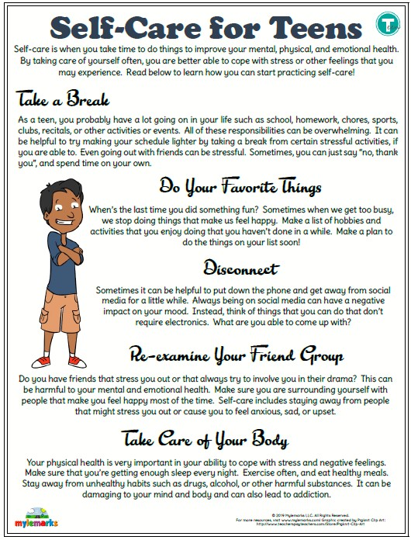
Self Care for Teens Self-care is when you take time to do things to improve your mental, physical and emotional health. By taking care of yourself often, you are better able to cope with stress or other feelings that you may experience. Read the information to learn how to start practicing self-care.

