Slide 1
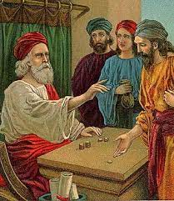
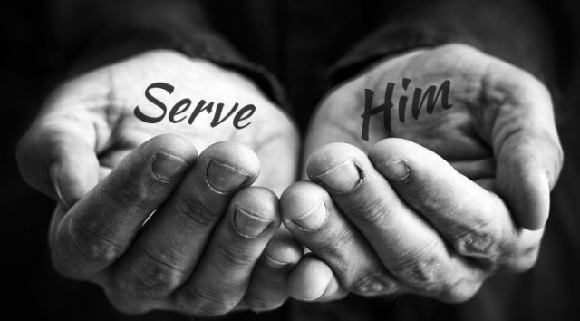
Twenty Fifth Sunday in Ordinary time
19th September 2022

Slide 2
Rescuer
Rend Collective - Rescuer (Good News) [Official Music Video] – YouTube

Slide 3
Generous God,
in you we have all we need.
Help us to put you first
in all that we do
and to trust that you will care for us always.
Amen.

Slide 4
How can I serve God this week?

Slide 5
The Lord be with you
And with your spirit
The Gospel according to Luke
Glory to you, O Lord
Jesus said to his disciples, “There was once a rich man who had a servant who managed his property. The rich man was told that the manager was wasting his master's money, so he called him in and said, ‘What is this I hear about you? Hand in a complete account of your handling of my property, because you cannot be my manager any longer.’ The servant said to himself, ‘My master is going to dismiss me from my job. What shall I do? I am not strong enough to dig ditches, and I am ashamed to beg. Now I know what I will do! Then when my job is gone, I shall have friends who will welcome me in their homes.’
So he called in all the people who were in debt to his master. He asked the first one, ‘How much do you owe my master?’ ‘100 barrels of olive oil,’ he answered. ‘Here is your account,’ the manager told him; ‘sit down and write fifty.’ Then he asked another one, ‘And you—how much do you owe?’ ‘A thousand sacks of wheat,’ he answered. ‘Here is your account,’ the manager told him; ‘write 800.’ As a result the master of this dishonest manager praised him for doing such a shrewd thing; because the people of this world are much more shrewd in handling their affairs than the people who belong to the light.”

Slide 6
And Jesus went on to say, “And so I tell you: make friends for yourselves with worldly wealth, so that when it gives out, you will be welcomed in the eternal home. Whoever is faithful in small matters will be faithful in large ones; whoever is dishonest in small matters will be dishonest in large ones. If, then, you have not been faithful in handling worldly wealth, how can you be trusted with true wealth? And if you have not been faithful with what belongs to someone else, who will give you what belongs to you?
“No servant can be the slave of two masters; such a servant will hate one and love the other or will be loyal to one and despise the other. You cannot serve both God and money.”
The Gospel of the Lord.
Praise to you, Lord Jesus Christ

Slide 7
The manager in this story’s job was to look after a rich man's property and money. Why was the rich man cross with his manager?
The rich man was cross because the manager was not careful with his money. He spent too much of it. And so the rich man told the manager he could no longer have a job.
There are many rich people in the world and there are even more people who have very little. Do you think it is fair that some of us are rich and have lots of nice things and some of us are poor and do not have clean water, a house to live in, a school to go to, clothes to wear or books to read from and learn?

Slide 8
Another word that is sometimes used instead of manager is steward. We are all stewards of this world but also of each other. We are called to look after both people and the earth, wisely and fairly.
In today’s gospel, Jesus says that if we can't be trusted in small things we won't be trusted with bigger things.
What small things are important to you and why? What big things are important to you and why? How can you be careful with all of them?

Slide 9
Jesus says we can’t serve both God and money in our lives. God must come first. Then other people. Then money and the things we own last. He also says that we should be generous with the money that we do have and use it to look after others. In this way, we will be welcomed into heaven by God.
When you think about what’s important to you, which comes first? God? Your friends and family, including our brothers and sisters around the world? Or your toys and clothes and other things?
How will you make sure that you put God and other people before your possessions in the coming week? What will you do to show that you serve God in your life?

Slide 10


Slide 11
We pray for world leaders:
that they may care for their people and for what is right
more than for money and power.
May they rule wisely and justly.
Lord, in your mercy…
We pray for our brothers and sisters in every country:
that we may share what we have with one another,
so that all people may have enough to live well.
Lord in your mercy...

Slide 12
We pray for our school, family and friends:
that we may share what we have fairly
and always remember what is truly important.
Lord in your mercy...

Slide 13
We pray for our late Queen, Queen Elizabeth II, may she rest in peace.
Amen
We pray for our new king, King Charles III. May he be guided by you Give him enduring wisdom and faith
in the service of the people of this land
and of you, his Lord and master.
Lord in your mercy

Slide 14
We ask Our Lady to take these and all of our prayers as we say,
Hail Mary…

Slide 15


