Slide 1

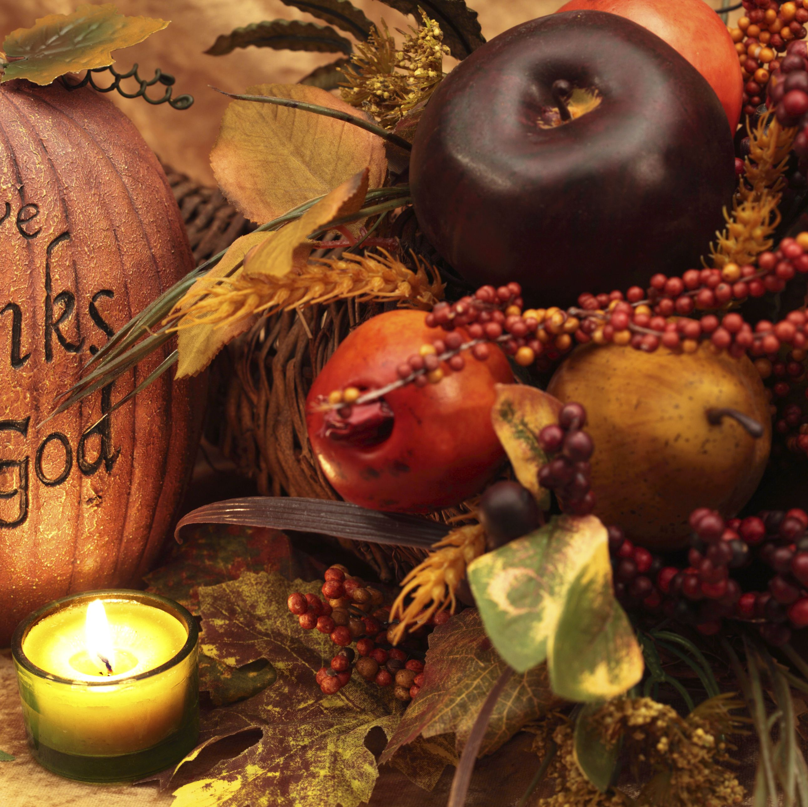

We must trust in God
My Lighthouse https://www.youtube.com/watch?v=lFBZJGSgyVQ
Thirty third Sunday in ordinary time

Slide 2



All-powerful God, nothing is greater than your love, so may we trust in you whatever difficulties and challenges we face. Amen.

Slide 3
The Lord be with you
And with your spirit.
A reading from the Gospel according to St Luke
Glory to you, O Lord
Some of the disciples were talking about the Temple, how beautiful it looked with its fine stones and the gifts offered to God. Jesus said, “All this you see—the time will come when not a single stone here will be left in its place; every one will be thrown down.”
“Teacher,” they asked, “when will this be? And what will happen in order to show that the time has come for it to take place?”
Jesus said, “Be on guard; don't be deceived. Many men, claiming to speak for me, will come and say, ‘I am he!’ and, ‘The time has come!’ But don't follow them. Don't be afraid when you hear of wars and revolutions; such things must happen first, but they do not mean that the end is near.”

Slide 4
He went on to say, “Countries will fight each other; kingdoms will attack one another. There will be terrible earthquakes, famines, and plagues everywhere; there will be strange and terrifying things coming from the sky. Before all these things take place, however, you will be arrested and persecuted; you will be handed over to be tried in synagogues and be put in prison; you will be brought before kings and rulers for my sake. This will be your chance to tell the Good News. Make up your minds beforehand not to worry about how you will defend yourselves, because I will give you such words and wisdom that none of your enemies will be able to refute or contradict what you say. You will be handed over by your parents, your brothers, your relatives, and your friends; and some of you will be put to death. Everyone will hate you because of me. But not a single hair from your heads will be lost. Stand firm, and you will save yourselves.
The Gospel of the Lord
Praise to you, Lord Jesus Christ

Slide 5
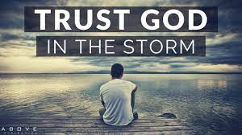

Slide 6

Let us pray

Slide 7
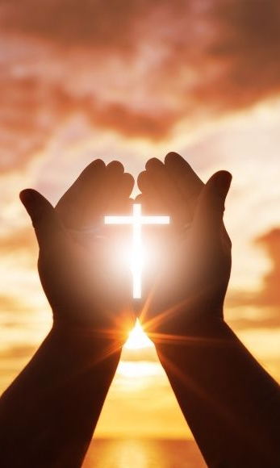
We pray for the Church: that it may support and welcome all people, especially those among us who are poor.
Lord, in your mercy…

Slide 8
We pray for our brothers and sisters in every country: that they may know that they are not forgotten as we do our best to help our neighbours around the world.
Lord, in your mercy…

Slide 9
We pray for our parish, family and friends: that with God’s help we may support each other in all things, especially when life is difficult. May we give each other hope.
Lord, in your mercy…

Slide 10

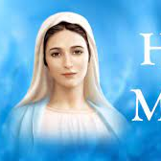

We ask Our Lady to take these and all of our prayers as we say,
Hail Mary ..

Slide 11
Jesus, help us to put our faith and trust in you at all times. May we not be afraid but instead believe that you will always keep us safe.
Amen.

Slide 12


Slide 13
Tolerance
We accept each other, even though we are all different.

Slide 14


