Slide 1
The Prodigal Son
12th September 2022

Slide 3
How will I share God's love with everyone I meet this week?

Slide 4
Forgiving God,
sometimes we forget you
or do things we know are wrong.
Yet you never stop loving us, and so
we thank you for never giving up on
us.
Amen.

Slide 5
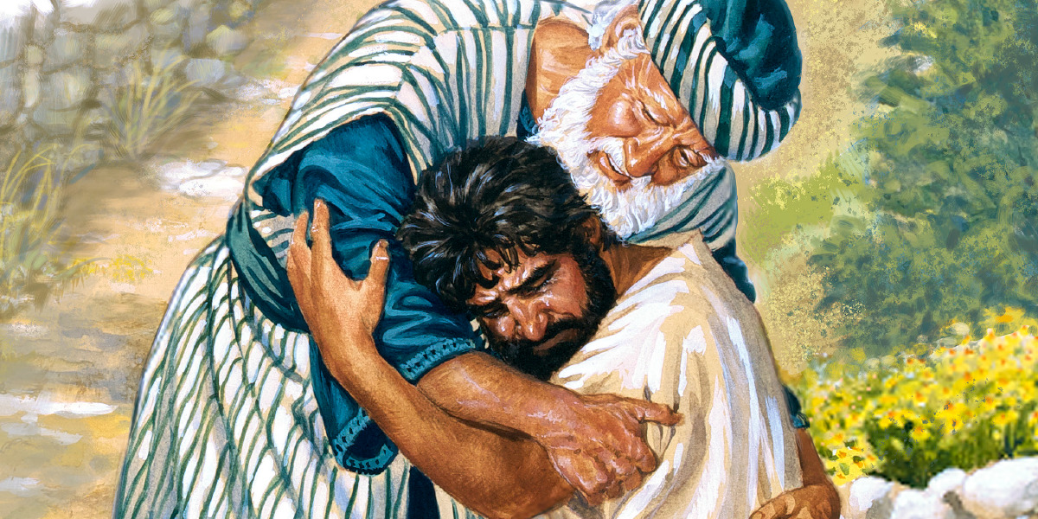
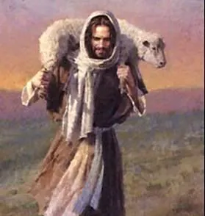
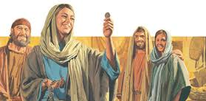

Slide 6
The Lord be with you,
And with your spirit.
The Gospel according to St John
Glory to you, O Lord.
One day when many tax collectors and other outcasts came to listen to Jesus, the Pharisees and the teachers of the Law started grumbling, “This man welcomes outcasts and even eats with them!” So Jesus told them this parable:
“Suppose one of you has a hundred sheep and loses one of them—what do you do? You leave the other 99 sheep in the pasture and go looking for the one that got lost until you find it. When you find it, you are so happy that you put it on your shoulders and carry it back home. Then you call your friends and neighbours together and say to them, ‘I am so happy I found my lost sheep. Let us celebrate!’ In the same way, I tell you, there will be more joy in heaven over one sinner who repents than over 99 respectable people who do not need to repent.
“Or suppose a woman who has ten silver coins loses one of them—what does she do? She lights a lamp, sweeps her house, and looks carefully everywhere until she finds it. When she finds it, she calls her friends and neighbours together, and says to them, ‘I am so happy I found the coin I lost. Let us celebrate!’ In the same way, I tell you, the angels of God rejoice over one sinner who repents.”

Slide 7
Jesus went on to say, “There was once a man who had two sons. The younger one said to him, ‘Father, give me my share of the property now.’ So the man divided his property between his two sons. After a few days the younger son sold his part of the property and left home with the money. He went to a country far away, where he wasted his money in reckless living. He spent everything he had. Then a severe famine spread over that country, and he was left without a thing. So he went to work for one of the citizens of that country, who sent him out to his farm to take care of the pigs. He wished he could fill himself with the bean pods the pigs ate, but no one gave him anything to eat.

Slide 8
At last he came to his senses and said, ‘All my father's hired workers have more than they can eat, and here I am about to starve! I will get up and go to my father and say, Father, I have sinned against God and against you. I am no longer fit to be called your son; treat me as one of your hired workers.’ So he got up and started back to his father.

Slide 9
He was still a long way from home when his father saw him; his heart was filled with pity, and he ran, threw his arms round his son, and kissed him. ‘Father,’ the son said, ‘I have sinned against God and against you. I am no longer fit to be called your son.’ But the father called his servants. ‘Hurry!’ he said. ‘Bring the best robe and put it on him. Put a ring on his finger and shoes on his feet. Then go and get the prize calf and kill it, and let us celebrate with a feast! For this son of mine was dead, but now he is alive; he was lost, but now he has been found.’ And so the feasting began.
“In the meantime the elder son was out in the field. On his way back, when he came close to the house, he heard the music and dancing. So he called one of the servants and asked him, ‘What's going on?’ ‘Your brother has come back home,’ the servant answered, ‘and your father has killed the prize calf, because he got him back safe and sound.’

Slide 10
The elder brother was so angry that he would not go into the house; so his father came out and begged him to come in. But he answered his father, ‘Look, all these years I have worked for you like a slave, and I have never disobeyed your orders. What have you given me? Not even a goat for me to have a feast with my friends! But this son of yours wasted all your property, and when he comes back home, you kill the prize calf for him!’ ‘My son,’ the father answered, ‘you are always here with me, and everything I have is yours. But we had to celebrate and be happy, because your brother was dead, but now he is alive; he was lost, but now he has been found.’”
The Gospel of the Lord
Praise to you, Lord Jesus Christ

Slide 12
In the same way as in the stories, all people are valuable to God, because God made us and loves us.
We are all different. We are all special. God cares for us and loves us. God wants us to do what is right. But sometimes we do not listen, we are not very generous, and we can be mean to others, or we do things we know are wrong. At these times we’re a bit like the sheep or the coin that is lost, because we are turning away from God.
But this doesn’t mean that God loves and cares for us any less. God cares for us and watches over us always. When we see that we have done something wrong, when we ask for forgiveness and turn back to God, then God is happy and welcomes us back and celebrates because we are no longer lost.

Slide 13


Slide 14

God loves us all and so we pray together...
We pray for the Church throughout the world: that she may show us God’s love and forgiveness for all people.
Lord, in your mercy…

Slide 15
We pray for our brothers and sisters in every country: that we may not turn away anyone who comes to us for help and that we may welcome everyone in our communities.
Lord, in your mercy…

Slide 16
We pray for our parish, family and friends: that we may be loving and forgiving towards all people
Lord, in your mercy…

Slide 17
We pray for our country at this time of national mourning: that we may join together as one. United in grief but giving thanks for her life and the way she served us and her country.
Lord, in your mercy…

Slide 18
We pray for Charles, the son of Queen Elizabeth, who is now our new King.
We pray that in his grief for his mother he will be inspired by her faith, finding comfort and courage as he steps into his new challenge as monarch.
Lord, in your mercy…

Slide 19
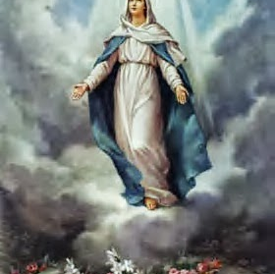
We ask Mary, our mother to take these and all of our prayers as we say,
Hail Mary....
This Photo by Unknown author is licensed under CC BY-SA-NC.

Slide 20
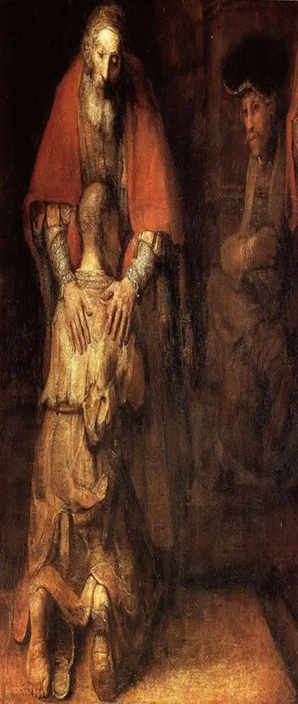
God of lost sheep, coins and all people, help us to remember you are with us in love and forgiveness every day. Guide us to share your love with others through all that we do.
Amen.

Slide 21
