Slide 1


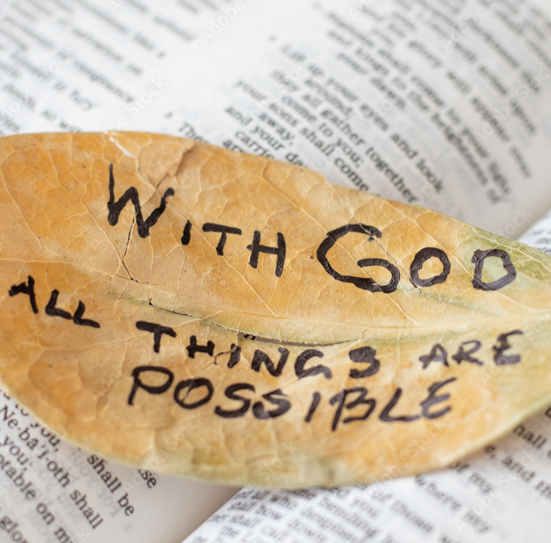
With God, all things are possible
Every Giant Will Fall - Rend Collective (Lyrics) – YouTube
Twenty seventh Sunday in ordinary time

Slide 2




God of light,
help us to see that even with the smallest amount of faith,
we can do anything
you ask of us.
We ask this
through Christ our Lord.
Amen.

Slide 3
The Lord be with you
And with your spirit.
A reading from the Gospel according to St Luke
Glory to you, O Lord
The apostles said to the Lord, “Make our faith greater.”
The Lord answered, “If you had faith as big as a mustard seed, you could say to this mulberry tree, ‘Pull yourself up by the roots and plant yourself in the sea!’ and it would obey you.
“Suppose one of you has a servant who is ploughing or looking after the sheep. When he comes in from the field, do you tell him to hurry and eat his meal? Of course not! Instead, you say to him, ‘Get my supper ready, then put on your apron and wait on me while I eat and drink; after that you may have your meal.’ The servant does not deserve thanks for obeying orders, does he? It is the same with you; when you have done all you have been told to do, say, ‘We are ordinary servants; we have only done our duty.’”
The Gospel of the Lord
Praise to you, Lord Jesus Christ

Slide 4
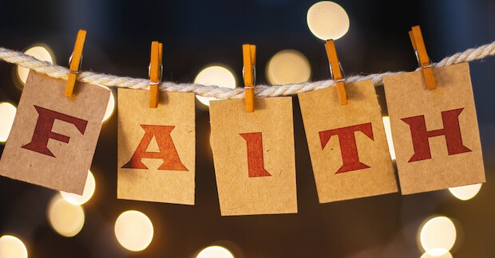

Slide 5
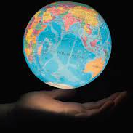
Even a little bit of faith can make a big difference to everyone.

Slide 6
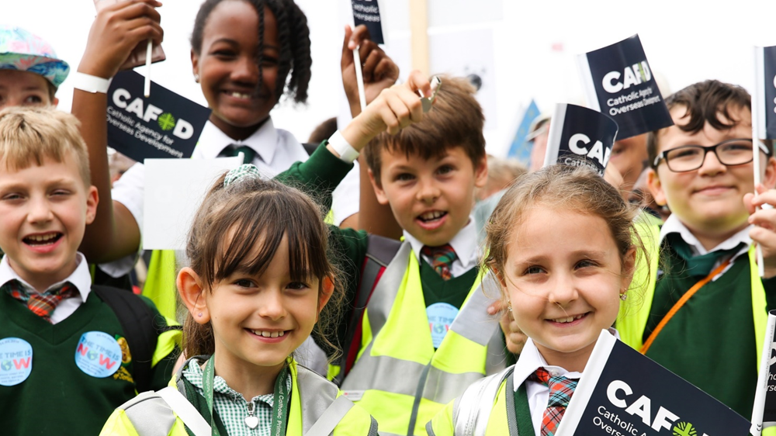
We could raise money to help families around the world have enough to eat. This week is Family Fast Day, when we might eat a simple meal and give the money that we save to CAFOD.
If we have more than we need, we can share what we have with others.
We can ask world leaders to make a change so that the world is a fairer place for all people.
And we can pray for a world where food is grown and shared fairly.

Slide 7
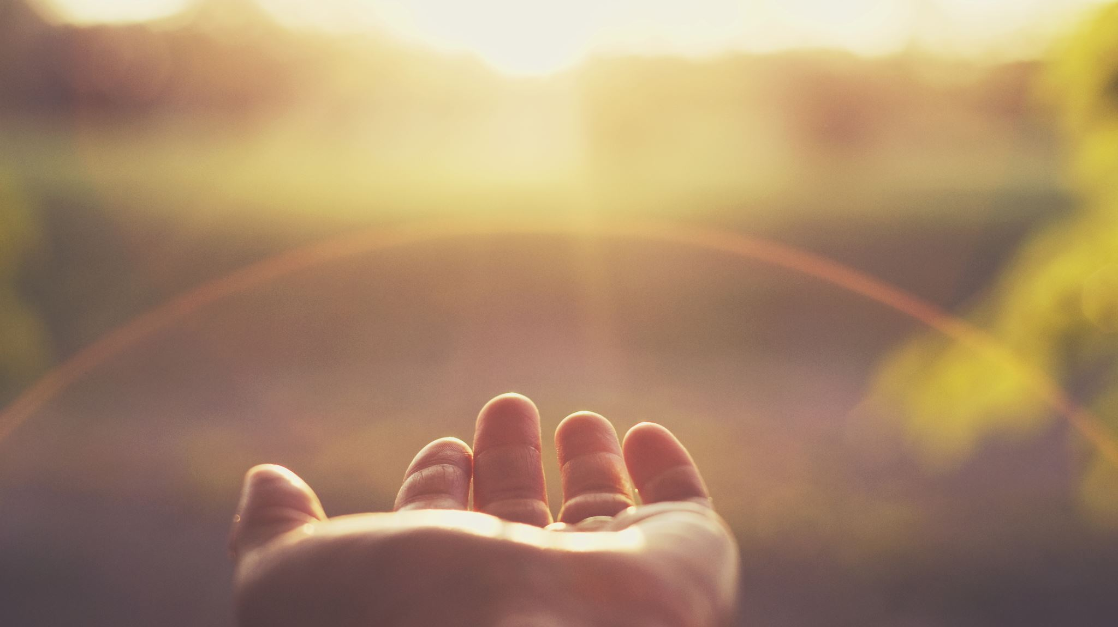
Let us pray

Slide 8
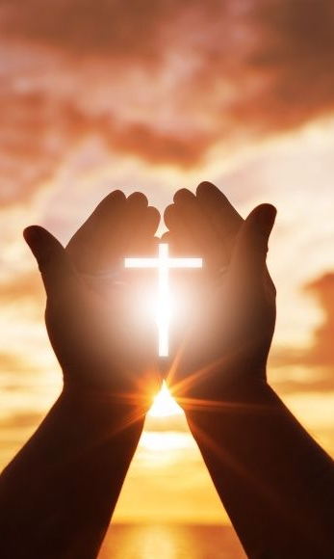
We pray for world leaders:
that they may see that real change is possible
and act to make the world a fairer place for everyone to live.
Lord, in your mercy…

Slide 9
We pray for all people throughout the world who do not have enough food or water: that they may have hope, faith and the support that they need, as they work to change their lives for the better.
Lord, in your mercy…

Slide 10
We pray for our school, family and friends: that we may have the faith and courage to try to make a real difference to our world so that it becomes a fairer place for all.
Lord, in your mercy…

Slide 11

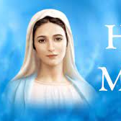

We ask Our Lady to take these and all of our prayers as we say,
Hail Mary ..

Slide 12

What change will you try to make in the world this week?

Slide 13
God of life,
give us the courage to try to make a change to our world, no matter how small, and the faith to know that with you all things are possible.
Amen.

Slide 14


