Slide 1
Welcome to Beech CLASS
Mrs Doolan, Mrs Mallett and Mrs Dahiru
St Clare’s Catholic Primary School

Slide 2
Welcome
Year 2 is a very busy year, with lots for the children to learn.
This year the children will continue to experience a broad and balanced curriculum.
On the next page is an overview of the year for our class and an overview of Autumn Term 1. These are also on the school website under our class page.
Notes:
LCC picked up our attendance was not high enough, therefore push on attendance.
FINES: 5 days or 10 sessions in 1 term or 7 days or 14 sessions over 2 terms.
Phonics handout – go into more detail on next slide.

Slide 3
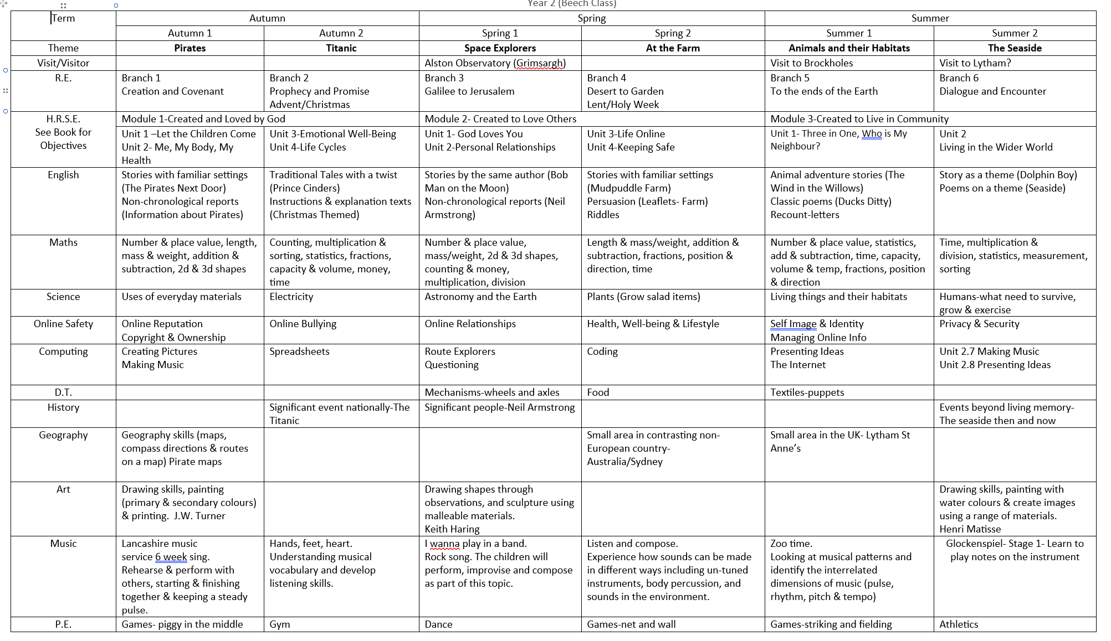
Notes:
LCC picked up our attendance was not high enough, therefore push on attendance.
FINES: 5 days or 10 sessions in 1 term or 7 days or 14 sessions over 2 terms.
Phonics handout – go into more detail on next slide.

Slide 4
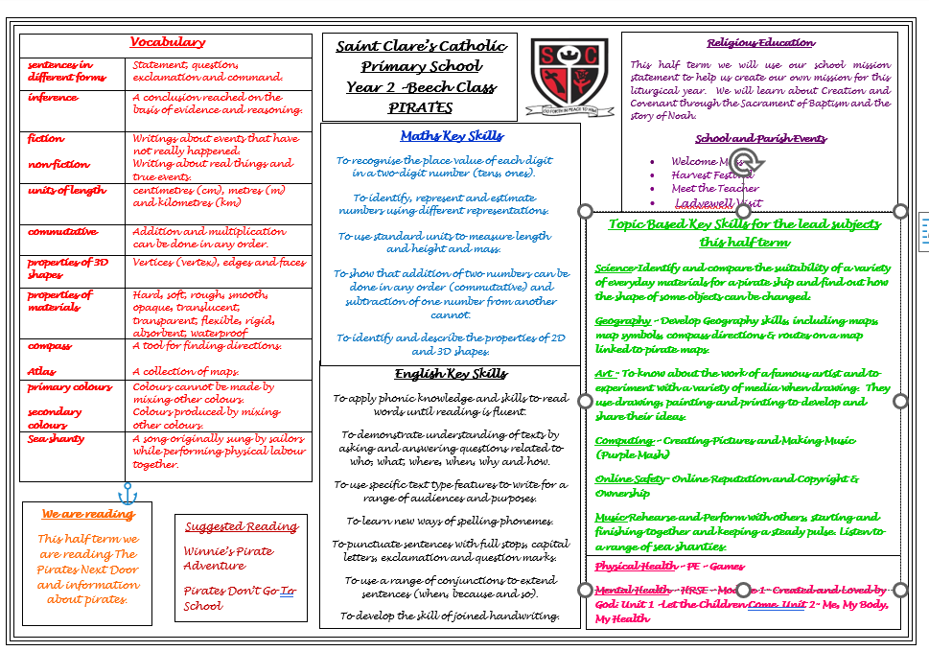
Autumn Term 1

Slide 5
English
Spellings
We do spellings everyday and learn four new words each week. A range of phonics and spelling patterns are incorporated within these spellings. We do not send spellings home for homework.
Handwriting
A big focus this year will be to develop the children’s cursive writing (joined up). We learn how to form the individual letters, then the joins before writing whole words.

Slide 6
Writing
By the end of the year we expect the children to punctuate their sentences correctly with capital letters, full stops, exclamation marks and question marks.
Children are expected to extend their sentences using a range of conjunctions such as and, so, but, because, when, while, before and after.
Some children will add interest to their writing by using noun phrases, adverbs and a range of suffixes.

Slide 7
Reading
Listening to your child read continues to be vitally important, even if they can read fluently.
The next stage of their reading development is to improve their comprehension skills. Children need to be able to make predictions, make inferences, read beyond the literal and understand the meaning of new vocabulary.
In your child’s reading wallet there is a bookmark, this has a range of suggestions for helping your child.

Slide 8
Mathematics
The key learning for this half term can be found on the half term overview.
The children are mainly working with 2 digit numbers.
Number bonds, times tables, doubles and halves will be sent home to learn. Please practise at home until they have instant recall. This will greatly support their independent work.
We learn the 2, 3, 5, and 10 x tables. Timestables.co.uk to practise these- do not use the multiplication check.
With addition and subtraction calculations they are completed horizontally (not vertically).
Please let the children be the teacher and show you how we do it now!

Slide 9
Homework
Homework is always a consolidation of what we are learning in class.
The children should complete the work in pencil and not pen.
Please annotate the work if your child needed any assistance and check it before sending it back to school.
English homework will be sent home on Wednesdays and Maths homework will be sent home on sheets. Both pieces should be returned by the following Monday.
Please aim to read with your child every night. This does not have to be a whole book, a few pages is better than nothing.

Slide 10
Jewellery
No jewellery is allowed in school except watches. No smart watches please.
One pair of plain stud earrings may be worn.

Slide 11
PE
Every Wednesday
PE kit – Red logo t-shirt, black shorts, black pumps.
  Outdoor – School red hoodie, black jogging pants – no leggings, black trainers with no logo if possible.
  All children should come into school on Wednesdays wearing their outdoor PE kit.
Earrings should be removed before school on PE days or covered with plasters. Watches must also be removed.
Please label all PE kits (and all other items of school uniform). Each year we are left with several unclaimed hoodies and jumpers!

Slide 12
HRSE
HRSE stands for Human Relationships and Sex Education.
It has recently been updated for 2026-2027. These updates will be taught in the next academic year and continue to be vital as HRSE relates to children’s relationships with themselves, others and God and keeping themselves safe and healthy.
This year we have made the decision to use TenTen:Life to the Full, in order to support our teaching of HRSE. You will be provided with a parent link so that you can access this excellent resource at home through their Parent Portal.
The Online Parent Portal is a tool that provides you with information about the programme content that your children will be following in school. You can also access suggestions for further activity and discussion at home linked to the sessions taught in school.
Please see the HRSE section on the school website for more information about this. If you have any questions, please don't hesitate to ask.
Username: parents-st-clares-catholic-primary-school
Password: StClare’s
Parent Portal: https://www.tentenresources.co.uk/parent-portal/

Slide 13
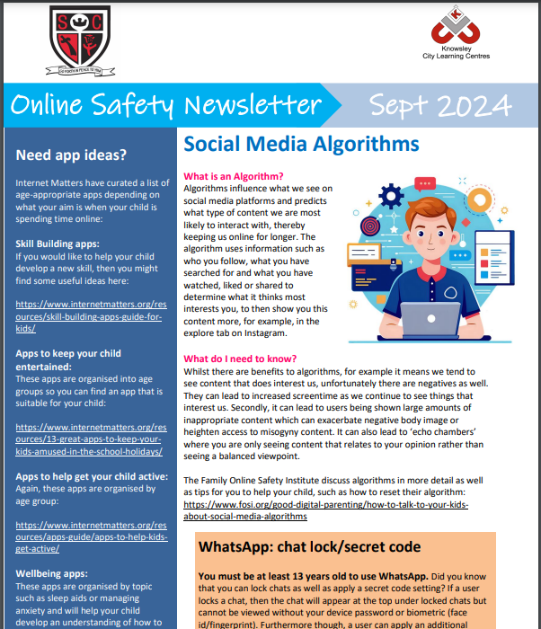
Online Safety
We have a section on our website for Online Safety with help and videos for parental controls etc. This can be found under Parents-Online Safety.
We also send out a monthly newsletter via email with all the latest information regarding games, platforms, social media.

Slide 14
Daily Routine
School’s doors open at 8.40am and begins at 8.50am. Please try to ensure your child is on time as we complete our spellings and daily maths as soon as the children arrive.
Children need to bring a water bottle to school (no juice please).
Please ensure your child has their bag every day. We listen to your child read throughout the week. Due to limited space smaller bags/ school book bags are better, thank you.

Slide 15

PLEASE REMEMBER WE ARE NUT FREE!

Slide 16
Thank you for your time
Any questions?

