Slide 1

Welcome to Year 5
Cherry Class

Slide 2
Class Teacher –
Mrs Bridgeman
Teaching Assistants –
Mrs Alexander
Mrs Brennan
PPA – Mrs Thorpe & Mrs Lee

Slide 3
Welcome letter
(A copy of this can be found on the class page on the school website)
https://www.st-clares.lancs.sch.uk/classes/class-7.php

Slide 4
Allergies
We have a child in school, who has an extreme nut allergy.
We are asking for parents to be very vigilant and ensure that all packed lunches do not contain nuts or traces of nuts.

Slide 5
Reading
Reading is key!
*Children are expected to read at least four times per week at home. When your child has read, it should be recorded in their home reading diary by an adult or older sibling (children are not allowed to record themselves in their reading diary). Reading diaries will be collected and checked on a Friday.
*Children can select a book from our class library or select an appropriate levelled book from home. Reading books and diaries are to be brought to school each day, as they will be given additional opportunity during the school day for independent and supported reading.
*When children have finished a book they will be expected to complete a book review to demonstrate their understanding.
*Reading targets will be set over the next couple of weeks so that they can work towards their reading badges and certificates.

Slide 6
Spellings
A spelling grid will be sent home for each half term, informing you of the spellings your child needs to learn and the date of each test.
Please look at the definition of each word and ensure your child is able to use each word in the right context.
Learning spellings will form part of your child’s weekly homework. Spelling tests will take place on a Friday.

Slide 7
Times tables
Times tables are essential to each Maths lesson, therefore it is important that your child practices their times table each week at home.
Your child will be tested on the 3 times tables on Friday 11th Sept. If your child gets full marks, then they will move on to practicing the 4 times tables. If they don’t get full marks, they will be tested again the following week. They will only move on to the next times table when they have achieved full marks on the previous one.

Slide 8
Homework
A piece of English homework; grammar, punctuation or comprehension and Maths calculations homework as well as a new reasoning style homework we are trialling, will get sent home each Friday.
It must be returned to school by the following Friday, ready to be marked and new homework to be send home.
If your child is struggling with their homework, they can ask me for support at anytime.

Slide 9
PE
Our PE day will be Friday for the first half term.
Children should wear their school PE kit on this day. If the weather is dry, we may be outside so it is important that track suits and trainers are worn.
If your child has earrings, please ensure they are removed on this day.

Slide 10
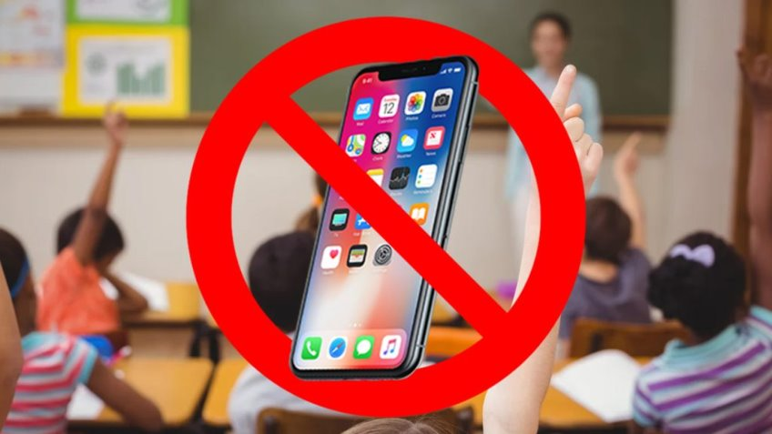
Mobile Phone Free School
From 1 September 2026, schools must follow the DfE's statutory guidance on mobile phones. This requires schools to have a policy that prohibits pupils from using or accessing mobile phones throughout the school day, including during lessons, between lessons, breaktimes and lunchtime.​

Slide 11
Jewellery
Just a reminder that children are allowed to wear one small pair of stud earrings and a watch only – not a smart watch.

Slide 12
Walking Home
If you would like your child to walk home from school on their own, a letter must be sent into school informing us of your intentions.

Slide 13
Termly / Yearly Overviews
On our class page you will also find Autumn 1 overview as well as our yearly overview.

Slide 14
HRSE
HRSE stands for Human Relationships and Sex Education.
It has recently been updated for 2026-2027. These updates will be taught in the next academic year and continue to be vital as HRSE relates to children’s relationships with themselves, others and God and keeping themselves safe and healthy.
This year we have made the decision to use TenTen:Life to the Full, in order to support our teaching of HRSE. You will be provided with a parent link so that you can access this excellent resource at home through their Parent Portal.
The Online Parent Portal is a tool that provides you with information about the programme content that your children will be following in school. You can also access suggestions for further activity and discussion at home linked to the sessions taught in school.
Please see the HRSE section on the school website for more information about this. If you have any questions, please don't hesitate to ask.
Username: parents-st-clares-catholic-primary-school
Password: StClare’s
Parent Portal: https://www.tentenresources.co.uk/parent-portal/

Slide 15
Castlerigg
Wednesday 23rd – Friday 25th September
At drop off, all parents need to accompany their child in to the school hall, where you will need to sign that your child is fit and well for the trip. The children will leave their bags in the hall, say their final goodbyes before heading up to class.
We will not be leaving until after lunch, so if your child usually has a packed lunch, then please send one in for them on the Wednesday. Anyone having a school lunch, will do so as normal.
On Wednesday 23rd September, any medication will need to be handed to myself, fully labelled including the prescription sticker attached.
All children will need a sleeping bag for this trip.

Slide 16
High school
Most high schools are offering opening evenings throughout the Autumn Term this year.
You may need to visit their websites or contact the schools you’re interested in to find out the dates.
Applications for high schools need to be completed by the 31st Oct 2026, which doesn’t give you a lot of time to make a choice if you leave looking around until next September.

Slide 17
Thank you for joining me tonight.

