Slide 1
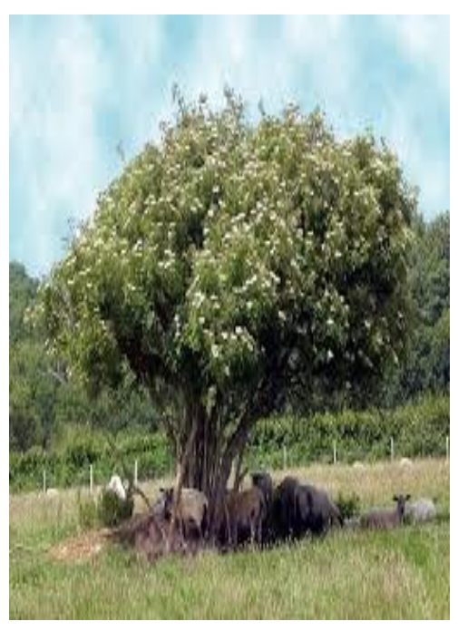
Welcome to Elder Class
Staff in Elder Class:
Mr Cummings(class teacher)
Mrs Thorpe (PPA teacher)
Mrs Brennan (teaching assistant)
Mrs Romero (teaching assistant)

Slide 2
A warm welcome to you all…
Welcome back
and
Happy New Year!!!

Slide 3
The Curriculum
Information about the Year 4 curriculum will be available on our Class Page on the school website.
https://www.st-clares.lancs.sch.uk/elder - more on the following slide
English and maths will be taught in the mornings, foundation subjects taught in the afternoons.
P.E. is on Friday afternoons so the children need to come in their P.E. kits every Friday.
  Please ensure earrings are removed and long hair is tied back. If your child requires an inhaler, please make sure it is clearly named and in date.
  Summer Term – Switch to a Tuesday for Coach Scott

Slide 4
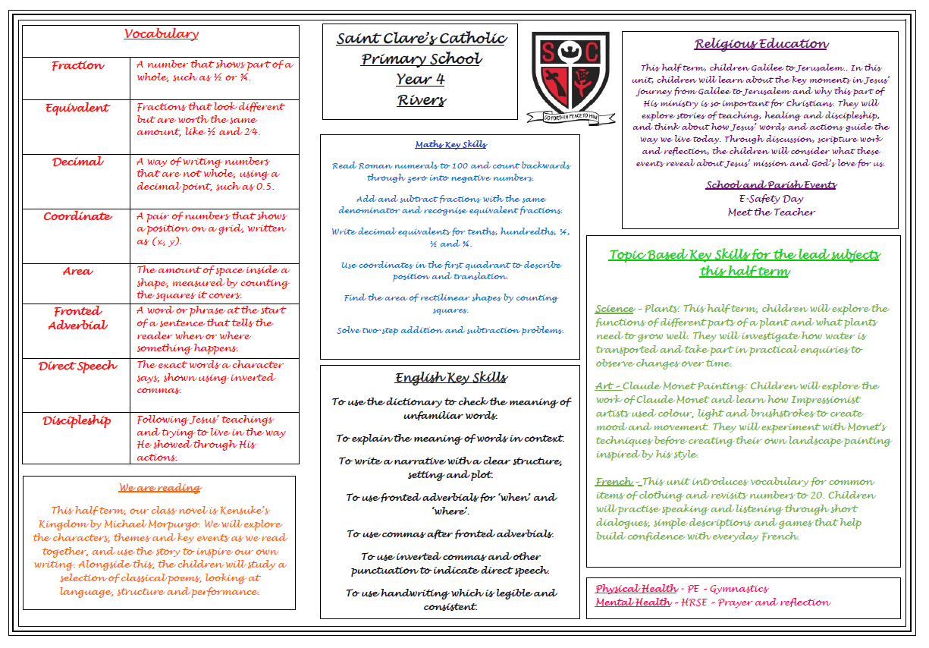

Slide 5
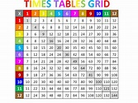
Times tables
Statutory tests in times tables will take place in Year 4. The link below is a great way to practise and get a better understanding of the times table you’re on. It is also good to start to practise mixed times tables to get the exposure and gain confidence.
https://www.timestables.co.uk/
Times tables tests will take place every Friday. The expectation is that all children should know by heart up to and including 12 x 12 by the end of Year 4.
In class, the children will be practising and using their times tables in maths lessons and practice in class.

Slide 6
Reading – Why?
By the age of 5, children who are read to every day may hear around 296,660 more words than children who are never read to.
When comparing children who are read to regularly with those who are not read to at all, this gap can grow to over one million words.
How often children are read to really matters. Daily reading exposes children to far more words than occasional or infrequent reading.
This so-called “million word gap” helps explain why some children find it easier to build vocabulary and become confident readers once they start school.

Slide 7

Reading
Regular reading and discussion are vital.
In school, children enjoy class novels, guided reading and individual books.
At home, children should read for around 30 minutes each night, with time to talk about what they’ve read.
Ask open questions that encourage explanation, inference and evidence from the text.
Some helpful prompts are included in their reading diaries.

Slide 8
National Year of Reading 2026
2026 is the National Year of Reading, and we’ll be celebrating with a reading-themed activity every month across the year.
To kick things off, we’re launching a whole-school reading competition.
Reading in an Unusual Place – Competition
Children are invited to take a photo of themselves reading their favourite book in an unusual place.
Along with the photo, please include a short mini review:
  1–2 sentences explaining
    why they like the book
    why they would recommend it

Slide 9
How to Enter
Details on where to email photos will be shared:
  via Arbor
  in this week’s newsletter
  on the school’s social media pages
The competition will be launched in Friday’s assembly.
Important Dates & Prizes
  Closing date: Friday 23rd January
  Prizes: Book vouchers awarded for the most imaginative entries

Slide 10

Spellings
Spelling should be steadily improving as a result of frequent reading.
In class, children will be exploring spelling patterns, rules and exceptions in their grammar sessions.
To support work in class, the children will receive spelling sheets each half term. These show which spellings your child needs to learn each week.
Spellings will be tested every Friday.
  If your child struggles with spelling, encourage them to break the word up, use their phonics and look for any spelling patterns, prefixes and suffixes.
  Dictionaries are a good support for spelling and in acquiring new vocabulary.
  Try using mnemonics or making a ‘tricky words’ poster for the wall!

Slide 11
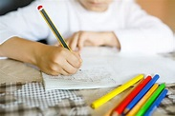
Homework
Children are expected to read daily and practise their spellings and multiplication facts regularly.
Each week, I will set a piece of English and Maths homework. This will be given out on a Monday and is to be handed in on the following Monday.
  If your child has difficulty with any homework, please annotate the homework so that we are aware. We can then find time to go over any misunderstandings.
  We are always pleased to receive any extra homework that children have chosen to do themselves in response to current class topics!

Slide 12

National Numeracy Challenge
The National Numeracy Strategy is to help your child to enjoy maths through engaging activities that are done together with an adult.
How can you help?
Our first impressions of maths and numbers were influenced by the grown-ups around us. We can make sure our children have a positive introduction to numbers even if we didn’t. Here are the National Numeracy’s Top Tips.
If you have any questions or feedback, please speak to your class teacher at the end of the meeting. Positive or negative comments are welcome as it helps us to report back to the National Numeracy Strategy team.

Slide 13
HRSE
HRSE stands for Human Relationships and Sex Education.
This subject was made statutory in 2020 and is especially important after the pandemic as it relates to children’s relationships with themselves, others and God.
We have incorporated PSHE objectives into our HRSE curriculum to ensure all children have the skills and understanding to lead confident, healthy and independent lives, building on their relationships with God and others.
Please see the HRSE section on the school website for more information about this.

Slide 14
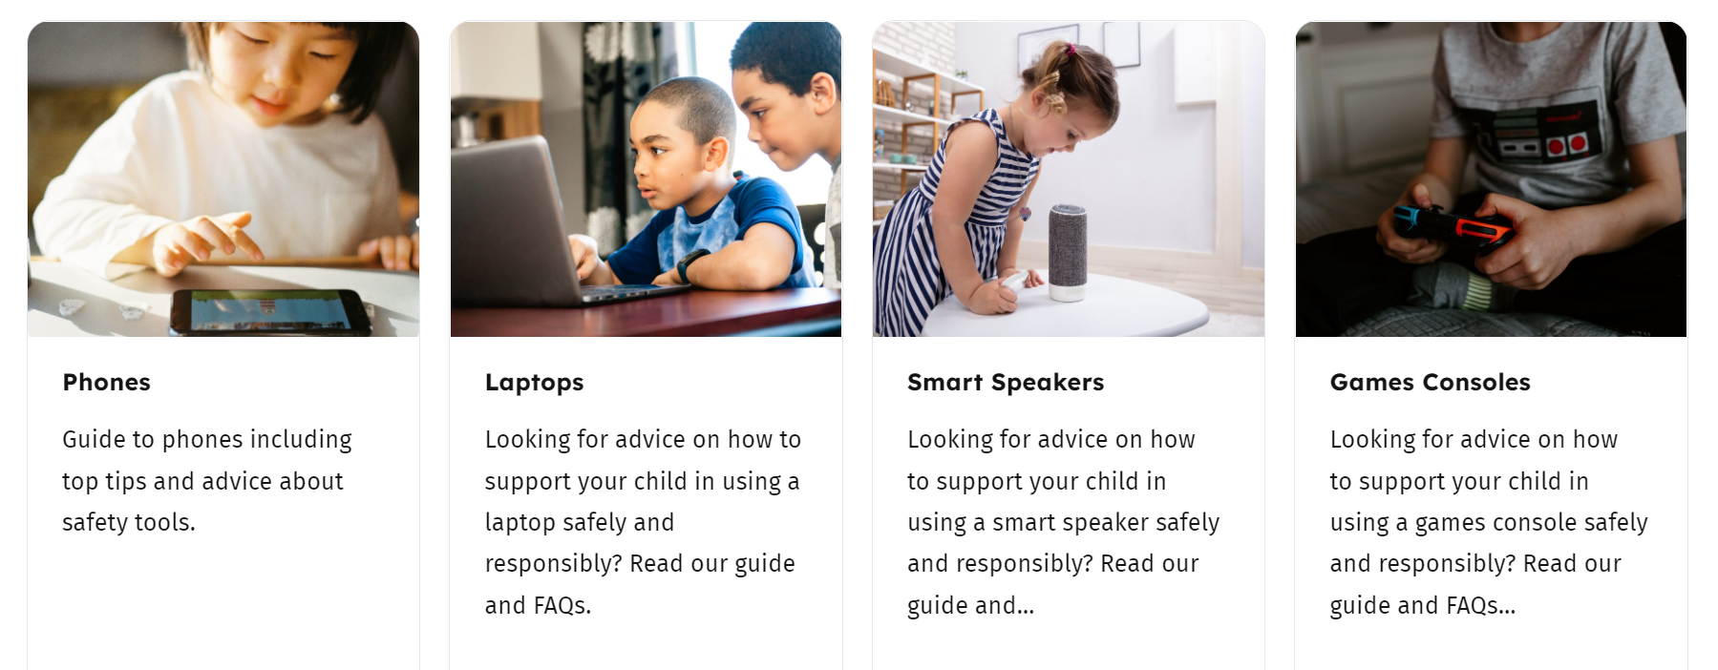
Online Safety
Please use the link to our online safety page. Here you will find useful links for parents and carers:
https://stclares.mecmat.org/about-us/safeguarding/online-safety
https://saferinternet.org.uk/guide-and-resource/parents-and-carers
We also email a newsletter to parents and carers every month.
Safer Internet Day!
Tuesday 10th February

Slide 15

The Fun Stuff!!!
River Ribble Trust – Next Week!
March- Let’s Go Sing
World Book Day – Next half term – check the newsletter!
June 2026 - Swimming
Other trips throughout the year – dates TBC

Slide 16
Let’s Go Sing!
Date: Thursday 19th March 2026
Venue: Blackburn Ice Rink
Seating: Zone 3 (Orange), facing blocks 8–14
Children have been practising regularly and are working with a visiting singing coach
Transport to the venue provided by school
Children to be collected from the venue by parents or carers after the concert
Tickets released: 12th January
  Booking link to be sent out shortly
  Please select the correct concert night, zone and school name
Songs can be practised at home:
Whoops A Daisy Music → Kidszone
Password: Sing26
More details to follow nearer the time

Slide 17


Slide 18
Other Information
Finally, we very much value the partnership we have with parents and we are always happy to discuss any further queries you may have.
Many thanks for your continued support.

Slide 19
Any Questions?

