Slide 1
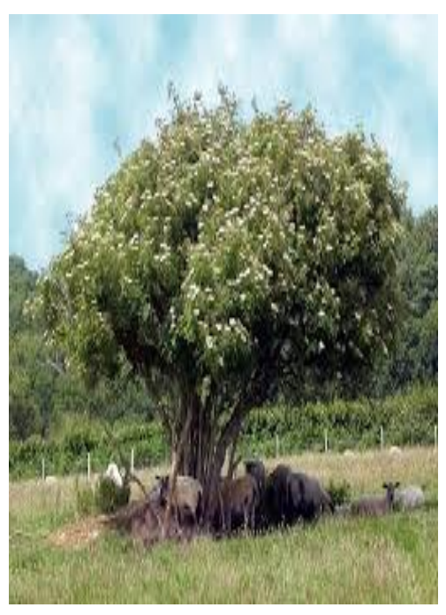
Welcome to Elder Class 2026
Staff in Elder Class:
Mr Cummings(class teacher)
Mrs Thorpe (PPA teacher)
Mrs Mills (teaching assistant)
Mrs Henderson (teaching assistant)

Slide 2
A warm welcome to you all…
We are delighted to welcome you back to St Clare’s.
It has been wonderful to see the children return after the summer break, full of energy and ready for a new year of learning, new experiences and fresh challenges.
We look forward to working with you as they begin this next chapter.
(These are all lies, I’d rather still be on my summer holidays!)

Slide 3
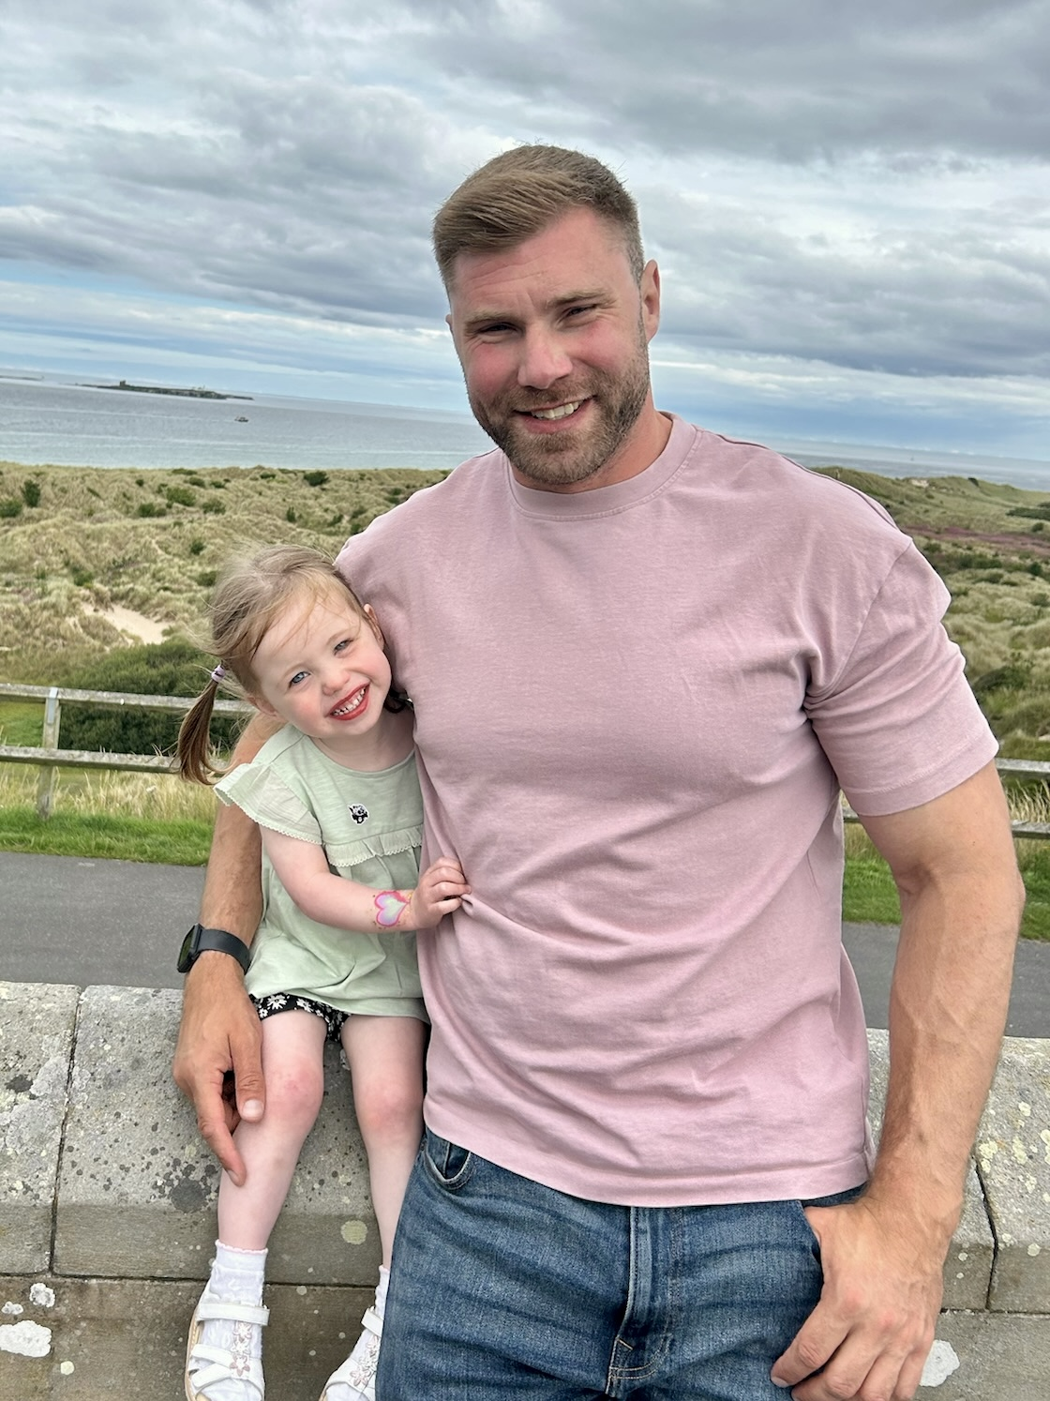
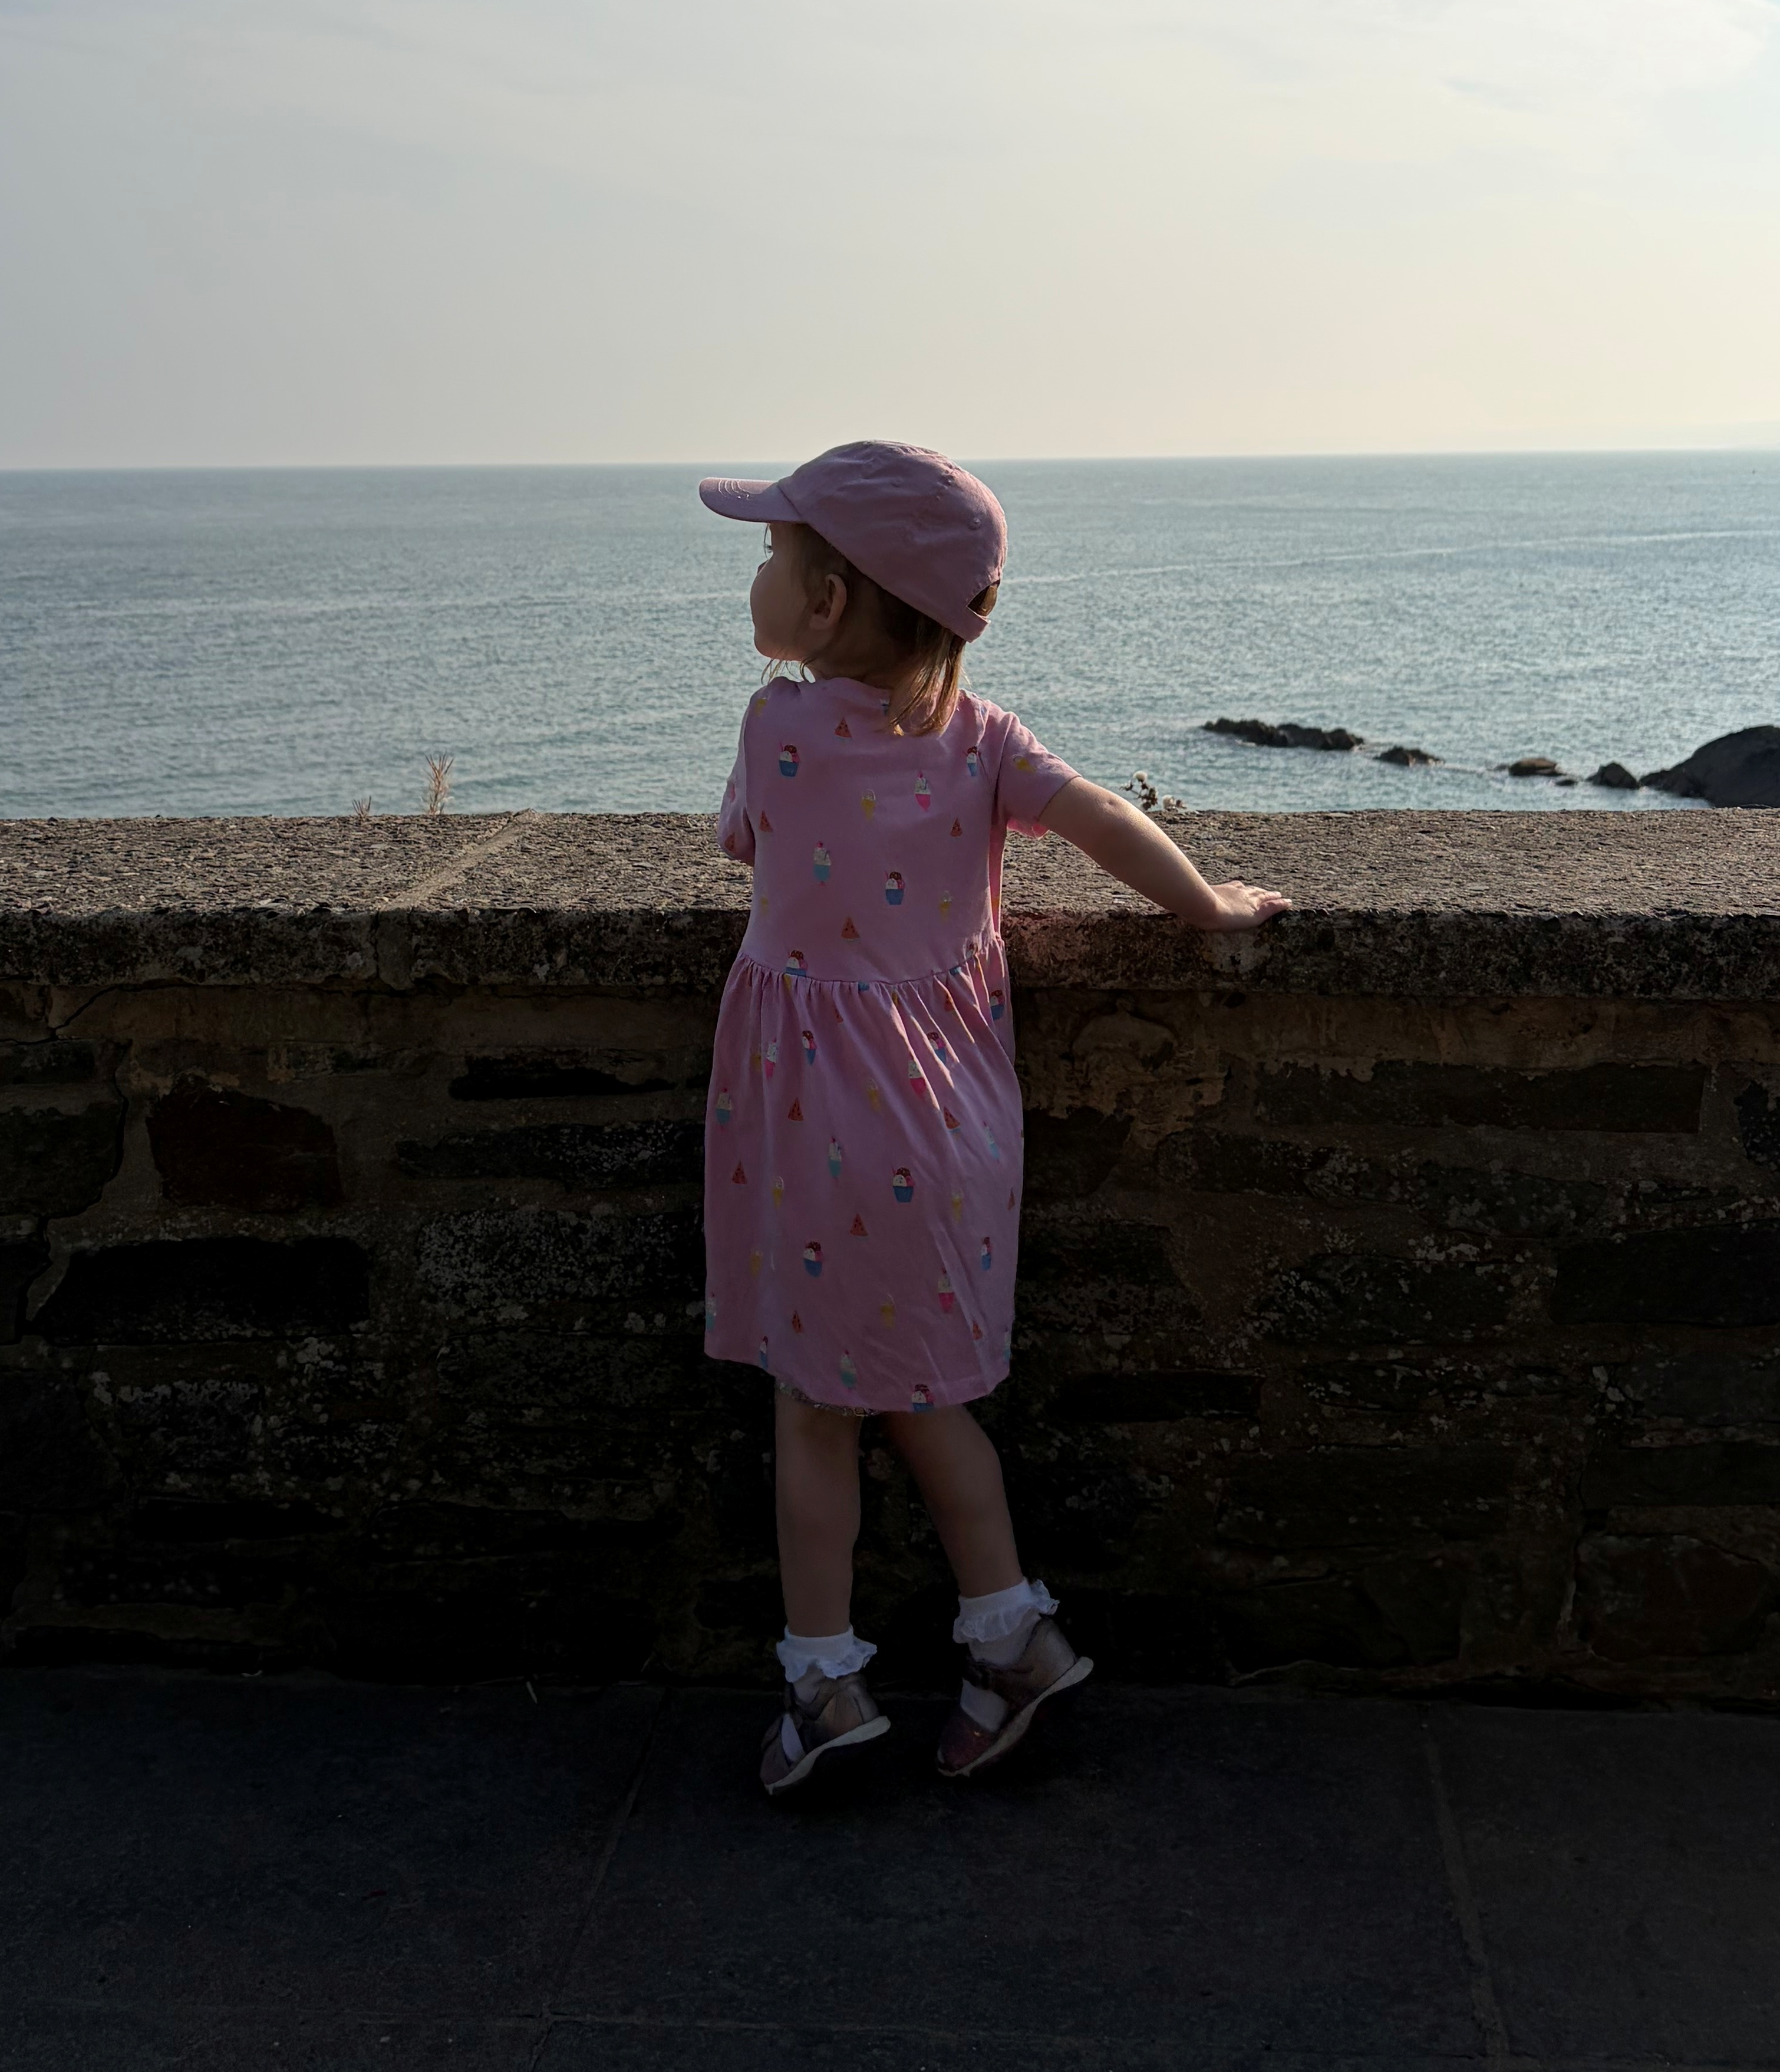
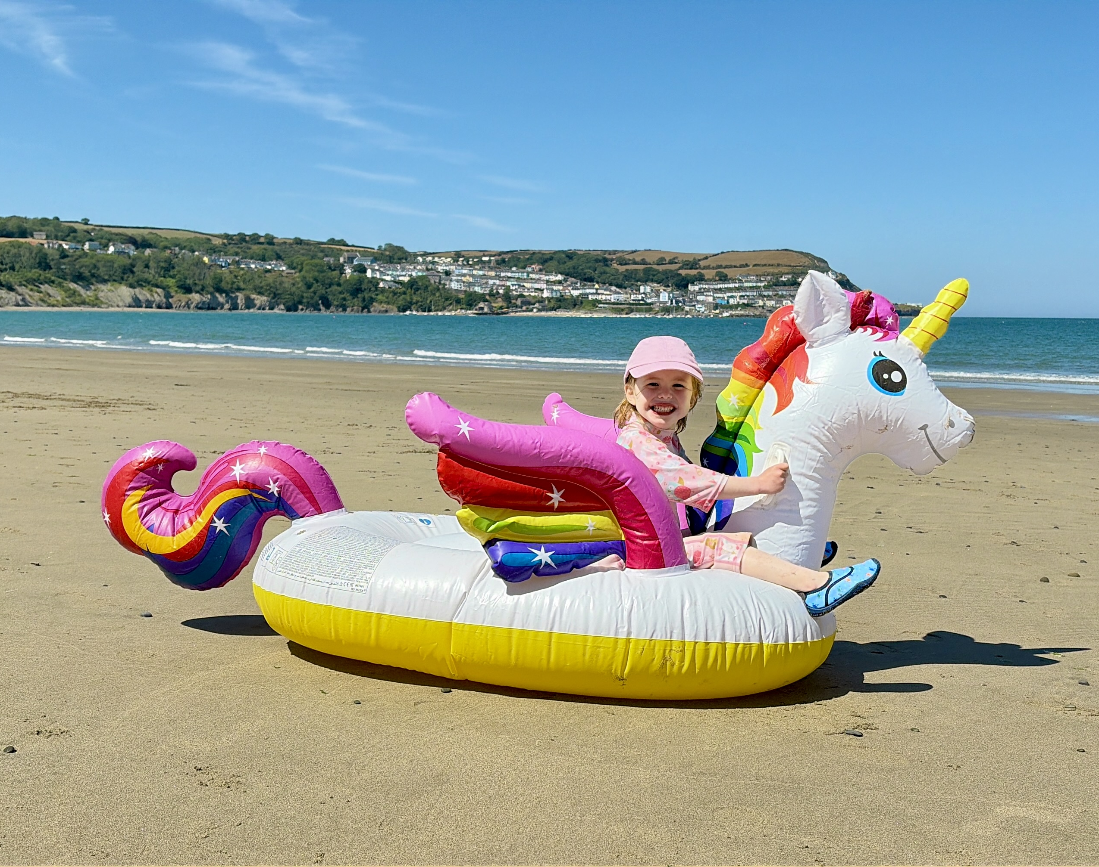
A bit about me…
Working in schools for 15 years
Teaching for 12 years
EYFS, KS1 and KS2
Active learning
Brain breaks (for me and the children!)

Slide 4
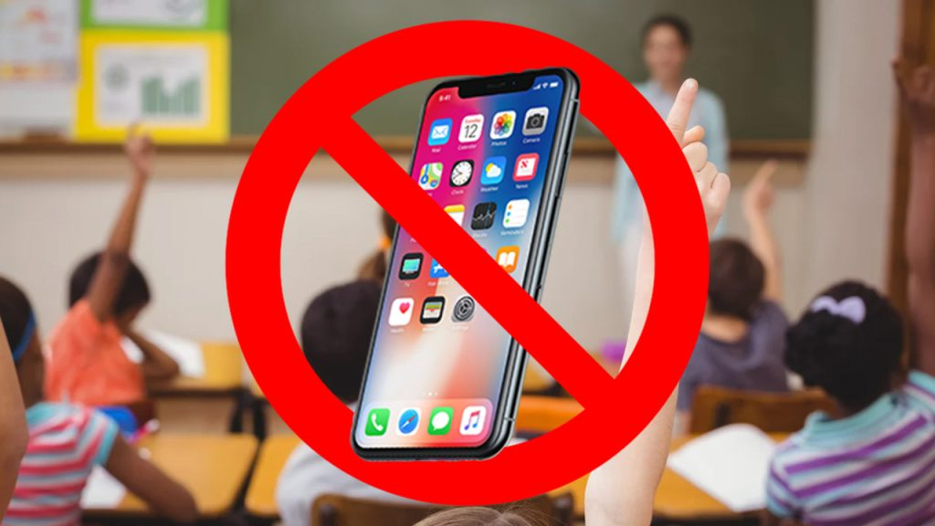

Mobile Phone Free Schools
From 1 September 2026, schools must follow the DfE's statutory guidance on mobile phones. This requires schools to have a policy that prohibits pupils from using or accessing mobile phones throughout the school day, including during lessons, between lessons, breaktimes and lunchtime.
Notes:
Discuss with staff what this means to them. Do they know schools response and what the policy says – which policy is this included in? Have they given consideration to medical pupils or pupils who use communication devices or assistive technology
What do your school do?
Is the policy published on your school website

Slide 5
The Curriculum
Information about the Year 4 curriculum will be available on our Class Page on the school website.
https://www.st-clares.lancs.sch.uk/elder - more on the following slide
English and maths will be taught in the mornings, foundation subjects taught in the afternoons.
P.E. is on Thursday afternoons so the children need to come in their P.E. kits every Thursday.
  Please ensure earrings are removed and long hair is tied back. If your child requires an inhaler, please make sure it is clearly named and in date.

Slide 6
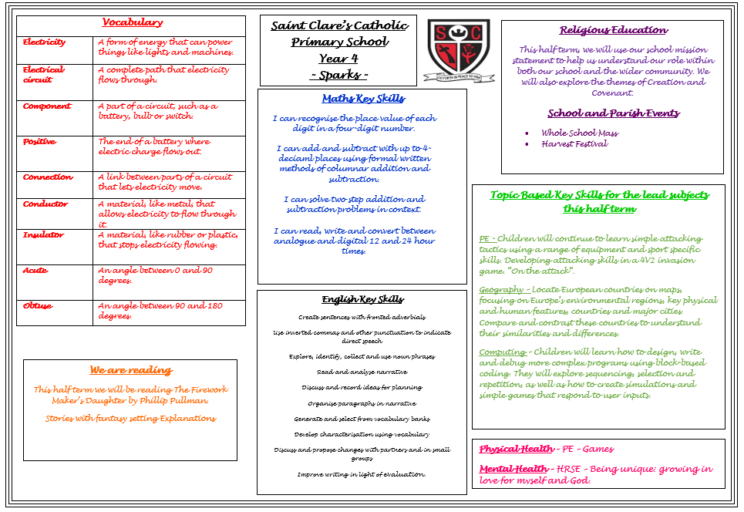

Slide 7
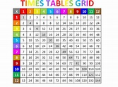
Times tables
Statutory tests in times tables will take place in Year 4. The link below is a great way to practise and get a better understanding of the times table you’re on. It is also good to start to practise mixed times tables to get the exposure and gain confidence.
https://www.timestables.co.uk/
Times tables tests will take place every Friday. The expectation is that all children should know by heart up to and including 12 x 12 by the end of Year 4.
In class, the children will be practising and using their times tables in maths lessons and practice in class.

Slide 8
Reading – Why?
Research shows that by age 5, children who are read to daily may hear about
296,660 more words than a child who is never read to, a gap that can reach over
a million words when comparing those read to extensively to those who aren’t
read to at all.
The frequency of reading significantly impacts the number of
words a child hears, with daily reading leading to an exponentially larger
vocabulary exposure compared to infrequent reading sessions. This "million word
gap" contributes to easier vocabulary acquisition and better reading development
in school.

Slide 9

Reading
Regular reading and discussion are vital.
In school, children enjoy class novels, guided reading and individual books.
At home, children should read for around 30 minutes each night, with time to talk about what they’ve read.
Ask open questions that encourage explanation, inference and evidence from the text.
Some helpful prompts are included in their reading diaries.

Slide 10

Spellings
Spelling should be steadily improving as a result of frequent reading.
In class, children will be exploring spelling patterns, rules and exceptions in their grammar sessions.
To support work in class, the children will receive spelling sheets each half term. These show which spellings your child needs to learn each week.
Spellings will be tested every Friday.
  If your child struggles with spelling, encourage them to break the word up, use their phonics and look for any spelling patterns, prefixes and suffixes.
  Dictionaries are a good support for spelling and in acquiring new vocabulary.
  Try using mnemonics or making a ‘tricky words’ poster for the wall!

Slide 11

Homework
Children are expected to read daily and practise their spellings and multiplication facts regularly (https://urbrainy.com/mtc)
Each week, I will set a piece of English and Maths homework. This will be given out on a Monday and is to be handed in on the following Monday.
  If your child has difficulty with any homework, please annotate the homework so that we are aware. We can then find time to go over any misunderstandings.
  We are always pleased to receive any extra homework that children have chosen to do themselves in response to current class topics!

Slide 12
Lets Go Sing
March- Let’s Go Sing
June 2026 - Swimming
Other trips throughout the year – dates TBC

Slide 13
HRSE
HRSE stands for Human Relationships and Sex Education.
This subject was made statutory in 2020 and is especially important after the pandemic as it relates to children’s relationships with themselves, others and God.
We have incorporated PSHE objectives into our HRSE curriculum to ensure all children have the skills and understanding to lead confident, healthy and independent lives, building on their relationships with God and others.
Please see the HRSE section on the school website for more information about this.

Slide 14
HRSE Continued
HRSE stands for Human Relationships and Sex Education.
It has recently been updated for 2026-2027. These updates will be taught in the next academic year and continue to be vital as HRSE relates to children’s relationships with themselves, others and God and keeping themselves safe and healthy.
This year we have made the decision to use TenTen:Life to the Full, in order to support our teaching of HRSE. You will be provided with a parent link so that you can access this excellent resource at home through their Parent Portal.
The Online Parent Portal is a tool that provides you with information about the programme content that your children will be following in school. You can also access suggestions for further activity and discussion at home linked to the sessions taught in school.
Please see the HRSE section on the school website for more information about this. If you have any questions, please don't hesitate to ask.
Username: parents-st-clares-catholic-primary-school
Password: StClare’s
Parent Portal: https://www.tentenresources.co.uk/parent-portal/

Slide 15


Slide 16
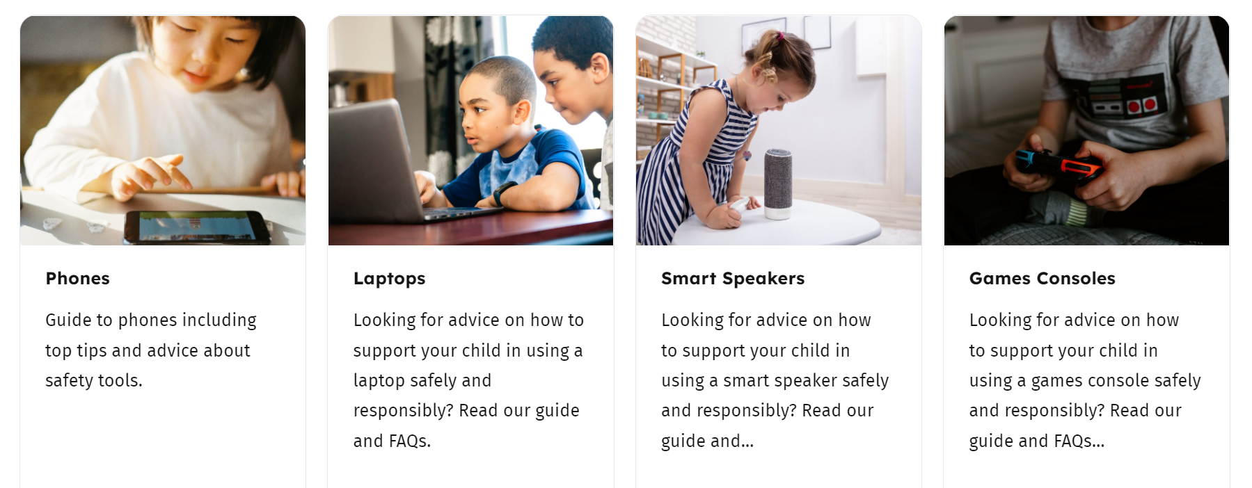
Online Safety
Please use the link to our online safety page. Here you will find useful links for parents and carers:
https://st-clares.lancs.sch.uk/computing/
https://saferinternet.org.uk/guide-and-resource/parents-and-carers
We also email a newsletter to parents and carers every month.

Slide 17
Other Information
Finally, we very much value the partnership we have with parents and we are always happy to discuss any further queries you may have.
Many thanks for your continued support.

Slide 18
Any Questions?

