Slide 1

Welcome to Hazel Class
Miss Scott
Mr Boardman
Mrs Dahiru
Mrs Noonan
St Clare’s Catholic Primary School

Slide 2
Timetable

Slide 3
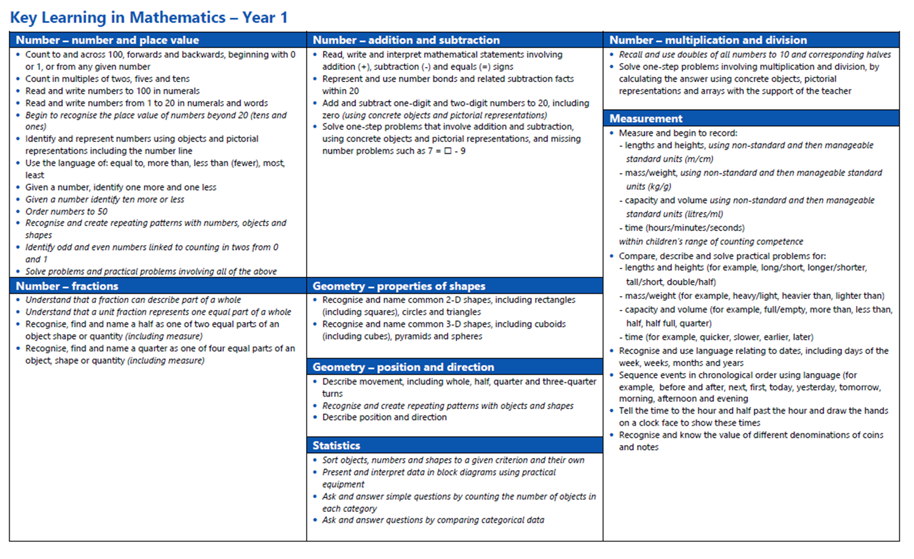

Curriculum
Year 1 Maths

Slide 4
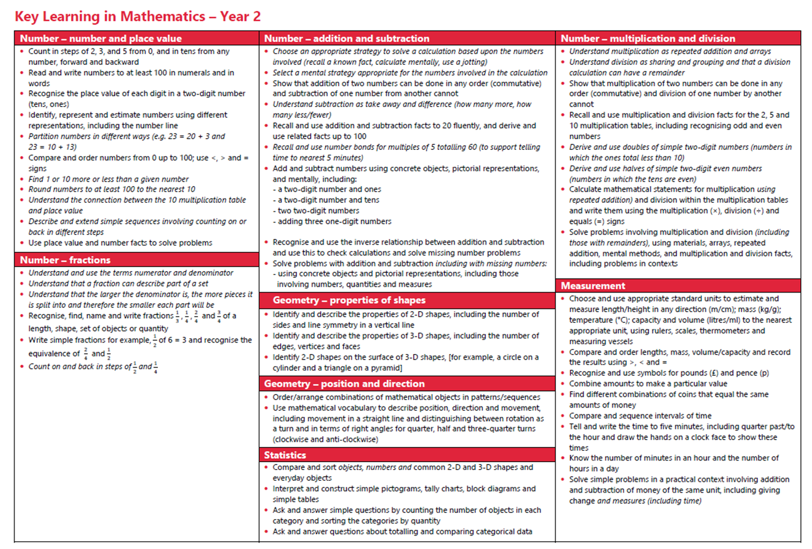

Slide 9
Homework
Reading books will be sent home every Tuesday and Friday
Please read with your child and sign the diary to say the book has been read so we can change it for a new one.
Every two weeks there will be a piece of ‘Talk Homework’ published on our class page. Please discuss the questions with your child and your family. It doesn’t have to be returned to school.
Homework and spellings are sent in a half termly pack.
Please help your child to complete one page a week and learn the weekly spelling list. Please return the whole pack each Friday so homework can be marked and spellings checked.

Slide 10
Assessment
Year 1 Phonics Screening takes place in June
Child is asked to read a series of real and non-sense words by a teacher they are familiar with.
The child’s score is recorded and the information is sent to DfE.
The DfE then calculate a pass score which is usually 32 out and 40.
Year 2 SATS papers in reading, mental arithmetic, maths reasoning and spelling and grammar are now optional
Assessments will be carried out as in other year groups but the results are not sent to DfE

Slide 11
Extra Information
No nuts or contains nuts food items
Please send in a water bottle with your child’s name on (with water in and not juice)
Inhalers please send in with your child’s name on and how often they may need it
Sun cream and sun hats can be sent in with your child’s name on
Website is full of information and pictures weekly
Please no jewellery and just small earring studs
Individual and class photos 2nd and 3rd October
Open day 9th October
Harvest Service 24th October
Online safety –webpage information and monthly newsletter

Slide 12
Thank You
Any questions?

