Slide 1

Welcome to Hazel Class
Miss Scott
Mr Boardman
Mrs Noonan
St Clare’s Catholic Primary School

Slide 2
Timetable
 | 8.45am-9.00am | 9.00am-9.10am | 9.10am-9.30am | 9.30am-10.30am | 10.45am-11.45am | 11.45-12pm | 1pm-2.00pm |  | 2.15pm-3pm | 3pm-3.20pm
Mon | Morning Activities | Register | Phonic groups | Y1 English Y2 English | Y1 Maths Y2 Maths | Story Time | Spelling -Readers | Guided Reading | Topic
Tues Change Reading Books Homework marked | Morning Activities | Register | Phonic groups | Y1 English Y2 English | Y1 Maths Y2 Maths | Story Time | Spelling -Readers | Guided Reading | Topic
Wed | Morning Activities | Register | Phonic groups | Y1 English Y2 English | Y1 Maths Y2 Maths | Story Time | Spelling -Readers | Guided Reading | Topic
Thurs | Morning Activities | Register | Phonic groups | Y1 SPAG English Y2 SPAG English | Y1 Maths Y2 Maths | Y1 R.E Input Y2 R.E Input | Spelling HRSE | Guided Reading | Y1 R.E Y2 R.E
Fri Change Reading Books | Morning Activities | Register | P.E | P.E | Y1 Maths Y2 Maths | Story Time | Spelling -Computing | Computing | Spelling Test | Assembly

Slide 3
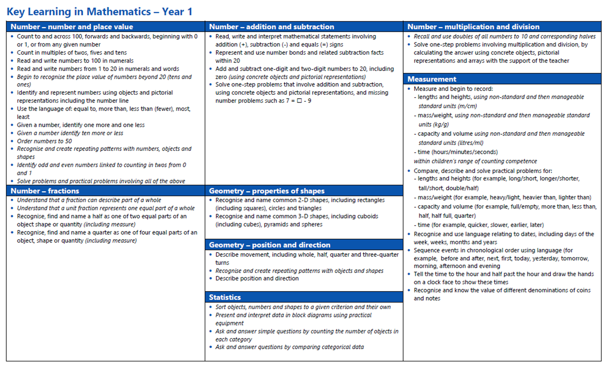

Curriculum
Year 1 Maths

Slide 4
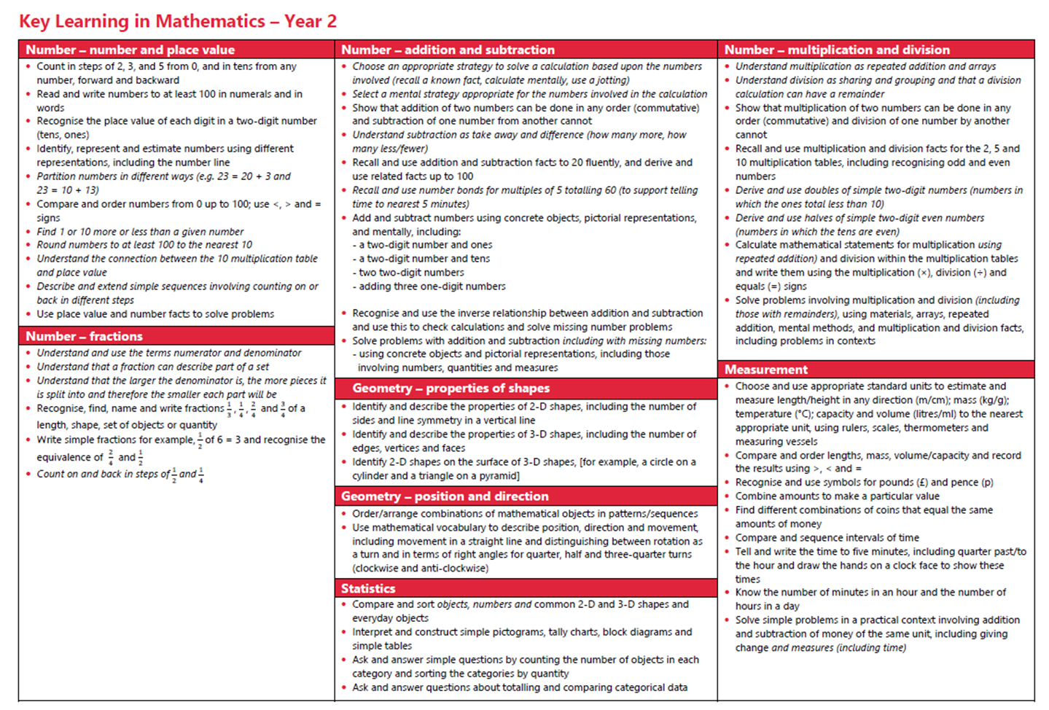

Slide 5
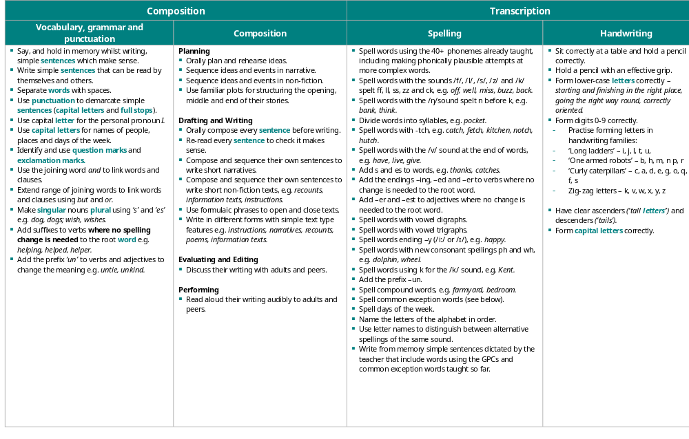

Slide 6
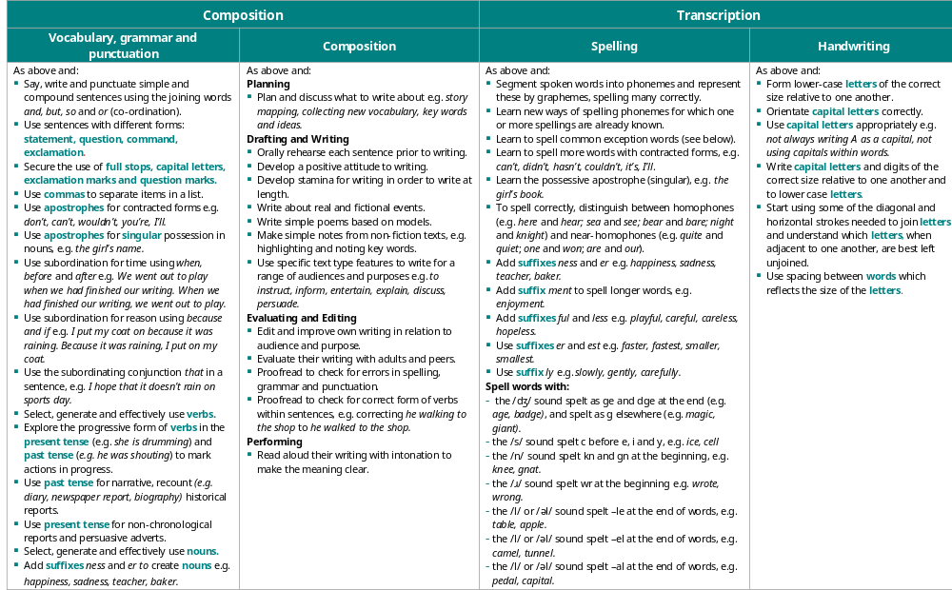

Slide 7
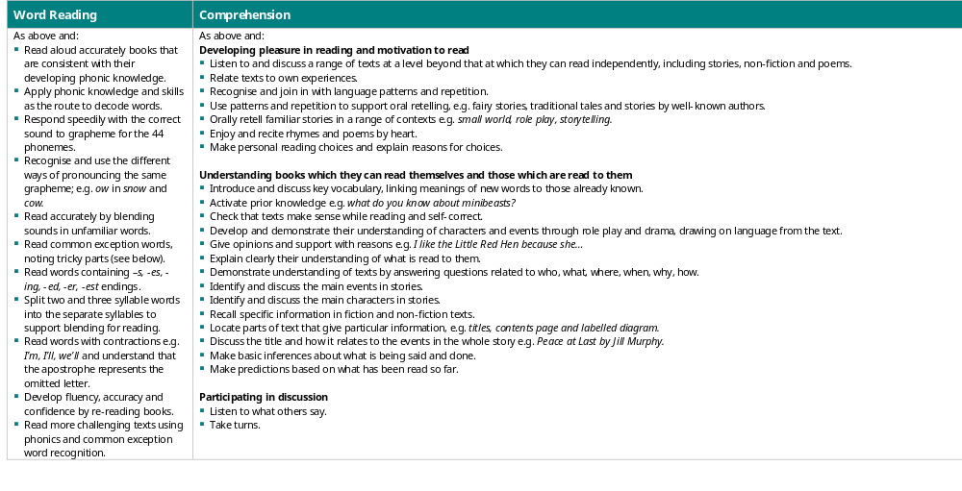

Slide 8
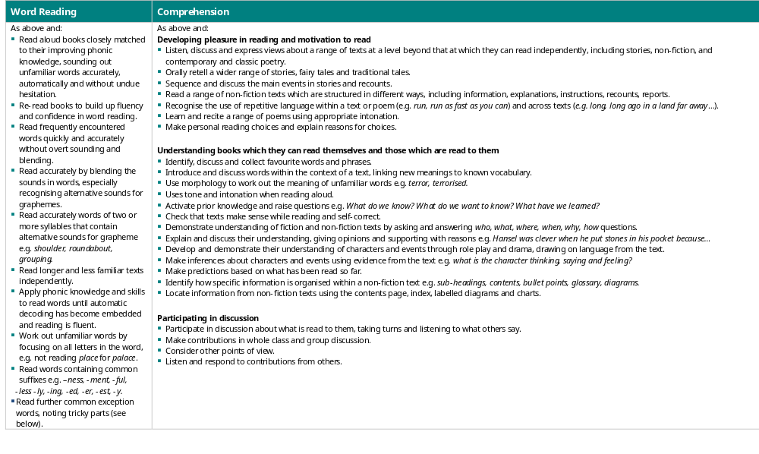

Slide 9
Homework
Reading books will be sent home every Tuesday and Friday
Please read with your child and sign the diary to say the book has been read so we can change it for a new one.
Every two weeks there will be a piece of ‘Talk Homework’ published on our class page. Please discuss the questions with your child and your family. It doesn’t have to be returned to school.
Homework and spellings are sent in a half termly pack.
Please help your child to complete one page a week and learn the weekly spelling list. Please return the whole pack each Tuesday so homework can be marked
Spellings will be checked every Friday.

Slide 10
Assessment
Year 1 Phonics Screening takes place in June
Child is asked to read a series of real and non-sense words by a teacher they are familiar with.
The child’s score is recorded and the information is sent to DfE.
The DfE then calculate a pass score which is usually 31/32 out and 40.
Year 2 SATS papers in reading, mental arithmetic, maths reasoning and spelling and grammar are now optional
Assessments will be carried out as in other year groups but the results are not sent to DfE

Slide 11
Extra Information
No nuts or contains nuts food items
P.E is on Fridays
No smart watches
Please send in a water bottle with your child’s name on (with water in and not juice)
Inhalers please send in with your child’s name on and how often they may need it
Sun cream and sun hats can be sent in with your child’s name on
Website is full of information and pictures weekly
Please no jewellery and just small earring studs
Individual and class photos 5th October
Open day 8th October
Harvest Service 23rd October
Online safety –webpage information and monthly newsletter

Slide 12
HRSE
HRSE stands for Human Relationships and Sex Education.
It has recently been updated for 2026-2027. These updates will be taught in the next academic year and continue to be vital as HRSE relates to children’s relationships with themselves, others and God and keeping themselves safe and healthy.
This year we have made the decision to use TenTen:Life to the Full, in order to support our teaching of HRSE. You will be provided with a parent link so that you can access this excellent resource at home through their Parent Portal.
The Online Parent Portal is a tool that provides you with information about the programme content that your children will be following in school. You can also access suggestions for further activity and discussion at home linked to the sessions taught in school.
Please see the HRSE section on the school website for more information about this. If you have any questions, please don't hesitate to ask.
Username: parents-st-clares-catholic-primary-school
Password: StClare’s
Parent Portal: https://www.tentenresources.co.uk/parent-portal/

Slide 13
Thank You
Any questions?

