Slide 1
Welcome Back
Miss Scott
Mr Boardman
Mrs Dahiru
Mrs Noonan
St Clare’s Catholic Primary School

Slide 2
Hello
Welcome back and it is lovely to see you all. It is great to be back!
Thank you for lovely cards, cakes and presents.

Slide 3
Routine
Book changing days Monday and Fridays. Each time your child will receive 2 books ( 4 each week).
One piece of homework each week either maths or English in homework book. Homework sent back to school each Friday.
Spellings for each week in front of homework book and will be checked each Friday.
P.E still on Fridays.
Forest School for Year 1 every Tuesday, please bring in £1.
Notes:
LCC picked up our attendence was not high enough, therefore push on attendance.
FINES: 5 days or 10 sessions in 1 term or 7 days or 14 sessions over 2 terms.
Phonics handout – go into more detail on next slide.

Slide 4
What is new?
Forest school sessions for each year one child and you should have received the letter. Forest school is led by Mrs Lee and supported by Mr Boardman. It is an outdoor education approach where learners develop confidence, self-esteem, and skills through regular, hands-on experiences in natural settings. It focuses on play, supported risk-taking, and learner-led exploration, fostering connection to nature and independence
Reading comprehension tasks for homework and we will be including comprehension bookmarks to support reading with your child.
Maths problems keyrings will be sent home to help children memorise simple number facts.

Slide 5
Information
Phonics new sounds and moving on to alternative pronunciations. We will provide a mat to support work at home.
This is the technique for split digraphs.
Reading
-Look for e at the end and find its best friend
make
Writing
-Sound out the word, try and picture it does it have a split digraph?
-Write it and make sure the best friends are split up by the last sound.

Slide 6
Children also need to be able to read nonsense words such as sprine.
We are preparing for phonics screening for year 1 and any year 2 children that required further support.

Slide 7

National Year of Reading 2026
2026 is the National Year of Reading. Each month throughout the year we are going to have a reading themed activities. To kick start this year, we are running a competition - asking each child to take a picture of themselves, reading their favourite book, in an unusual place.
Along with the picture, we would like a mini review - 1/2 sentences saying why they like this book and why they would recommend it.
Details of where to email photos, will be sent out via Arbor, can be found on this weeks Newsletter or on our social media feeds, once launched
Competition closing date: Friday 23rd January
Prizes - book vouchers will be rewarded to the most imaginative pictures.
Details of future events to follow.

Slide 8

National Numeracy Challenge
The National Numeracy Strategy is to help your child to enjoy maths through engaging activities that are done together with an adult.
How can you help?
Our first impressions of maths and numbers were influenced by the grown-ups around us. We can make sure our children have a positive introduction to numbers even if we didn’t. Here are the National Numeracy’s Top Tips.
If you have any questions or feedback, please speak to your class teacher at the end of the meeting. Positive or negative comments are welcome as it helps us to report back to the National Numeracy Strategy team.

Slide 9

click to see all text
Reading
Year 2 SATs
The Reading Test consists of two separate papers:
Paper 1 – consists of a combined reading prompt and answer booklet.
Paper 2 – consists of an answer booklet and a separate reading booklet.
The texts will cover a range of poetry, fiction and non-fiction.
The Reading Test consists of two separate papers:
Paper 1 – consists of a combined reading prompt and answer booklet. The paper includes a list of useful words and some practice questions for teachers to use to introduce the contexts and question types to pupils. The test takes approximately 30 minutes to complete, but is not strictly timed.
Paper 2 – consists of an answer booklet and a separate reading booklet. There are no practice questions on this paper. Teachers can use their discretion to stop the test early if a pupil is struggling. The test takes approximately 40 minutes to complete, but is not strictly timed.
The texts will cover a range of poetry, fiction and non-fiction.

Slide 10
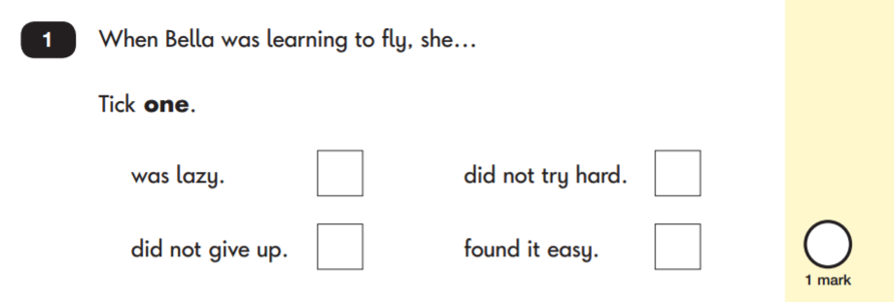
Reading: Sample Questions
Questions are designed to assess the comprehension and understanding of a child’s reading.
There are a variety of question types:
Multiple Choice

Slide 11
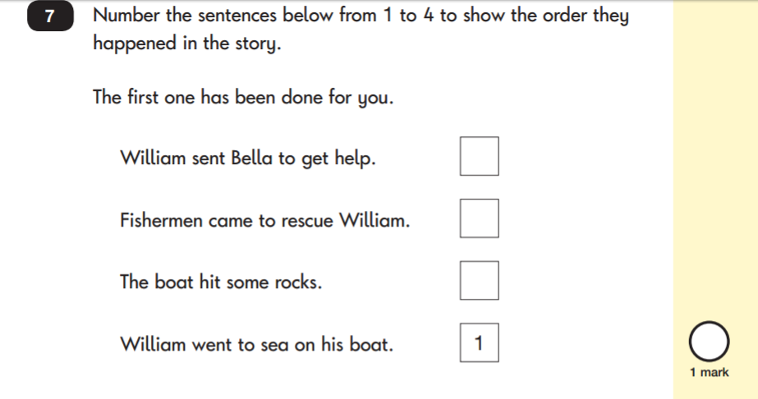
Reading: Sample Questions
Ranking/Ordering

Slide 12
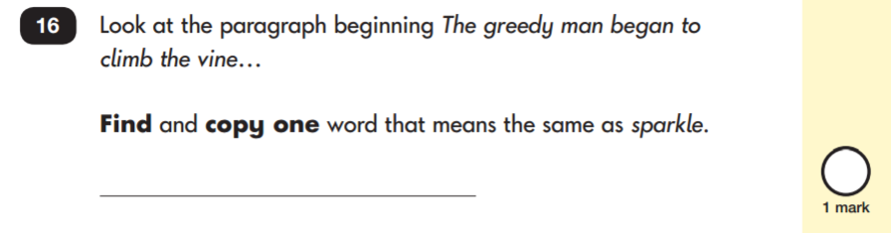
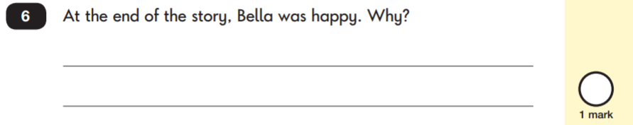
click to see all text
Reading: Sample Questions
Find and Copy Questions
Open-Ended Questions

Slide 13
Spelling, Punctuation and Grammar
The test consists of two separate papers:
Paper 1: Spelling - pupils to spell 20 missing words within a test booklet..
Paper 2: Grammar, Punctuation and Vocabulary - a combined question and answer booklet focusing on pupils’ knowledge of grammar, punctuation and vocabulary.

Slide 14
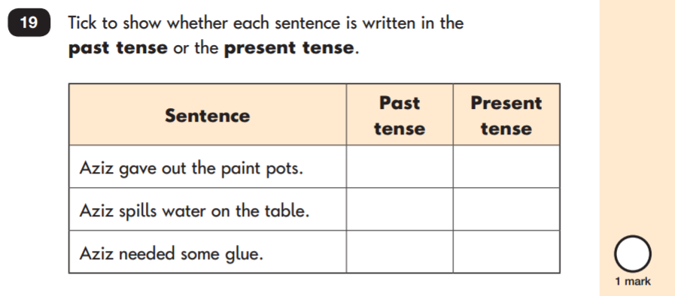
Grammar, Punctuation & Spelling: Sample Questions
Grammar, Punctuation and Vocabulary Paper

Slide 15
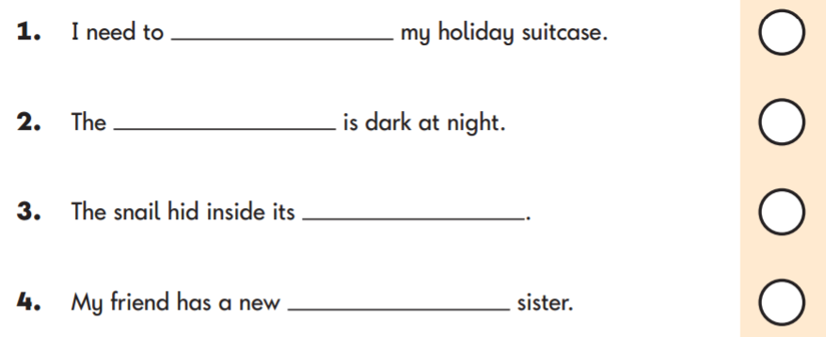
Grammar, Punctuation & Spelling: Sample Questions
Spelling Paper
Within the assessment, the spelling words are read out to the children to fill into the gaps within the sentences. In this example, the missing spelling words are: pack, sky, shell and baby.

Slide 16
Mathematics
Children will sit two tests: Paper 1 and Paper 2:
Paper 1: Arithmetic -
Paper 2: Reasoning -.

Slide 17
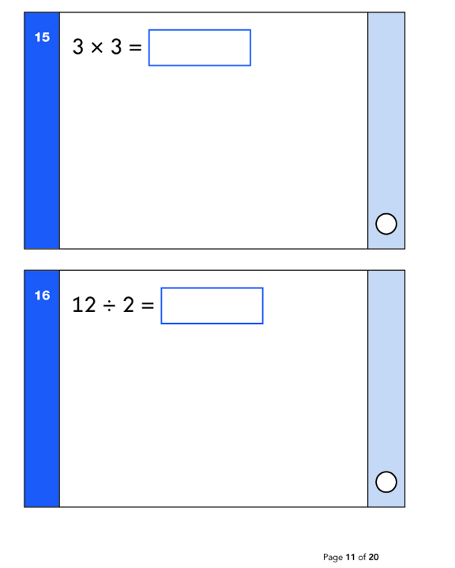
Mathe: Sample Questions
Maths Paper 1: Arithmetic

Slide 18
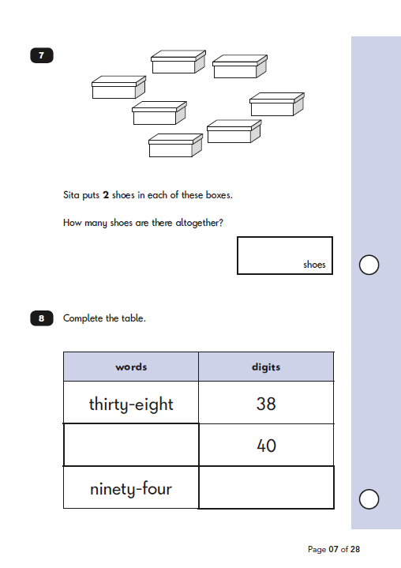
Maths: Sample Questions
Maths Paper 2: Reasoning

Slide 19
Dates for the diary
5th March World Book Day

Slide 20
How can you help at home?
Read, Read, Read!
Discussion using bookmark
Encourage children to speak in full sentences.
Maths flashcards
Complete homework tasks
Ensure your child has the best possible attendance at school.

Slide 21
Thank You
Any questions?

