Slide 1
Mathematics
Webpage in Curriculum in Maths folder provides
-a list of key learning for EYFS
-policies that model how to support your child

Slide 2
What are we working on…
Mathematics Children at the expected level of development will:
Children count reliably with numbers from 1 to 20,
Place 1-20 in order
Say which number is one more or one less than a given number.
Using quantities and objects, they add and subtract two single-digit numbers and count on or back to find the answer.
They solve problems, including doubling, halving and sharing.
They recall number facts.
They recognise odd and even numbers.

Slide 3
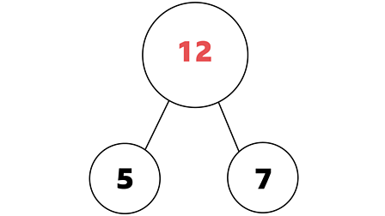
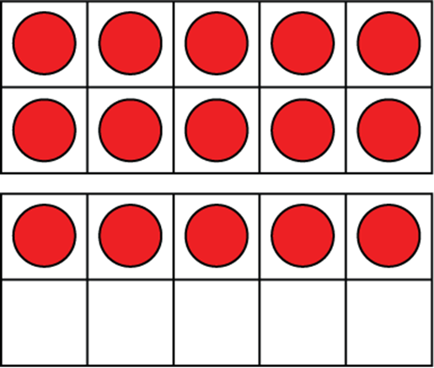
What to do at home
Count everything!
Look for numbers in the environment, houses, bus numbers, signs etc… with a focus on teen numbers
Talk about what makes up the numbers

Slide 4
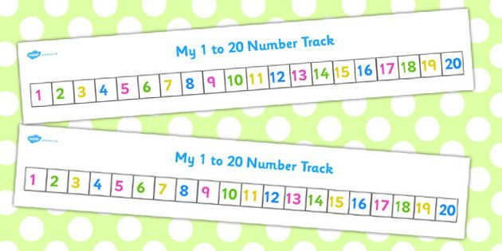

Ask what is one more or one less
Use objects to add, take away

Slide 5
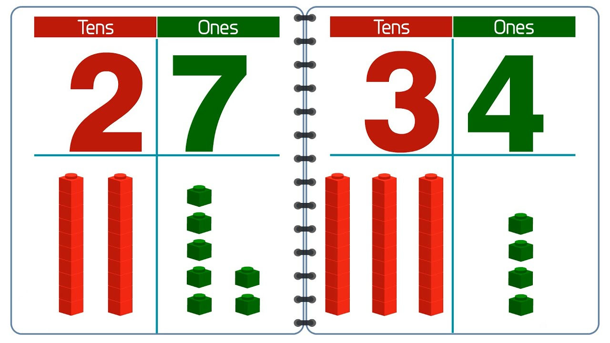
Ask what the different teen numbers are out of sequence
Ask how many tens and ones are making up a number

Slide 6



Ask your child what numbers can you add together to make ten? Can they sing the number bond song?
Talk about odd and even numbers, even numbers can be partners and odd numbers one is always alone.

Slide 7


Talk about size, weight, capacity, position, distance, time and money to compare quantities and objects.

Slide 8
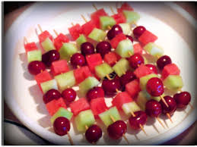
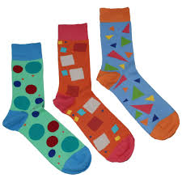
Recognise, create and describe patterns.
Talk about and name the different shapes around us.

Slide 9
Thank You
Any questions?

