Slide 1
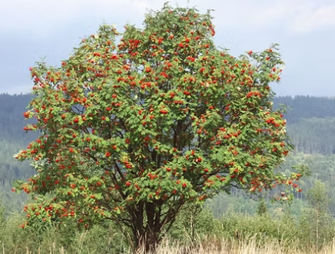

Rowan Class
Mrs. Clack (Class Teacher)
Mrs. Donaldson (Higher Level Teaching Assistant)
Miss. Lowe (Teaching Assistant)
Miss. Clarkson (Teaching Assistant)
Mrs. Hobbs (Teaching Assistant)
St. Clare’s Catholic Primary School

Slide 2
A warm welcome…
It has been wonderful to welcome your children into our family here at St. Clare’s Catholic Primary School. Their first year at school marks the beginning of a new and exciting academic year, along with all the learning opportunities, experiences and fresh challenges that it entails.
We are very much looking forward to working with you and your children, as they begin a new chapter of their educational journey.
Play, learn and grow together with Christ

Slide 3
Seven areas of learning
These are the different topics we cover throughout the year.
Three Prime Areas:
Communication and Language
Physical Development
Personal, Social and Emotional Development
Four Specific Areas:
Literacy
Mathematics
Understanding the World
Expressive Arts and Design

Slide 4
Characteristics of Effective Learning
These are the skills we encourage the children to demonstrate:
• Playing and exploring – children investigate and experience things, and ‘have a go.’
• Active learning – children concentrate and keep on trying if they encounter difficulties and enjoy achieving.
• Creating and thinking critically – children have and develop their own ideas, make links between ideas and develop strategies for doing things.
Each half term a planner is available on our webpage, that explains in more detail what we will be learning.
https://st-clares.lancs.sch.uk/rowan/

Slide 5
HRSE stands for Human Relationships and Sex Education.
It has recently been updated for 2026-2027. These updates will be taught in the next academic year and continue to be vital as HRSE relates to children’s relationships with themselves, others and God and keeping themselves safe and healthy.
This year we have made the decision to use TenTen:Life to the Full, in order to support our teaching of HRSE. You will be provided with a parent link so that you can access this excellent resource at home through their Parent Portal.
The Online Parent Portal is a tool that provides you with information about the programme content that your children will be following in school. You can also access suggestions for further activity and discussion at home linked to the sessions taught in school.
Please see the HRSE section on the school website for more information about this. If you have any questions, please don't hesitate to ask.
Username: parents-st-clares-catholic-primary-school
Password: StClare’s
Parent Portal: https://www.tentenresources.co.uk/parent-portal/

Slide 6
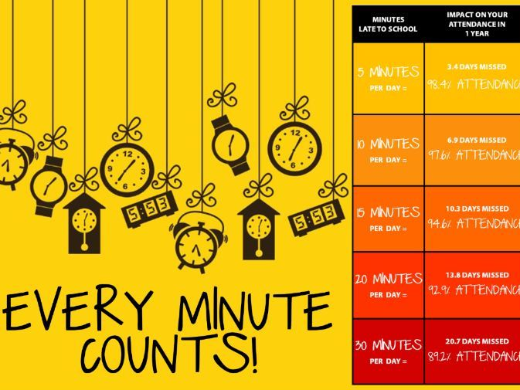

Slide 7
Daily Routine
The school gate opens at 8:40am
Children come in and spend time in the different areas and we have daily exercise challenges
Daily English and maths sessions
Daily guided snack and chat sessions
Daily phonics sessions
Understanding of the world, expressive art and design sessions
Notes:
Phonics handout – go into more detail on next slide.

Slide 8
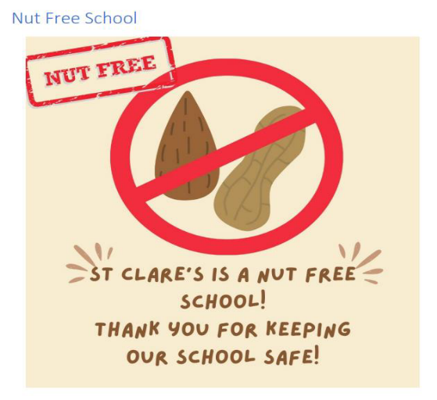
Lunchtime - children are supported and monitored by staff
Physical Education (P.E) sessions are every Thursday. Please send your child’s P.E kit in a bag and it will stay in school
P.E kit – Red logo t-shirt, black shorts, black pumps.
  Outdoor – St. Clare’s hoodie, black jogging pants
All hair tied back
Earrings removed
All items should be clearly named

Slide 9

Homework
Reading books will be sent home every Monday and Thursday. Please read with your child and sign their diary to say the book has been read so we can change it for a new one.
Later in the term, additional tasks will be sent home to support your child with their next steps for learning.

Slide 10
Extra Information
Please send in wellies with your child’s name on
Please send in a water bottle with your child’s name on (with water in and not juice)
Inhalers - please send in with your child’s name on and how often they may need it
Sun cream and sun hats can be sent in with your child’s name on
Please sign up for the school app (Arbor)
Please no jewellery and just small earring studs
Another date for the diary, coffee morning to raise
money for MacMillan Cancer Support, Monday 28th September
Phonics parent workshops – Autumn 2026
Online safety –webpage information and monthly newsletter
Please use the link to our online safety page. Here you will find
useful links for parents and carers:
https://st-clares.lancs.sch.uk/computing/

Slide 11
Finally, we very much value the partnership we have with parents and we are always happy to discuss any further queries you may have.
Many thanks for your continued support.

Slide 12
Questions

