Slide 1


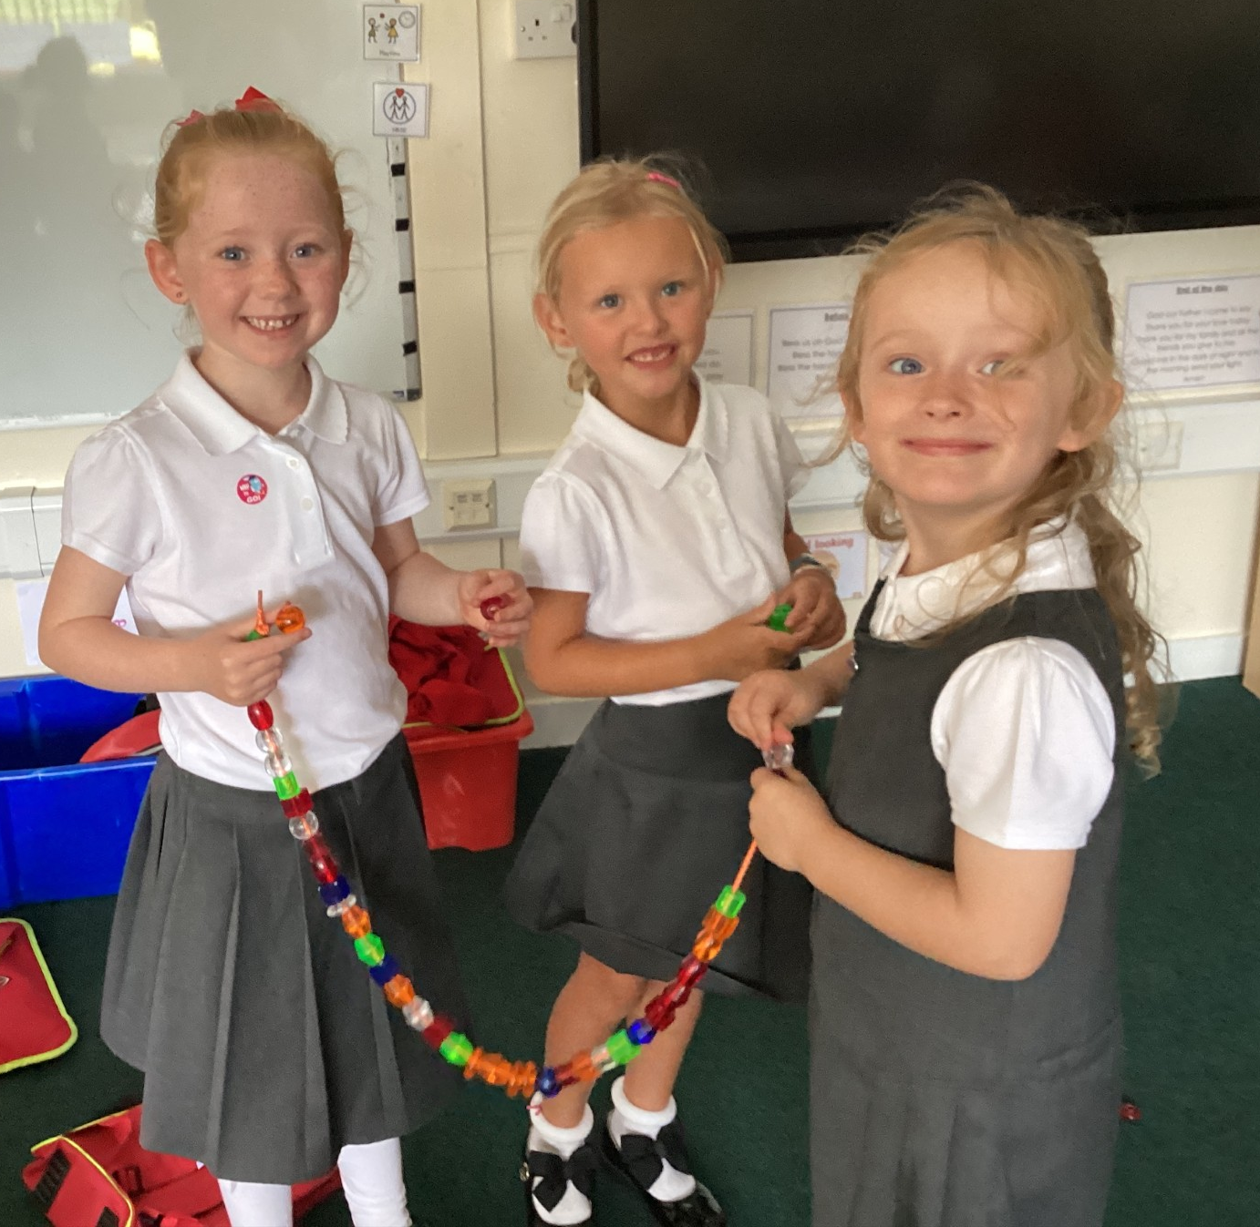
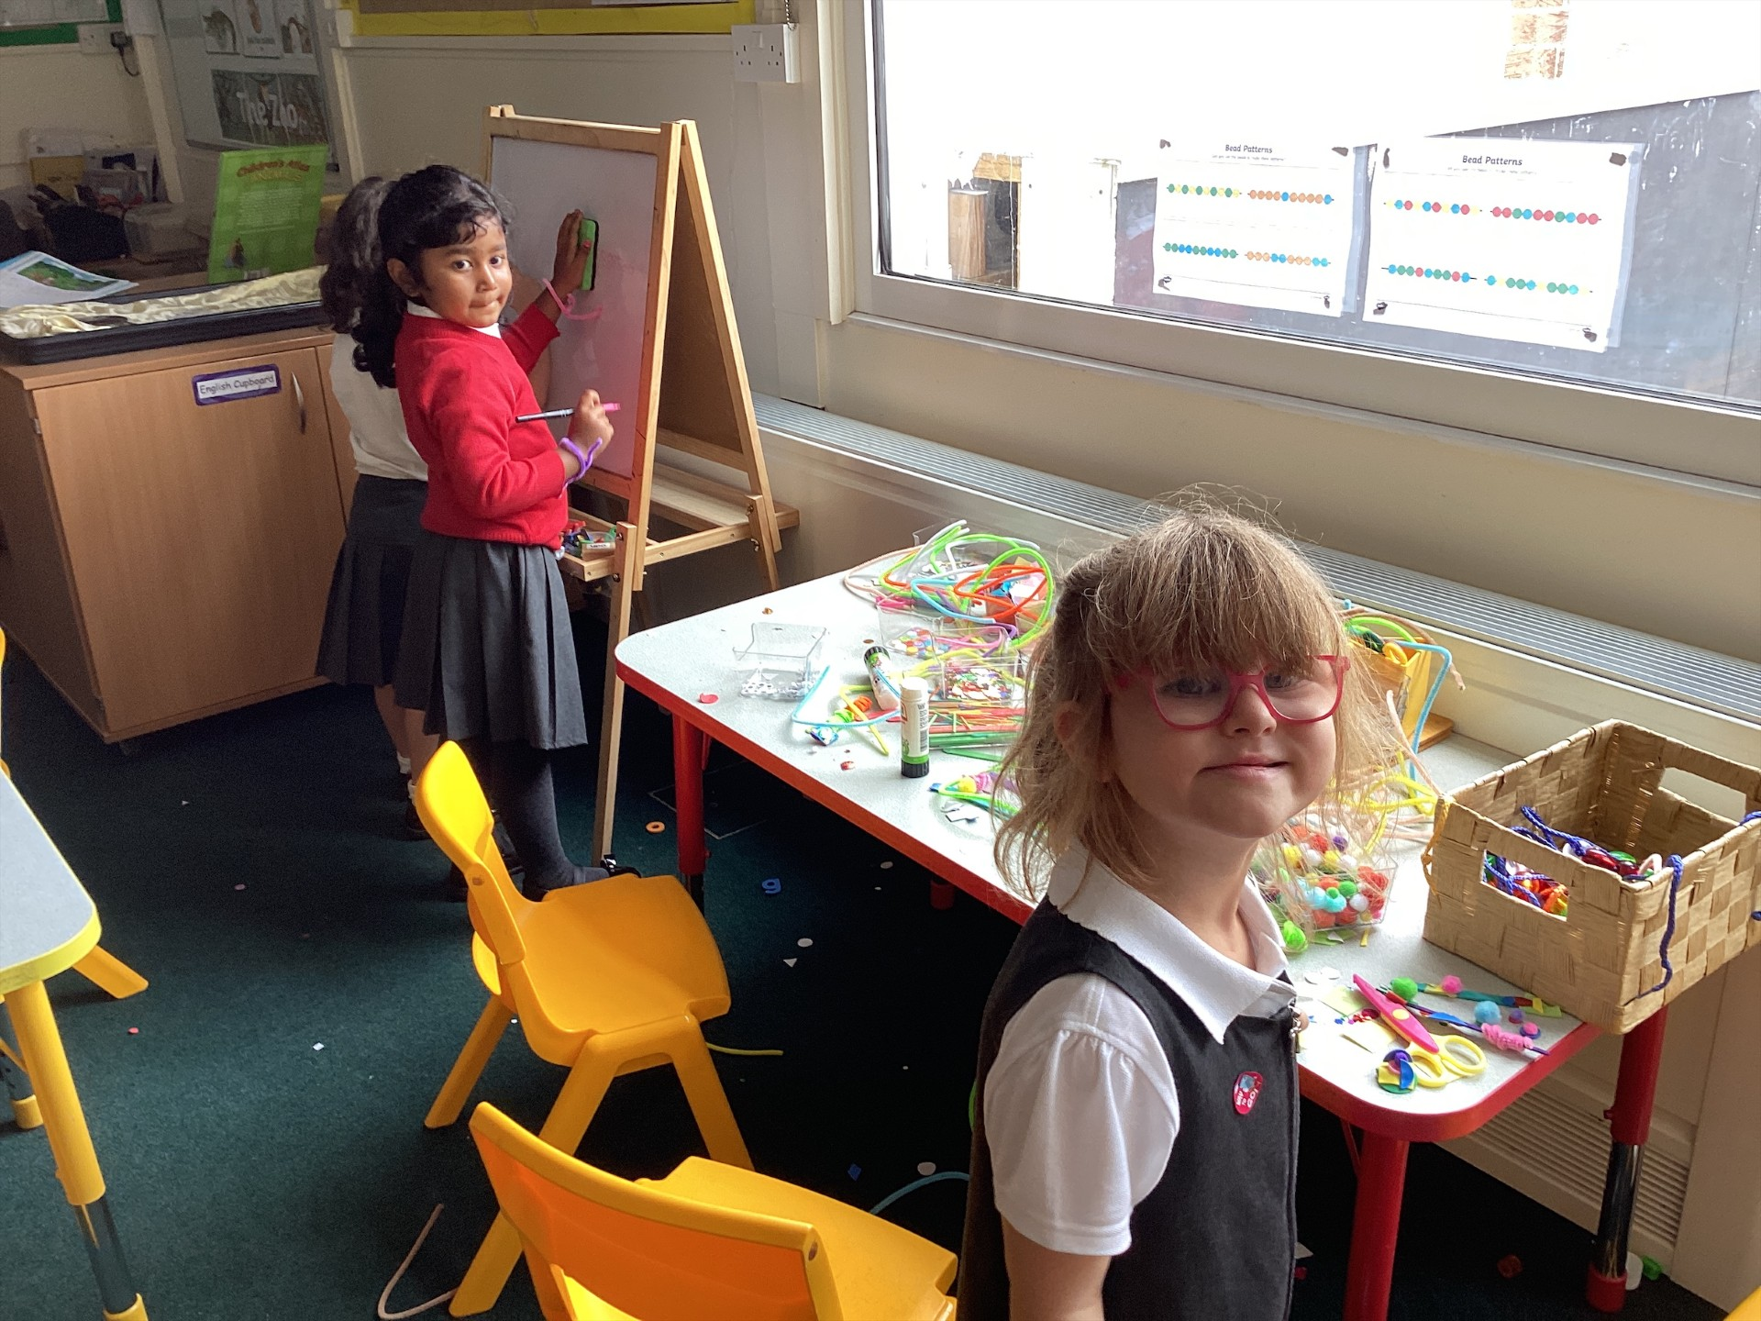
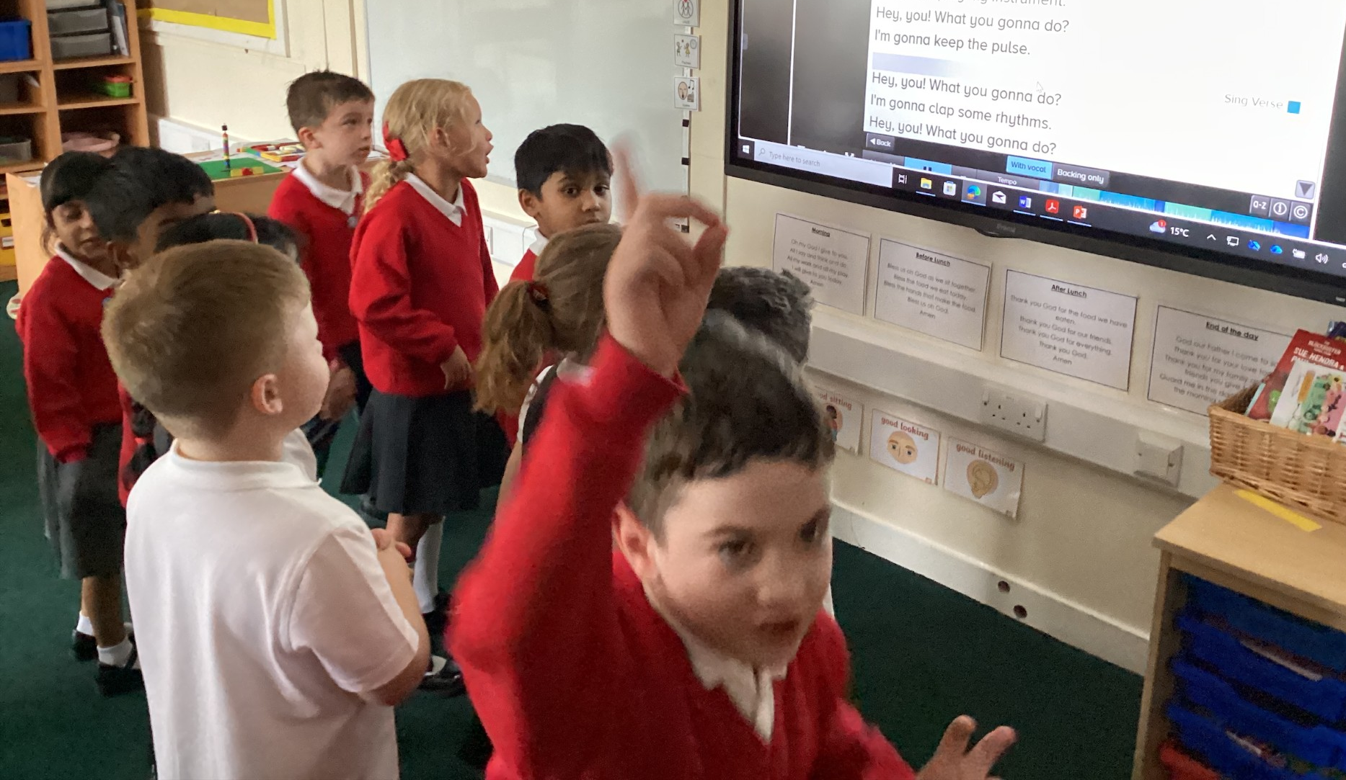
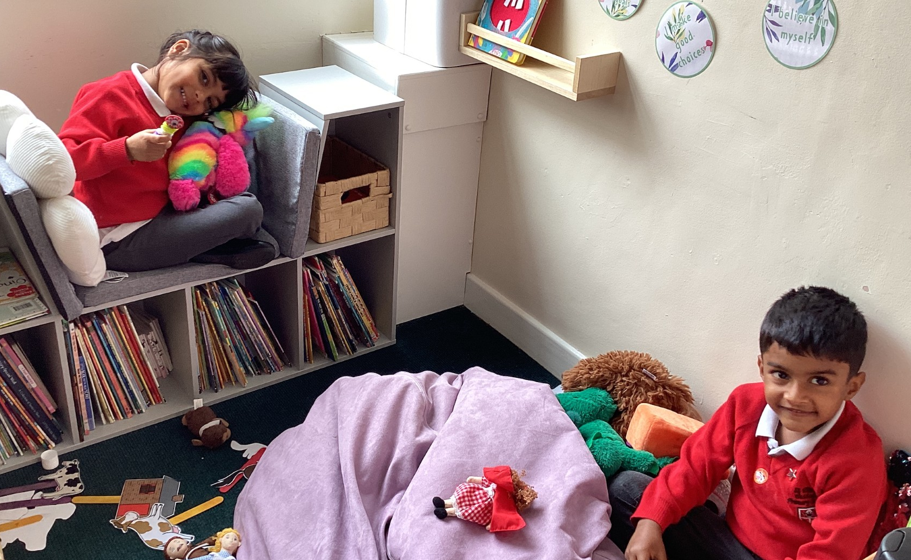
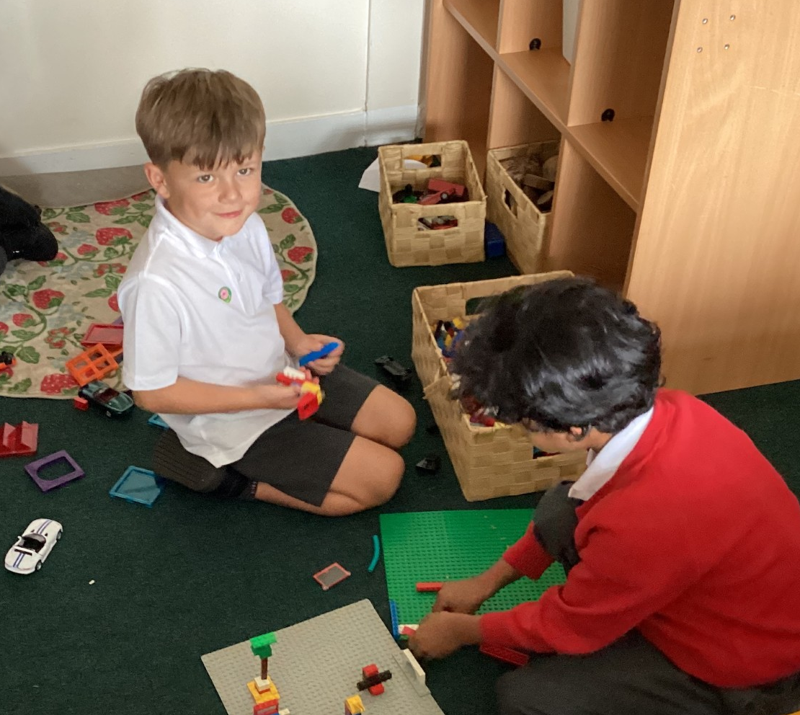
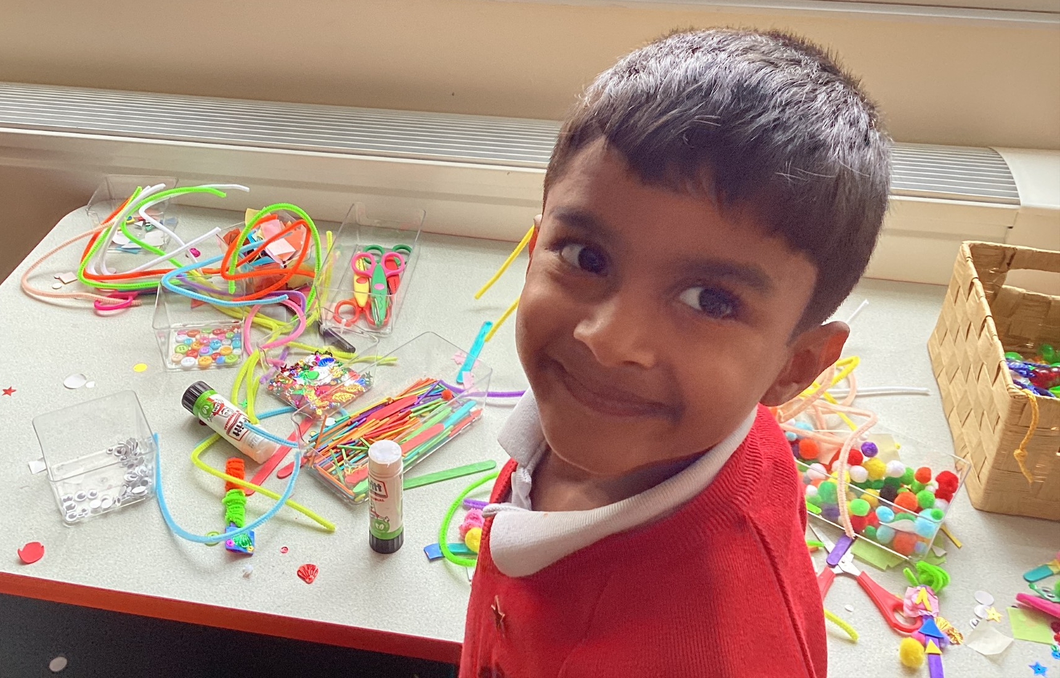
WELCOME TO WILLOW CLASS!
Miss Salt
Miss Martinez
PPA - Mrs Lee

Slide 2

A TYPICAL DAY:
8:40 - Doors open
  Phonics first thing!
  Daily English and Maths
  Topic subjects in the afternoon

Slide 3
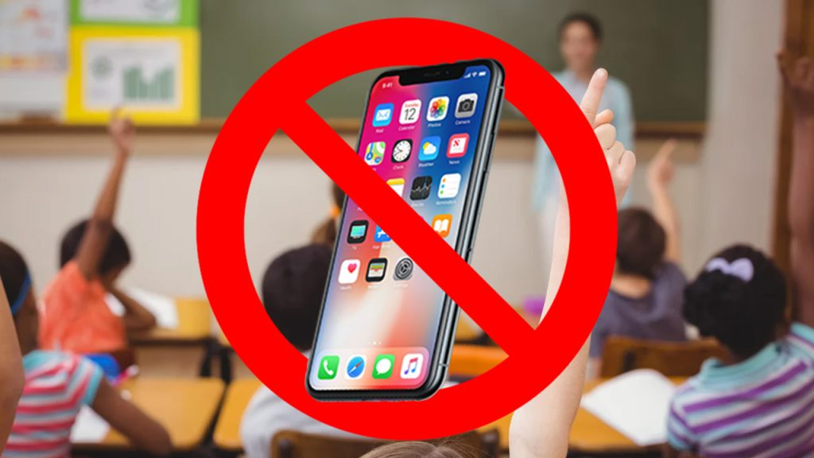

Mobile Phone Free Schools
From 1 September 2026, schools must follow the DfE's statutory guidance on mobile phones. This requires schools to have a policy that prohibits pupils from using or accessing mobile phones throughout the school day, including during lessons, between lessons, breaktimes and lunchtime.
Notes:
Discuss with staff what this means to them. Do they know schools response and what the policy says – which policy is this included in? Have they given consideration to medical pupils or pupils who use communication devices or assistive technology
What do your school do?
Is the policy published on your school website

Slide 4

PHONICS:
Sea
Cloin
Shup
Kite
  The phonics screening test takes place in June.
  They will be asked to read ‘real’ and ‘nonsense’ words.
  It will be administered by a different teacher that they are not familiar with.
  The pass rate changes every year but is usually around 32 out of 40.

Slide 5
HOW YOU CAN HELP AT HOME:
  Read, read, read! Aim to read with them everyday and ask them questions about what they’re reading.
  Encourage them to write - it can be anything (shopping lists, cards, poems, etc.)
  Playing I Spy - you could even adjust this to make it more phonics based, e.g. ‘I spy something containing the ‘oi’ sound.

Slide 6
PE
  PE lessons are every Tuesday afternoon.
  They will need to bring their PE top, red school hoodies, black shorts, and black PE pumps.
  Please no earrings for PE (at other times, one pair of plain stud earrings are allowed)
  Please label your PE kit and other school uniform items :)

Slide 7

HOMEWORK AND READING BOOKS:
  Reading books will be changed every Monday and Thursday. Please write a comment and sign their reading records every time you hear them read.
  There will be a variety of different homework tasks throughout the term and they will have clear instructions with it so you are able to effectively help your child. This will be given on a Wednesday and due back on the Monday.

Slide 8
OUR TOPICS THIS HALF-TERM:
  RE = Creation and covenant
  HRSE (Human Relationships and Sex Education) = Communicating our feelings, when to tell an adult, the groups we belong to, the roles within our family.
  English = Lost and Found (Oliver Jefferies) - stories, poems, and non-chronological reports
  Maths = recognising teen numbers, number bonds and subtraction facts to 20,
  Science = Animals
  Computing (Mrs Lee) = Grouping and Sorting
  Geography = Continents and Oceans

Slide 9
HRSE
HRSE stands for Human Relationships and Sex Education.
It has recently been updated for 2026-2027. These updates will be taught in the next academic year and continue to be vital as HRSE relates to children’s relationships with themselves, others and God and keeping themselves safe and healthy.
This year we have made the decision to use TenTen:Life to the Full, in order to support our teaching of HRSE. You will be provided with a parent link so that you can access this excellent resource at home through their Parent Portal.

Slide 10
HRSE
The Online Parent Portal is a tool that provides you with information about the programme content that your children will be following in school. You can also access suggestions for further activity and discussion at home linked to the sessions taught in school.
Please see the HRSE section on the school website for more information about this. If you have any questions, please don't hesitate to ask.
Username: parents-st-clares-catholic-primary-school
Password: StClare’s
Parent Portal: https://www.tentenresources.co.uk/parent-portal/

Slide 11
MEDICAL:
  If your child requires an inhaler or any medication please send it into class labelled with your child’s name and the dosage required.
  NO NUTS SCHOOL

Slide 12
Thank you!
Any questions?

