Slide 1



Our focus is to ensure that every child is offered equal opportunities to be able to grow within our setting as individuals. We have a relaxed, welcoming enriched environment which supports our children’s desires to explore and discover as they learn and develop.

Slide 2
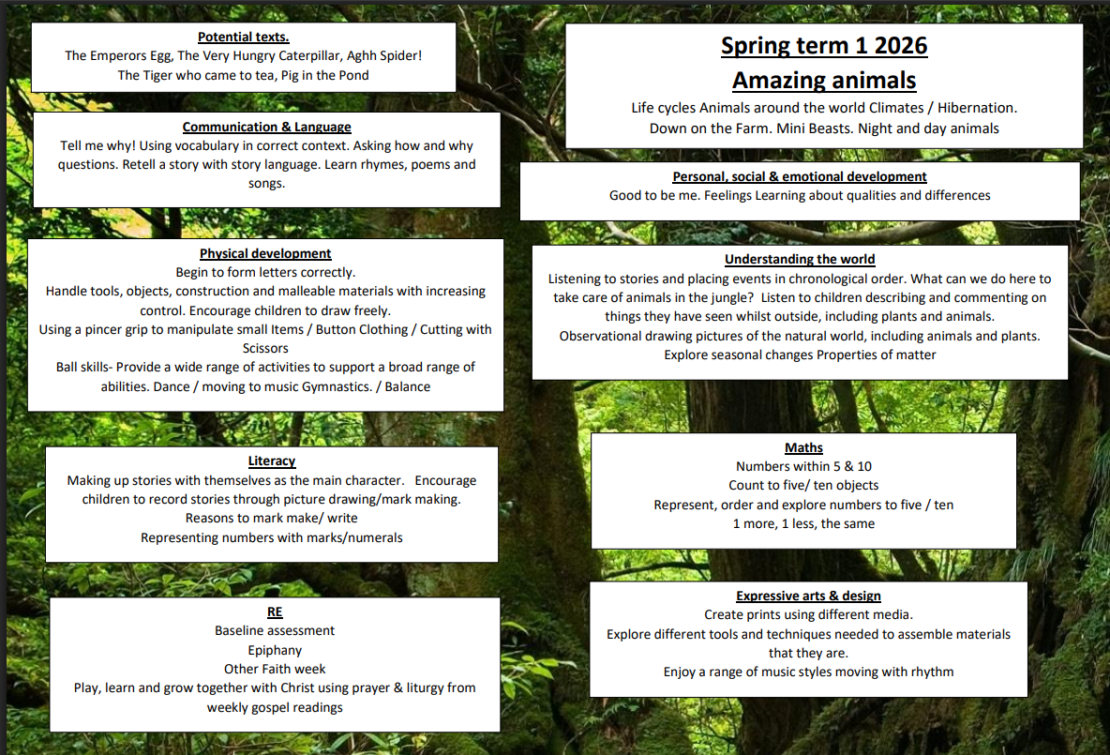

Slide 3

National Year of Reading 2026
2026 is the National Year of Reading. Each month throughout the year we are going to have a reading themed activity. To kick start this year, we are running a competition - asking each child to take a picture of themselves, reading their favourite book, in an unusual place.
Along with the picture, we would like a mini review - 1/2 sentences saying why they like this book and why they would recommend it.
Details of where to email photos, will be sent out via Arbor, can be found on this weeks Newsletter or on our social media feeds, once launched.
Competition closing date: Friday 23rd January
Prizes - book vouchers will be rewarded to the most imaginative pictures.
Details of future events to follow.

Slide 4
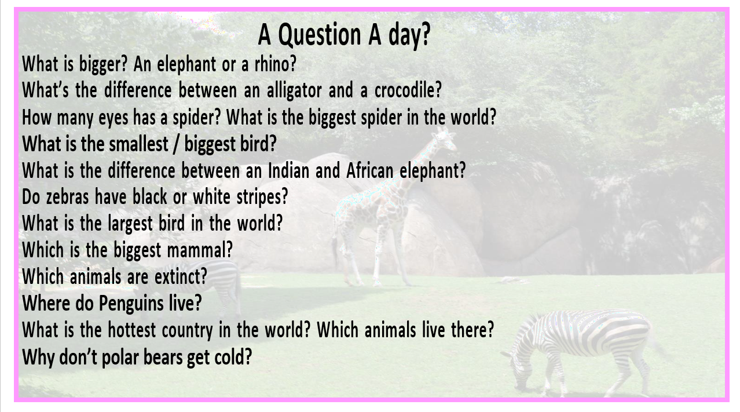

Grow
- Knowledge of their body and what shapes a healthy lifestyle
- Enjoying being physically active
- Using a variety of tools to develop muscle growth
- To confidently communicate needs, interests, thoughts and ideas
- Be an active contributor within our classroom
- Show an appreciation for the voice of others
'Have a strong sense of self and well-being'
- Be a kind and caring member of the school community
- Be able to recognise and manage a range of emotions
- Being responsible and independent within their own self-care.

Slide 5
How can I help my child?
We recognise parents as the first and most important educators of their children. All staff see themselves as partners with parents in providing care and education for your child. There are many ways in which parents take part in making our class a welcoming and stimulating place for all children and parents, such as:
Encouraging independence with self care skills at home particularly putting on coats, shoes and boots. Allowing children to feed themselves with a knife and fork and drink from a glass/mug.
Exchanging knowledge about your child’s needs, activities, interests and progress at home with staff.
Sharing your own special interests with the children.
Helping to provide, make and look after equipment and materials used in the children’s play activities i.e children tidying up at home.
Taking part in events about the activities and curriculum provided in class.
Joining in activities in which your children take part.
Building friendships with other parents in the class.
On our class page on the school website https://stclares.mecmat.org/little-saplings-pre-school you can find information on what we have been learning, our curriculum and day.

Slide 6
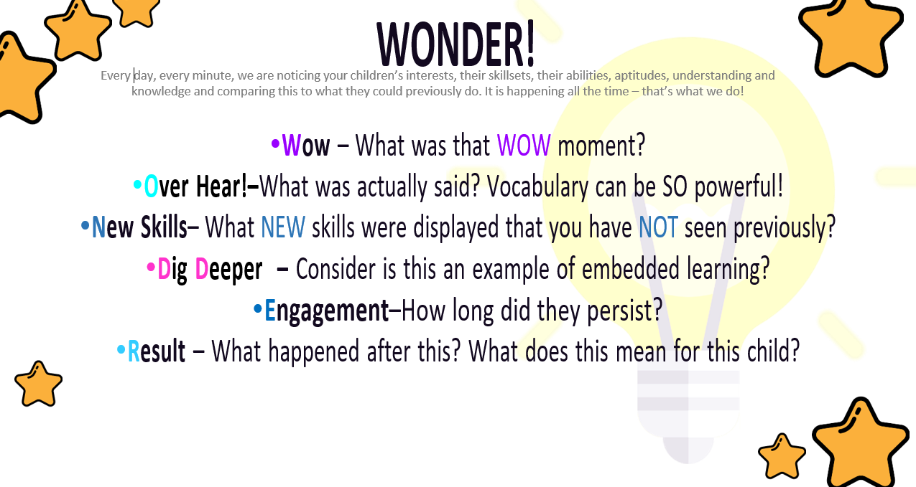
Early Years Foundation Stage
“Every child deserves the best possible start in life and the support that enables them to fulfil their potential.” EYFS 2021
Our curriculum is underpinned by the 7 areas of learning within the EYFS Statutory Framework. Children are provided with a range of experiences and opportunities that support all areas within the EYFS.
Prime Areas
Personal, Social and Emotional Development
Physical Development
Communication and Language
Specific Areas
Literacy
Mathematics
Understanding the World
Expressive Arts and Design

Slide 7
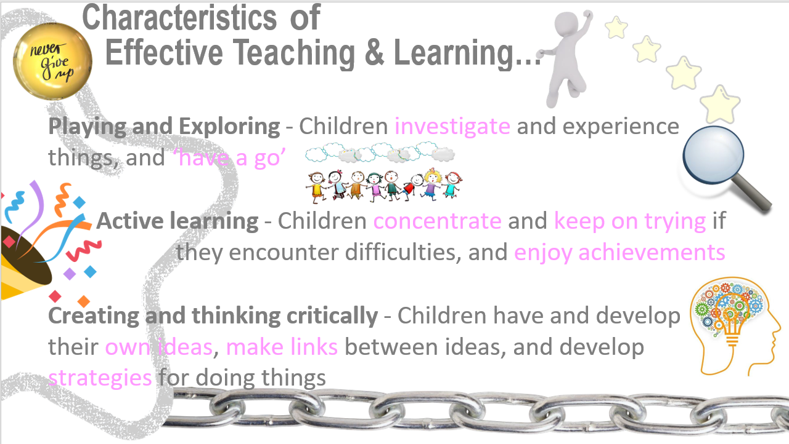
Discover
'Develop a love of literature'
- Enjoy listening to, reading and retelling favourite stories, songs and rhymes
- Embrace and explore real life experiences
- Express ourselves through a range of media
'Experience your creative potential'
- Use a variety of resources to create and explore
- Engage independently on imaginative play in a range of contexts
- Being independent in accessing opportunities within a range of environments
'Begin to understand you are part of a wider world'
- Join in with and embrace other cultures and beliefs
- Know what is important to us, our family and what makes us unique
- How I can make a difference in the world

Slide 8
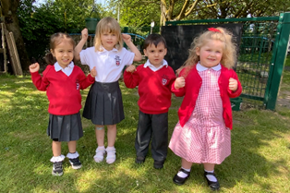
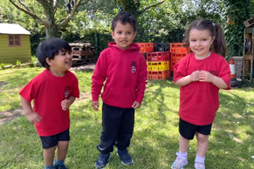
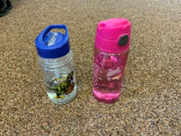
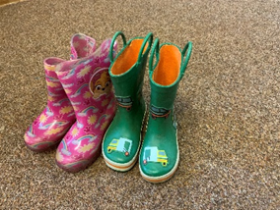
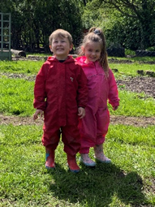
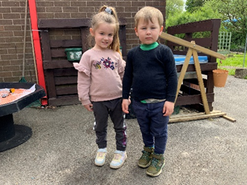
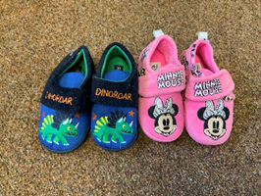
What will my child need?
All children need a full change of clothes including socks. Please make sure your child’s clothes are named. Hats suitable for the season are important. I hope that we may still have some sun in September so your child may still need a sun hat.
PE kit – Red logo t-shirt, black shorts, black pumps/trainers. Outdoor – School red hoodie, black jogging pants – no leggings. Any earrings will need to be removed or covered up for PE
PE is on a Monday
Your child will need a water bottle to be left in school with their name on it. These will be regularly cleaned.
Wellington boots are to be left in school with their name inside.
Friday is camping day. This is all year no matter what the weather is. Your child needs to come to school suitably dressed for the weather to be outdoors all day. During the winter months if you wish to send gloves for your child, they need to be the waterproof type. Gloves made from wool get damp and cold. Please do not send your child with mittens as these make it hard for your child to access resources and activities. This includes suitable clothes shoes and waterproofs. We will only use the indoors for toileting on this day. There is no such thing as bad weather just unsuitable clothing
Slippers are optional. We have a slipper box for children to wear inside should they wish to do so. These need to have a sole and a back on. They need to be suitable for going outside should there be a fire drill.

Slide 9

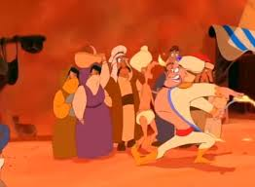


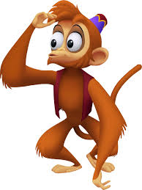
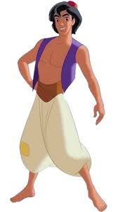
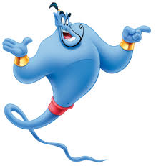
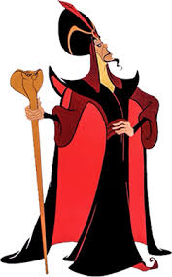
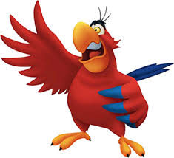
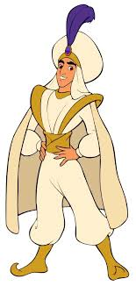
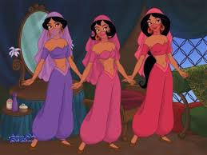
Dates for your diary:
Monday 23rd February – teacher inset day closed for children
Tuesday 24th February- Open for children
Friday 27th February – Proposed class trip. More details to follow
Thursday 5th March – World Book Day – Our class chosen text and theme for the day is ‘ Aladdin’ There are lots of characters from the book your child can dress up as as we become characters from the story throughout the day.
Friday 13th March – Mothers day spa. More details to follow

