Slide 1
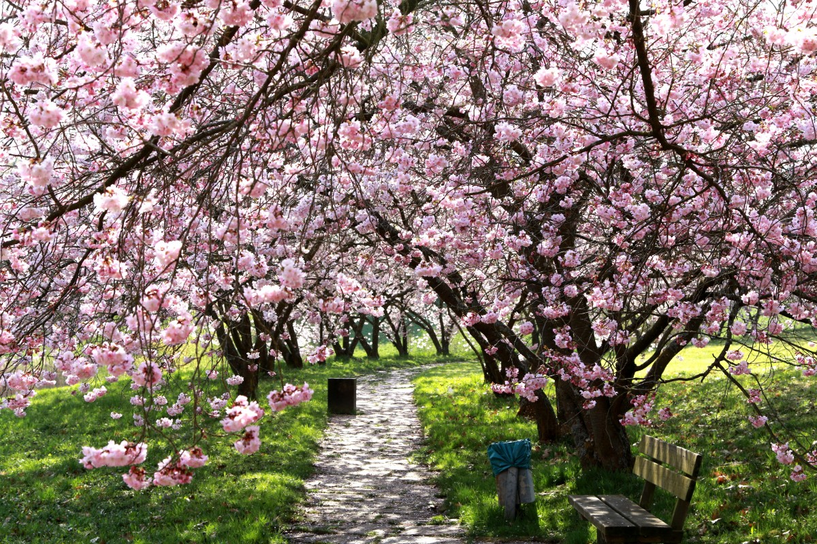
Cherry Class
Mrs Bridgeman
Spring Term 26

Slide 2
Half termly overview and class blog
Spring Term 1 overview is now on the class page of the website.
Each week we will post a blog filling you in on what we have been up to.

Slide 3
Homework
Weekly spellings and x tables – practise at home and test is on a Friday.
Maths and English home work must be completed at home and returned to school each Thursday. If your child is having problems with any part of their homework, please let us know and we will support them in school.
Maths homework will continue to focus on calculations – the policy, including methods on is the website.
English homework will focus on Grammar and Punctuation for this half term.

Slide 4


The National Numeracy Strategy is to help your child to enjoy maths through engaging activities that are done together with an adult.
How can you help?
Our first impressions of maths and numbers were influenced by the grown-ups around us. We can make sure our children have a positive introduction to numbers even if we didn’t. Here are the National Numeracy’s Top Tips.
If you have any questions or feedback, please speak to your class teacher at the end of the meeting. Positive or negative comments are welcome as it helps us to report back to the National Numeracy Strategy team.

Slide 5
Reading
Whole school focus on reading.
Home reading and questioning is extremely important.
In Year 5, I ask that the children can read at least four times a week, at home. Their reading diary needs to be signed by an adult at home each time. Reading diaries are checked on a Friday.
Please use the question bookmarks that have been sent home to question your child about their book.
Reading award badges - which the children can earn by counting up the number of reads they have completed at home.

Slide 6

National Year of Reading 2026
2026 is the National Year of Reading. Each month throughout the year we are going to have a reading themed activity. To kick start this year, we are running a competition - asking each child to take a picture of themselves, reading their favourite book, in an unusual place.
Along with the picture, we would like a mini review - 1/2 sentences saying why they like this book and why they would recommend it.
Details of where to email photos, will be sent out via Arbor, can be found on this weeks Newsletter or on our social media feeds, once launched.
Competition closing date: Friday 23rd January
Prizes - book vouchers will be rewarded to the most imaginative pictures.
Details of future events to follow.

Slide 7

PE
PE will be on a Wednesday this Term. Some weeks we may be outside, so joggers, hoodies and appropriate footwear is needed.
Polite reminder – joggers and shorts need to be plain black – no cycling shorts, leggings or branded items.
Reminder – LCC guidelines are that earrings need to be removed for PE.

Slide 8

Bikeability
Monday 11th May – Thursday 14th May
Advanced notice -all children will need access to a bike & a helmet (can be borrowed), and preferably be able to ride it, so that they can access the whole course.

Slide 9

World Book Day
Advanced notice - Dressing up as a book character on Thursday 5th March

Slide 10
Thank you for your continued support.

