Slide 1
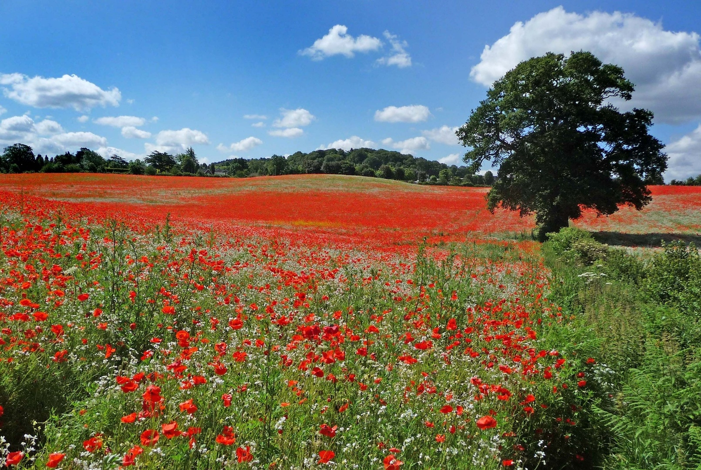
Corpus Christi Remembrance Liturgy
World War 1 Project by Harvey
2018

Slide 2
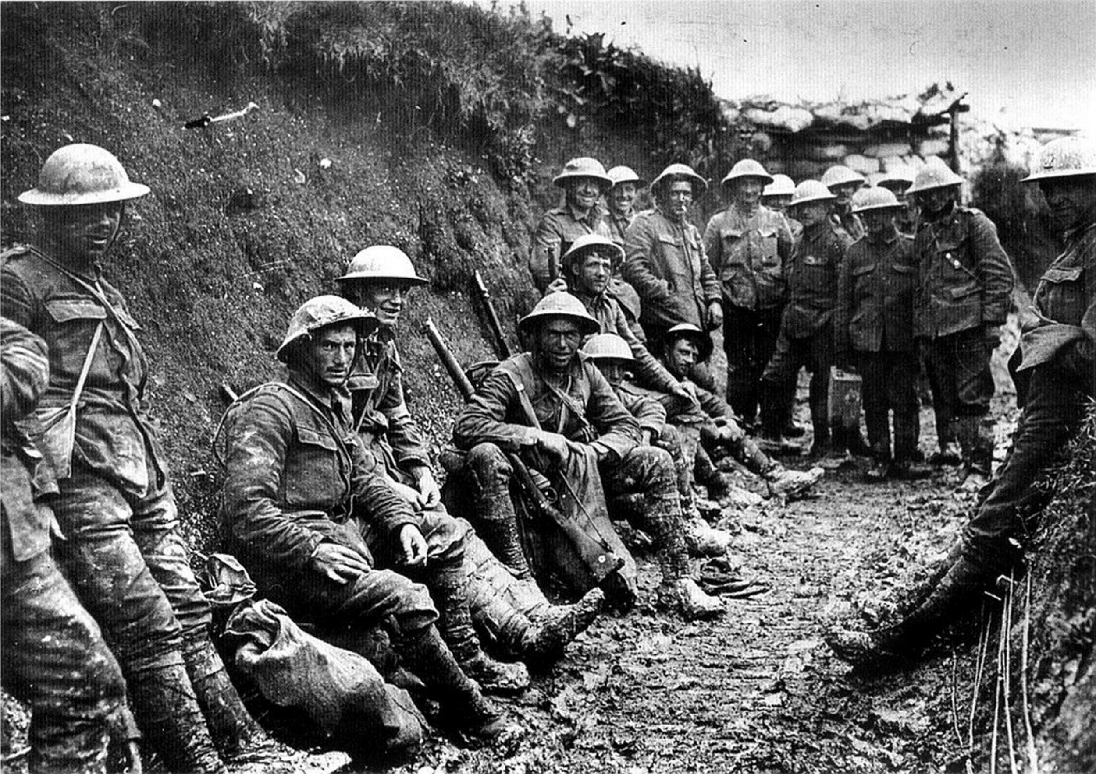
World war one started on 28 July 1914 to 11 November 1918 it lasted 4 years 3 months and 2 weeks and 20 million people died and 21 million people were wounded.

Slide 3
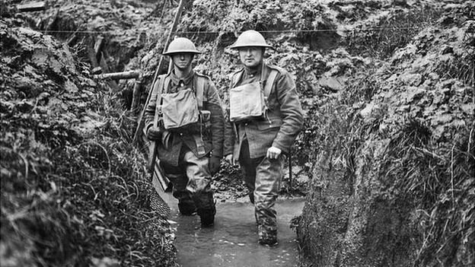
Trenches
Trenches were long, narrow ditches dug into the ground where soldiers lived. They were very muddy, uncomfortable and the toilets overflowed. conditions caused some soldiers to develop problems such as trench foot.

Slide 4

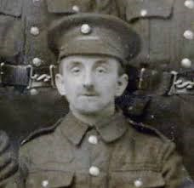
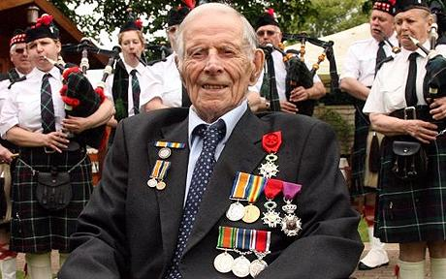
A Soldiers Story: Harry Patch
Harry Patch was the last surviving combat soldier. He was he was nicknamed “ the last fighting tommy”. He was born on the 17 June 1898 and died on 25 July 2009 aged 113.He fought in the first world war from 1916 to 1918. He said “if any man tells you he went into the front line and he wasn’t scared he is a liar. You were scared from the moment you got there.

Slide 5
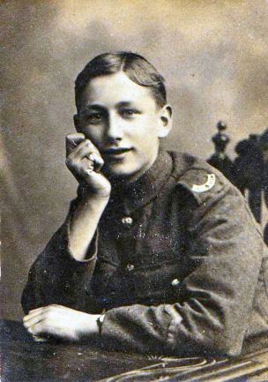
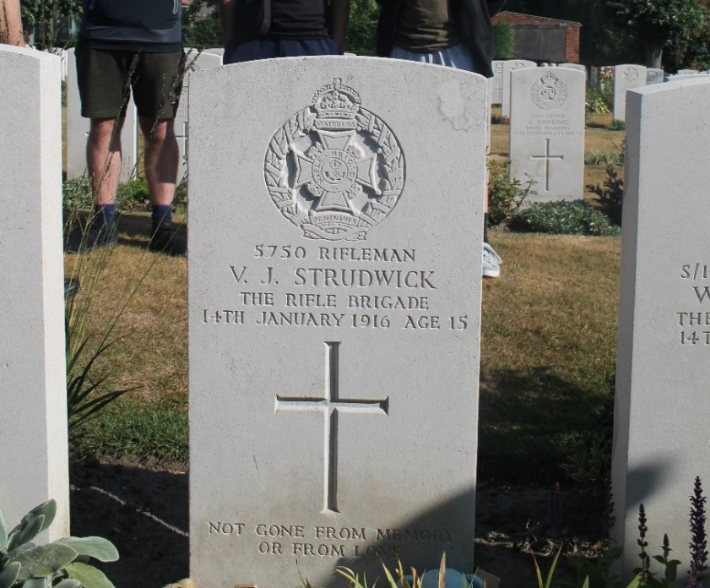
Valentine Strudwick:
Valentine ‘Joe’ Strudwick was one of the youngest soldiers known to have been killed in action in World War One . He was born on Valentine's Day ,1900,in Dorking. …Then ,when war broke out in 1914 ,Joe joined up . After a few weeks training,He was sent overseas where his two best friends were killed and he was gassed. He died in action at Boezinge, West Flanders in Belgium on Friday 14th of January 1916. He was not yet 16 years old and became one of the youngest battle casualties of the war.

Slide 6
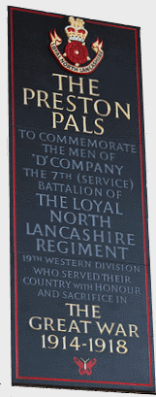
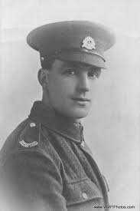
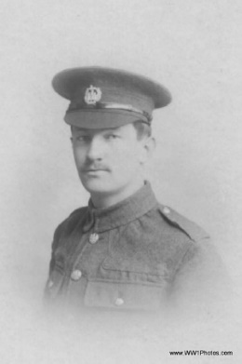
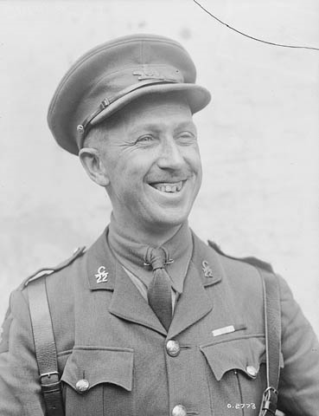
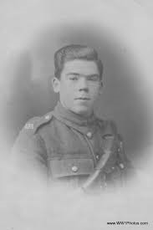
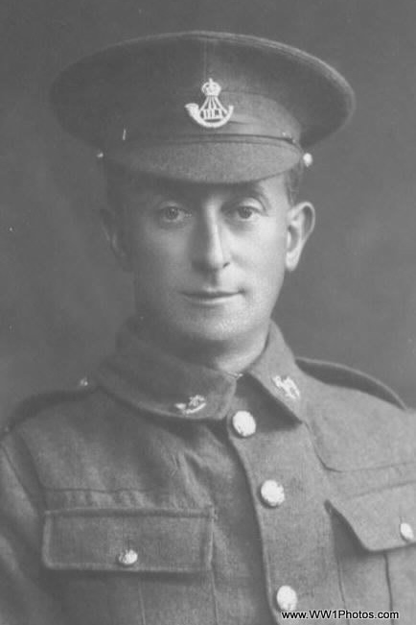
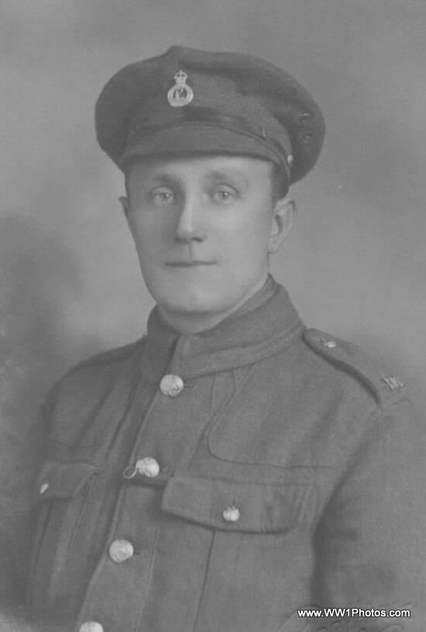
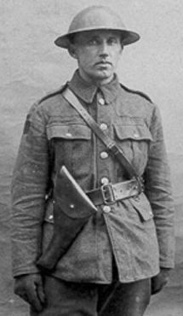
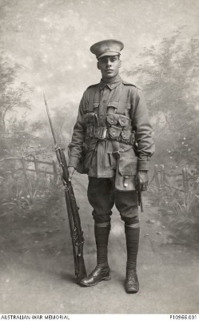
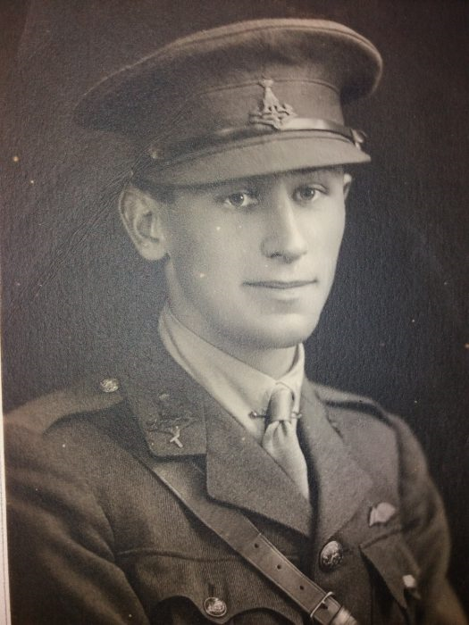
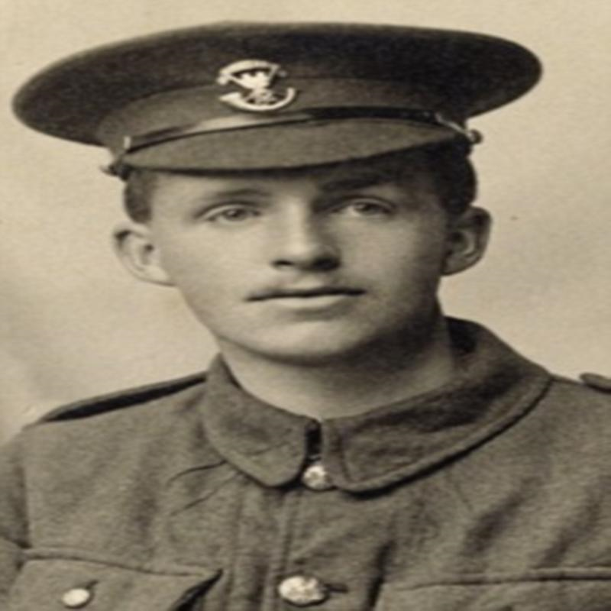
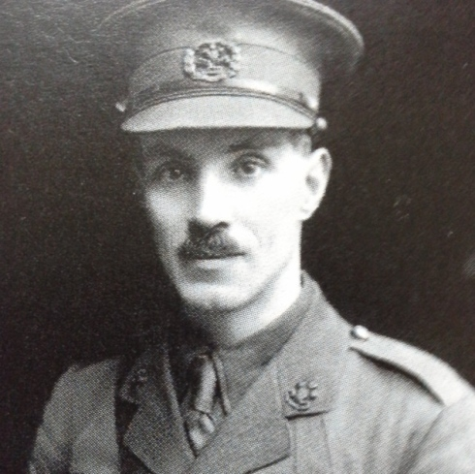
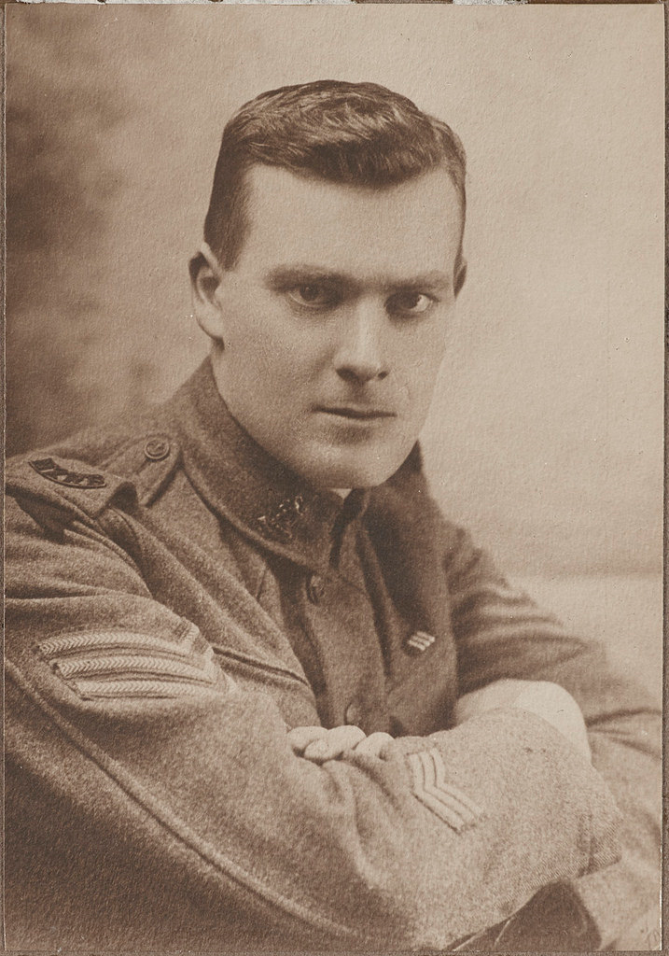
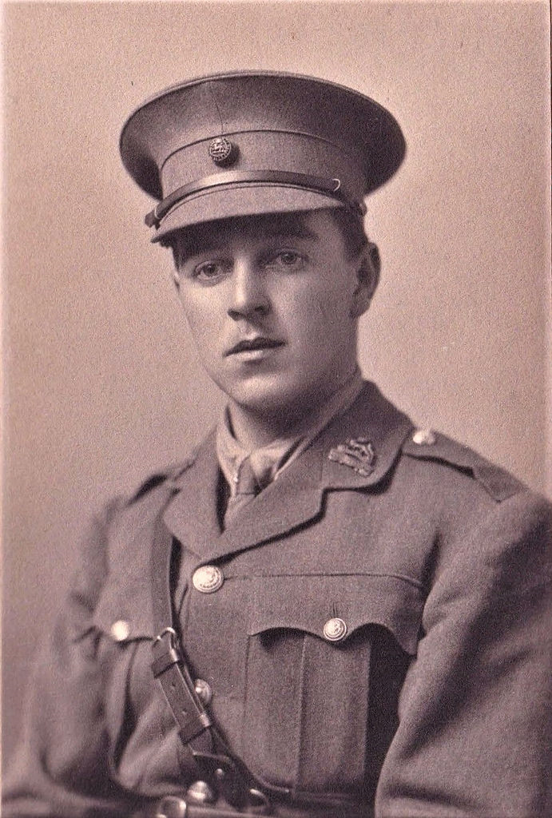
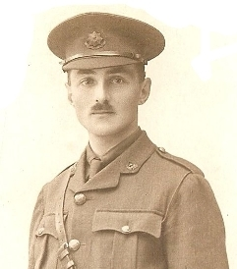
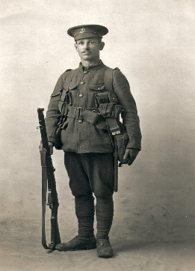
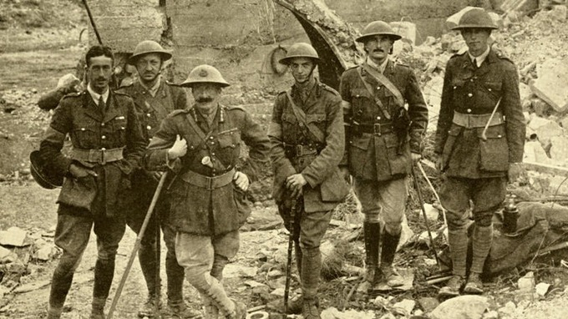
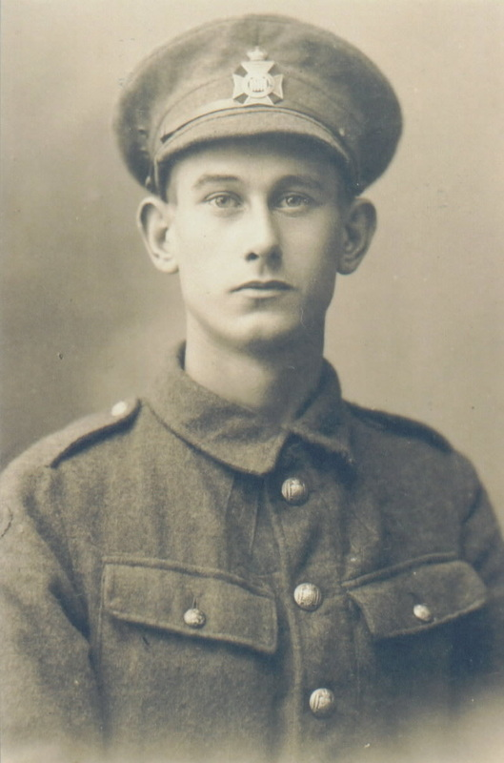
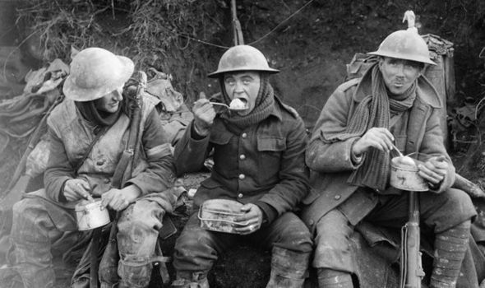
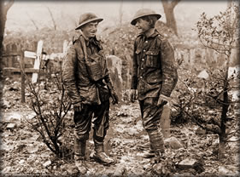
Names and Faces of the First World War:

Slide 7

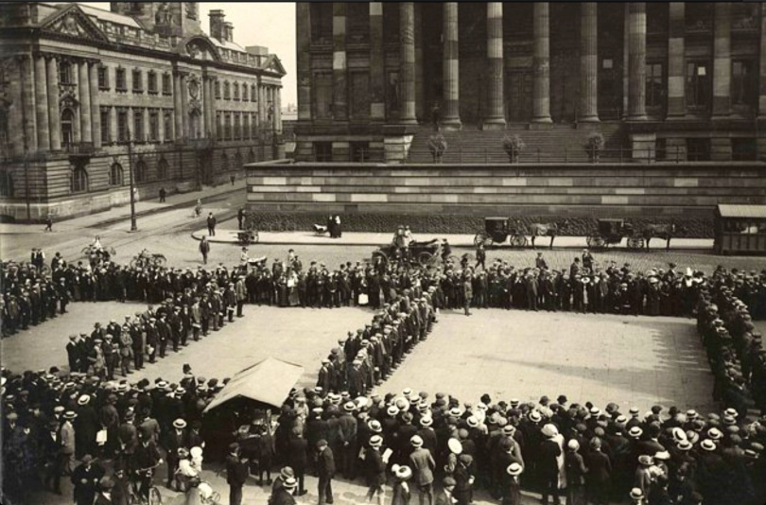

Slide 8
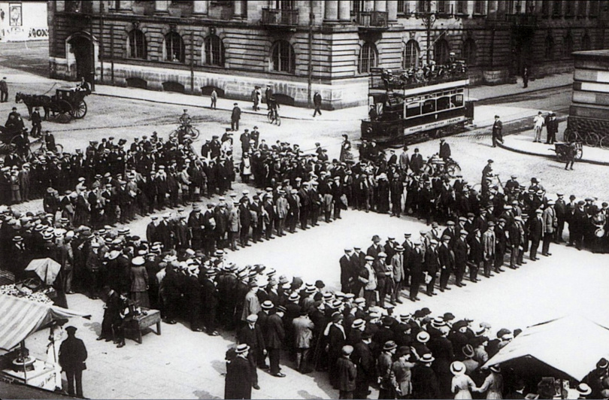


Slide 9
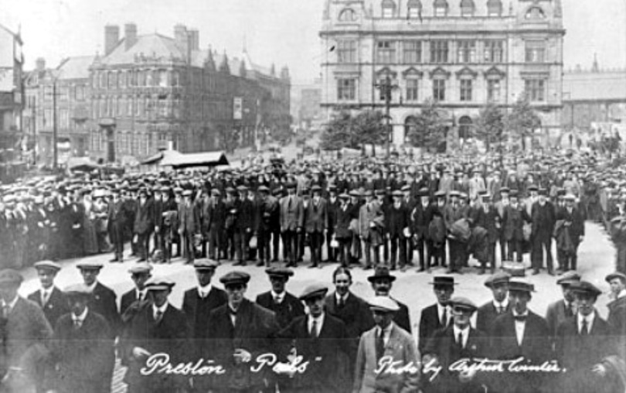

Slide 10
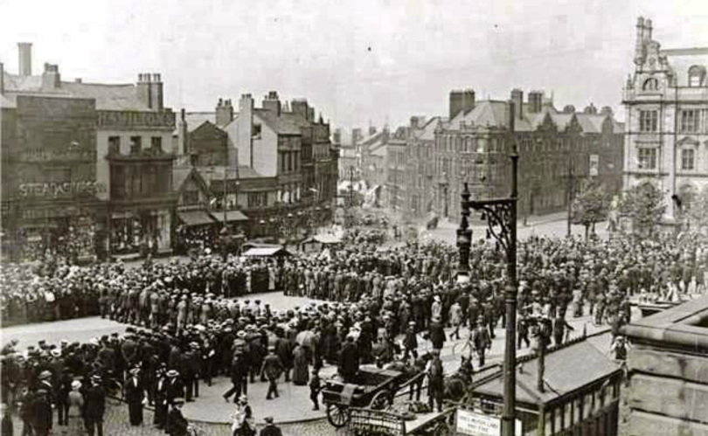

Slide 11
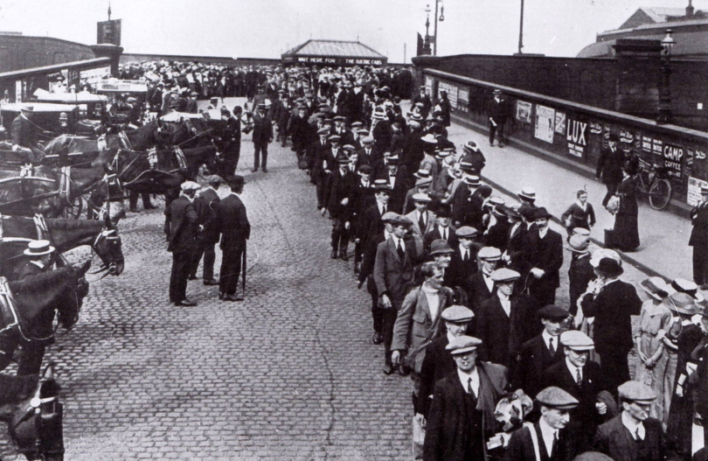

Slide 12
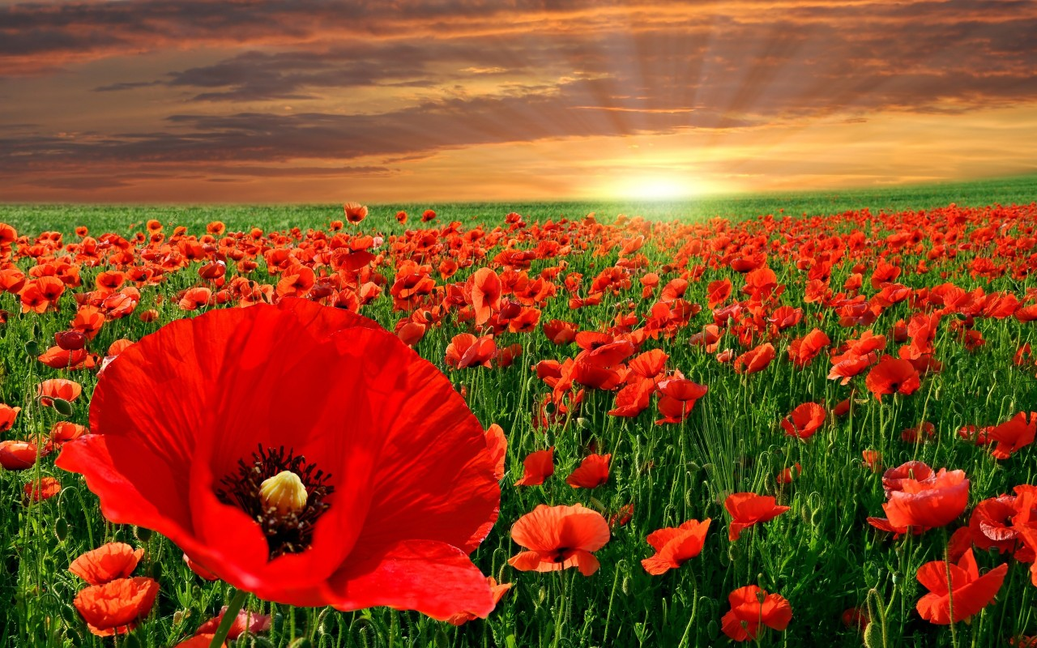


Slide 13
The Ode of Remembrance
They shall grow not old, as we that are left grow old:
Age shall not weary them, nor the years condemn.
At the going down of the sun and in the morning
We will remember them.
We will remember them.

Slide 14
