Slide 1
GCSE & A-Level Advance Exam Information 2021-2022

Slide 2
What is advance information?
Advance information is intended to communicate in advance some of the aspects of the specification that will be assessed in the examination papers.
The breadth, depth and presentation of the advance information will vary between subjects to reflect their different characteristics.
The information will detail the focus of particular aspects of the examination; for example, the content, contexts, texts, topics, sub-topics, themes and skills that will be assessed in the 2022 exams.
This information will look different across a variety of subjects.
It will support revision in the time before the examination.

Slide 3
Will advance information change how exams look/are structured?
No. Advance information does not require any changes to a question paper’s usual structure, which means that the examination assessments will:
- Be familiar to teachers and students.
- Allow continued relevance of associated assessment and teaching resources, including past papers.
- Support student confidence in minimising the unexpected in the layout or structure of question papers.

Slide 4
Which subjects have advance information?
It will be available for the majority of GCSE, AS and A level subjects.
There will be advance information for all subjects except GCSE English Literature, History, Ancient History, Geography and Art and Design, and A and AS level Art and Design.
The exceptions are either because of the nature of assessments in those subjects (assessment is by NEA in art and design qualifications) or because, following consultation by DfE and Ofqual, it has been decided that advance information will not be provided in subjects where optionality (students having a choice) is being introduced for 2022.

Slide 5
Does advance information cover everything on exams?
NO.
The advance information will not always detail
everything that is in the examination. In some
cases this would risk good education,
progression, or fair results; in others it would
be unhelpful to teachers and students, for
example by listing topics that could lead to
excessive teaching or revision on areas that are
worth few marks.

Slide 6
How and when should advance information be used?
Advance information can be used from the point of release.
It can be used flexibly by centres to achieve its purpose of supporting revision.
It should not, however, be used to narrow teaching and learning.
It can be used by teachers in supporting their students’ revision and referred to by students in their revision and final examination preparation.
It cannot be brought into the examinations.
It will not be at a level that allows questions to be predicted or answers prepared. Preparation should continue to focus on knowledge and understanding that can be applied appropriately in the context of unseen examination questions.

Slide 7
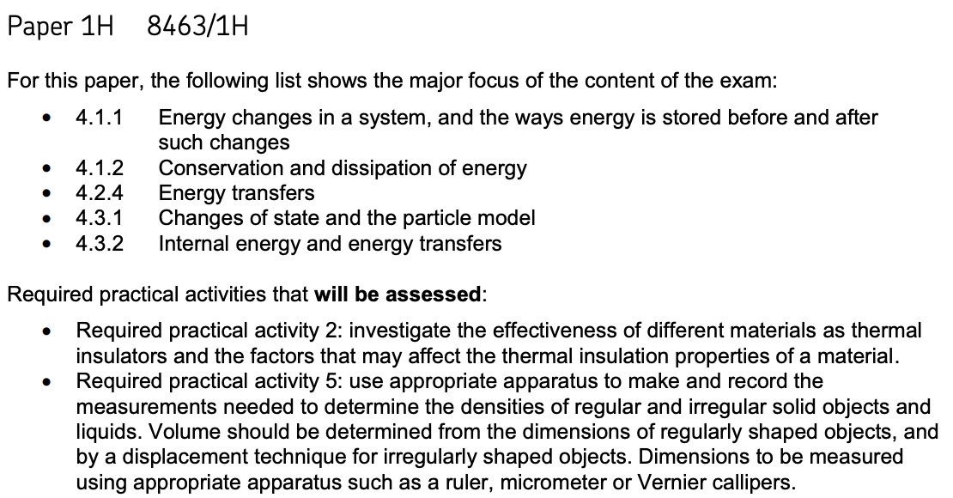
GCSE Advance Information
Subject: Physics Higher
Paper 1

Slide 8
GCSE Advance Information
Subject: Physics Higher
What do students not have to know?
Paper 1

Slide 9
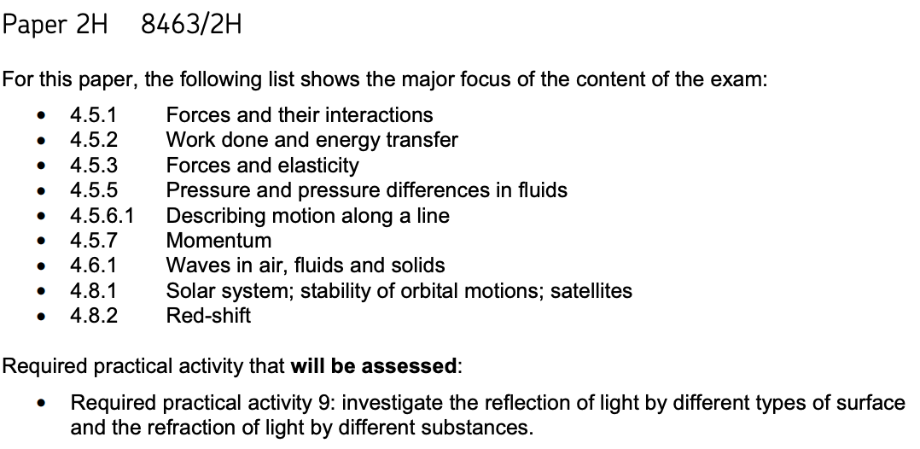
GCSE Advance Information
Subject: Combined Science: Physics Higher
Paper 2

Slide 10
GCSE Advance Information
Subject: Combined Science: Physics Foundation
What do students not have to know?
Paper 2

Slide 11
What happens next…?
Completion of teaching of the specification
Completion of coursework/portfolio work
Targeted homework tasks
Teaching focused on advance information areas
Intervention focused on advance information areas
Timed exam past paper practice
Student completion of revision materials
Student completion of feedback to mock exams
Any issues or questions – please ensure you ask?

