Slide 1

Key Stage 4
Guided Choices
Year 9 into 10
Subject: Animal Management
Team Leader: Kirsty Price
Notes:
**** See notes underneath each slide ****

Slide 2
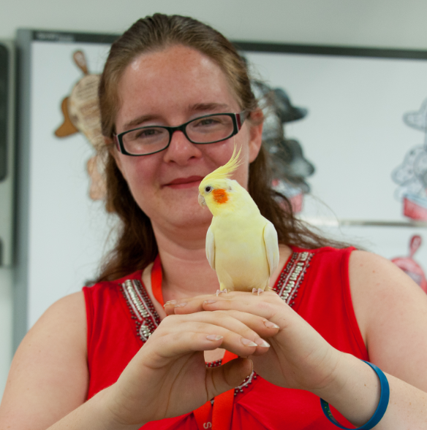

Slide 3
Course Topics
Unit 1 Animal Health
Unit 2 Animal Handling
Unit 3 Legislation
Unit 4 Animal Housing and Accommodation
Notes:
Unit 1 Health in various species, signs and symptoms of different illnesses, parasites fleas, mite, roundworm. Micro organisms and transmissions including virus, bacteria and fungi and diseases they cause. Preventing diseases
Vaccines and checking Pulse, Temperature and Weight.
Unit 2 is about risk assessment, handling techniques, health checks, legislation in the workplace, restraint equipment, grooming.. Demonstrating when you should and shouldn’t handle.
Unit 3 is about legislation and the use of animals as pets, sports, commercial, agriculture, security, working, media. They will need to learn about different organisations involving animals. This includes breed societies, rescue, assistance organisations, conservation.
Unit 4 is about assessing enclosures, how to clean them out and what limits effective cleaning out practices?

Slide 4
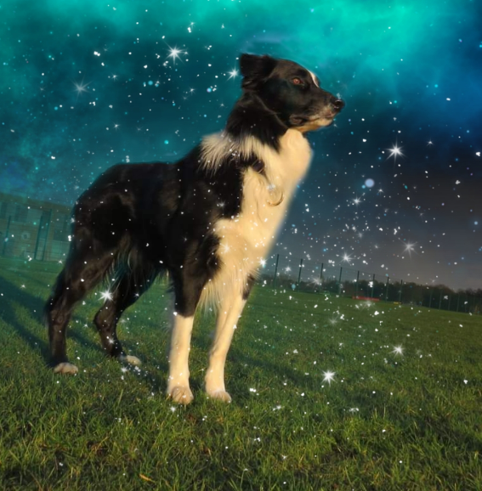
Zero

Slide 5
Which skills does the course require?
Extended answers
Team work
Practical handling
Practical cleaning out
Attention to detail
Communication skills
Following instructions
Notes:
Practical and theory. Within the practical, you will be working as a team to safely clean out animals, carry out health checks and practice handling skills. Within theory to gain a L2 Pass. You must be able to explain your answers, whereas L1 Pass you need to be able to state and describe. For a L2 Merit, you must be able to compare and contrast and demonstrate. For Distinction, evaluation and factoring in ethics and legislation are important.

Slide 6
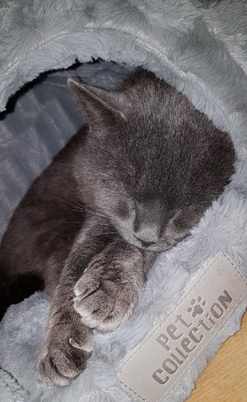
Winter

Slide 7
How is the course assessed?
Unit 1 Animal Health – Exam – 25% of final grade
Unit 2 Animal Handling – Coursework – 25% of final grade
Unit 3 Legislation – Coursework – 25% of final grade
Unit 4 Animal Housing and Accommodation – Coursework – 25% of final grade

Slide 8
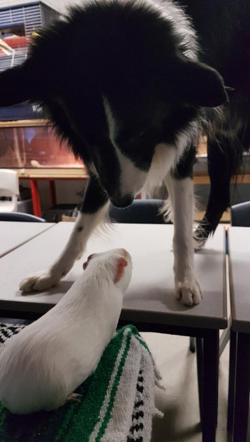
Zero greeting a new pet

Slide 9
Careers Links
Natural Pet Products Speciality Pet Services
Behavioural Consultant Pet Sitting
Dog Grooming Canine Hydrotherapist
RSPCA Inspector Zoo Keeper
Farrier Veterinary Nurse
Horse Riding Instructor Police Dog Handler
Notes:
There are many careers that you can progress to, from doing animal care. Here are a few. The animal or pet industry. Is a booming sector. From bespoke collars to being a chiropractor.

Slide 10
Frequently Asked Questions (FAQs)
How much of the course is Coursework? 75%
What is Pass, Merit and Distinction? Pass equates to a L4, Merit equates to a L5/6. Distinction equates to L8 and Distinction* equates to L9.
Do we have to handle animals and clean out? Yes!
Is it easy? Hard work but achievable
Notes:
You will see that a grade 5 is higher than a grade C – we will be raising our expectations and efforts to meet this new higher standard

Slide 11
Frequently Asked Questions (FAQs)
Can I move onto A levels using this course? Yes
If I’m scared of a type of animal, can I do this course? Yes
When are the exams? January and Summer sittings
Notes:
You will see that a grade 5 is higher than a grade C – we will be raising our expectations and efforts to meet this new higher standard

Slide 12
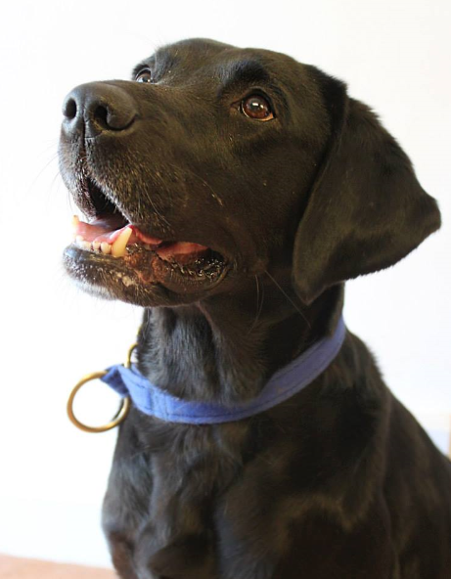
Poppy

Slide 13
Views From Current Students
It is interesting and you learn a lot of different skills
The teachers are very good
There is lots of handling and I’m glad I picked the course
You get attached to the animals like pets, and they are good emotional support
You are trusted and given lots of responsibility
It’s really fun and you do loads of activities with the animals

Slide 14
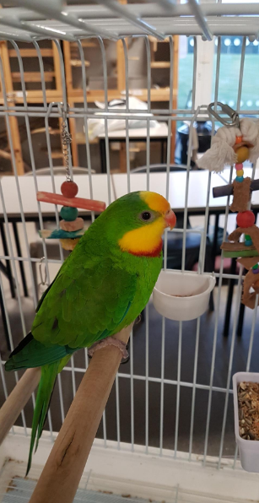

Slide 15
What are my favourite parts of the course?
Freedom to choose which animals to clean out and the teacher not setting limits.
Getting work done and having fun
Handling animals
Zero supporting me when I was upset
Learning about animals
Having a Degu on my shoulder
Playing with Zero
Listening to Miss Price

Slide 16
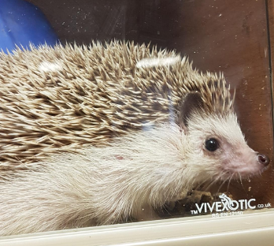
Minnie

Slide 17
Final Comments
The course is hard work and you have to do 3 units of coursework. You will be supported with your literacy, please don’t worry.
If you want to do well, and put the work in, you will succeed. Though you have to work hard, it is fun, relaxed and plenty of practical too. We aren’t just a subject, we are also a support system. Both myself and Mr Dovey, the animals and especially Zero.
We look forward to meeting you in September.

Slide 18
Contact Details For Further Questions…
Miss Price
kprice@tscacademy.org.uk
Notes:
Reinforce choices returns deadline

