Slide 1
Key Stage 4 Guided Choices Year 9 into 10
Subject: BTEC Level 1 Introductory Certificate in Construction
Team Leader: Mr Wilson
Notes:
**** See notes underneath each slide ****

Slide 2
Course Topics
The qualification is made up of a minimum of 5 units:-
2 core units (which are set by BTEC)
3 sector units that the academy specialise in.
Core unit - Being organised
Core unit - Developing a Personal Progression Plan
Sector unit - Drawing a plan of a room
Sector unit – Joinery (making Carpentry joints)
Sector unit – Plumbing (fixing a water pipe)
Notes:
Curriculum changed for Sept 2014 and again for Sept 2017; might have older brothers/sisters who have done a different model

Slide 3
How is the course assessed?
Centre-devised assessment (internal assessment)
Each unit is worth 20% of the final grade. Each has specified learning outcomes and assessment criteria. There is no formal examination on this course.
Notes:
In addition …
More detail on all these later

Slide 4
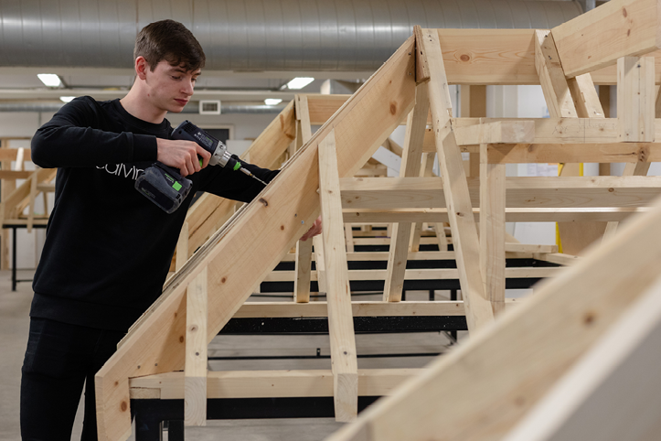
Careers Links
BTEC Specialist qualifications are work-related qualifications. They give learners the knowledge, understanding and skills they need to prepare for employment in a specific occupational area. The development of transferable skills is the main focus. It is intended that students have the opportunity to develop key transferable skills through both core and our specialist sector units:
Joinery and carpentry
Construction Drawing
Plumbing

Slide 5
Frequently Asked Questions (FAQs)
Is this a GCSE course?
No, it is a BTEC level 1 certificate
Can anyone take the option?
It is aimed at students who are more comfortable with a hands on approach to learning and have an interest in construction.
Is there an exam?
No, units are assessment based. Work is moderated internally and verified by a BTEC standards verifier
Is it all practical based?
No. The two core units are theory based. Although the Construction Drawing unit is classed as practical, it is Technical Drawing
Notes:
You will see that a grade 5 is higher than a grade C – we will be raising our expectations and efforts to meet this new higher standard

Slide 6
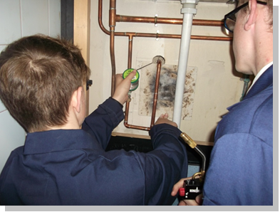
What are my favorite parts of the course?
The different units appeal to different students. Many former students have specialised in the different areas. Many favour Joinery/Carpentry and Plumbing.
Notes:
Potential importance of full EBacc (and Language in particular) for University applications
Science could be Double/Combined Science or 2/3 from Ph, Chem, Biol, Computer Sc
All students will choose AT LEAST one of Hist/Geog or MFL or Computer Science in their Y9/10/11 Guided Pathways – this helps keep it ‘broad and balanced’
Emphasise difference between achieving the FULL EBacc (grades 5+ in all the subjects) and the requirement for all students to choose at least one EBacc subject
Students will be guided down this pathway if we believe it is appropriate for them; all students can access this pathway and study for the full EBacc
Not just about the full EBacc – these subjects individually are known as the facilitating subjects as they are good subjects that are valued in the world beyond year 11

Slide 7
Contact Details For Further Questions…
jtaylor@tscacademy.org.uk
Notes:
Reinforce choices returns deadline

