Slide 1
Key Stage 4 Guided Choices Year 9 into 10
Subject: Drama
Team Leader: Stacey Gatheral
Notes:
**** See notes underneath each slide ****

Slide 2
NEW 2022 BTEC level 2 in Performing Arts - Drama
UNIT 1-3
The BTEC TECH Award consists of 3 Components:
• Component 1: Exploring the Performing Arts: Production Arts (Internally assessed) (YEAR 10)
• Component 2: Developing skills and techniques in the Performing Arts (Internally Assessed) (Year 10 and 11)
• Component 3: Performing to a Brief (Externally Assessed + 40% of the overall grade) (Year 11)
GRADING
PASS
MERIT
DISTINCTION
ASSESSMENT
Practical work + Coursework.
Notes:
Curriculum changed for Sept 2014 and again for Sept 2017; might have older brothers/sisters who have done a different model

Slide 3
BTEC Course Topics
UNIT 1:
Exploring the Performing Arts
Investigate how professional performance or production work is created
Demonstrate understanding of the skills, techniques and approaches used by professionals to create performance/production work.
UNIT 2
Developing skills and techniques in the Performing Arts
Use rehearsal or production/design processes
Apply skills and techniques in performance or realisation
Review own development and application of performance or design skills.
UNIT 3
Performing to a Brief
Understand how to respond to a brief
Select and develop skills and techniques in response to a brief
Apply skills and techniques in a workshop performance in response to a brief
Evaluate the development process and outcome in response to a brief
Notes:
Curriculum changed for Sept 2014 and again for Sept 2017; might have older brothers/sisters who have done a different model

Slide 4
Which skills does the courses require?

Slide 5
How is the Level 2 course assessed?
Unit 1 Exploring the Performing Arts | Unit 2 Developing Skills and Techniques in the Performing Arts | Unit 3 Responding to a Brief
Non-exam internal assessment set by Pearson, marked by the centre and moderated by Pearson. The Pearson-set Assignment will be completed in approximately 12 hours of supervised assessment. 60 marks | Non-exam internal assessment set by Pearson, marked by the centre and moderated by Pearson. The Pearson-set Assignment will be completed in approximately 15 hours of supervised assessment. 60 marks. | Task set and marked by Pearson completed under supervised conditions. Learners will be given the set task 12 weeks before the supervised assessment period in order to carry out the development of creative ideas and rehearsal for the workshop performance. The set task will be completed in 3 hours within the period timetabled by Pearson. 60 marks
Notes:
In addition …
More detail on all these later

Slide 6
Careers Links

Slide 7
Frequently Asked Questions (FAQs)
Where have students progressed too? Students chose the route to sixth form and potentially studying Level3 Diploma in Creative and Performing Arts (DRAMA) or going to college.
What is my child going to gain from this subject? Either skills to take their passion of the subject forward to make a career out of it, or transferable skills (indicated earlier) that can we used in a number of different ways.
Will this subject support a choice at university that isn’t in the creative arts? Yes, as the skills that are gained in the Level 2 award are skills that are transferable to other subject areas.
Notes:
You will see that a grade 5 is higher than a grade C – we will be raising our expectations and efforts to meet this new higher standard

Slide 8
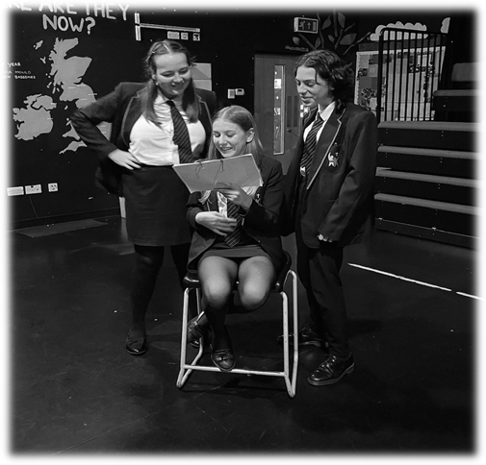
Views From Current year 10 BTEC Students
Drama is like a family; we support each other whilst being creative. The BTEC has been exciting from new start, as we can really explore contemporary plays and perform throughout the academic year. This also supports my types of learning more to achieve better things.
H Fletcher Yr 10
I picked drama to be creative and express myself. I like how we are exploring so many different plays, practitioners and that we are always working in a practical way, linking out academic studies alongside this.
A Marshall YR10
Notes:
Career ? A Levels ?
But we know that this isn’t always possible at this stage and is subject to (many !!) changes
We will guide students to keeping the overall package ‘broad and balanced’ … thus ensuring no doors are closed later in life

Slide 9
Final Comments

Slide 10
Contact Details For Further Questions…
sgatheral@tscacademy.org.uk
Notes:
Reinforce choices returns deadline

