Slide 1
Key Stage 4 Guided Choices Year 9 into 10
Subject: FILM STUDIES
Team Leader: MR C ALLOTT
Notes:
**** See notes underneath each slide ****

Slide 2
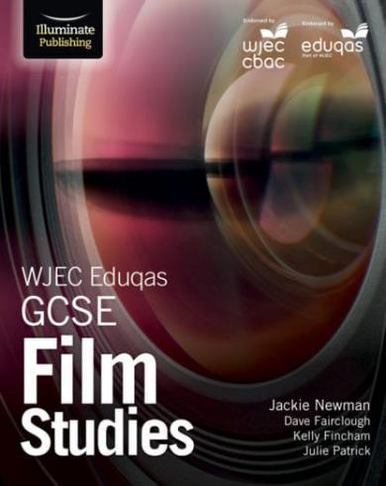
Course Topics
American ‘Hollywood’ films from different time periods
Development of genres
Changing social contexts and representations
Technological developments and changes in filmmaking
Key developments in the history of Hollywood
The important technological developments, going right back to the first recorded moving images in 1895
US Independent film, and contemporary UK film
Different contexts of film production
Analysing critical responses to film
Films from other cultures (including non-English language film)
Different contexts
Alternative approaches to filmmaking
The ‘language’ of film analysis:
Cinematography
Mise-en-scene
Representation
Notes:
Curriculum changed for Sept 2014 and again for Sept 2017; might have older brothers/sisters who have done a different model

Slide 3
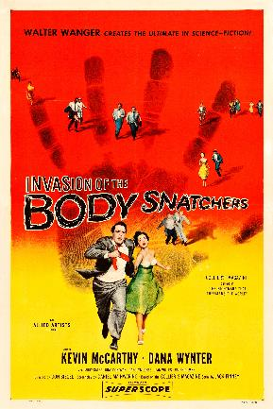
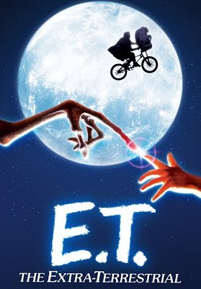
How is the course assessed?
2 Exams – each worth 35% of the final grade (70% in total)
COMPONENT 1: Key Developments in US Film
One film produced between 1930 – 1960
One film produced between 1961 – 1990
Timeline of Developments in Film Making Technologies
One independent US-produced film
COMPONENT 2: Global Film: Narrative, Representation and Film Style
One ‘Global’ English language film (produced outside of UK/USA)
One ‘Global’ Non-English language film
One contemporary UK-produced film
1 NEA production piece – worth 30% of the final grade:
Production of a short film sequence
Screenplay
Notes:
In addition …
More detail on all these later

Slide 4
Which skills does the course develop?
ANALYSIS
Consistently thinking about the HOW and, more importantly, the WHY
Enabling the development of reasoning and analysis skills (both verbal and written)
‘Digging deeper’, and understanding in more perceptive ways
Consistently helping each other to develop, through discussion and collaboration
EMPATHY AND CRITICAL THINKING
Film is a medium which tells us a lot about how we understand ourselves, and understand each other
Exploring how historical, cultural and social contexts influence the production of films provides deeper enjoyment of film, but also teaches us about different cultures and ways of living
All of these ‘critical thinking’ skillsets will also help students to improve their responses in English, History, RS and any other writing-based subjects.

Slide 5
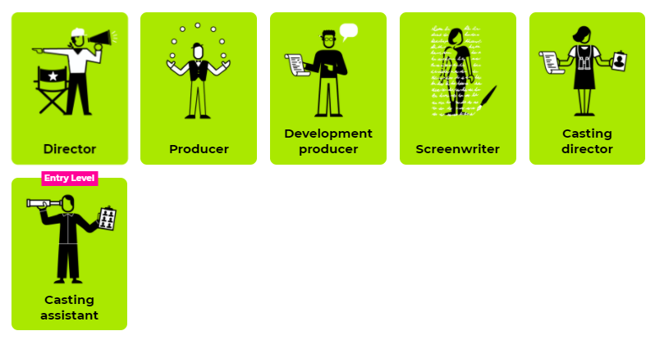
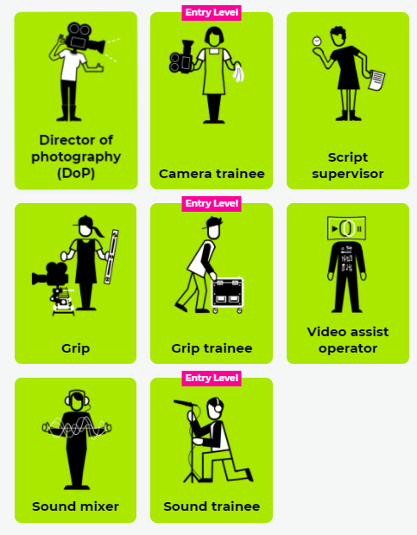
Careers Links
MANY options!
Suiting a wide range of skills and talents
Opportunities to work around the world
https://www.screenskills.com/careers/job-profiles/film-and-tv-drama/

Slide 6
Frequently Asked Questions (FAQs)
Isn’t Film Studies ‘just sitting around, watching films’?
NO! Film is a complex art form, and utilises its own ‘language’!
Analysing the production of films, the construction of representations, and appreciating how contexts influenced them is tough but rewarding!
Isn’t Film Studies a bit pointless – what am I actually going to do with it?
NO! As you’ve already seen, there are so many different jobs within the film industry – there’s truly something to suit everyone’s favoured skills/talents!
Even if you don’t go on to work in the film industry, the analytical skills that you develop in Film Studies will greatly enhance your abilities in other subject/career areas.
Notes:
You will see that a grade 5 is higher than a grade C – we will be raising our expectations and efforts to meet this new higher standard

Slide 7
Views From Current Students
I really enjoyed learning about how films can be about more than one thing, like in Spirited Away: it’s not just about a girl who fights to be reunited with her parents, it’s also about the different ways that American culture has influenced and changed Japan over time.
I have learnt how to analyse cinematography in depth, such as analysing why certain camera angles are used and how they help to present important details about a character.
I love that we learn about the roles which contribute to the filmmaking process, so we can have a good idea of which professions we want to pursue, if that's what interests us.
Notes:
Career ? A Levels ?
But we know that this isn’t always possible at this stage and is subject to (many !!) changes
We will guide students to keeping the overall package ‘broad and balanced’ … thus ensuring no doors are closed later in life

Slide 8
Final Comments
Film Studies is a rich, interesting course that teaches you a range of analytical skills, as well as a whole new ‘language’ of filmmaking – concepts such as cinematography, mise-en-scene and representation.
It’s rewarding, but also requires lots of hard work! There’s no shying away from the fact that there is lots of writing, but you’ll be writing about something interesting, so it won’t seem boring!

Slide 9
Contact Details For Further Questions…
Please contact
Chris Allott: callott@tscacademy.org.uk
I’ll be happy to answer any questions, or share some example tasks/assessments etc ☺
Notes:
Reinforce choices returns deadline

