Slide 1

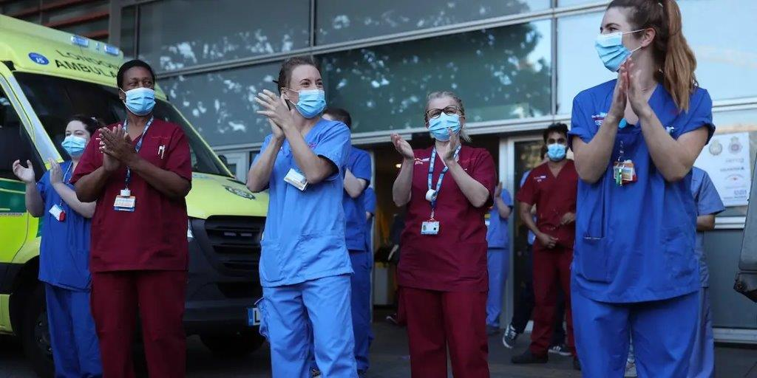
Key Stage 4
Guided Choices
Year 9 into 10
Subject: Health & Social Care
Team Leader: Kirsty Price

Slide 2

Course Topics
Component 1: Human Lifespan Development (30% of the total grade)
Looking into a celebrities biography and mapping key events that have made them who they are.
Researching two people who have had life altering events happen to them and how it impacted them.
Component 2: Health and Social Care Services and Values (30% of the total grade)
Levels of healthcare available to a range of individuals.
Barriers to health care.
Key skills and ethics in care.
Component 3: Health and Wellbeing (40% of the total grade)
Factors effecting health and well-being.
Indicators of health and well-being.

Slide 3
Which skills does the course require?
This course will require a range of subjects, many of which you will have already gained from other subjects from year 7-9.
1. Essay writing and paragraph structuring.
2. Critical thinking and applying your knowledge to the real world.
3 .Empathy and understanding of others.
4. Motivation and commitment to work hard. This is because a lot of your work for the grade is classroom based instead of exams.

Slide 4
How is the course assessed?
This course is a mixture of written exams and coursework.
The exams will be identical to your other exams, except they will be done throughout year 10 and 11 instead of at the end of year 11.
The coursework will be a mixture of written essays, group work, research, and practical’s.
You will have four pieces of coursework and one exam. All of which need to be completed to get your grade at the end of year 11.

Slide 5

Careers Links
  This course will be an excellent stepping stone for anyone considering higher education or a college course in Health and Social Care, Psychology, Sociology, Criminology, Health Science, social care etc.
  This subject can also lead to apprenticeships and full employment in many different aspects of health and well being in the UK, but here are some common destinations:
  Registered care homes.
  Hospitals and primary care trusts.
  Nursing homes.
  Health centres.
  Mental Health practices and establishments.

Slide 6
Frequently Asked Questions (FAQs)
Q: What is coursework?
Coursework are projects and essays you complete in lessons, which are marked by teachers and kept in a folder, at the end of year 11 all of the work and projects are put together to make up 2/3 of your grade you will take with you in GCSE. These are done weekly which replaces the revision you would do for exams.
Q: What is a PASS/MERIT/DISTINCTION
These are the grades we give in BTEC’s, this does not make them any less of a grade than other GCSE’s they are just worded differently. With a PASS being a level 4, Merit being 5/6, and distinction being 7/8.
Q: Is it hard work?
Yes and no, yes there is a lot of work to complete, and will require motivation every week, but if you get on with your work each week, you will have a good grade by the end of it, without the extra revision and workload in year 11.
Q: When is the exam?
The exam is held twice during the course, as this will depend on students who may want to re-take the exam, or prioritise coursework. These will take place in January and the summer term.

Slide 7
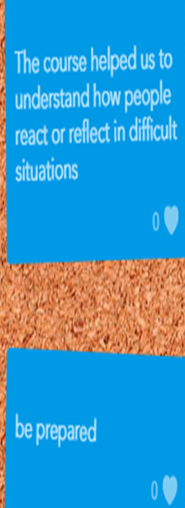
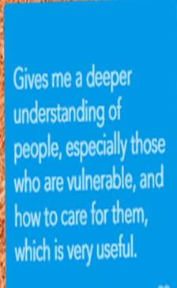
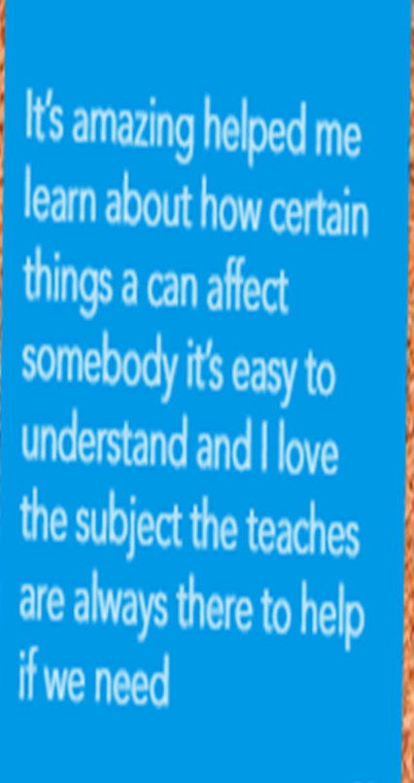
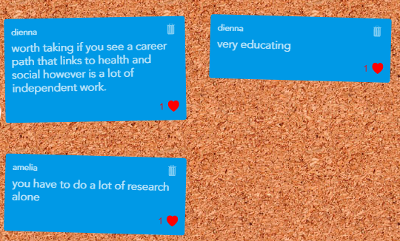
Views From Current Students

Slide 8
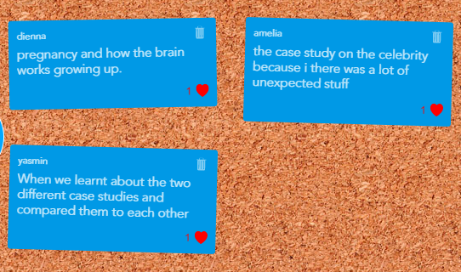
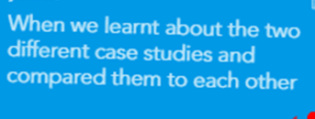
What are my favourite parts of the course?

Slide 9
Contact Details For Further Questions…
Miss Price: Head of Vocational Studies.
Mr. Dovey: Teacher of Health and Social Care.
Vocational department rooms: R33, R34 (pavilion)

