Slide 1
23rd November 2023 Welcome to our Year 11 Information Evening

Slide 2
Contact Us
year11staffteam@tscacademy.org.uk
This will go to Mr Vallance, Mrs Jephson and Mrs Reeks

Slide 3
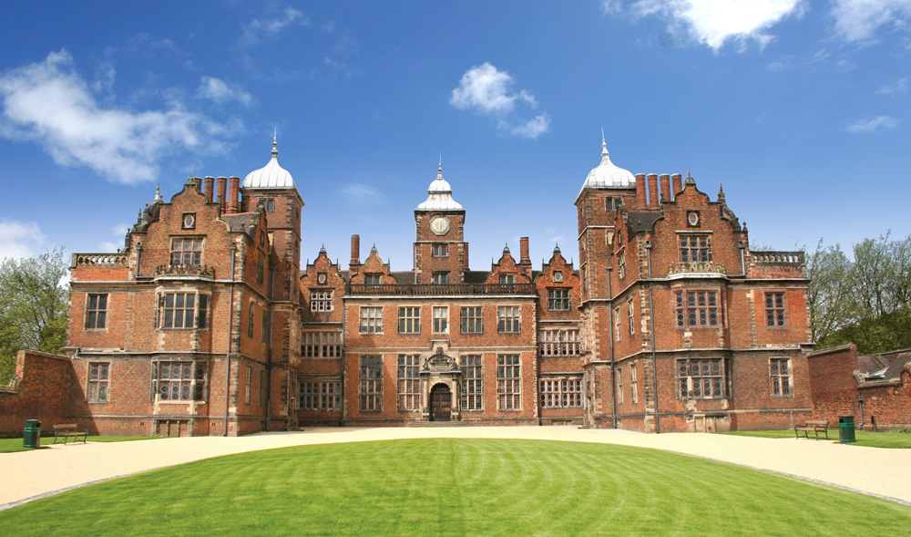
The Vision – Y11 Prom

Slide 4
The Vision
The shared vision for results day
The individual vision for what your results will lead to

Slide 5
Exam Dates
Exams start on W/C 6th May
Final day of exams (contingency day) is Wednesday 26 June 2024

Slide 6
The journey we are on
178 students
25 weeks – including holidays
20 weeks – without holidays

Slide 8
Belief
The key element to the equation
You have been on a journey for almost 11 years
It’s time to achieve your potential

Slide 9
Revision Day Today
Students participated in sessions including:
Revision organisation and timetables
Revision tools and techniques
Marginal Gains
English and Science revision

Slide 10
Support
When you say you can’t do something……
…… What you mean is you can’t do something yet
Quality first wave teaching
Intervention tailored to the individual (RAG and year team meetings)
Before and After school subject support sessions
Small group core subject intervention
Half term classes
Mock exams/mock results days
Parents evenings/reports
Non-academic support – Learning manager, counselling, sport
Careers and next steps guidance
Revision skills/timetabling

Slide 11
What can you do to support yourself?
Attendance
Effort
Wanting it for ‘yourself’
Revision – Today – Revision skills
Little but often - increasing
Time-tabled
Focussed
What works for you?
Rest & recuperate
Be resilient

Slide 12
Before and After School Intervention
 | Monday | Tuesday | Wednesday | Thursday | Friday
8am to 8.30am | Business (invited students) W13 | Health and Social Care (drop in) H17 |  | Art (invited students) N12 | Science (drop in) R12
3pm | Maths (drop in) S16 | Separate Science lesson | Tech Systems/Timbers (drop in) R26 | English (invited students) H22
 | GCSE PE (invited students) W13 | Dance (invited students) W11 | Hairdressing (drop in) Salon | Geography (drop in) N13
 | RS (drop in) R25 | MFL French & Spanish (invited students) H16&H18 |  | Maths Higher (Invited Students) S11
 | Animal Care (drop in) R34 | History (invited students) N15, N16, N17
If these sessions are compulsory for your child, they will be added to Bromcom under 'Clubs and Trips'

Slide 13
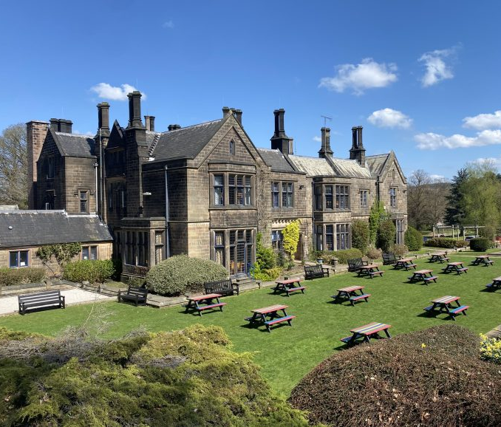
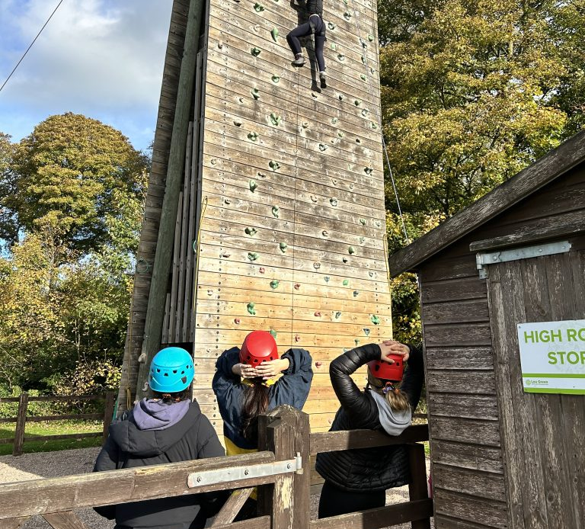
Year 11 Residential
2 nights away in Derbyshire
Outdoor adventure activities and team building
Revision and skills workshops
Places will be limited
Cost will be subsidised as much as possible

Slide 14
Science Success

Slide 15
Structure of the Exams
AQA Exam Board
6 Exams - 1 hour and 15 minutes long
Separate Science (11C1/11S1): 1 hour 45 minutes
Two papers each: Biology, Chemistry, and Physics
Each paper is 70 marks
Separate Science: 100 marks
Each exam is 16.7% of the total grade (combined science)
Separate science is 50% each of Paper 1 and Paper 2 per subject.
At the end, students come out with TWO GCSEs for combined science, and THREE for separate science.

Slide 16
Exam Dates
Paper 1: Biology 10 May 2024 am
Paper 2: Biology 07 June 2024 pm
Paper 1: Chemistry 17 May 2024 am
Paper 2: Chemistry 11 June 2024 am
Paper 1: Physics 22 May 2024 am
Paper 2: Physics 14 June 2024 pm

Slide 17
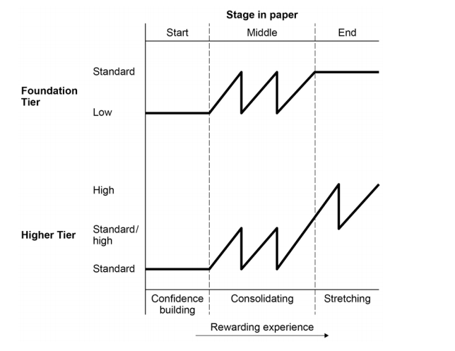
Grade 55 and below
Grade 55 and above

Slide 18
The Exam Breakdown
Required practicals make up 15% of exam
Maths component: 10% biology, 20% chemistry, 30% physics
40% of exam is recall knowledge
40% of exam is application of knowledge
20% analysing information

Slide 19
Assessment
Practice Exams/Exam Questions
Mock exam period in January 2024
Students’ performance will monitored and given the appropriate intervention if needed
Use materials given: equation sheet, Periodic Table, calculator

Slide 20
Exam Success
What you can do… ‘control the controllables’
Encourage your child to complete assigned homework and practice exam questions – 20 minutes of recall a day
Check BromCom for assignments and revision
Encourage your child to attend intervention sessions
Make revision posters/note sheets and key word cards at home (key vocabulary)
What we will do…
Small group intervention
Before school drop-in intervention on Friday mornings 8 – 8:30 am
E-mails of revision materials
Practice exams/Exam questions
Notify parents of upcoming assessments/revision opportunities in science

Slide 21
For the students
Complete assigned homework
Practice exam questions/past exams
Practice key vocabulary
Attend intervention sessions
Take pride and ownership in their work
Revise topics they struggle with
Ask teachers for specific materials

Slide 22
Revision Resources
AQA 9-1 Science Revision Guides (CGP)
AQA – past papers (aqa.org.uk)
Read e-mails for upcoming exams/intervention sessions
Seneca learning
GCSE Bitesize
https://sites.google.com/view/scienceteacher

Slide 23
English Success

Slide 24
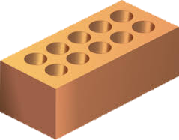
Structure of the Exams
Language Paper 1: Explorations in Creative Reading and Writing
23rd May 2024 (am)
Overview
Written exam: 1 hour 45 minutes
80 marks
50% of GCSE
Section A: Reading
One literature fiction text (40 marks) (25%)
1 short form question (1 x 4 marks)
List 4 things…
2 longer form questions (2 x 8 marks)
How does the writer use language…
How does the writer structure…
1 extended question (1 x 20 marks)
To what extent do you agree…
Section B: Writing
Descriptive or narrative writing (40 marks) (25%)
1 extended writing question (24 marks for content, 16 marks for technical accuracy)
Descriptive writing: Writing that paints a picture​
Narrative writing : Writing that tells a story

Slide 25
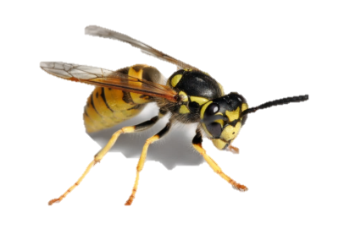
Structure of the Exams
Language Paper 2: Explorations in Creative Reading and Writing
6th June 2024 (am)
Overview
Written exam: 1 hour 45 minutes
80 marks
50% of GCSE
Section A: Reading
One non-fiction text and one literary non-fiction text (40 marks) (25%)
1 short form question (1 x 4 marks)
True/False statements.
2 longer form questions (1 x 8, 1 x 12 marks)
Write a summary …
How does the writer’s use of language …
1 extended question (1 x 16 marks)
How the writers present…
Section B: Writing
Writing to present a viewpoint (40 marks) (25%)
1 extended writing question (24 marks for content, 16 marks for technical accuracy)
Writing to argue for or against a point of view

Slide 26
Structure of the Exams
Language What does that all mean?
Reading
Non-fiction texts:
A genre of writing based on facts and real life
Literary non-fiction texts:
A type of writing which uses similar techniques as fiction to
create an interesting piece of writing about real events.
One literature fiction text:
A genre of writing that has a creative element to it and tends to use literary devices for effect.
reviews
letters
diaries
newspaper articles
information leaflets
magazine articles
feature articles
essays
travel writing
accounts of famous events
sketches (a fact file profile)
autobiographies

Slide 27
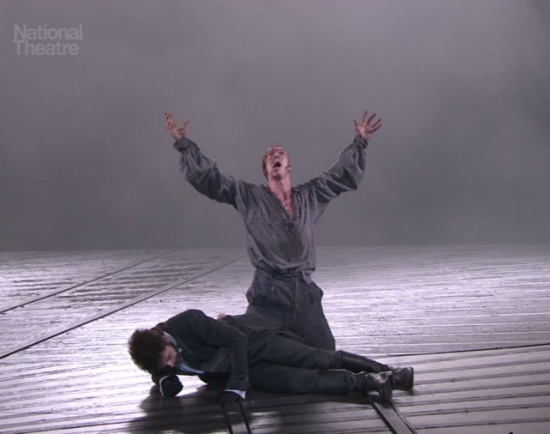
Structure of the Exams
Literature Paper 1: Shakespeare and the 19th Century Novel
Overview
Written exam: 1 hour 45 minutes
64 marks
40% of GCSE
Section A: Shakespeare
All students have studied
Romeo & Juliet& Juliet
Section B: The 19th-Century Novel
Either:
Frankenstein
A Christmas Carol
or
Jekyll and Hyde
They are closed-book exams.
13th May 2024 (am)

Slide 28
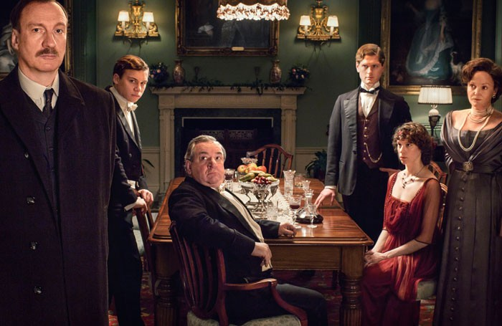
Structure of the Exams
Literature Paper 2: Modern texts and poetry
20th May 2024 (am)
Overview
written exam: 2 hour 15 minutes
96 marks
60% of GCSE
Section A: Modern Texts
All students have studied An Inspector Calls
Section B: Poetry
One comparative question on one named and one other poem from the ‘Power and Conflict’ cluster in their Anthology
Section C:
One question on one unseen poem
One question comparing this poem with a second unseen poem

Slide 29
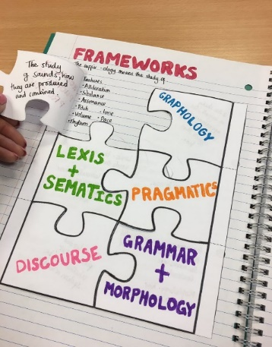
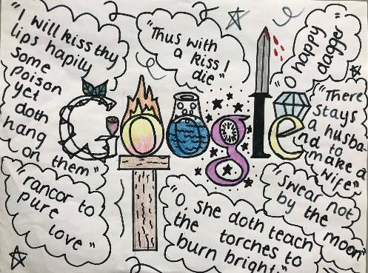
Exam Success
What you and your child can do…
Ensure your child does all homework set
Encourage them to read for 15 minutes a night (either non-fiction, literary non-fiction or fiction)
Encourage your child to create revision materials
Create posters/flash cards with key quotations/definitions to display around the home
Watch Mr. Bruff on Youtube
Visit GCSE Bitesize
What we will do…
Small group intervention
Period 6 revision sessions
Revision guides
Retail price: £6.50

Slide 30
GCSE Mathematics Success

Slide 31
Structure of the Exam
All Papers 1hr 30min long
100% Exam
3 Equally Weighted Papers
1 Non-Calculator Paper
2 Calculator Papers

Slide 32
Being prepared for the exam:
Essential Knowledge
Fluency
Problem Solving

Slide 33
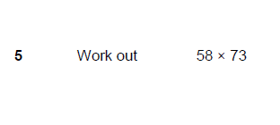
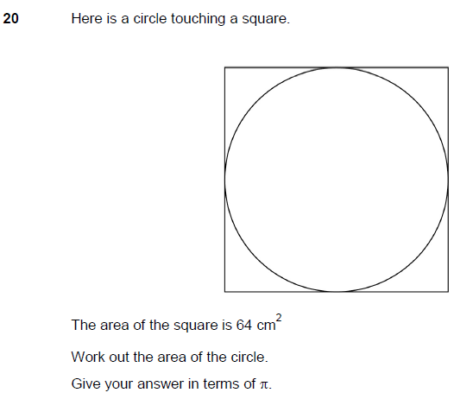
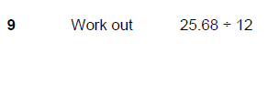
Foundation
Fluency Confidence

Slide 34
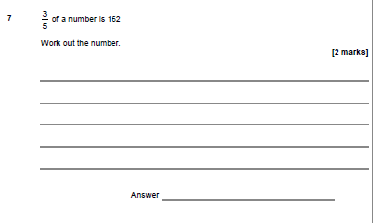
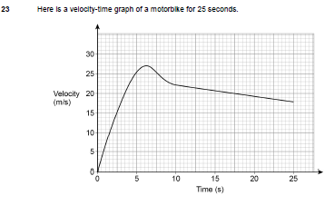
Higher
Fluency Confidence

Slide 35
Problem Solving

Slide 36
Problem Solving

Slide 37
Half a GCSE practice paper
Problem Solving

Slide 38
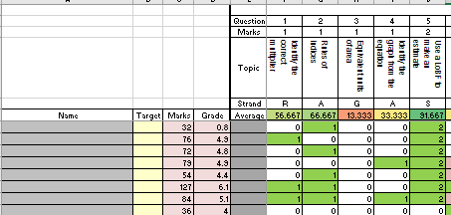
Supporting your areas to develop
Maths Revision Period 6
Pythagoras
Area of a Circle…..

Slide 39
Assessment
Practice Exams
Mock exam period in January
All students’ performance will monitored and given the appropriate intervention if needed.

Slide 40
Intervention
Mathswatch Revision Timetable
1:1 Tutor
Bespoke After School sessions

Slide 41
Homework
Exam papers starting Christmas
If stuck on a question, watch the relevant video on mathswatch, then try the question again

Slide 42
The Students should …..
Complete each piece of homework
Attend each intervention session offered
Take ownership
Revise topics they know they struggle with

Slide 43
Revision
Vle.mathswatch.co.uk
www.mathsbot.com
Corbett maths 5 a day

Slide 44
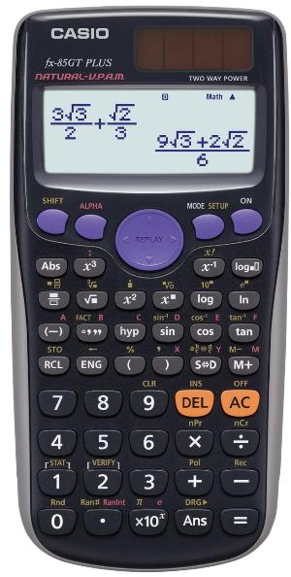
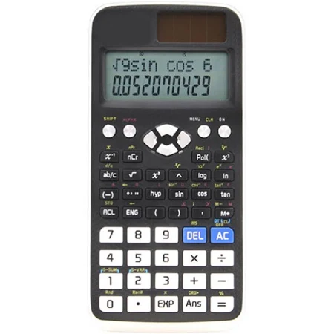
Maths success
What else can you do?
Calculator –
Casio fx85 GT Plus or Casio fx991 ex classwis
Casio fx991 es (A Level)

Slide 45
Religious Studies Success

Slide 46
Structure of the Exams
Paper 1: Faith, Christianity and Buddhism or Christianity and Islam. 9th May 2024 (am
Overview
Written exam: 1 hour 45 minutes
Marks 102, 50% of GCSE
Section A: Christianity beliefs and teachings
5 questions (1 mark to 12 marks with 3 SPAG)
Section B: Buddhism beliefs and teachings (Islam beliefs and teachings)
5 questions (1 mark to 12 marks)

Slide 47
Structure of the Exams
Paper 2: Themes (4, them A, B, D E) 16th May 2024 (pm)
Overview
Written exam: 1 hour 45 minutes
102 marks, 50% of GCSE
Theme A Religion and Relationships
5 questions (1 mark to 12 marks)
Theme B Religion and Life
5 questions (1 mark to 12 marks)
Theme D Religion, peace and conflict
5 questions (1 mark to 12 marks)
Theme E Religion, crime and punishment
5 questions (1 mark to 12 marks)
3 marks for SPAG
Each 12 mark question will be marked for spag.
The highest score will be counted

Slide 48
Structure of the Exams
Question 1 – knowledge question
1 mark
Have to select the keyword
Which one of the following is not a means of salvation?
Grace Law Spirit Health
Students tick a box

Slide 49
Structure of the Exams
Question 2 – knowledge question
2 marks
Have to write a teaching
Give two Christian beliefs about the Trinity.
Students write 2 words or 2 sentences

Slide 50
Structure of the Exams
Question 3 – knowledge and understanding
4 marks
Have to write a teaching and how it influences behaviour
Explain two ways in which belief in judgement by God influences Christians today.
Students write a sentence to state the belief, sentence to say how a person shows that belief. 2 marks
Students write a sentence to state the belief, sentence to say how a person shows that belief. 2 marks

Slide 51
Structure of the Exams
Question 4 – knowledge and understanding and evidence
5 marks
Have to write teachings in detail and support with scripture
Explain two Christian beliefs about crucifixion, Refer to sacred writings or another source of Christian belief and teaching in your answer.
Students write 2 detailed sentences to state the belief and what is shows. 2 marks
Students write 2 detailed sentences to state the belief and what is shows. 2 marks
Need to refer to teaching and/or scripture to support 1 of the sentences. 1 mark (e.g. In the Bible it states, the Buddha taught)

Slide 52
Exam Success
Question 5 – knowledge, understanding and evaluating
12 marks
Have to write teachings in detail and support with scripture
Have to evaluate within each section
Have to conclude
“For Christians, what the Bible says about creation is true.’ Evaluate this statement” In your answer you should: refer to Christian teaching, give reasoned arguments to support this statement, give reasoned arguments to support a different point of view, reach a justified conclusion.
Meaning of the keyword in a sentence
Beliefs, teachings, reasons, actions and scripture to agree with the statement (student only need 2 points)
Points should be in detail with clear evidence and reasons and what it shows about the religion
They need to evaluate the paragraph to state f it a strong or weak argument
Beliefs, teachings, reasons, actions and scripture to disagree with the statement (student only need 2 points)
Points should be in detail with clear evidence and reasons and what it shows about the religion
They need to evaluate the paragraph to state f it a strong or weak argument
A conclusion to state if the statement is true. No more than 2 sentences

Slide 53
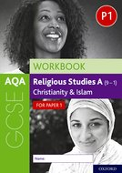
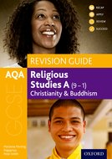
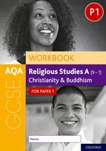
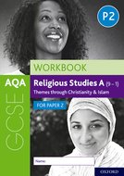
Where to access the revision materials ….
Oxford university press

Slide 54
Revising for Exams

Slide 56
Weekly Revision Timetable
Students have been taught how to RAG rate their revision topics and plot out a week of revision sessions as below:
Times | Mon | Tues | Wed | Thurs | Fri
Session 1 3.30-4.15 | Geography Waterfalls | Science B1 - Genes | Maths Trigonometry - SOH | History American West Consequences | French Sport/ Vocab
Session 2 4.30-5.15 | Maths Trigonometry | Geography Case Study 1 | History American West Causes | French Travel/Vocab | Science B1 - Genes
Session 3 6.30 – 7.15 | Geography Drainage Basins | Science C1 - Alkalines | Maths Trigonometry - SOH | History American West Causes | French Shopping Vocab
Session 4 7.30 – 8.15 | Homework | Homework | Homework | Homework | Science P1 - Forces
Times | Sat | Sun
Session 1 9 - 9.45 | Maths | History
Session 2 10 – 10.45 | Maths | History
Session 3 11 – 11.45 | Science | English
Session 4 12 – 12.45 | Science | English
Session 5 6 – 6.45 | Maths | History
Session 6 7 – 7.45 | Science | English
Session 7
Session 8
Each session should only be 45 minutes long with 15 minutes break

Slide 57
Parent Tips
Weekly review of revision timetable
Monthly review of revision materials produced – revision cards, mind maps, and revision journeys. Information PP available on our website
Review of type of revision – are students only trying to memorise material or are they using exam questions
Front of fridge/In-tray idea – to avoid conflict between students and parents – revision materials timetables could be left in an agreed place (at an agreed time) for parents to check. This then takes the conversation element out of this process.
Use of staff email – please contact us if you have any issues with individual subjects or any overall issues
If it doubt, please contact us
Use of parent guides (these PowerPoints) to be involved in student’s work
Little and often rewards – nightly treat, half-termly reward (day out)

Slide 58
Items that may be useful during revision period…
Familiar pen/calculator
In-tray (for students to leave their revision timetables/materials to review).
Rainbow revision cards – allows students to have a different coloured revision card per subject. These are available from Wilkinsons.
Revision card holder – students learnt how to produce flashcards today This is useful to collate their work.
A3 paper – for mind maps/revision journeys (again techniques learnt by students today).

Slide 59
Marginal Gains – Exam Technique…
A dividing ‘current’ folder – keeps revision resources together
Buy a pack of BIC black pens and 2/3 packs of cheap highlighters
Get your parents to buy you a ‘case’ of cheap bottled water
Decide if you like bananas
If you don’t eat breakfast, possibly start from about March/April. If not, try Belvita!
Walking/running the night before exams (cold showers)
Talk to your employers now…if you can’t…we will!
Pin your exam timetable up…and cross them off
May half term – 2/3 days blocked out

Slide 60
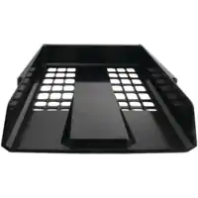
Marginal Gains – Every Day
Go to bed 30 mins earlier – that is 2.5 hours per week
Minimise arguments with parents…buy a letter tray
Stop drinking energy drinks
Talk to your parents about your ‘incentives’
Ask for a mentor…
Exams only What’s App group
Plan a day out the week you finish exams
Check Show My Homework first thing on Monday and last thing on Friday
Carry your revision guides/revision cards with you as much as possible…revision opportunities!

Slide 61
What Next?
Time with staff present
Opportunity to ask questions
Decisions around items to purchase – revision guides, equipment, rewards.
Decisions around any family system
Parent meetings* (Planned and Unplanned)
Careers interviews
Post-16 applications to
Sixth Form here - interview and final offer process
Mock Exams (next set start on 15th January)

Slide 62
Thank you so much for coming …. have a safe journey home

