Slide 1



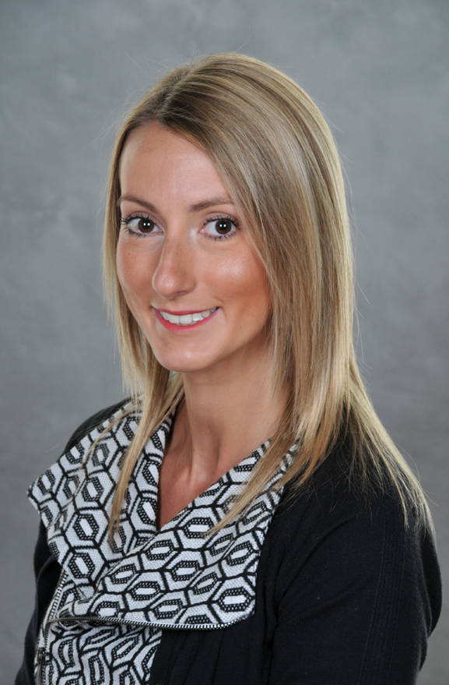
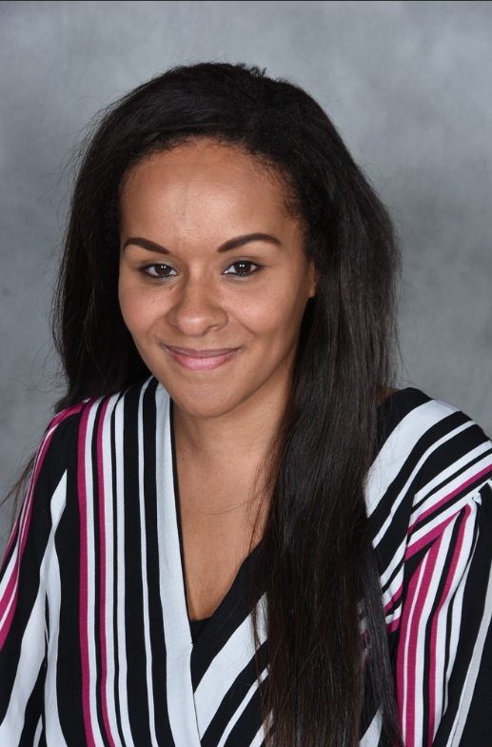
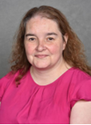
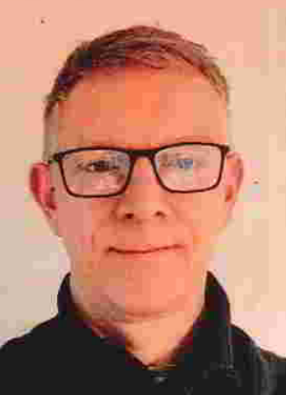
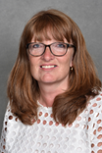
SAFEGUARDING AND CHILD PROTECTION
Mrs K Fisher - Deputy Headteacher
Deputy Designated Safeguarding Lead
Health & Safety Lead
Mrs E Kuffour - Headteacher
Deputy Designated Safeguarding Lead
Miss K Edwards - Assistant Headteacher / SENDCo
Designated Safeguarding Lead
Designated Teacher for
Looked After Children
Mrs K Davies
Deputy Designated Safeguarding Lead
Mr S Caton
Academy Council/ Governor Lead for Safeguarding
Mrs V Sayer
Deputy Designated Safeguarding Lead

