Slide 1
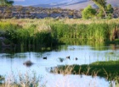
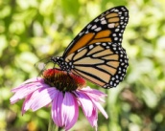
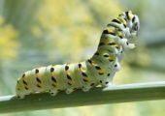
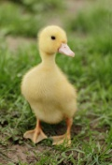
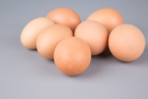
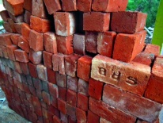
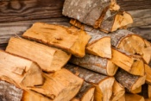
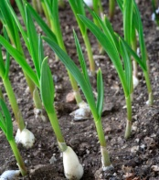
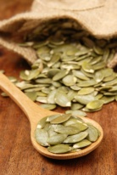
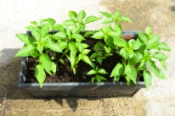
Year 2 Science Learning Journey
Living things & their habitats
Identify what is living, dead and never alive;
Understand that most living things needs a habitat;
Understand the basic needs of plants and animals;
Identify a range of habitats and micro-habitats;
Describe how animals get their food and describe food chains.
Think back to your learning in Reception and Year 1.
Animals including humans
Notice that animals have offspring that grow into adults;
Understand the basic needs of animals;
Describe the importance of exercise, different types of food and hygiene.
Materials
Identify and compare materials for particular uses;
Find out how some solid materials can be changed.
Plants
Observe and explain how bulbs and seeds turn into mature plants;
Find out and describe how plants need water, light and a suitable temperature to grow and stay healthy.

