Slide 1
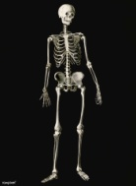
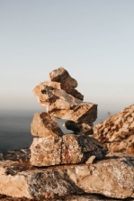
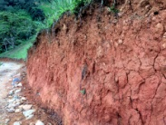
Year 3 Science Learning Journey
Animals including humans
Identify that animals need the right nutrition, they cannot make their own food and get it from what they eat;
Identify that some animals have skeletons and muscles for support, protection and movement.
Think back to your learning in Year 2 – build on it and refer back to it.
Rocks and soils
Compare and group rocks on their appearance and properties;
Recognise that soils are made from rocks and other matter;
Describe how fossils are formed.
Light
Understand why we need light and what darkness is;
Notice that light is reflected;
Understand why we need to protect our eyes from the Sun;
Understand how shadows are formed;
Find patterns in how shadows change.
Plants
Identify and describe the different functions of each part of a plant;
Describe how what a plant needs varies from plant to plant;
Investigate how water is transported;
Explore the role of flowers in the life cycle of a flowering plant.
Forces & Magnets
Compare how things move on different surfaces;
Understand how different forces act, whether they need contact or distance;
Understand what attract and repel means when thinking about magnets;
Compare and group materials on whether they are magnetic;
Describe the poles and predict how they will interact with each other.

