Slide 1
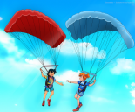
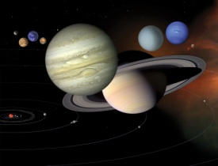
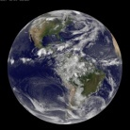
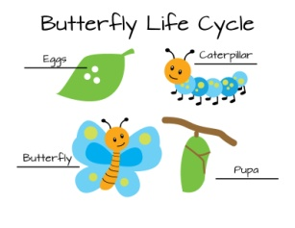
Year 5 Science Learning Journey
Properties and change of materials
Understand what dissolving and a solution is and how it can be recovered;
Use prior learning of solid, liquids and gasses and how mixtures might be separated;
Demonstrate reversible and irreversible changes;
Understand that some changes create new materials.
Think back to your learning in Year 2, 3 and 4 – build on it and refer back to it.
Earth and Space
Describe the movement of Earth and other planets, relative to the Sun;
Describe the movement of the moon relative to the Earth;
Describe the shape of the Sun, Earth and moon;
Understand how we get day and night.
Forces
Understand what gravity does to unsupported objects;
Identify the effects of air resistance, water resistance and friction, that act between moving surfaces.
Recognise that some mechanisms, including levers, pulleys and gears, allow a smaller force to have a greater effect.
Animals including humans
Describe the changes as humans develop to old age.
Living things and their habitats
Describe the differences in the life cycles of a mammal, an amphibian, an insect and a bird.
Describe the life process of reproduction in some plants and animals.

