Slide 1
Lunches at Seaton Academy
22/09/25

Slide 2
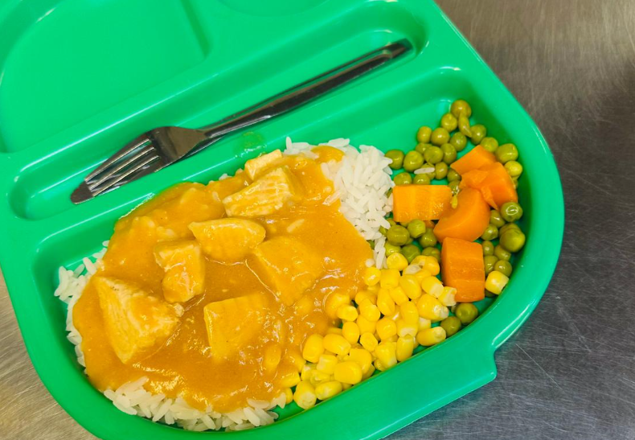
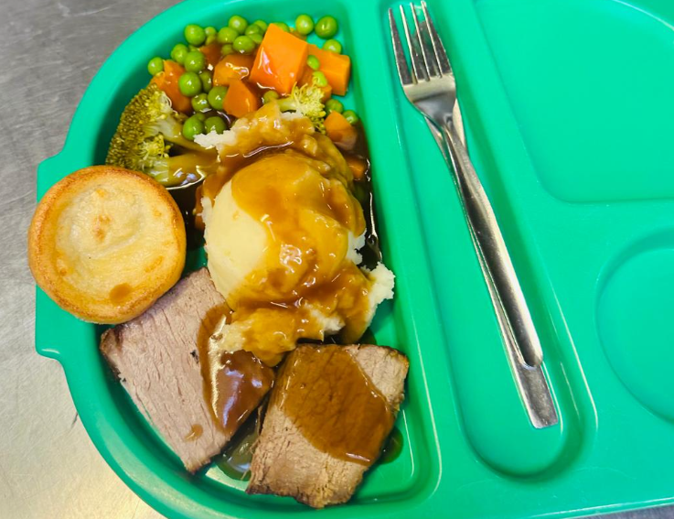
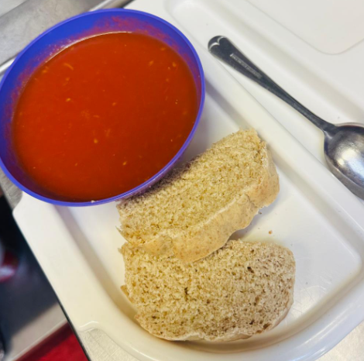
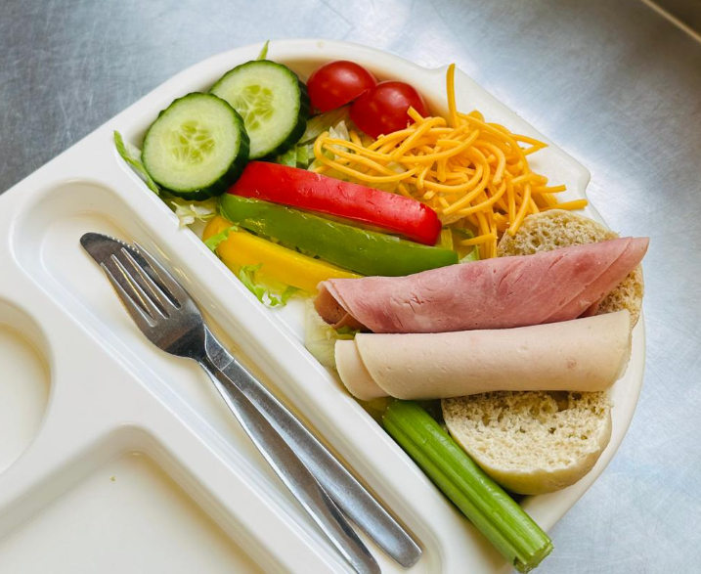
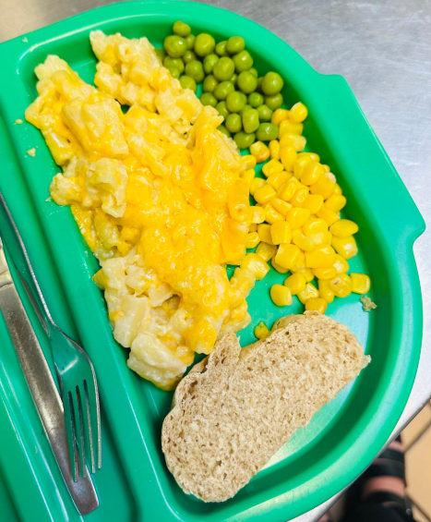
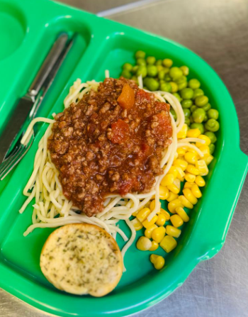
Home made chicken curry
Home made Roast Beef dinner
Home made Tomato soup
Sandwich option
Home made Mac and Cheese
Home made Spaghetti Bolognaise

Slide 3
Our meat is sourced from a local, high quality butcher.
All meals are made fresh every day.

Slide 4
Everyday children are offered fruit and vegetables.
If children wants more fruit, or any vegetables, this is never a problem.

Slide 5
Packed lunches….
At this time, we are not permitting packed lunches brought from home. This decision is based on several factors, including allergy management, concerns around items such as crisps and biscuits, and our commitment to the free school meal initiative, which ensures every child has access to a healthy, hot meal each day.

Slide 6
We aim for a ‘try it’ approach where children are offered a variety of foods, but on many occasions children don’t want some items i.e. peppers, tomato's and they are never forced to eat them.

Slide 7
Any questions about school meals?

Slide 8
Any suggestions for different meals?

Slide 9
Now there is an option to try some of the lunch options. We are available to talk/chat is you wish.

