Slide 1
What you need to know
APPRENTICESHIPS

Slide 2
What does an apprenticeship include?
How does learning through an apprenticeship differ from learning at school, college or University?
Career led learning and specialised training sessions
Approximately one day of learning a week
No student debt
You will learn new technical skills in a short amount of time
Instant on- the-job experience
Paid employment with holiday leave
Hands-on-experience in a sector/role of interest
80% on job training
Formal assessments which leads to a nationally recognised qualification

Slide 3
How much will I get paid?
Quite often an employer will pay above the NMW as there is no maximum wage.
As an apprentice you should be working a minimum of 30 hours a week.
That is £129 per week on current apprenticeship rate and if over 19 years old and more than a year into your apprenticeship, you would earn a minimum of £196.80
If under 18 years old you can work up to 40 hours a week and if over 18 this increases to 48 hours a week, which means your wages would be higher.
This will depend on the employer. However you cannot be paid less than the apprenticeship National minimum wage (NMW)
Aged 16-18 = £4.81
Aged 19 or over in your first year = £4.81
Aged 19 and completed first year of their apprenticeship = National minimum wage £6.83

Slide 4
The range of apprenticeships
Accounting
Aviation
Horticulture
Architect
Creative and digital
Teaching
Cyber security
Surveying
Project management
Nursing
Dental nursing
Hospitality
Hairdressing
Legal services
Journalism
Building
Mechanical
Plus many more

Slide 5
How many Apprenticeships are in my area?
5 Miles = 54 Vacancies
10 Miles = 201 Vacancies
15 Miles = 270 Vacancies
20 Miles = 317 Vacancies
30 Miles = 370 Vacancies
England = Over 10000 Vacancies
Distance from
NE25

Slide 6
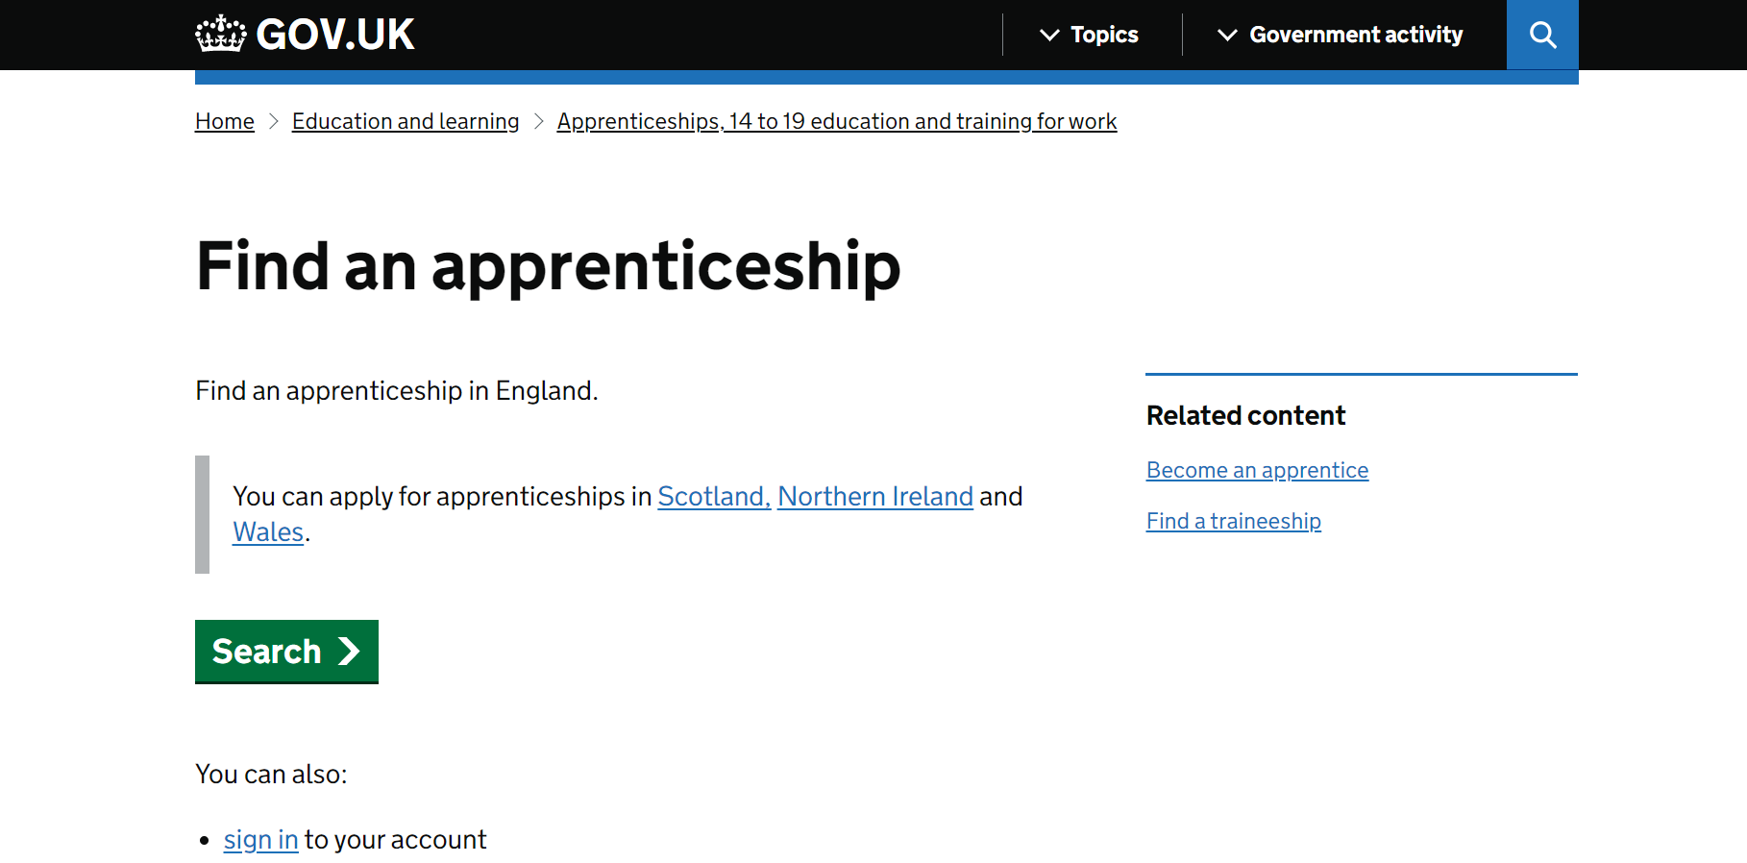
Find an Apprenticeship

Slide 7
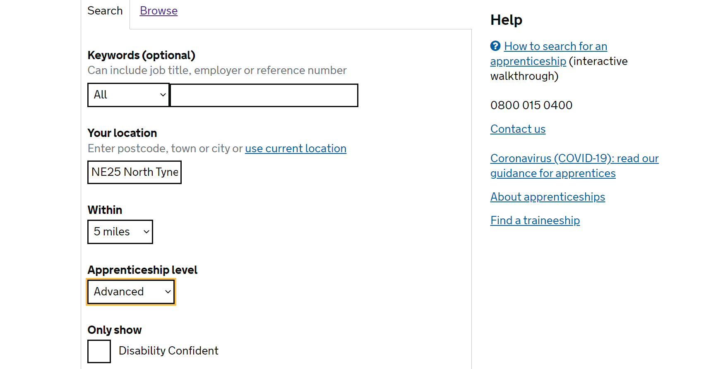

Slide 8
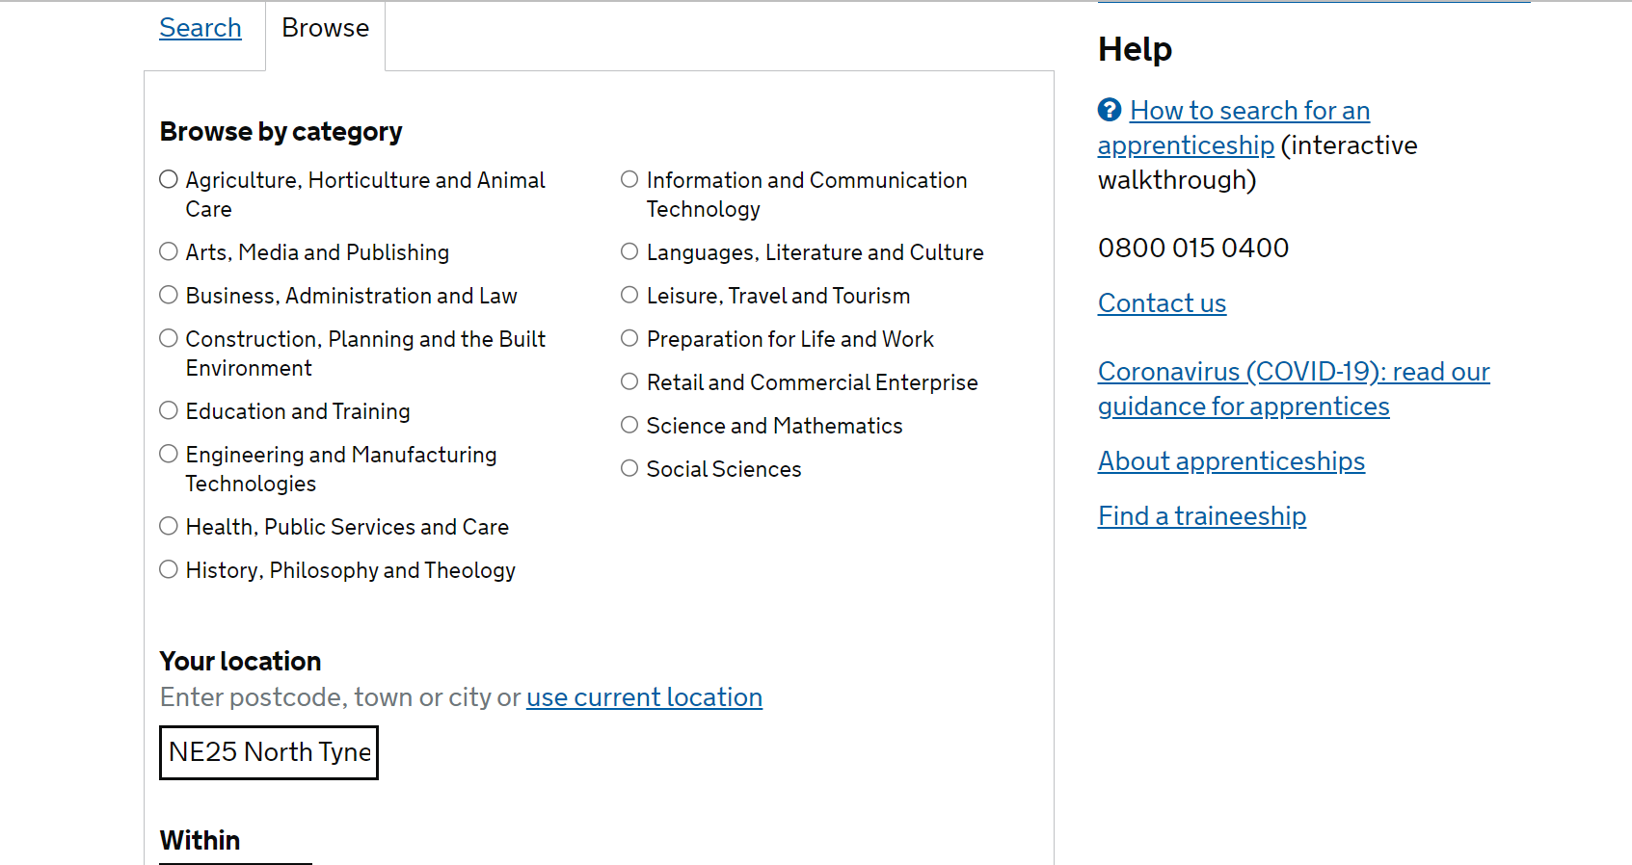

Slide 9
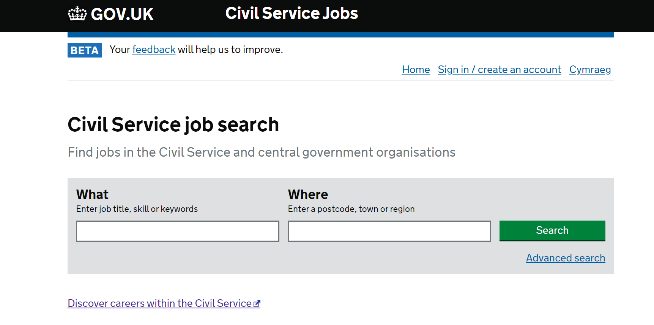

Slide 10
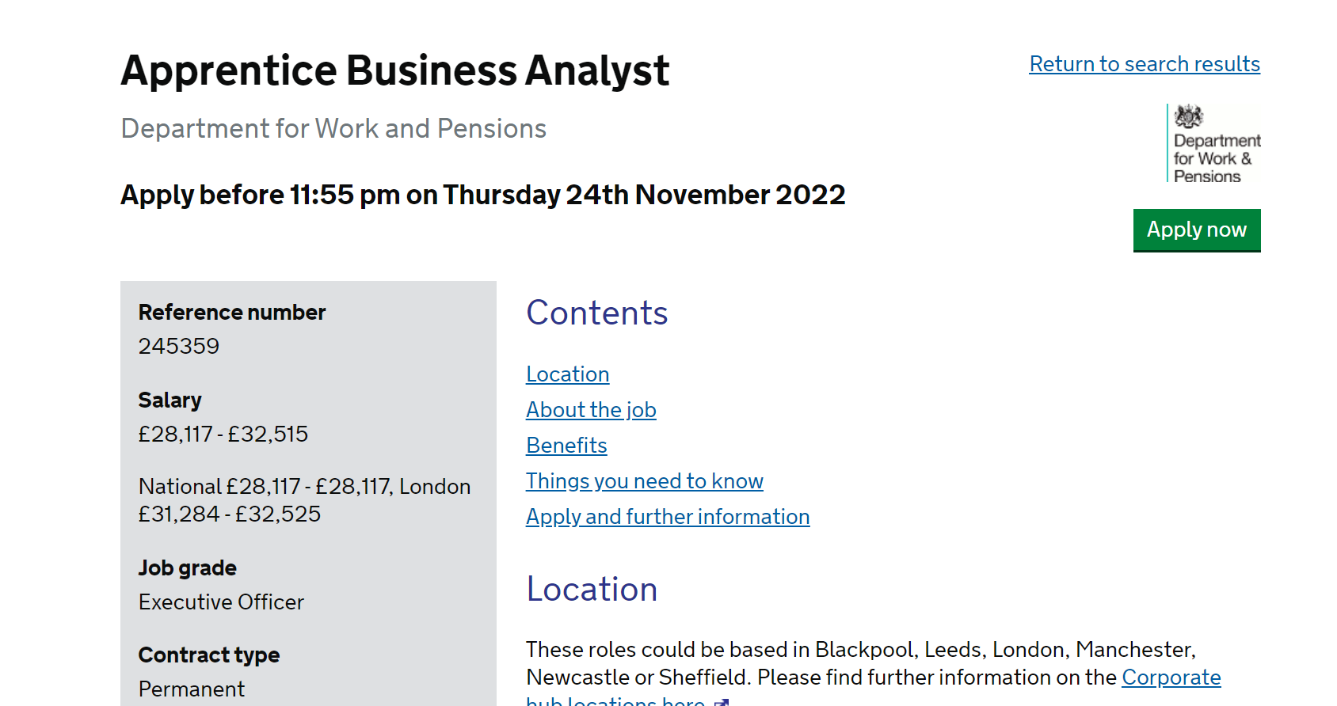

Slide 11
If you’re interested in a specific sector try visiting individual company websites and searching on their apprenticeship offers

Slide 12
Amazing Apprenticeships also provide a huge amount of information and guidance

Slide 13
Useful links and contacts
www.unifrog.org
www.gov.uk
www.amazingapprenticeships.com
www.nationalcareers.service.gov.uk
www.careersatnissan.co.uk
Also Twitter is a great place to keep updated

Slide 14
Over to you for any questions

