Slide 1
READING MOCK ACTIVITIES

Slide 2
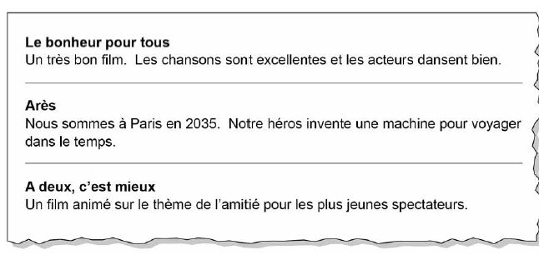
How do we know that film 1 in a musical?
What does the hero do in Film 2 and what type of film is it?
Which words tell us that it is about friendship? For young people?

Slide 3
1. C’est mon rêve d’avoir une salle de cinéma et une bibliothèque
2. Je voudrais une maison en face de la mer. Elle sera blanche
3. Je rêve d’avoir un petit appartement avec balcon. Je voudrais avoir une belle vue.
4. Je rêve de vivre à la campagne. Je veux me relaxer mais j’aime aussi faire des promenades.
What does rêve mean?
What is the French for library?
What is the French for facing the sea?
3 details about house 3
3 details about house 4

Slide 4
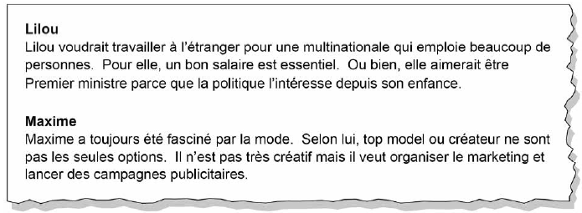
3 details for career ambition of Lilou
What does Maxime say about fashion?
What does he say he is not?
What does he want to do?

Slide 5
What is the French for
Happy
Better health
No question of
Neglecting
ADVANTAGE? RISK?

Slide 6
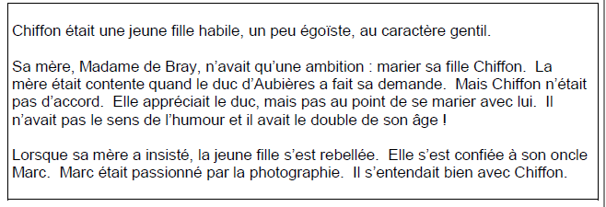
LITERARY TEXT
French for kind / selfish
Ne…que/qu’ = only – what is Madame de Bray’s only ambition
Two problems with le Duc?
Marc is Chiffon’s uncle – what is he passionate about? Does he get on with Chiffon?

Slide 7
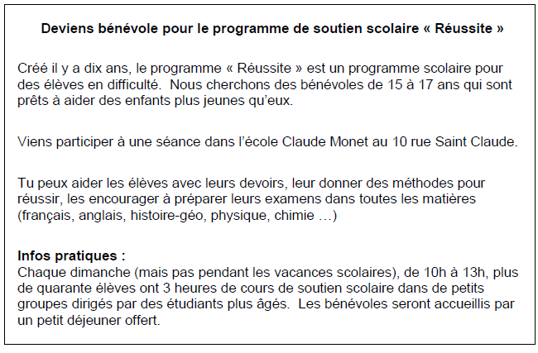
Do you get paid?
Who is it for?
What type of people are wanted?
2 tasks
When? 3 details
How many kids?
What do you get free if you take part?

Slide 8
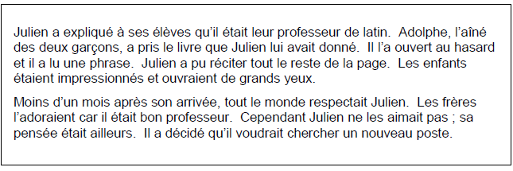
What is Julien’s job?
What did Adolphe do?
What was the reaction from the other children?
How did the pupils feel about Julien less than a month after he arrived? (3)
How did Julien feel?

Slide 9
1. nouveau a. I bought
2. hier b. angry
3. compris c. new
4. fâché d. 40 years old
5. après e. yesterday
6. je suis allé f. a present
7. magasins g. shops
8. j’ai acheté h. understood
9. un cadeau i. a present
10. prochain j. next
11. quarante ans k. after

Slide 10
1. nouveau a. I bought
2. hier b. angry
3. compris c. new
4. fâché d. 40 years old
5. après e. yesterday
6. je suis allé f. a present
7. magasins g. shops
8. j’ai acheté h. understood
9. un cadeau i. I went
10. prochain j. next
11. quarante ans k. after
C 2. E 3. H 4. B 5. K 6.I 7. G 8.A
9. F 10.J 11.D

Slide 11
1 I hate
2 my new English teacher
3 Yesterday
4 I did not understand his instructions
5 so he got angry with me
6 After school I went to the shops
7 where I bought a present
8 Next Saturday
9 my mum will be 40 years old

