Slide 1
Our Guide to Student Finance
Notes:
Type your notes

Slide 2
What we'll cover
Tuition Fees
Living Costs
Non-Repayable Finance
Applying
Loan Repayment
Notes:
Type your notes

Slide 3
Tuition Fees
Notes:
Type your notes

Slide 4
Tuition Fees
Maximum fee permitted to charge UK/EU students is set by the UK government
2023/24 fees stand at £9,250 and are now frozen for a further year - up to and including academic year 2024 to 25
Notes:
Type your notes

Slide 5
Student support
Where do tuition fees go?
Cutting edge research
World Class facilities
Staff
Infrastructure
Notes:
Type your notes

Slide 6
Tuition Fee Loans
Apply through Student Finance England /Wales/Scotland/NI
Student Finance is a separate organisation to universities
Full-time or part-time students can apply
You can apply to receive the full Tuition Fee Loan (£9,250) or only part of it
Loan goes straight to the University
Notes:
Type your notes

Slide 7
Maintenance Loan
Notes:
Type your notes

Slide 8
Living Costs
Living costs and spending will differ vastly from person to person
Includes: Rent, Food, socialising, books, travel etc.
Our website has examples of average spend for various categories, let's take a look...
Maintenance Loans
Bursaries and Extra Help
Notes:
Type your notes

Slide 9
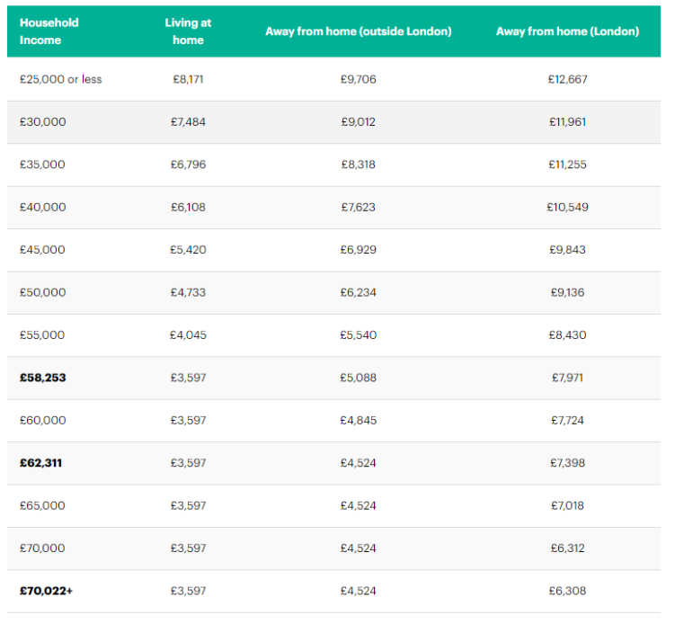
Maintenance Loan for Living Costs
Means tested
Apply through Student Finance England
Loan goes straight into your bank account
EU students and students aged 60 and over cannot apply for a Maintenance Loan
Received in three almost equal instalments
Notes:
Type your notes

Slide 10
Student spends (per month)
Notes:
Type your notes

Slide 11
See how much you may be eligible for
https://www.gov.uk/student-finance-calculator
Notes:
Type your notes

Slide 12
Additional Support
Notes:
Type your notes

Slide 13
Non-Repayable Grants
Special Support Grants
You must be a full time student. Part-time and EU students cannot apply.
You may be eligible if you qualify for: Income Support, Housing Benefit
You may also be eligible if you are a lone parent or have certain disabilities.
You will be told if you are eligible for this grant when you apply for
Student Finance
Notes:
Type your notes

Slide 14
Non-Repayable Grants
Special Support Grants
Students with dependents may be eligible for:
Childcare Grant
Parents' Learning Allowance
Adult Dependants Grant
Notes:
Type your notes

Slide 15
Non-Repayable Grants
Course-specific
Course-Specific Support:
Medicine, Dentistry and Health Care students- help with costs of travel to UK clinical placements
Social Work bursaries available
Financial support for teacher training students
If you are going to Study Abroad, you may be entitled to a grant to help cover travel expenses
COMPLETE UNIVERSITY GUIDE WEBSITE
Notes:
Type your notes

Slide 16
Disabled Student Allowance (DSA)
Grant to help with extra costs you might have due to a disability, long-term health condition, mental health condition, or specific learning difficulty e.g. dyslexia, anxiety, autism etc.
DSAs can help to pay for:
Specialist equipment you need for studying, like computer software
Non-medical helpers, for example a note taker or reader
Additional travel costs you may pay as a direct result of your disability
Full-time or part-time students eligible
Applying for DSA
Top Tips
Notes:
Type your notes

Slide 17
Applying for DSA
Log in to your Student Finance Account and complete DSA 1F Form:
www.gov.uk/studentfinance
Get your eligibility notification
Book and attend your assessment
Get your Entitlement Notification
Order equipment & arrange support
before your course starts
Our Top Tips
Apply as early as possible to ensure support is in place for when you start your course.
Applications can take around 14 weeks.
Notes:
Type your notes

Slide 18
Student bank accounts and student discounts
Students can apply for a student bank account from one bank, and with that they usually offer perks such as an amazon voucher or railcard.
Most student bank accounts also offer an overdraft at 0% interest.
Check out student discount websites and apps!
Look out for student weeks in your city/university.
Notes:
Type your notes

Slide 19
Applying for
Student Finance
Notes:
Type your notes

Slide 20
How to apply
Create an account
Usually, within 6 weeks you'll get a loan declaration in the post - sign and return it
Login and complete the online application form
You may be asked to send in proof of identity
Notes:
Type your notes

Slide 21
When to apply
To get your funding in time for the start of the academic year, you must apply by:
End of May 2023: New (September 2023) students
End of June 2023: Continuing students
Apply at: www.gov.uk/student-finance
Notes:
Type your notes

Slide 22
Repayment
Notes:
Type your notes

Slide 23
Repayment
Repayment Amounts
E.g. Earn £28,800 a year (£2,400 a month)
That is £126 over the threshold (monthly income)
9% of 126 = £11/month
Pay nothing back until you earn over £27,295 per year (£2,274 a month)
Repayment deducted directly from salary at 9% of anything earned over £27,295
Repayment based on what you earn, not what you owe
Written off after 30 years
Interest Rates
You pay interest from the first loan installment until the loan is
paid off in full OR written off
Notes:
Type your notes

Slide 24
Interest explained
Whilst Studying: Interest is 4.5%
After studying: This rate applies until the 5 April after you finish or leave your course, or for the first 4 years of your course if you’re studying part-time, unless the RPI changes.
After that, your interest rate depends on your income in the current tax year.
£27,295 or less = Just RPI
£27,296 to £49,130 = RPI plus up to 3%
Over £49,130 = RPI plus 3%
However, the interest rate is currently capped until 28 February 2023 due to inflation. Interest rates on Plan 2 loans will not go above 6.5% while the cap is in place.
Notes:
Type your notes

Slide 25
Financial Support at Newcastle
Notes:
Type your notes

Slide 26
Support at Newcastle
Bursaries and Scholarships
Opportunity scholarship
Subject-specific scholarship
Non-repayable grant from your university
Newcastle University is investing £32 million in its scholarships over the next five years
Check university websites to see what you could be entitled to
Sports scholarship
Sanctuary Scholarship
Notes:
Type your notes

Slide 27
Opportunity Scholarship
In your Student Finance Application, tick the box to share information with your university
If you're eligible, you will automatically be awarded the scholarship
Notes:
Type your notes

Slide 28
Subject-specific Scholarship
Subject specific scholarships worth up to £5,000 per year:
Engineering
Mathematics and Statistics
Natural & Environmental Sciences
Physics
Science, Technology, Engineering and Mathematics subjects (STEM)
Music
www.ncl.ac.uk/undergraduate/fees-funding/scholarships-bursaries/
Notes:
Type your notes

Slide 29
Sports Scholarship
Regional/National/International standard within the last 12 months.
Allocated on case-by-case basis: Up to £10,000
Students should be part of a National Governing Body Performance Squad or equivalent.
Email: performance.sport@ncl.ac.uk
Notes:
Type your notes

Slide 30
Sanctuary Scholarship
Applicants can receive full tution fees and living expenses paid for (commences September 2023)
The following cateorgories of applicants can apply under this scheme:
Asylum Seekers
Children of asylum seekers and unaccompanied asylum-seeking children (ed children migrants under 18)
Applicants with refugee status (ineligible for Student Finance government funding
www.ncl.ac.uk/undergraduate/fees-funding/scholarships-bursaries/sanctuary/
Notes:
Type your notes

Slide 31
Budgeting
Understanding the cost of living is an important part of university life.
The average living costs for a student in the UK is £1,112.50 per month, so budgeting is a crucial part of undergraduate life.
A lot of the living costs associated with student life are typically lower in the UK's northern cities, meaning your money will go further.
Notes:
Type your notes

Slide 32
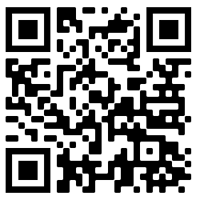
Tell us what you think..
We'd love to hear what you thought of today's session and in return, you'll be entered into a prize draw to win some Newcastle University branded goodies!
From Newcastle. For the world.
Notes:
Type your notes

Slide 33
Thank you for listening.
Any Questions?
Notes:
Type your notes

