Slide 1
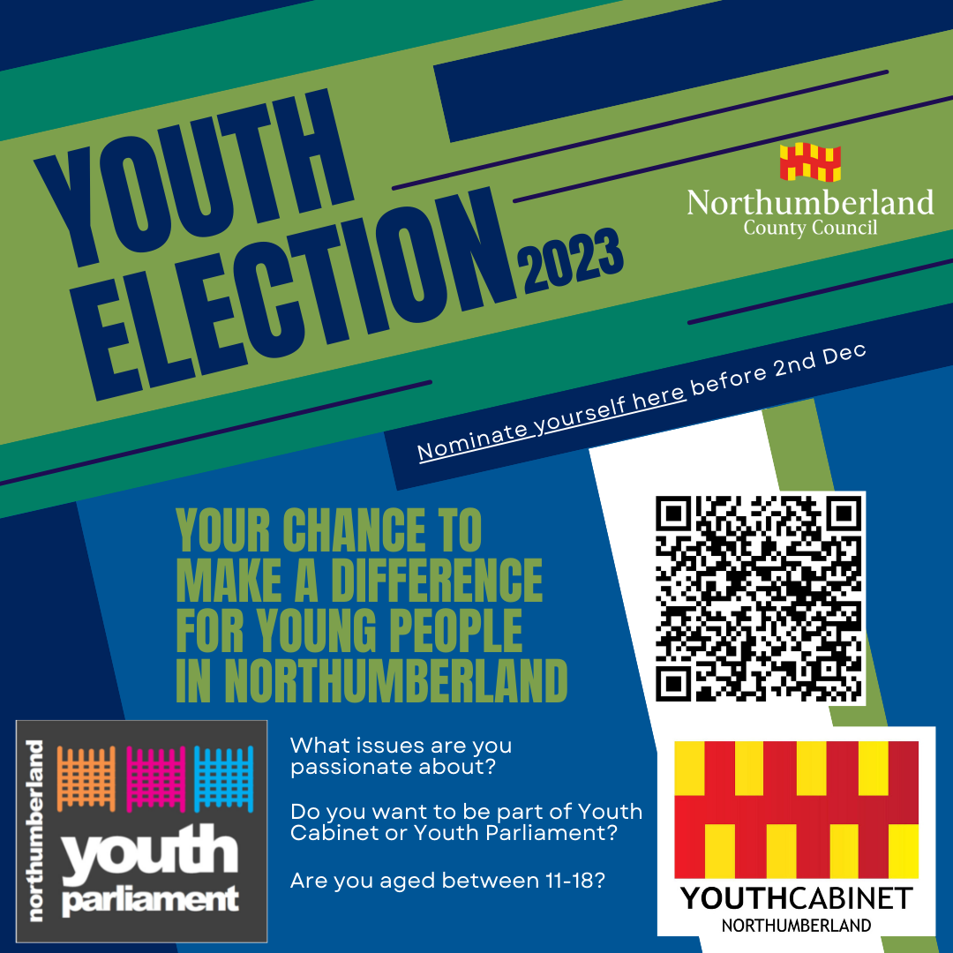
Northumberland Youth Elections 2023
Your chance to represent young people from across Northumberland, Making sure the issues that are important to them are listened too.

Slide 2
Youth Cabinet
A group of 10 elected young people who influence decision making across the County.
5 candidates elected each year.
Serve a two year term.
Meet at least monthly as a group, sometimes more.
Previous projects:
Mental Health Work
Climate Change
Consultation with young people
Regular meetings with Councillors and decision-makers

Slide 3
Youth Parliament
A group of 4 elected young people who take the issues of young people to a regional and national level.
2 elected each year.
Serve a two year term.
Meet at least monthly, sometimes more.
Previous Projects:
Attendance at the ‘Annual UK Youth Parliament conference’ residential weekend.
Promoting the national campaigns
Representation at regional and national events
Mental Health awareness campaigns
Make Your Mark national consultation
Debating in the House of Commons chamber!

Slide 4
Are you up for it?
Scan the code and register your interest.
Election day is February 15th 2023.
Registration of interest closes 2nd December 2022

Slide 5
