Slide 1
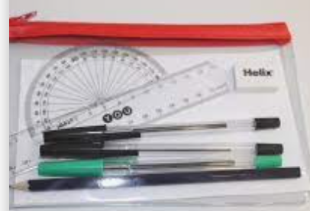
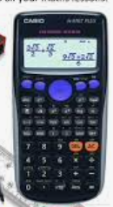
How to Revise Maths 2023
Exam board - Edexcel
Paper 1 non calc 19th May
Paper 2 calc 7th June
Paper 3 calc 14th June
Equipment
Calculator (Casio or Aurora)
Protractor Pen, Pencil
Compasses Ruler
Formulae
Frequency
Each topic for each grade has a
worksheet of exam questions -
and worked answers on
For videos and homework

Slide 2
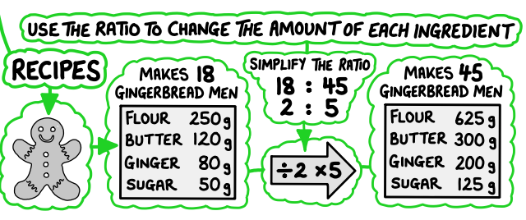
Fluency
Flexibilty - working through past papers.
You will be doing this in lessons and for homework.
Also you can get access to past papers from
Lesson starters.
Basic skills.
Key words.
&methods
Revision classes
Faith
Be organised
Work hard
Eat well
Sleep well
Take breaks
Any questions please contact
Mrs Ward Head of Maths
carolyn.ward@achs.svf.org.uk
GOOD LUCK

